Slide 1
一带一路 METRANS INTERMODAL OPERATOR WITH THE LARGEST RAIL & TERMINAL NETWORK IN EUROPE

Slide 2
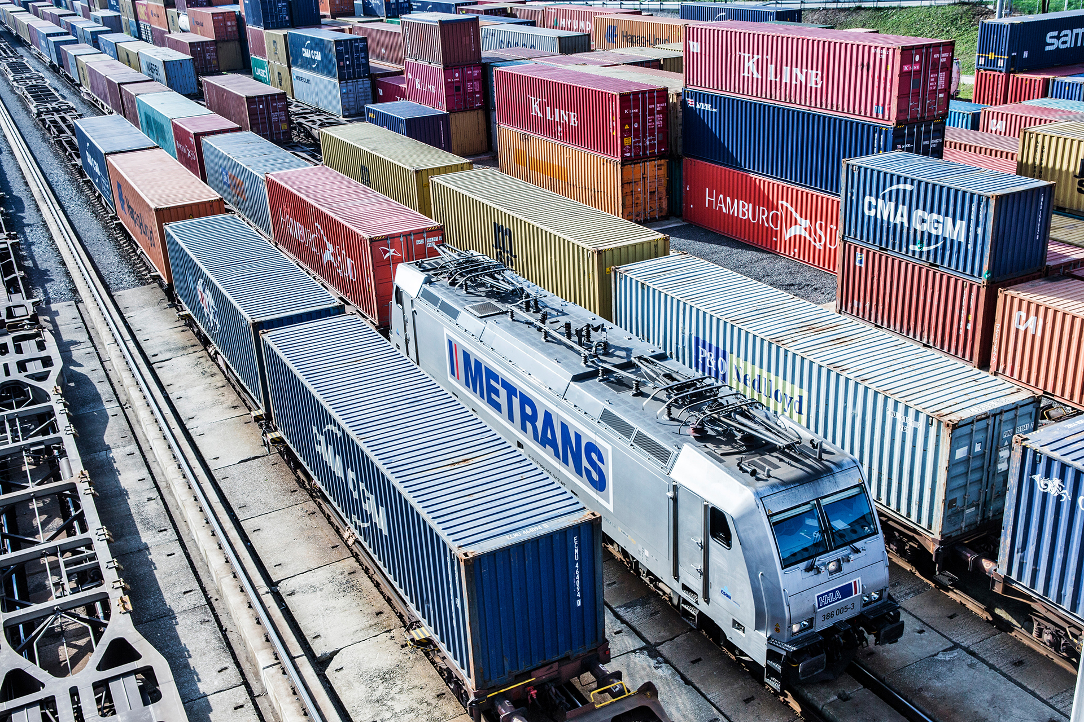
METRANS
2022 figures
General information:
founded 1991, 100% HHLA
Revenue:
over 560 million EUR
Intermodal:
over 1,4 million TEU
Depots:
over 1,2 million TEU
Employees:
2 500 (December 2022)

Slide 3
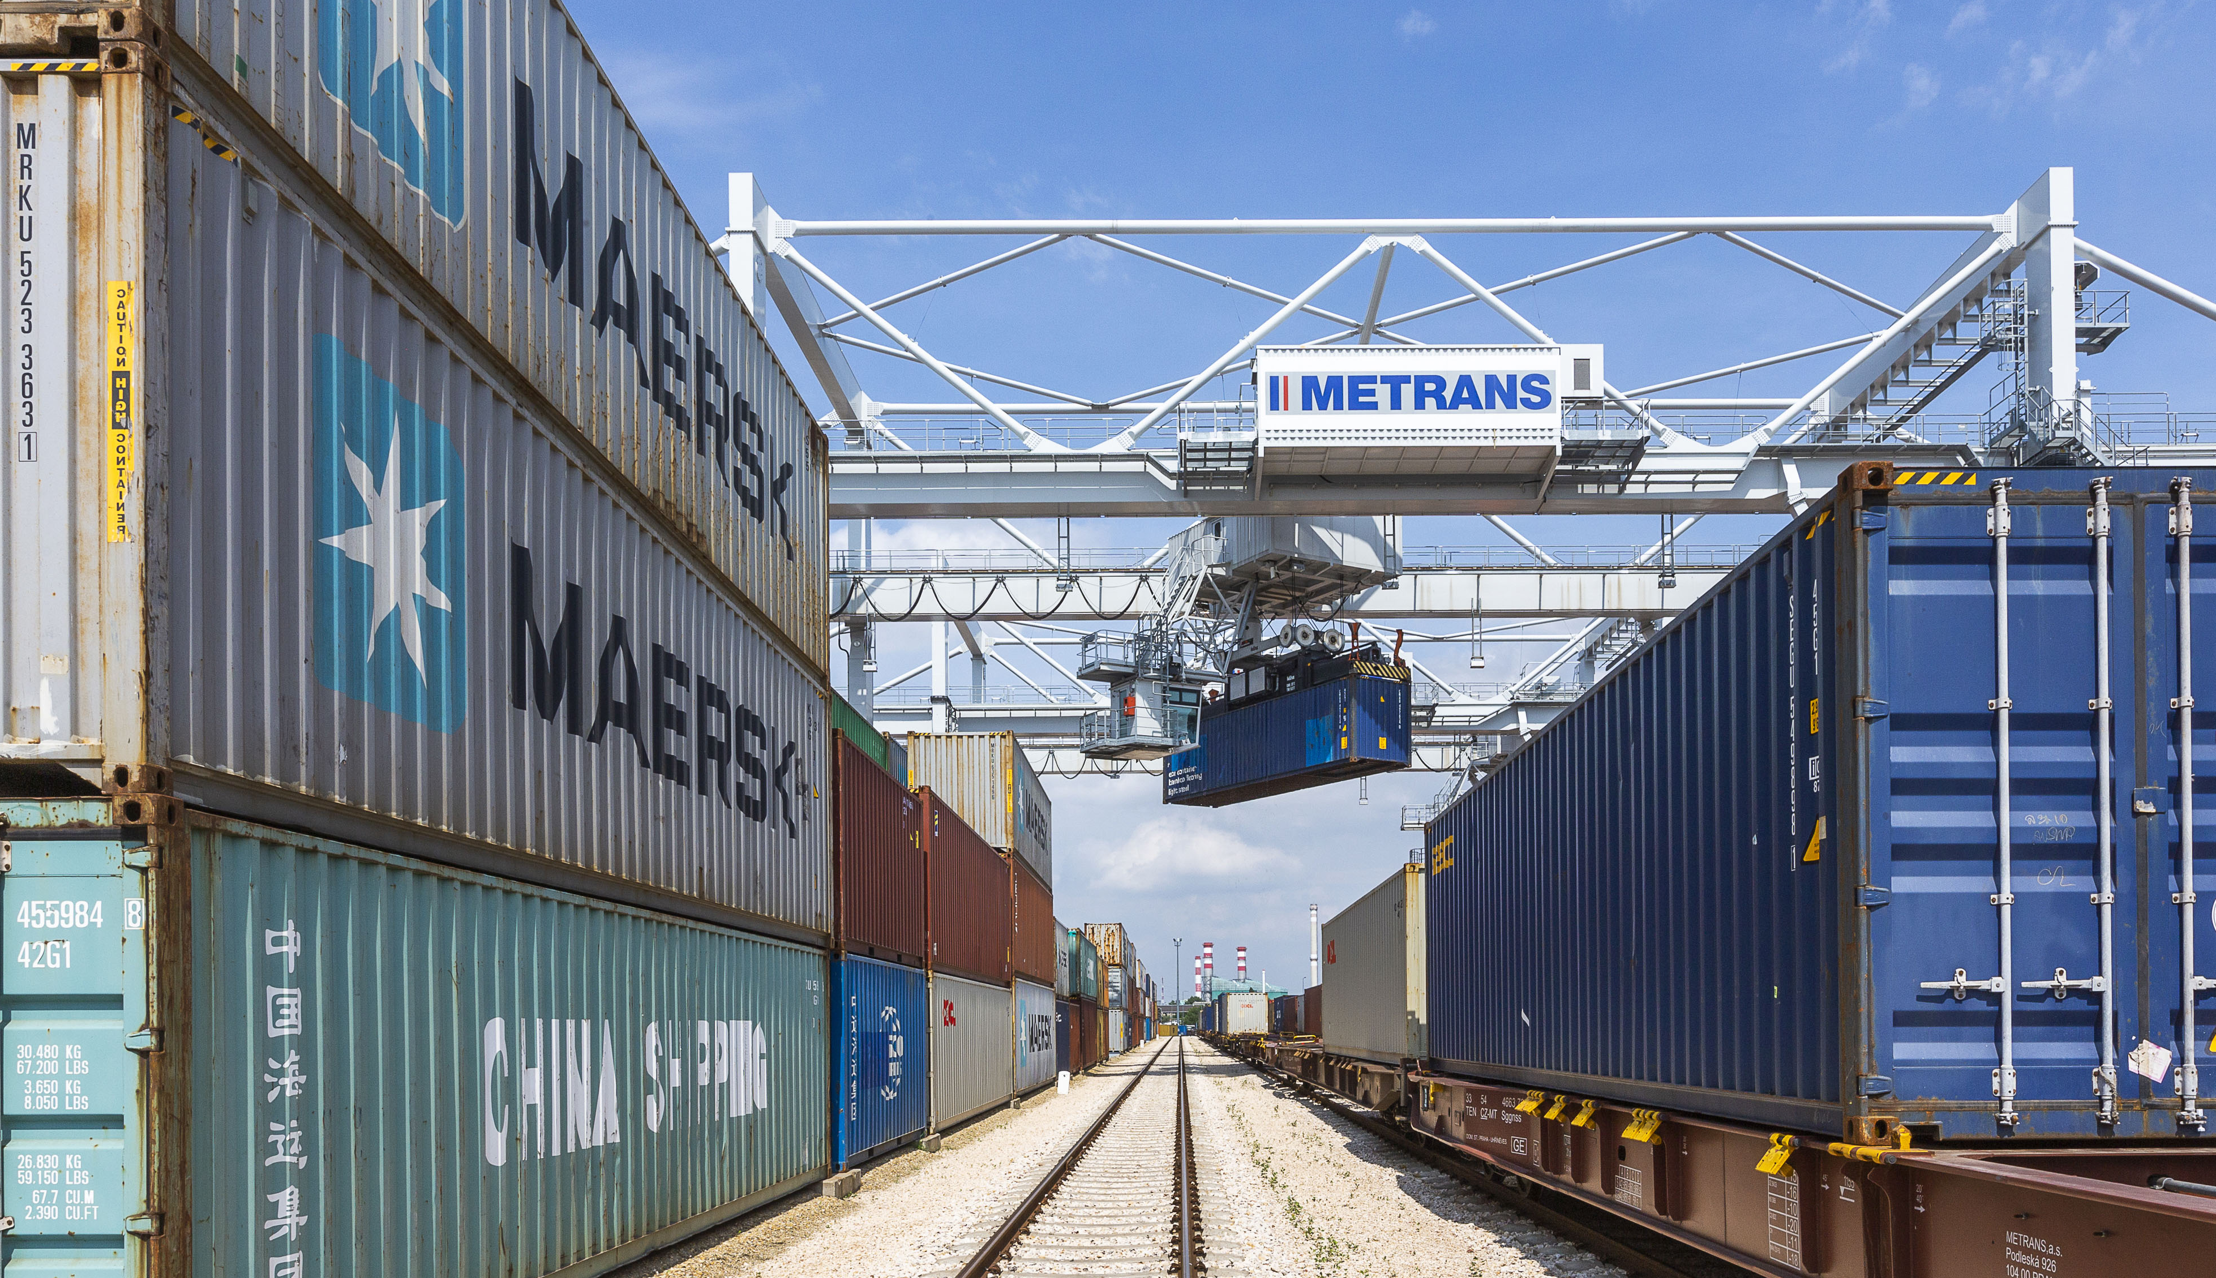
Profile of the METRANS Group
Terminals, Locomotives, Wagons and Repair Shops
8 HUB terminals & depots
Czech Republic, Slovakia, Poland, Hungary and Austria
13 inland terminals & depots
Czech Republic, Slovakia, Poland, Serbia & Germany
NEW MEMBER - ADRIA RAIL
NEW Office - Rijeka
NEW Terminal – Indija (Serbia)
Over 2 million m² on Depot & Terminal capacities
More than 130 locomotives
More than 3 700 wagons
2 repair shops for locomotives & wagons
Kolin & Dunajska Streda
Offices in the ports
of Hamburg, Bremerhaven & Koper

Slide 4
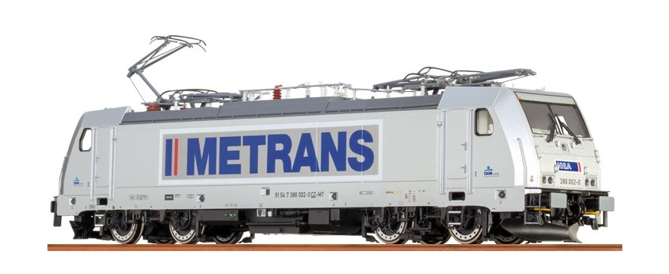
METRANS Group
Established in 1991,
sites in 9 countries,
more than 2 500 employees
METRANS /Danubia/, a.s.
Slovakia
METRANS Danubia Kft.
Hungary
METRANS /Danubia/ Krems GmbH
Austria
METRANS Konténer Kft.
Hungary
METRANS Railprofi Austria GmbH
Austria
METRANS d.o.o.
Croatia
METRANS DYKO Rail Repair Shop, s.r.o.
Czech Republic
METRANS Rail, s.r.o.
Czech Republic
METRANS ADRIA d.o.o.
Slovenia
METRANS Rail /Deutschland/ GmbH
Germany
UniverTrans Kft.
Hungary
METRANS Umschlagsgesellschaft mbH
Germany
TIP Žilina, s.r.o.
Slovakia
Umschlagsgesellschaft Königs Wusterhausen mbH
(50%)
Germany
METRANS /Polonia/ Sp. z o.o.
Poland
METRANS Rail Sp. z o.o.
Poland
METRANS, a.s.
Prague, Czech Republic
CL EUROPORT Sp. z o. o.
Poland
METRANS Zalaegerszeg Kft.
Hungary
METRANS Szeged Kft.
Hungary
METRANS Istanbul STI
Turkey
ADRIA RAIL Operator d.o.o.
Rijeka
www.metrans.eu
ADRIA RAIL d.o.o.
(51%)
Croatia
DRUŠTVO ZA INTERMODALNI PREVOZ I USLUGE ADRIA RAIL DOO INDIJA
Indija

Slide 5
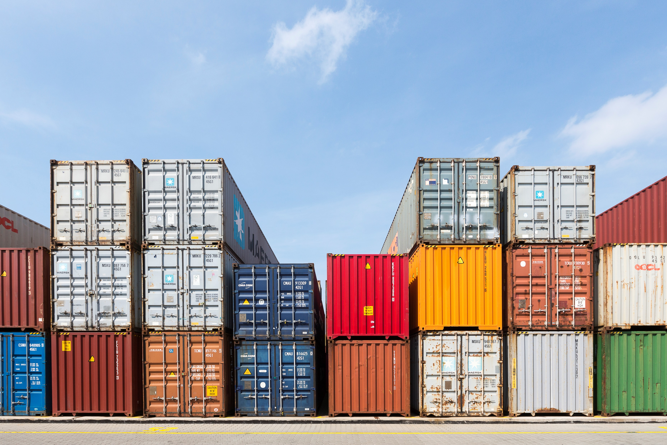
The largest European network
We provide all-inclusive just-in-time intermodal rail-road transportation service
METRANS operates own shuttle trains with cargo in maritime
deep sea and short sea and for long haul trains
Transport of standard equipment, reefers, tank and special
containers to / from the
Czech Republic / Slovakia / Hungary / Germany /
Austria / The Netherlands / Belgium /
Slovenia / Poland / Italy
We connect these countries by rail with major
European ports
Hamburg / Bremerhaven / Rotterdam
/ Duisburg
or southbound rail connection to
Koper / Trieste / Rijeka

Slide 6
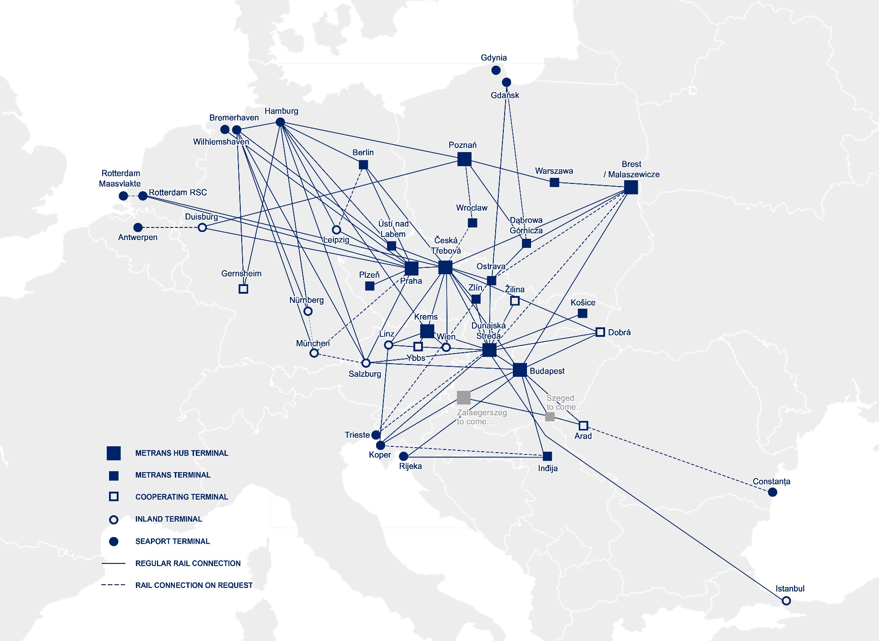
METRANS
Over 650 regular train connections per week
From/To
Trains per Week
Hamburg | ↔ | Praha | 54
Hamburg | ↔ | Ceska Trebova | 32
Hamburg | ↔ | Dunajska Streda | 14
Hamburg | ↔ | Salzburg | 3
Hamburg | ↔ | Berlin | 10
Hamburg | ↔ | Gernsheim | 6
Hamburg | ↔ | Gadki | 18
Hamburg | ↔ | Nürnberg | 16
Hamburg | ↔ | München | 16
Hamburg | ↔ | Leipzig | 14
Bremerhaven | ↔ | Praha | 13
Bremerhaven | ↔ | Ceska Trebova | 12
Bremerhaven | ↔ | Dunajska Streda | 6
Bremerhaven | ↔ | Nürnberg | 8
Bremerhaven | ↔ | München | 8
Rotterdam | ↔ | Praha | 12
Rotterdam | ↔ | Ceska Trebova | 6
Duisburg | ↔ | Praha | 6
Koper | ↔ | Dunajska Streda | 35
Koper | ↔ | Budapest | 28
Praha | ↔ | Ceska Trebova | 28
Praha | ↔ | Salzburg | 9
Praha | ↔ | Leipzig | 1
Praha | ↔ | Wilhelmshaven | 4
Ceska Trebova | ↔ | Dunajska Streda | 28
Ceska Trebova | ↔ | Kosice | 4
Ceska Trebova | ↔ | Zlin | 14
Ceska Trebova | ↔ | Ostrava | 12
Ceska Trebova | ↔ | Krems | 4
Ceska Trebova | ↔ | Linz | 6
Dunajska Streda | ↔ | Kosice | 12
Dunajska Streda | ↔ | Budapest | 13
Dunajska Streda | ↔ | Krems | 2
Nürnberg | ↔ | München | 8

Slide 7
Is there a real demand for rail movements between CHINA & EUROPE and v.v.?
 |  | 2011 | 2012 | 2013 | 2014 | 2015 | 2016 | 2017 | 2018 | 2019 | 2020 | 2021 | 2022
TOTAL No. of trains on the Silk Road |  | 17 | 42 | 80 | 308 | 815 | 1702 | 3673 | 6363 | 8225 | 12400 | 15000 | 16000

Slide 8
21 terminal & depots
Czech Republic, Slovakia, Poland, Hungary, Austria, Germany & Serbia
Over 2 million sqm Depot & Terminal capacities
More than 130 locomotives
More than 3700 wagons
2 repair shops for locomotives & wagons
Offices in the ports of Hamburg, Bremerhaven, Koper & Rijeka
METRANS keeps NEUTRALITY also on the movements connected to SILK ROAD
Wide range of benefits to our customers
Customs clearance directly at the terminal
Chinese speaking employee
Dedicated customer service desk for shipments connected to SILK ROAD
Local trucking

Slide 9
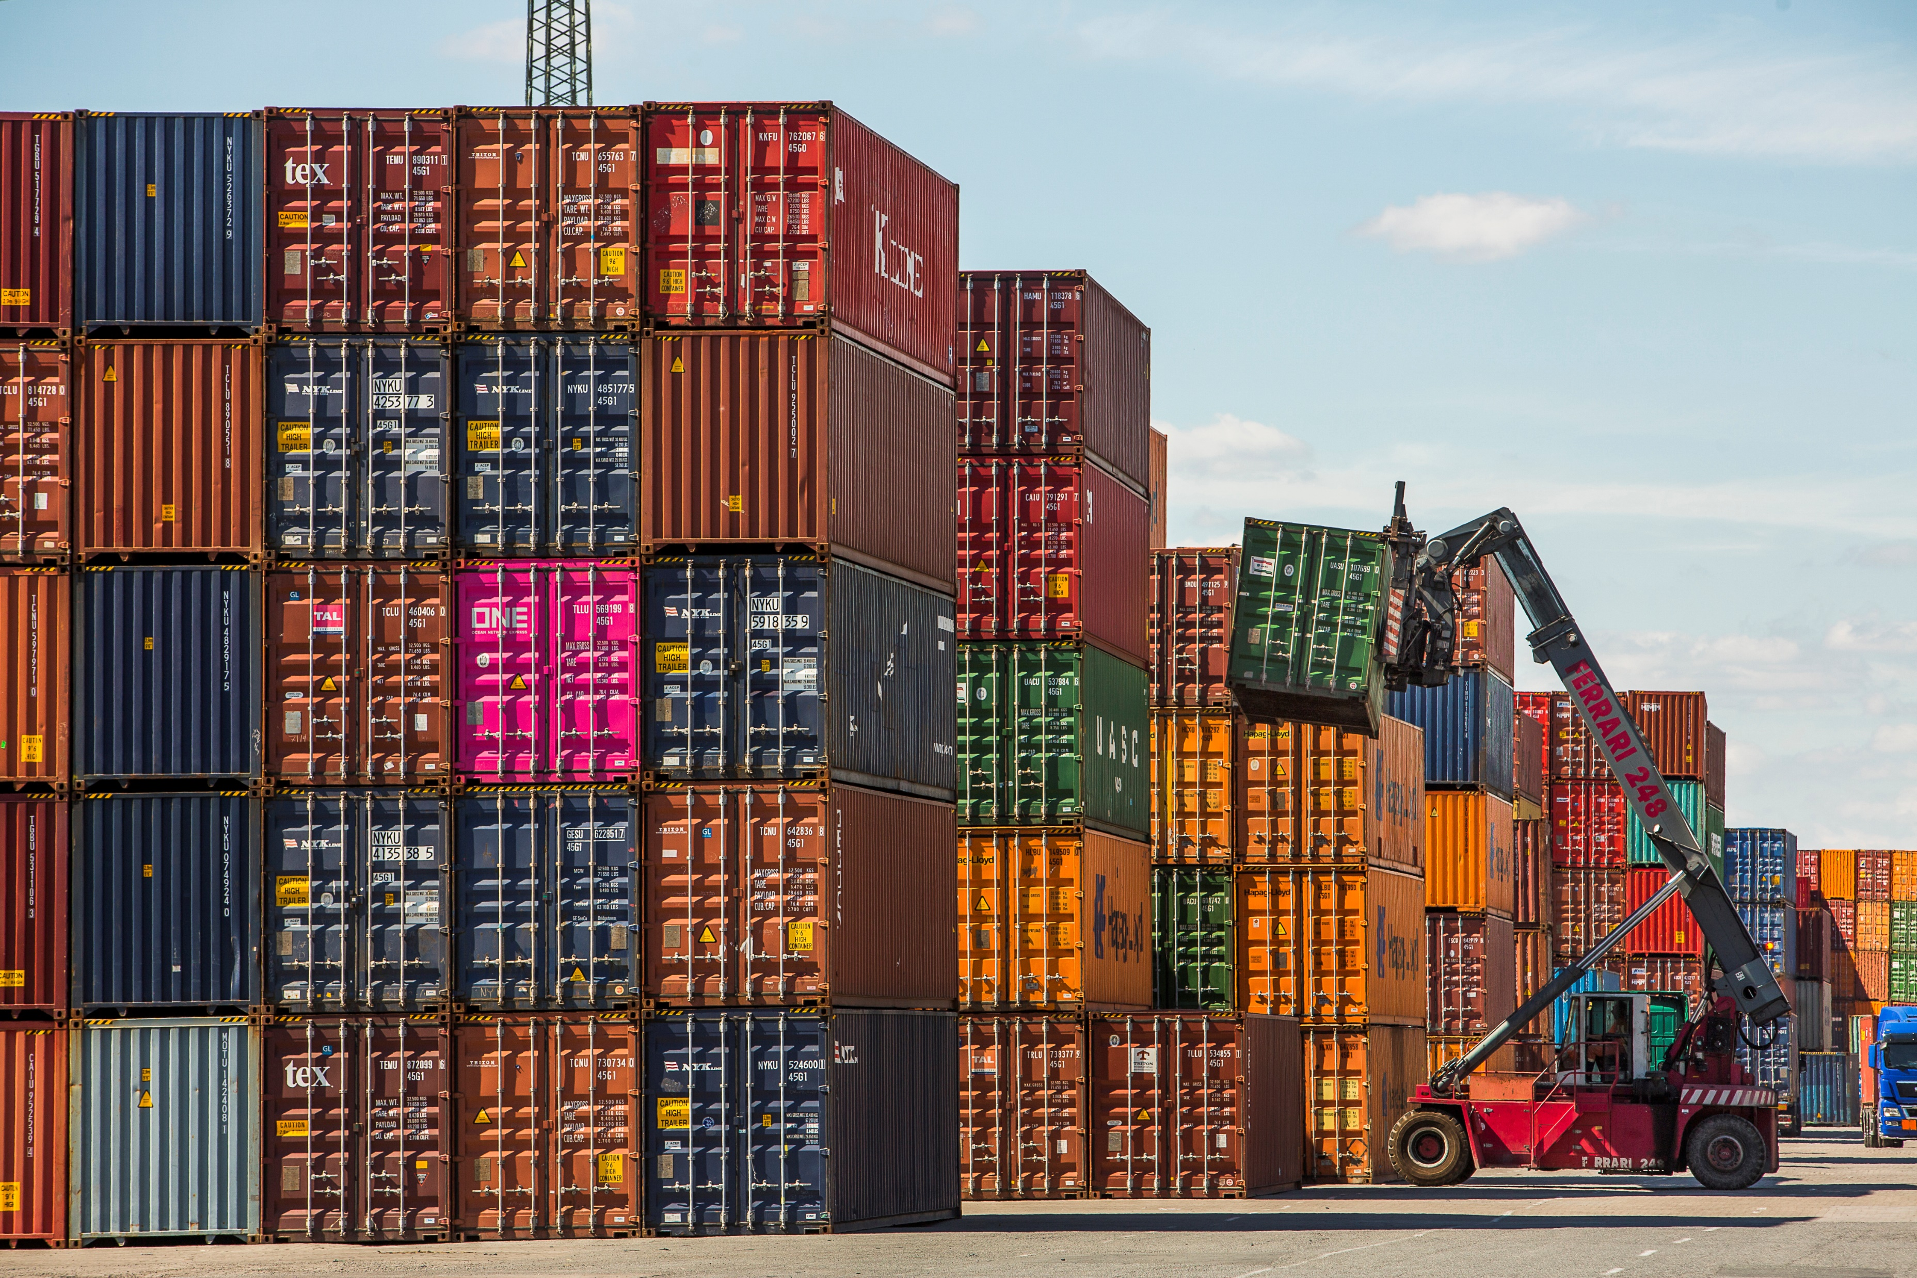
Why to choose METRANS
NETWORK & SOLUTION
We connect The Belt and Road initiative to the Europe via
Malaszewice / Brest (PL / BY)
with our network of own, high sophisticated container terminals & depots and modern railway hubs in
Prague (CZ) / Ceska Trebova (CZ) /
Dunajska Streda (SK) / Budapest (HU) /
Poznan (PL)

Slide 10
Connection To SILK ROAD
Xian & Wuhan – Ceska Trebova (CZ)
2 x Trains ex Xian per week
1x Train ex Wuhan per week
Routing via Malaszewicze
HUB Concept to METRANS Network
connection to Prague, Dunajska Streda, Krems, Salzburg, Budapest, Hamburg, Duisburg
Zhengzhou – Hamburg (DE)
2 x Trains per week
Direct connection to Hamburg and via Hamburg to Munich
Zhengzhou – Dabrowa Gornicza (PL)
1 x Train per week
Xian – Milano (IT)
1 x Train per week
Jinhua – Budapest (HU)
1 x Train per week

Slide 11
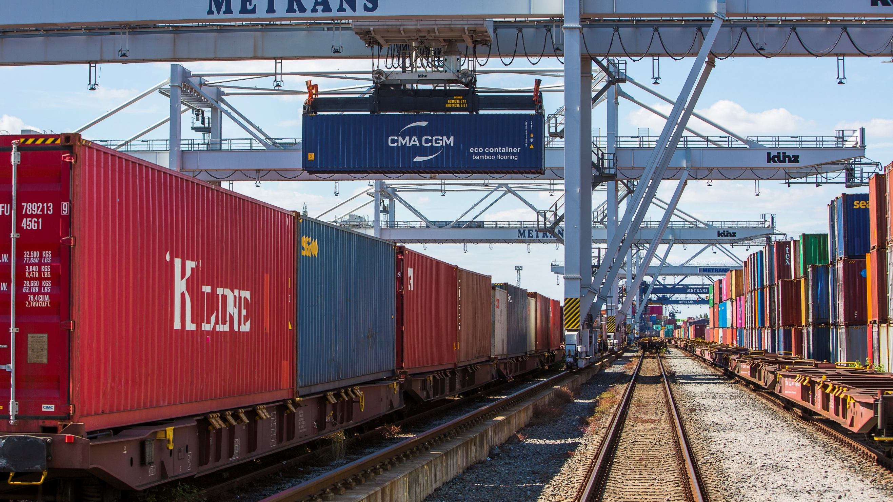
Why to choose our network for cargo from / to Far East?
Connect your cargo to METRANS network!
METRANS operates regular weekly trains and supports partners from
several Chinese origins as well as destinations and connecting them
with our network
Only last / first mile from / to ´´HUB´´ or ´´END´´ terminal is arranged
by trucks
By using of latest technologies and innovations on the field of
transport and handling we are reducing CO₂ emissions as
much as possible.
Possibility to connect with terminals of other operators
using METRANS network within the whole Europe –
neutrality guaranteed
Dobra terminal on the border with Ukraine as
entry point to European Union and perfect
connection to METRANS network
Malaszewicze / Brest terminals
connected

Slide 12
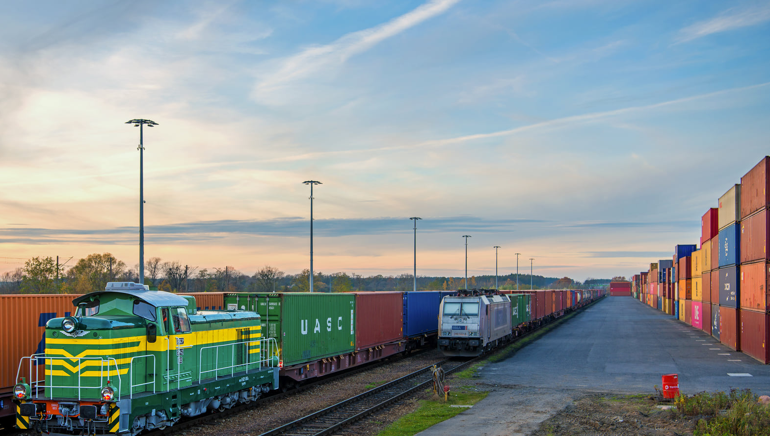
Why to choose our network for cargo from /
to Far East?
Connect your cargo to METRANS network!
Strong and fast growing network of METRANS allows to find
the most efficient way for your cargo
Ability to combine export cargo from different European
countries and choose the nearest HUB terminal
(Ceska Trebova, Dunajska Streda or
Budapest)
Ready for a new alternative solution (i.e. via
Turkey/Azerbaijan/Constanta to EU )

Slide 13
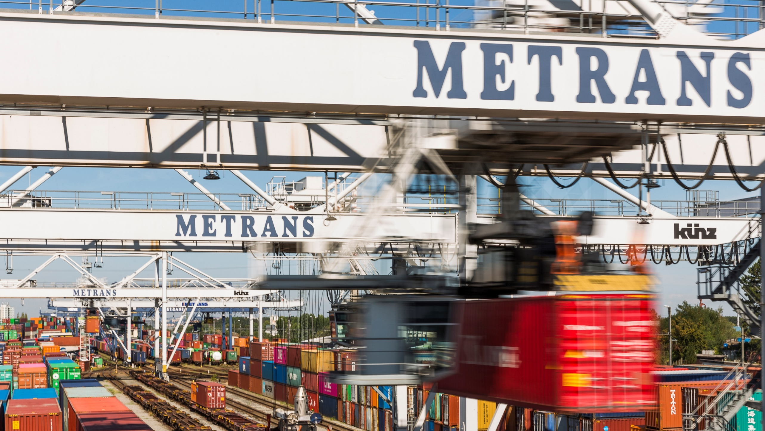
Why to choose our network for cargo from /
to Far East?
Connect your cargo to METRANS network!
METRANS keeps neutrality also on the movements
connected to SILK ROAD
High quality service – METRANS keeps on all of
his services highest standards
Cargo connected to Europe largest rail &
terminal network
Wide range of benefits to our customers
Customs clearance directly at the terminal
Chinese speaking employee
Dedicated customer service desk for
shipments connected to SILK ROAD

Slide 14
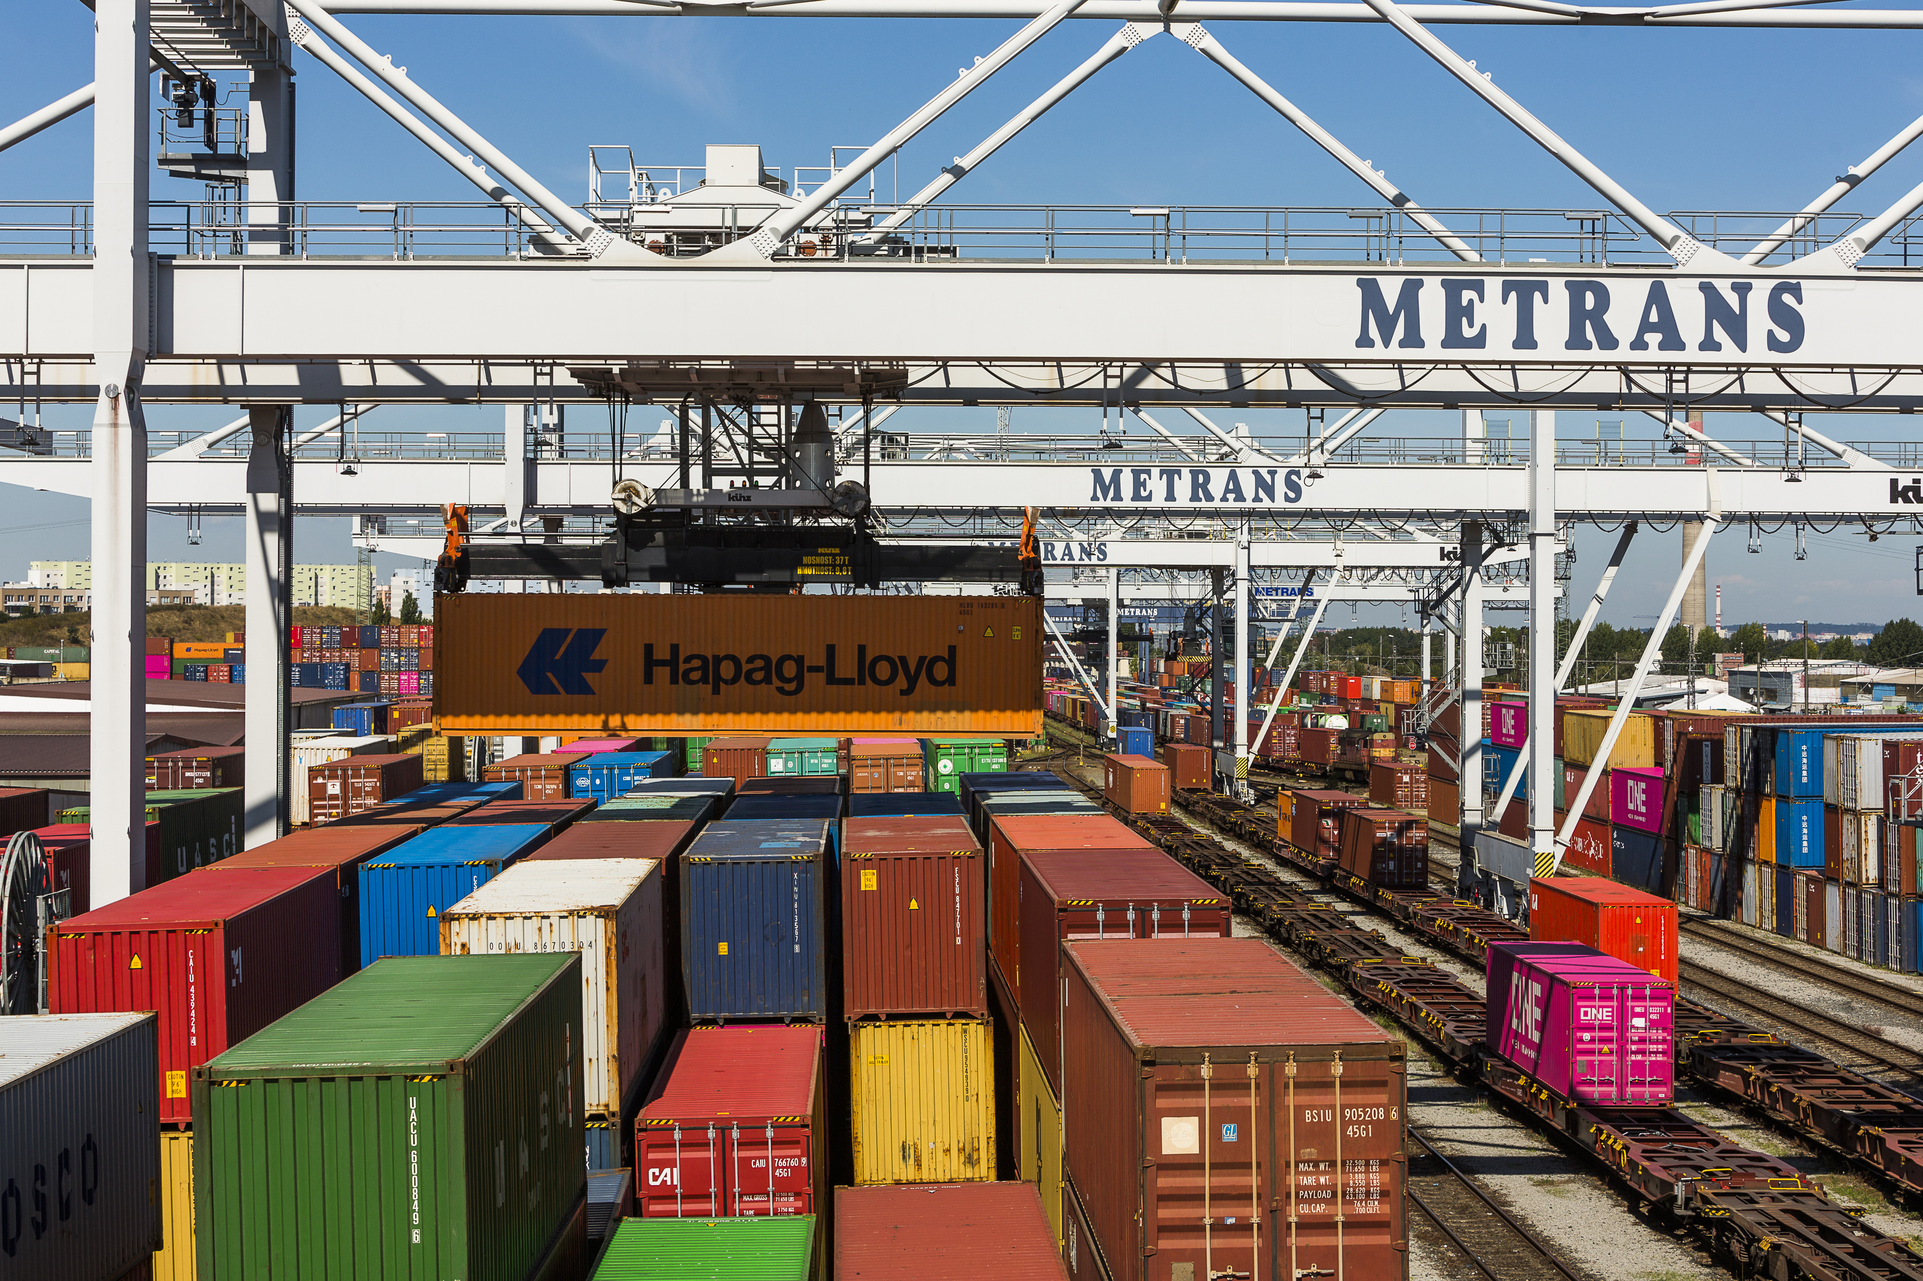
THANK YOU
FOR YOUR ATTENTION!

