Slide 1
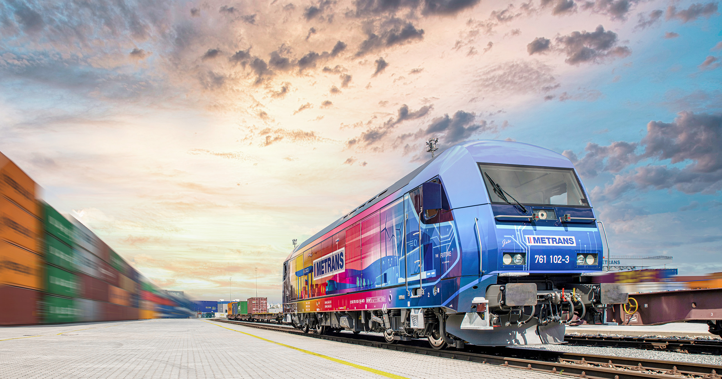
THE INTERMODAL BUSINESS OF METRANS
THE NEUTRAL & GLOBAL INTERMODAL SOLUTIONS

Slide 2
2024
GENERAL INFORMATION
Founded 1991, 100% HHLA
REVENUE
Over 590 million EUR
METRANS
2023 key figures
INTERMODAL
Over 1,35 million TEU
DEPOTS
Over 1,2 million TEU
EMPLOYEES
2 650 (2023)

Slide 3
METRANS GROUP PROFILE
Terminals, Locomotives, Wagons and Repair Shops
2024
7 HUB TERMINALS & DEPOTS
Czech Republic, Slovakia, Poland, Hungary and Austria
MORE THAN 130 LOCOMOTIVES
13 END TERMINALS & DEPOTS
Czech Republic, Slovakia, Poland, Serbia, Germany & Romania
MORE THAN 4 000 WAGONS
DEPOT & TERMINAL CAPACITIES
Over 2 million m²
2 REPAIR SHOPS FOR LOCOMOTIVES & WAGONS
Kolin (CZ) & Dunajska Streda (SK)
NEW MEMBER – ADRIA RAIL
NEW OFFICE – RIJEKA
NEW TERMINAL – BELGRADE (INDJIJA)
+ 2 TERMINALS
UNDER CONSTRUCTION
OFFICES IN THE PORTS
of Hamburg, Bremerhaven & Koper, Rijeka

Slide 4
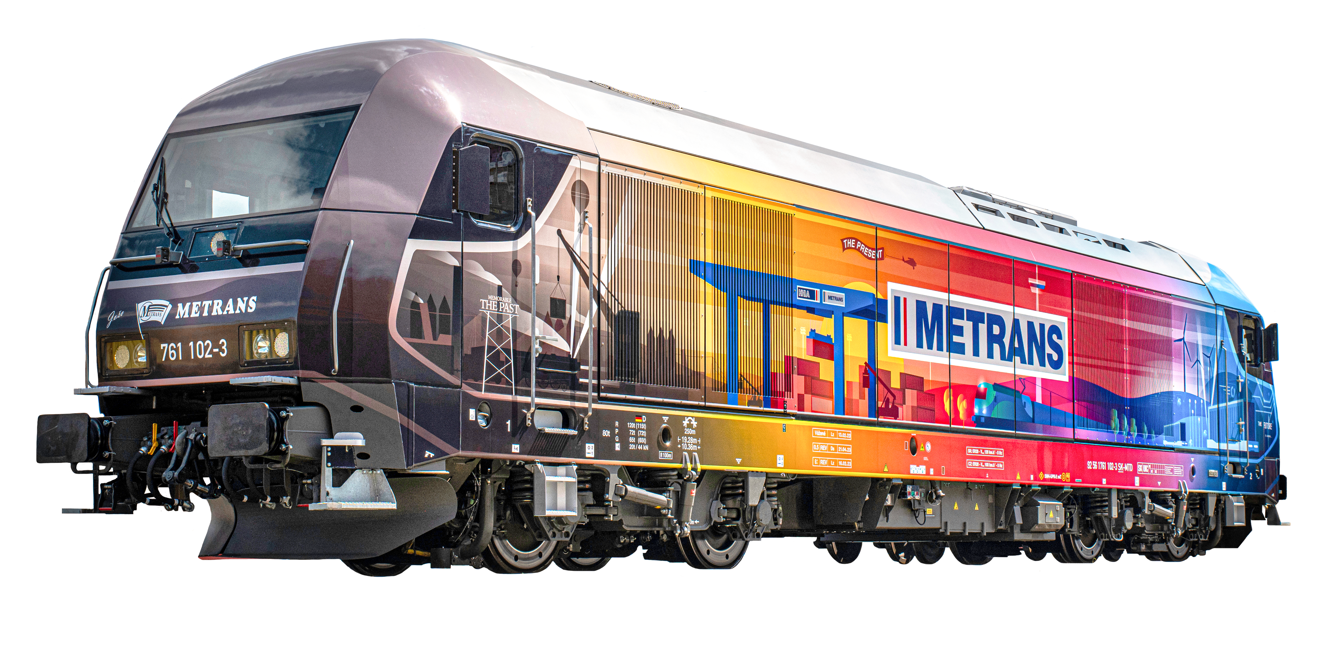
METRANS /Danubia/, a.s.
Slovakia
METRANS Danubia Kft.
Hungary
METRANS GROUP
Company structure
METRANS /Danubia/ Krems GmbH
Austria
2024
METRANS Konténer Kft.
Hungary
METRANS Railprofi Austria GmbH
Austria
METRANS DYKO Rail Repair Shop, s.r.o.
Czech Republic
METRANS d.o.o.
Croatia
METRANS Rail, s.r.o.
Czech Republic
METRANS ADRIA d.o.o.
Slovenia
METRANS Rail /Deutschland/ GmbH
Germany
UniverTrans Kft.
Hungary
METRANS Umschlagsgesellschaft mbH
Germany
Umschlagsgesellschaft Königs Wusterhausen mbH (50%)
Germany
TIP Žilina, s.r.o.
Slovakia
METRANS /Polonia/ Sp. z o.o.
Poland
METRANS Rail Slovakia, s.r.o.
Slovakia
METRANS Rail Sp. z o.o.
Poland
CL EUROPORT Sp. z o.o.
Poland
METRANS, a.s.
Prague, Czech Republic
METRANS Zalaegerszeg Kft.
Hungary
METRANS Szeged Kft.
Hungary
ADRIA RAIL Operator d.o.o.
Croatia
METRANS Istanbul STI
Turkey
www.metrans.eu
DRUŠTVO ZA INTERMODALNI PREVOZ I USLUGE ADRIA RAIL DOO INDIJA
Serbia
ADRIA RAIL d.o.o. (100%)
Croatia
M-RAIL doo za železnički prevoz robe Krnješevci (33,3%)
Serbia
EMA RAIL S.R.L. (33,3%)
Romania

Slide 5
METRANS
Actual rail & terminal network
THE LARGEST EUROPEAN NETWORK
2024
We provide all-inclusive just-in-time intermodal rail-road transportation service.
METRANS operates own shuttle trains with cargo in maritime deep sea and short sea and for long haul trains.
Transport of standard equipment, reefers, tank and special containers to / from
Czech Republic / Slovakia / Hungary / Germany / Austria / The Netherlands / Belgium / Slovenia / Poland / Italy
We connect these countries by rail with major European ports:
Hamburg / Bremerhaven / Rotterdam / Duisburg
or southbound rail connection to
Koper / Trieste / Rijeka

Slide 6
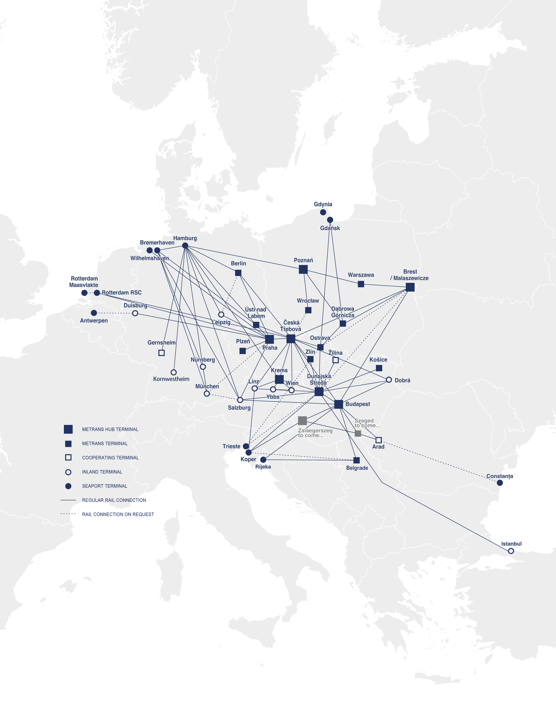
METRANS
Over 650 regular train connections per week
2024
FROM ↔ TO
TRAINS PER WEEK
FROM ↔ TO
TRAINS PER WEEK
Hamburg ↔ Praha
47
Nürnberg → München
6
Hamburg ↔ Ceska Trebova
up to 38
Duisburg ↔ Praha
6
Hamburg ↔ Dunajska Streda
14
Koper ↔ Dunajska Streda
35
Hamburg ↔ Berlin
6
Koper ↔ Budapest
28
Hamburg ↔ Gernsheim
6
Praha ↔ Plzeň
12
Hamburg ↔ Gadki
22
Praha ↔ Ceska Trebova
28
Hamburg ↔ Nürnberg
18
Praha ↔ Salzburg
9
Hamburg ↔ München
18
Praha → Leipzig
1
Hamburg ↔ Leipzig
up to 14
Praha ↔ Wilhelmshaven
8
Hamburg ↔ Kornwestheim
10
Ceska Trebova ↔ Dunajska Streda
36
Hamburg ↔ Krems
3
Ceska Trebova ↔ Zlin
14
Salzburg → Hamburg
3
Ceska Trebova ↔ Ostrava
12
Bremerhaven ↔ Praha
9
Ceska Trebova ↔ Krems
2
Bremerhaven ↔ Ceska Trebova
11
Ceska Trebova ↔ Linz
up to 2
Bremerhaven ↔ Dunajska Streda
6
Ceska Trebova ↔ Salzburg
9
Bremerhaven ↔ Nürnberg
6
Ceska Trebova ↔ Budapest
4
Bremerhaven ↔ München
6
Ceska Trebova ↔ Malaszewice
up to 4
Bremerhaven ↔ Gadki
up to 13
Dunajska Streda ↔ Kosice
12
Malaszewice ↔ Budapest
up to 2
Ostrava ↔ Dabrowa Gornicza
12
Malaszewice ↔ Hamburg
up to 2
Dunajska Streda ↔ Zilina
12
Gdansk ↔ Ostrava
12
Dunajska Streda ↔ Budapest
24
Gdansk ↔ Dabrowa Gornicza
12
Dunajska Streda ↔ Krems
6
Gadki ↔ Pruszkow
up to 8
Dunajska Streda ↔ Halkali
up to 3
Gadki ↔ Dabrowa Gornicza
6
Budapest ↔ Arad
up to 3
Gadki ↔ Katy Wroclawskie
6
Budapest ↔ Belgrade (Indjija)
up to 1
Rotterdam ↔ Praha
12
Rijeka ↔ Budapest
up to 3
Rotterdam ↔ Ceska Trebova
up to 8
Rijeka ↔ Belgrade (Indjija)
up to 3

Slide 7
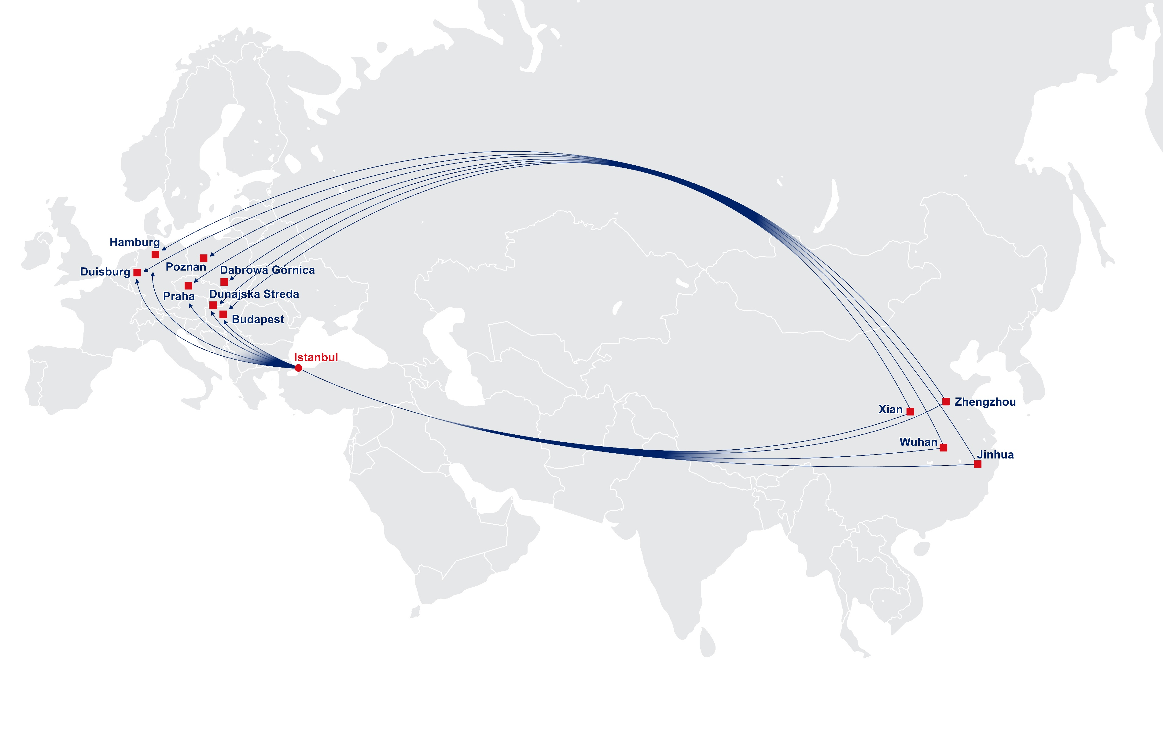
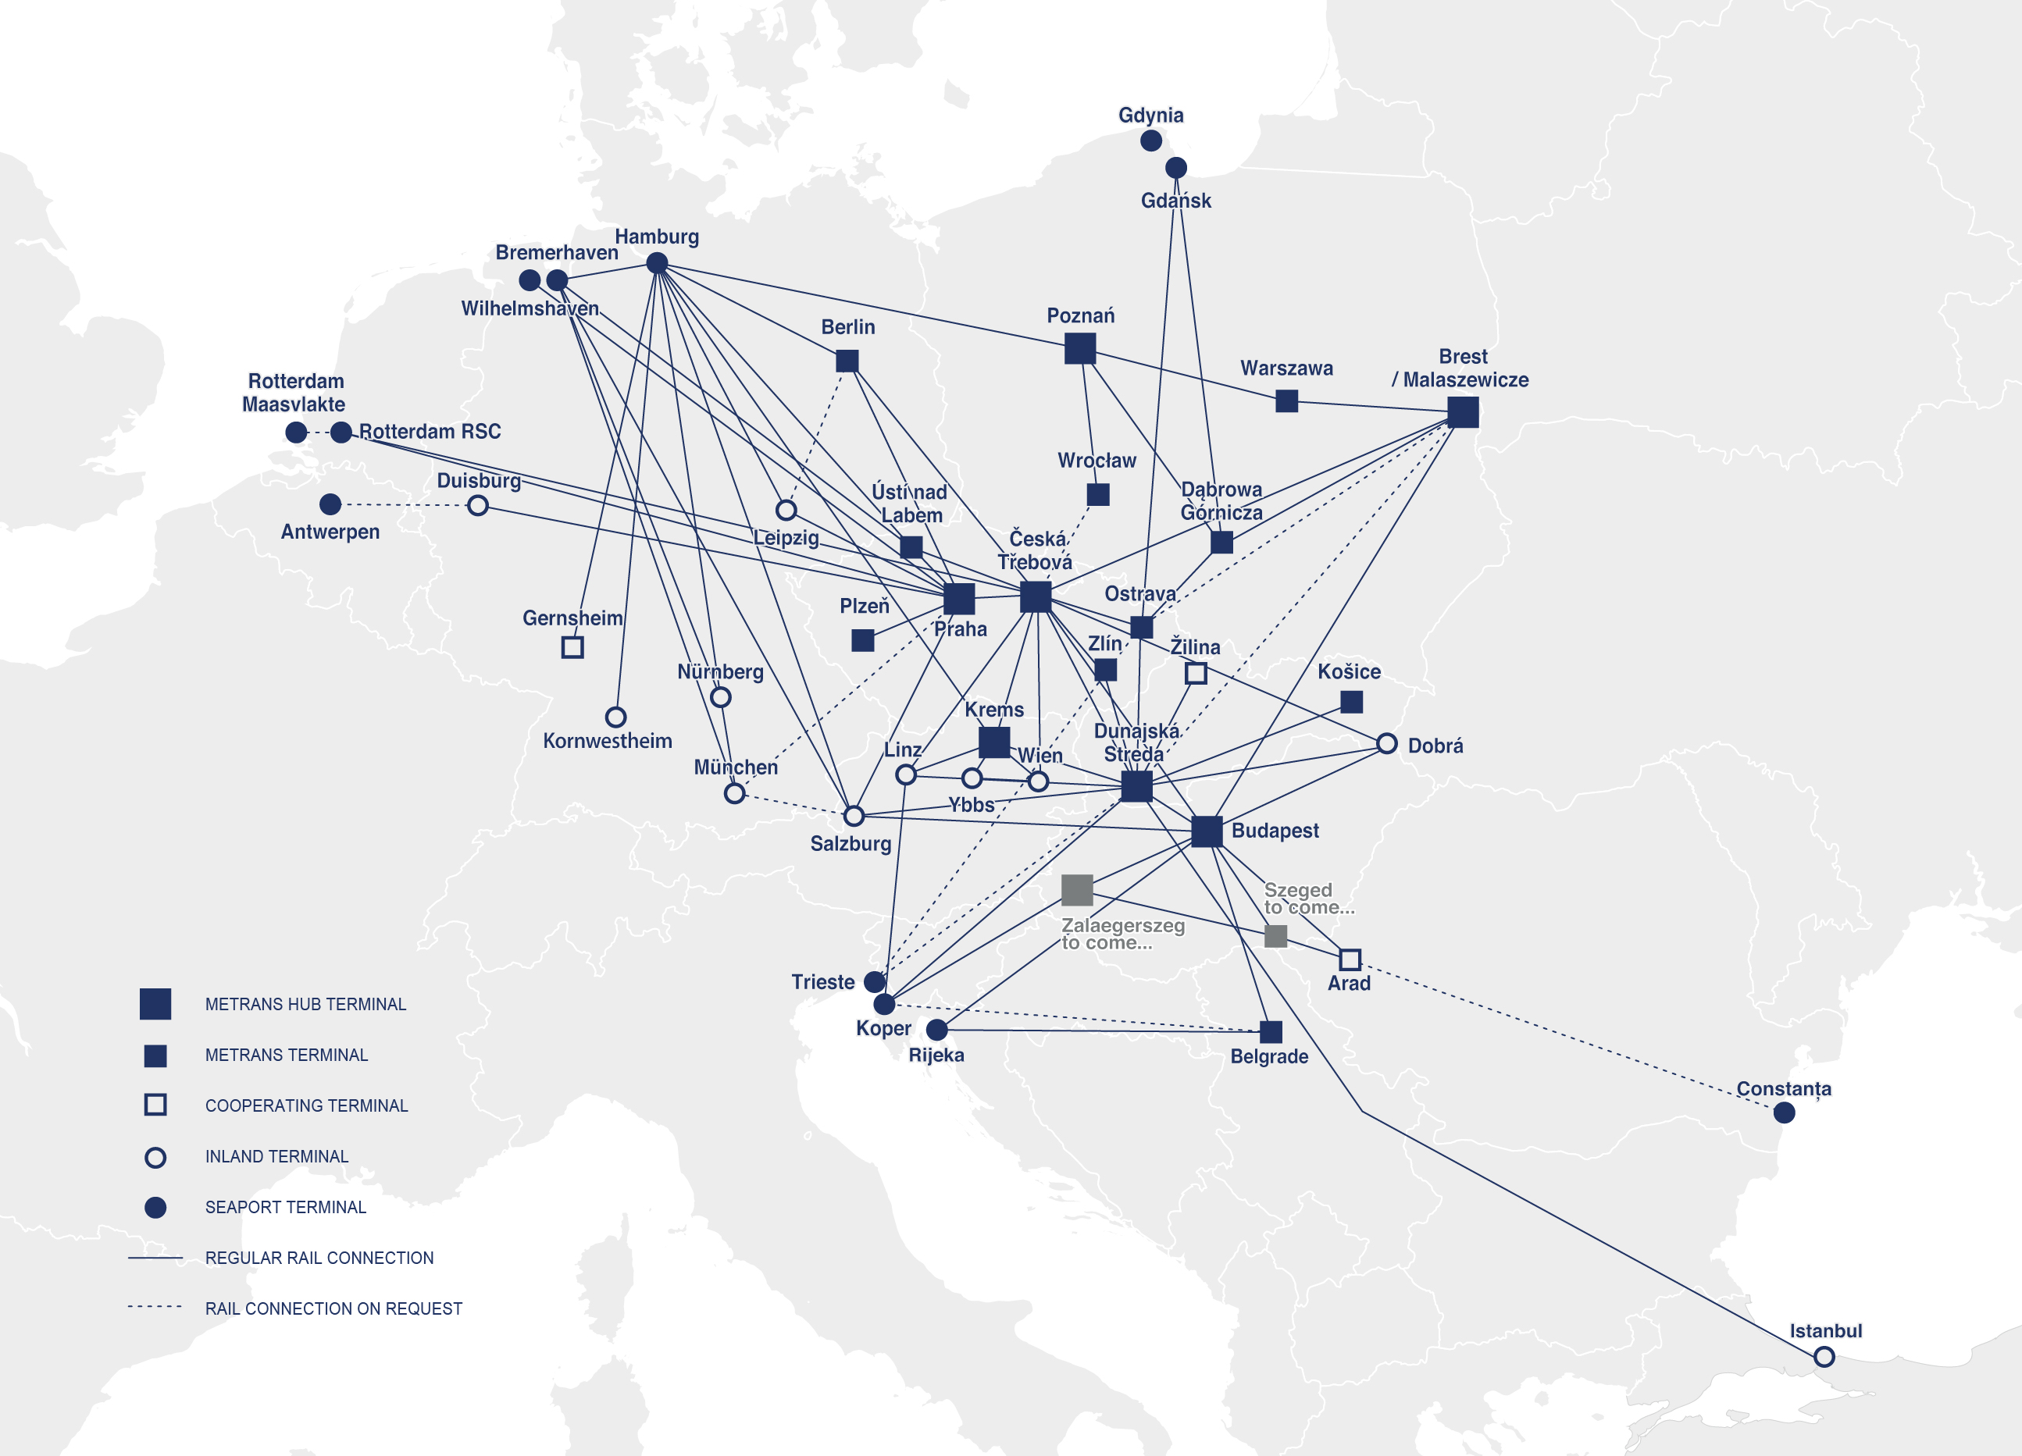
METRANS CONNECTIONS
to the New Silk Road
2024
20 terminal & depots: Czech Republic, Slovakia, Poland, Hungary, Austria & Germany
Over 2 million sqm Depot & Terminal capacities
Over 130 locomotives & 4000 wagons
2 repair shops for locomotives & wagons
Offices in the ports of Hamburg, Bremerhaven & Koper
METRANS also maintains NEUTRALITY on the SILK ROAD connections
Wide range of benefits to our customers:
Customs clearance directly at the terminal
Chinese speaking employee
Dedicated customer service desk for shipments
Local trucking

Slide 8
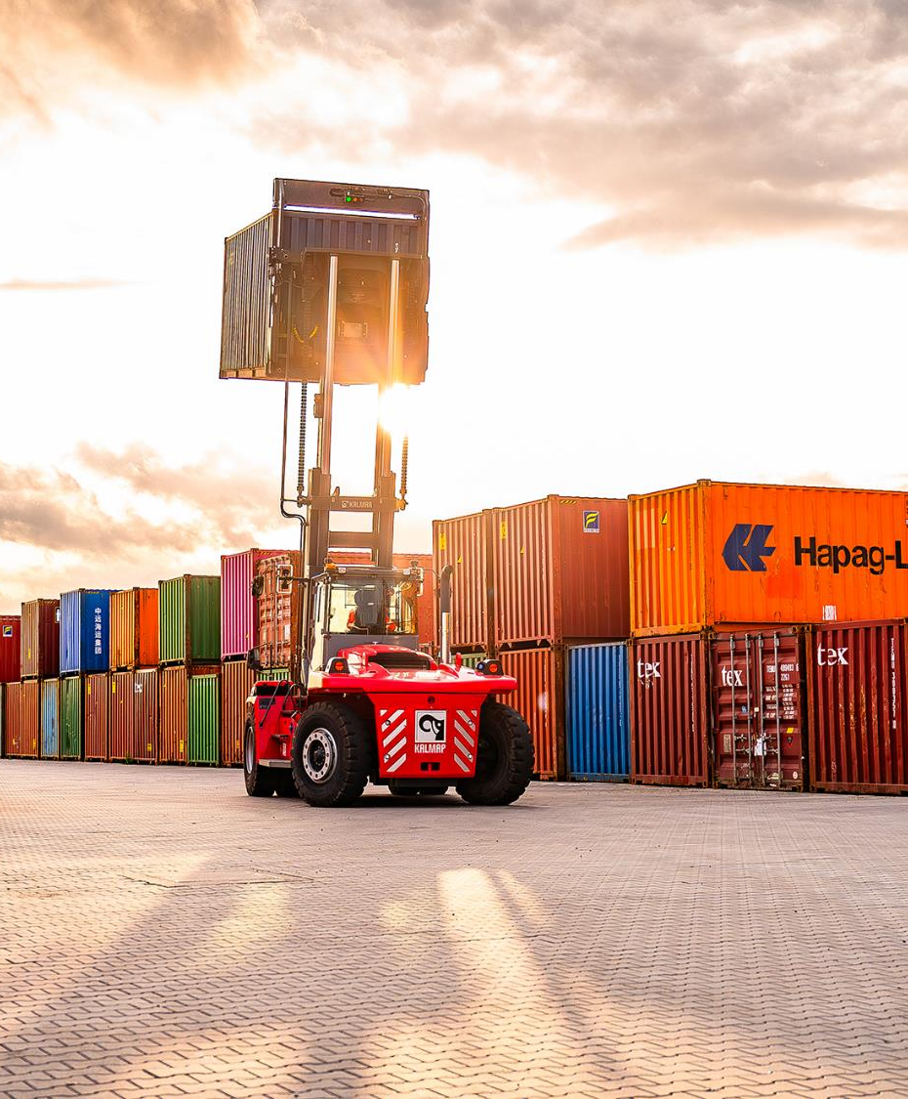
METRANS
Actual rail & terminal network
2024
WHY TO CHOOSE METRANS NETWORK & SOLUTION
We connect The Belt and Road initiative to the Europe via
Malaszewice / Brest (PL / BY)
with our network of own, high sophisticated container terminals & depots and modern railway hubs in
Prague (CZ) / Ceska Trebova (CZ) / Dunajska Streda (SK) / Budapest (HU) / Poznan (PL)

Slide 9
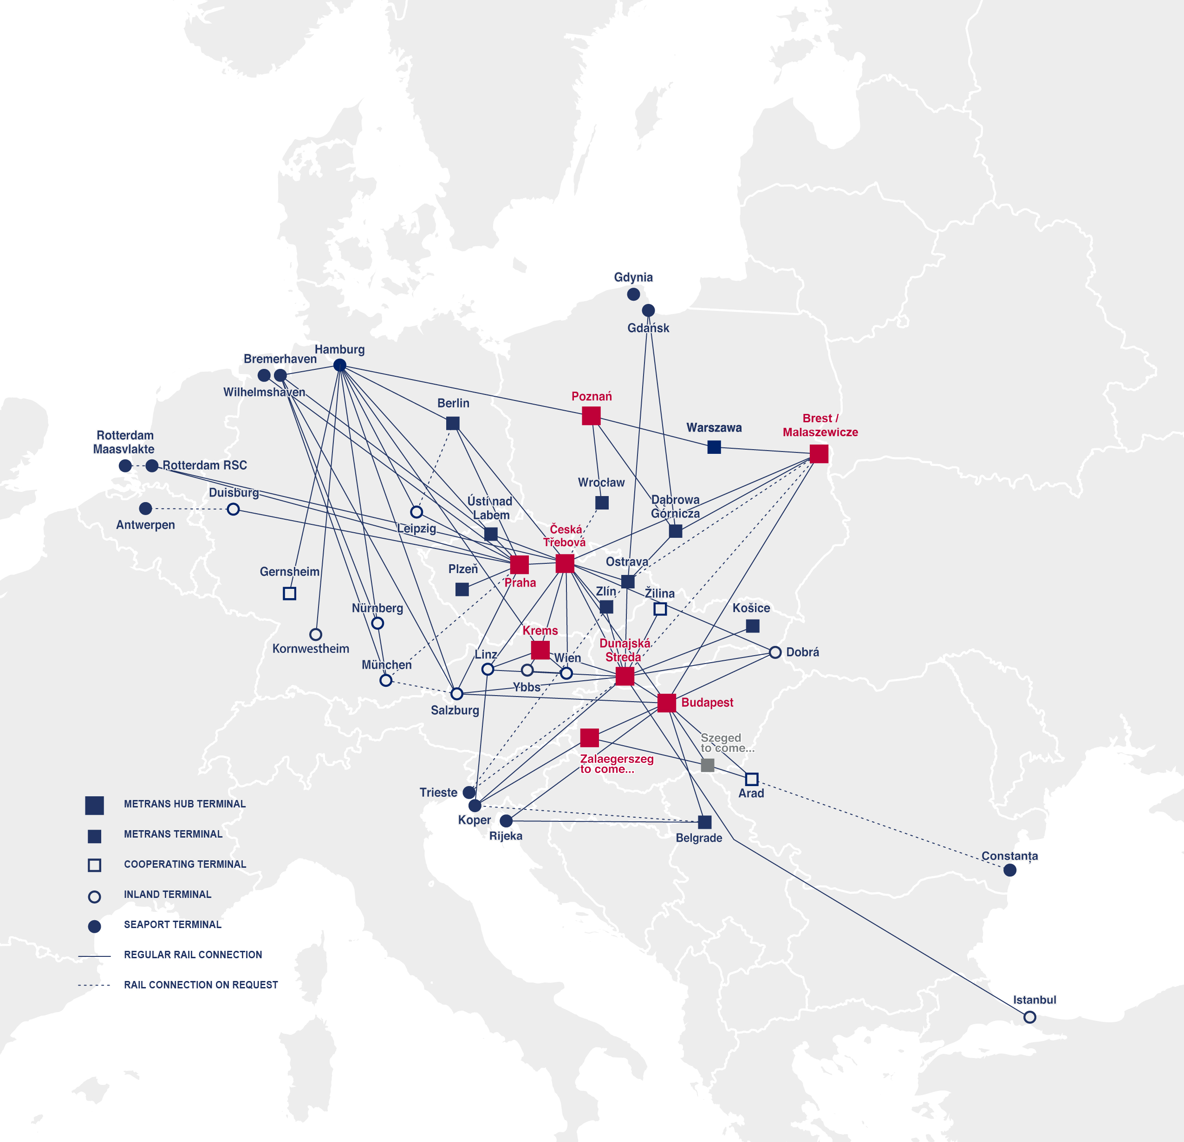
CONNECTION TO SILK ROAD
Network of METRANS
2024
XIAN & WUHAN – CESKA TREBOVA (CZ)
2 x Trains ex Xian per week
1 x Train ex Wuhan per week
Routing via Malaszewicze
HUB Concept to METRANS Network connection to Prague, Dunajska Streda, Krems, Salzburg, Budapest, Hamburg, Duisburg
ZHENGZHOU – HAMBURG (DE)
2 x Trains per week
- Direct connection to Hamburg and via Hamburg to Munich
ZHENGZHOU – BEOGRAD (RS)
1 x Train per week
XIAN – BUDAPEST (HU)
1 x Train per week

Slide 10
2024
WHY TO CHOOSE OUR NETWORK FOR CARGO FROM / TO ASIA?
CONNECT YOUR CARGO
TO METRANS NETWORK!
METRANS operates regular weekly trains and supports partners from several Chinese origins as well as destinations and connecting them with our network
Only last / first mile from / to “HUB“ or “END“ terminal is arranged by trucks
By using of latest technologies and innovations on the field of transport and handling we are reducing CO₂ emissions as much as possible.
Possibility to connect with terminals of other operators using METRANS network within the whole Europe – neutrality guaranteed
Malaszewicze / Brest terminals connected

Slide 11
WHY TO CHOOSE OUR NETWORK FOR CARGO FROM / TO FAR EAST?
2024
CONNECT YOUR CARGO
TO METRANS NETWORK!
Strong and fast growing network of METRANS allows to find the most efficient way for your cargo
Ability to combine export cargo from different European countries and choose the nearest HUB terminal (Ceska Trebova, Dunajska Streda or Budapest)
Ready for a new alternative solution (i.e. via Turkey / Azerbaijan / Constanta to EU)
METRANS keeps neutrality also on connections to SILK ROAD
High quality service – METRANS keeps on all of his services highest standards
Cargo connected to Europe largest rail & terminal network
Wide range of benefits to our customers
Customs clearance directly at the terminal
Chinese speaking employee
Dedicated customer service desk for shipments to SILK ROAD

Slide 12
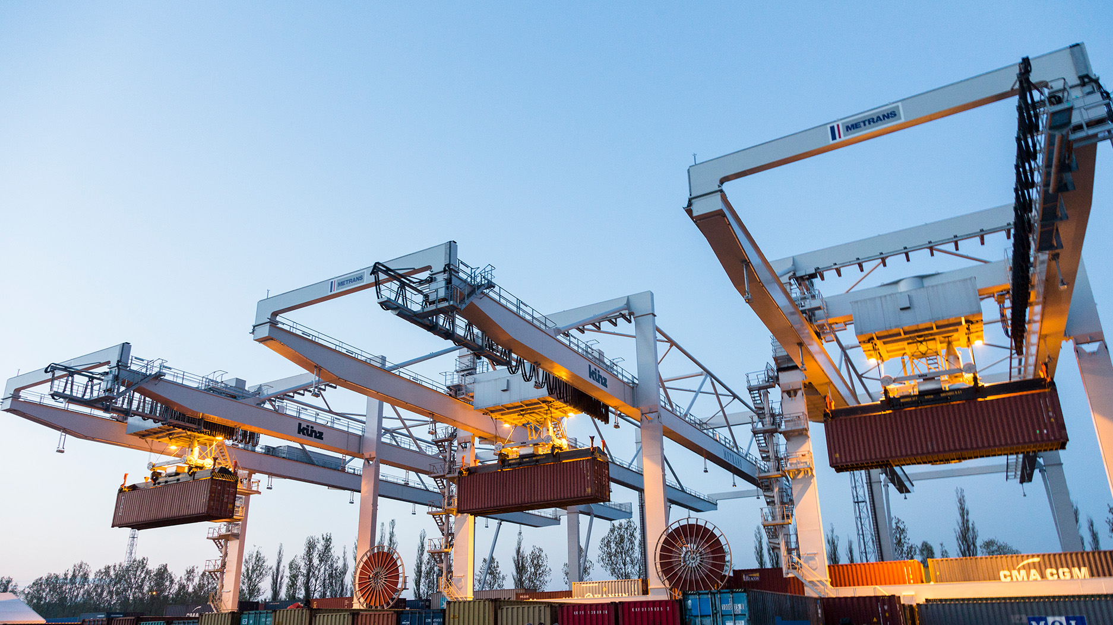
THANK YOU!
Find us on metrans.eu and

