Slide 1
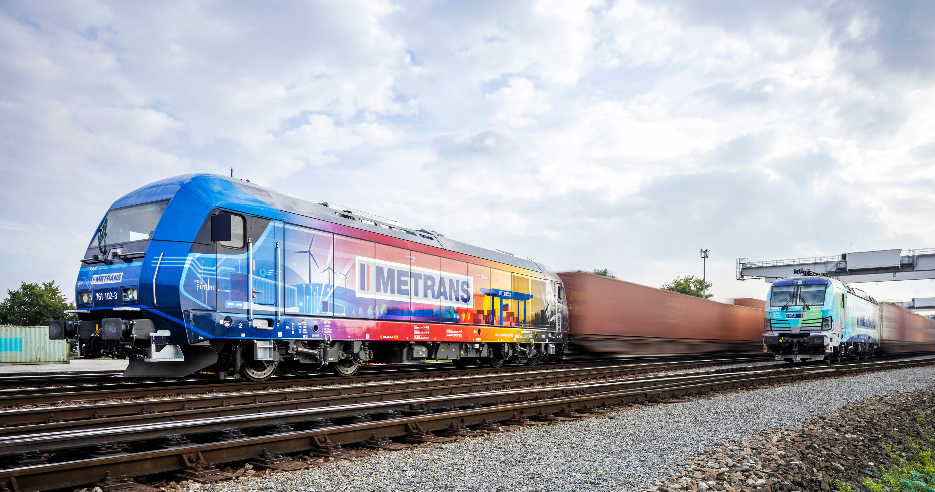
THE INTERMODAL LOGISTICS OF METRANS
THE NEUTRAL & GLOBAL INTERMODAL SOLUTIONS

Slide 2
2024
CONTAINER
Container handling
Container-related services (e.g. repair and maintenance)
HHLA
Group Segments
INTERMODAL
Rail & road transport services in the ports’ hinterland
Operation of hinterland terminals
PORT LOGISTICS SUBGROUP
LOGISTICS
Specialist handling – dry bulk, fruit, ro-ro, etc.
Consultancy
www.metrans.eu
REAL ESTATE
Speicherstadt, the historical warehouse district
Port real estate
Fischmarkt Hamburg-Altona

Slide 3
2024
GENERAL INFORMATION
Founded 1991, 100% HHLA
REVENUE
Over 590 million EUR
METRANS
2023 key figures
INTERMODAL
Over 1,35 million TEU
DEPOTS
Over 1,2 million TEU
EMPLOYEES
2 650

Slide 4
METRANS GROUP PROFILE
Terminals, Locomotives, Wagons and Repair Shops
2024
7 HUB TERMINALS & DEPOTS
Austria, Czech Republic, Hungary, Poland & Slovakia
MORE THAN 130 LOCOMOTIVES
13 END TERMINALS & DEPOTS
Czech Republic, Germany, Romania, Poland, Serbia & Slovakia
MORE THAN 4 000 WAGONS
DEPOT & TERMINAL CAPACITIES
2,6 million m²
2 REPAIR SHOPS FOR LOCOMOTIVES & WAGONS
Kolin (CZ) & Dunajska Streda (SK)
NEW
24/7 OPERATION BELGRADE (INDJIJA)
NEW OFFICES IN ISTANBUL & ROTTERDAM
NEW SERVICE THE GAS MEASUREMENT
FURTHER DEVELOPMENT OF THE HHLA PURE – CO₂ NEUTRAL TRANSPORTATION
+ 2 NEW TERMINALS
IN PLAN
FOR HUNGARY
+ DEVELOPMENT
OF THE PRESENT NETWORK
OFFICES IN THE PORTS
of Bremerhaven,Hamburg, Koper & Rijeka

Slide 5
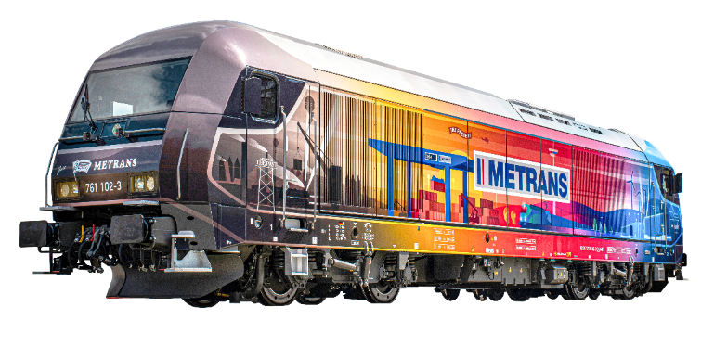
METRANS /Danubia/, a.s., SK
METRANS Danubia Kft., HU
METRANS GROUP
Company structure
METRANS Rail Slovakia, s.r.o., SK
METRANS Konténer Kft., HU
2024
METRANS /Danubia/ Krems GmbH, AT
METRANS d.o.o., HR
METRANS Railprofi Austria GmbH, AT
METRANS ADRIA d.o.o., SI
METRANS DYKO Rail Repair Shop, s.r.o., CZ
UniverTrans Kft., HU
METRANS Rail, s.r.o., CZ
TIP Žilina, s.r.o., SK
METRANS Rail /Deutschland/ GmbH, DE
METRANS Umschlagsgesellschaft mbH, DE
Umschlagsgesellschaft Königs Wusterhausen mbH (50%), DE
METRANS /Polonia/ Sp. z o.o., PL
METRANS Rail Sp. z o.o., PL
CL EUROPORT Sp. z o.o., PL
METRANS, a.s.
Prague, Czech Republic
METRANS Zalaegerszeg Kft., HU
METRANS Szeged Kft., HU
METRANS Istanbul STI, TR
www.metrans.eu
ADRIA RAIL d.o.o. (100%), HR
ADRIA RAIL Operator d.o.o., HR
M-RAIL doo za železnički prevoz robe Krnješevci (33,3%), RS
DRUŠTVO ZA INTERMODALNI PREVOZ I USLUGE ADRIA RAIL DOO INDIJA, RS
EMA RAIL S.R.L. (33,3%), RO
METRANS Rail Netherlands, NL
METRANS Rail Belgium B.V., BE

Slide 6
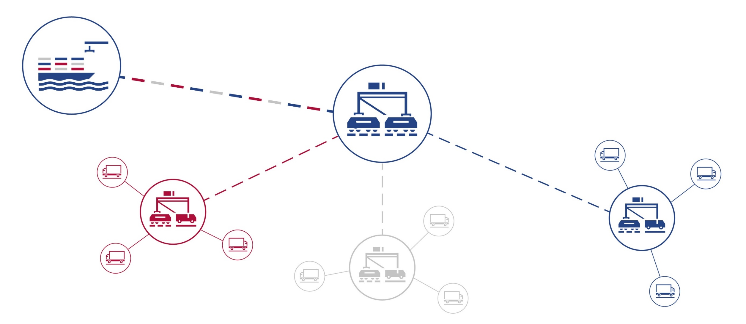
THE HUB & SHUTTLE SYSTEM
The Ports are linked with a Network of HUB and Inland Terminals
2024
www.metrans.eu

Slide 7
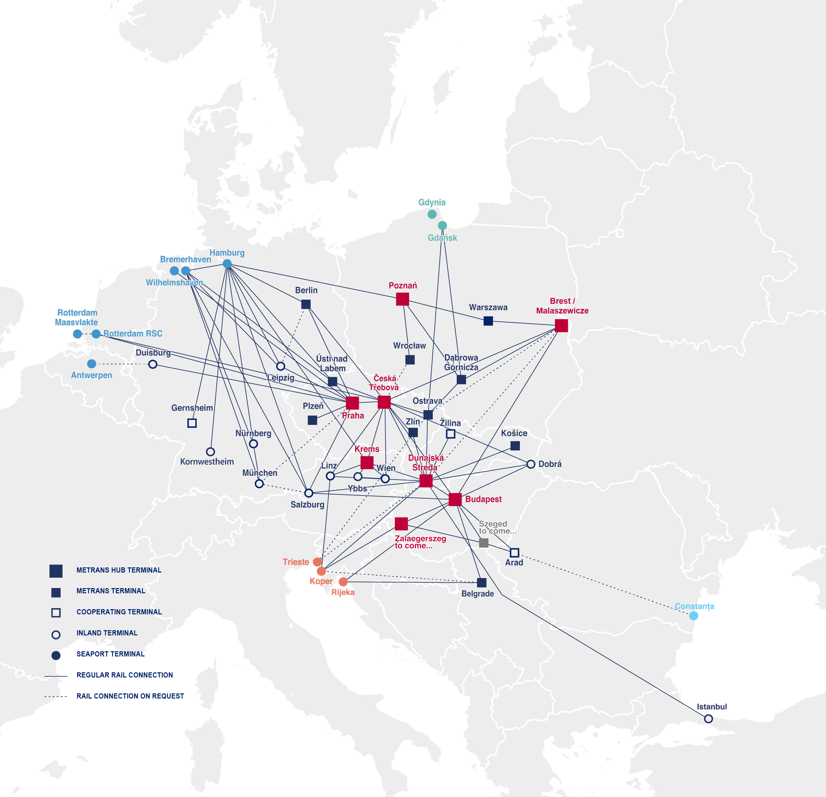
OVER 650 REGULAR TRAINS PER WEEK
2024
METRANS
The European Intermodal RAIL Bridge
TERMINALS
7 METRANS HUB TERMINALS
Praha & Ceska Trebova, CZ
Krems, AT
Dunajska Streda, SK
Poznan & Malaszewicze, PL
Budapest (+ Zalaegerszeg to come), HU
13 METRANS END TERMINALS
DE, CZ, PL, RO, RS, SK
SEAPORTS
NORTH SEA
ADRIATIC SEA
Hamburg, Bremerhaven,
Wilhelmshaven - DE
Rotterdam - NL
Antwerpen - BE
Rijeka – HR
Koper – SI
Trieste – IT
BALTIC SEA
BLACK SEA
Gdansk, Gdynia - PL
Constanta – RO

Slide 8
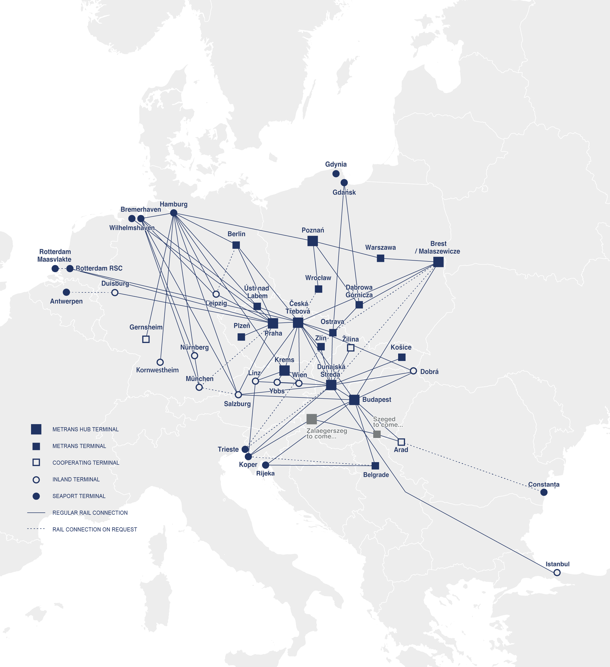
METRANS
Over 650 regular train connections per week
2024
TRAINS PER WEEK
TRAINS PER WEEK
FROM ↔ TO
FROM ↔ TO
Budapest ↔ Arad
up to 3
Hamburg ↔ Berlin
6
Budapest ↔ Belgrade (Indjija)
up to 3
Hamburg ↔ Ceska Trebova
up to 38
Bremerhaven ↔ Ceska Trebova
11
Hamburg ↔ Dunajska Streda
14
Bremerhaven ↔ Dunajska Streda
6
Hamburg ↔ Gadki
22
Bremerhaven ↔ Gadki
up to 13
Hamburg ↔ Gernsheim
6
Bremerhaven ↔ München
6
Hamburg ↔ Kornwestheim
10
Bremerhaven ↔ Nürnberg
6
Hamburg ↔ Krems
3
Bremerhaven ↔ Praha
9
Hamburg ↔ Leipzig
up to 14
Bremerhaven ↔ Leipzig
3
Hamburg ↔ München
18
Ceska Trebova ↔ Budapest
4
Hamburg ↔ Nürnberg
18
Ceska Trebova ↔ Dunajska Streda
36
Hamburg ↔ Praha
47
Ceska Trebova ↔ Krems
2
Koper ↔ Budapest
28
Ceska Trebova ↔ Linz
up to 2
Koper ↔ Dunajska Streda
35
Ceska Trebova ↔ Malaszewice
up to 4
Malaszewice ↔ Budapest
up to 2
Ceska Trebova ↔ Ostrava
12
Malaszewice ↔ Hamburg
up to 2
Ceska Trebova ↔ Zlin
14
Nürnberg → München
6
Duisburg ↔ Praha
6
Ostrava ↔ Dabrowa Gornicza
12
Dunajska Streda ↔ Budapest
24
Praha ↔ Ceska Trebova
28
Dunajska Streda ↔ Halkali
up to 3
Praha → Leipzig
1
Dunajska Streda ↔ Kosice
12
Praha ↔ Plzeň
12
Dunajska Streda ↔ Krems
6
Praha ↔ Salzburg
9
Dunajska Streda ↔ Zilina
12
Praha ↔ Wilhelmshaven
8
Gadki ↔ Dabrowa Gornicza
6
Rijeka ↔ Belgrade (Indjija)
up to 3
Gadki ↔ Katy Wroclawskie
6
Rijeka ↔ Budapest
up to 3
Gadki ↔ Pruszkow
up to 8
Rotterdam ↔ Ceska Trebova
up to 8
Gdansk ↔ Dabrowa Gornicza
12
Rotterdam ↔ Praha
12
Gdansk ↔ Ostrava
12
Salzburg → Hamburg
3

Slide 9
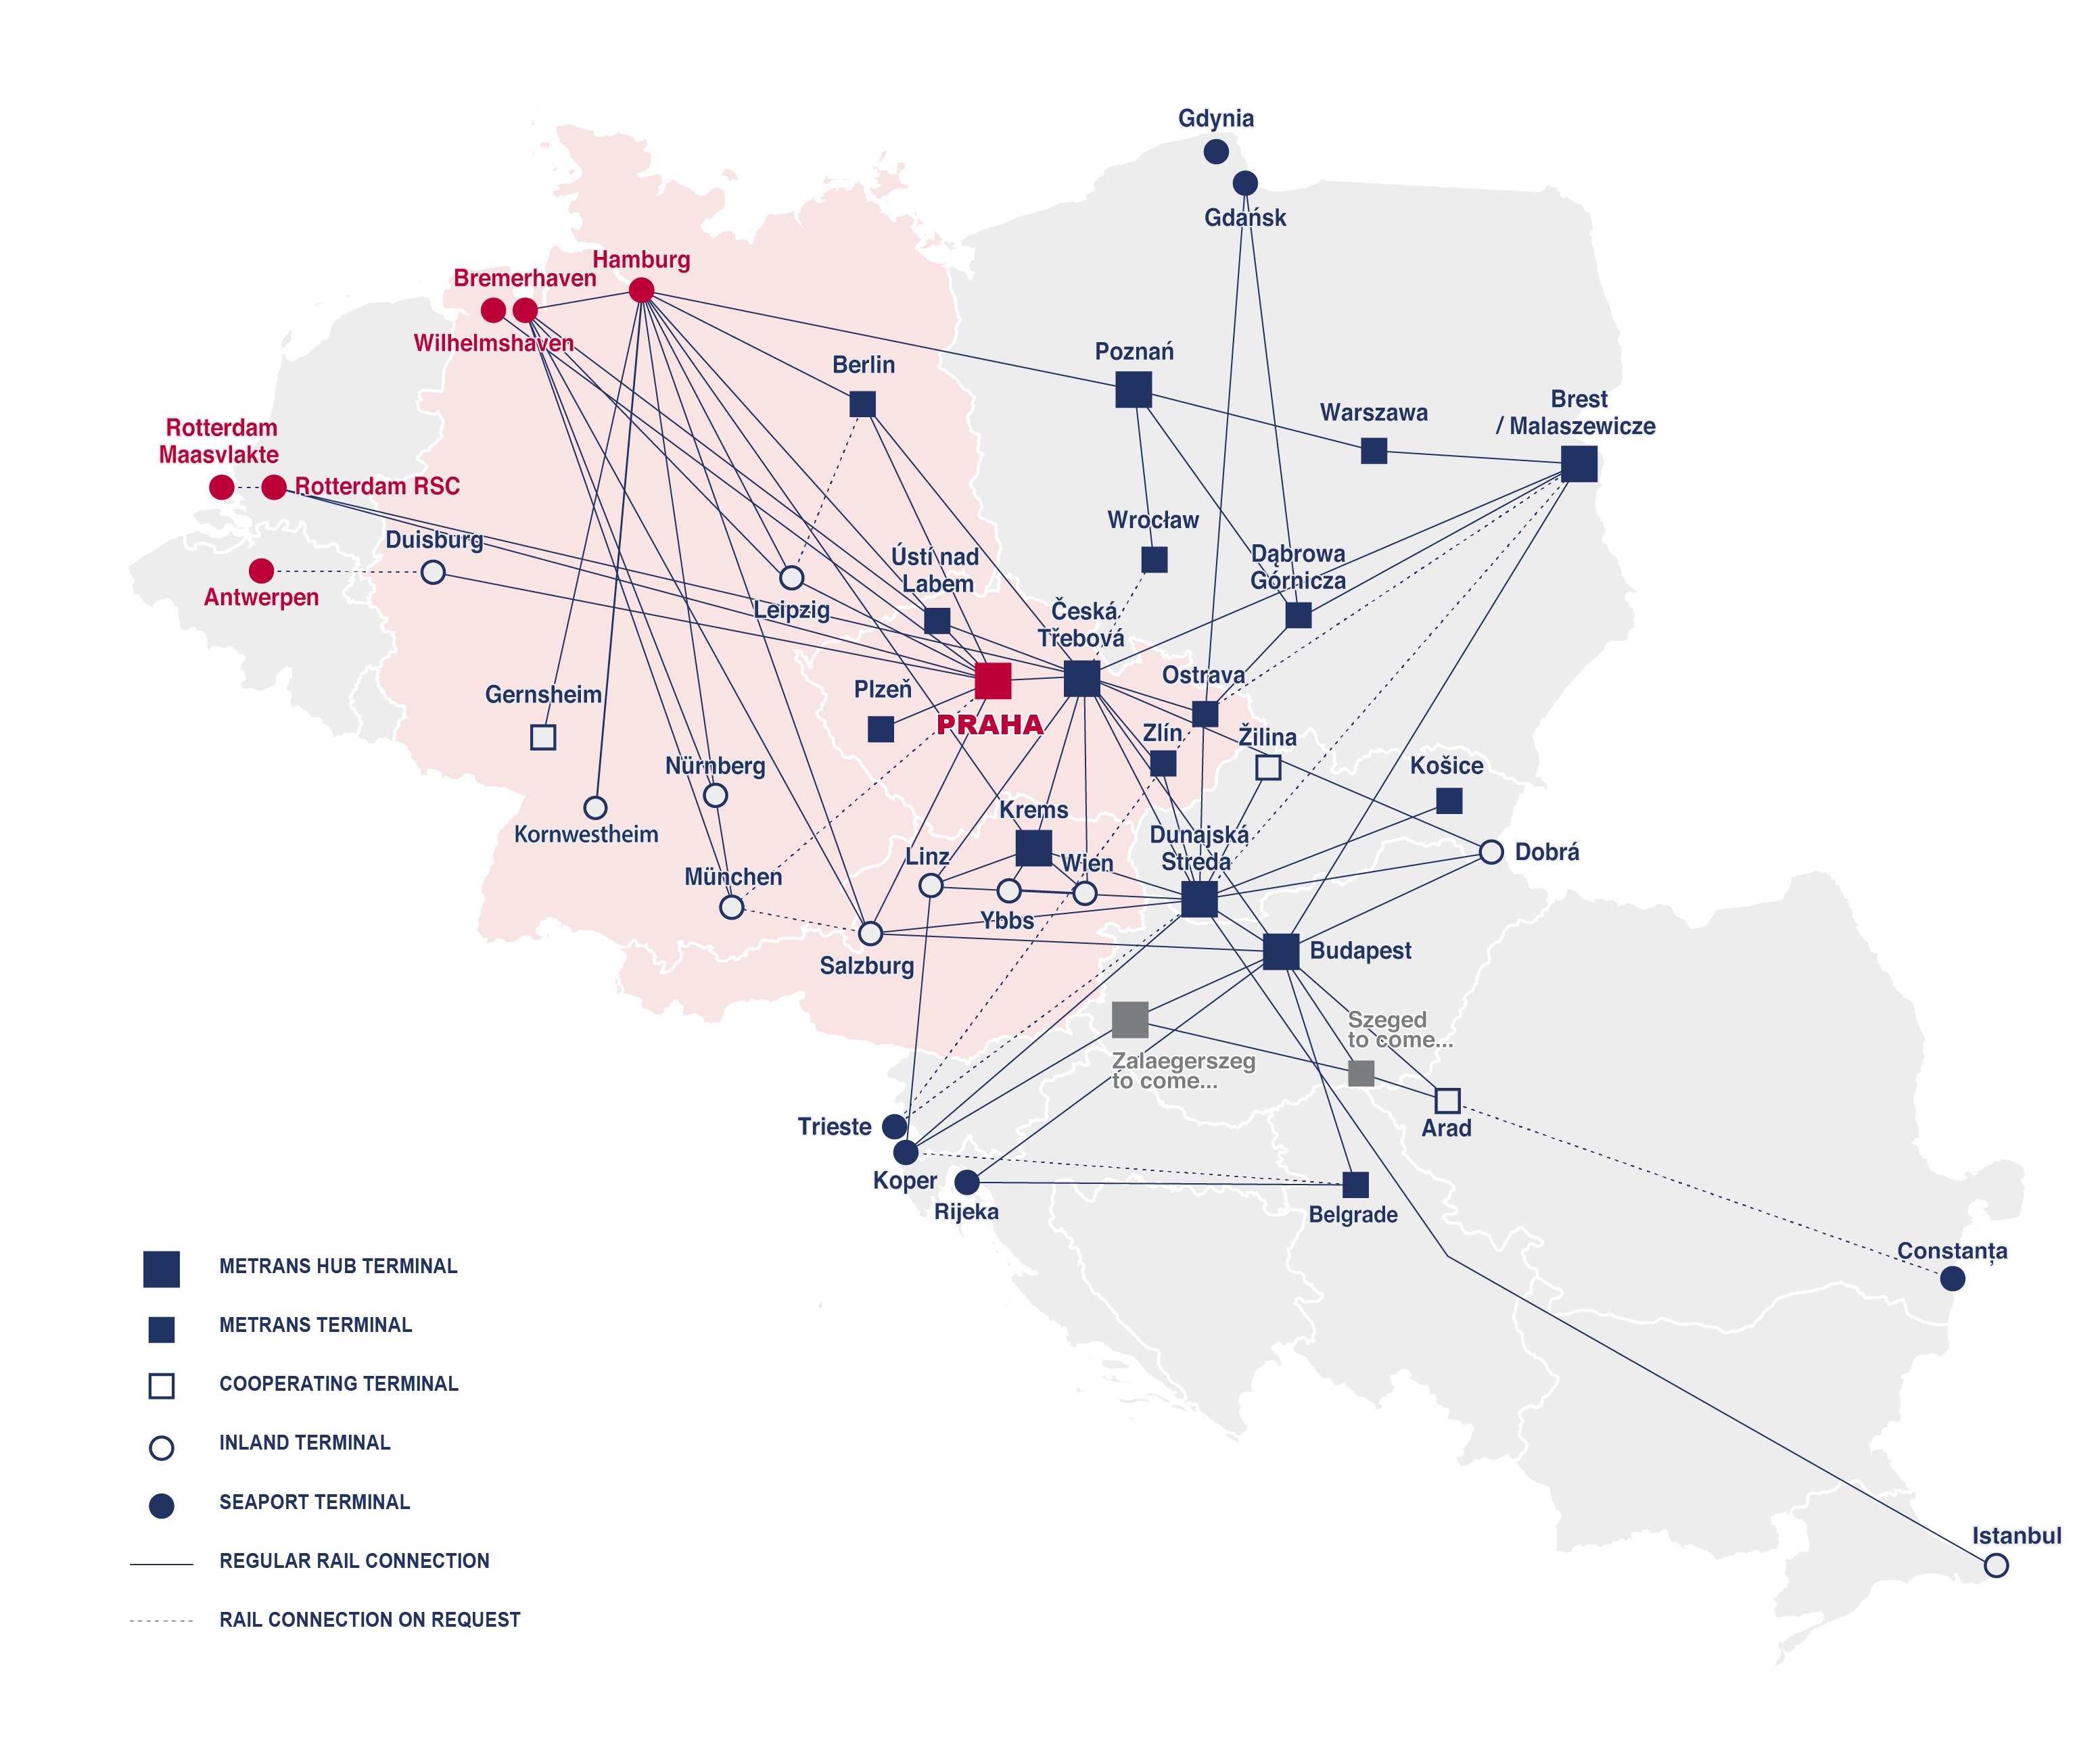
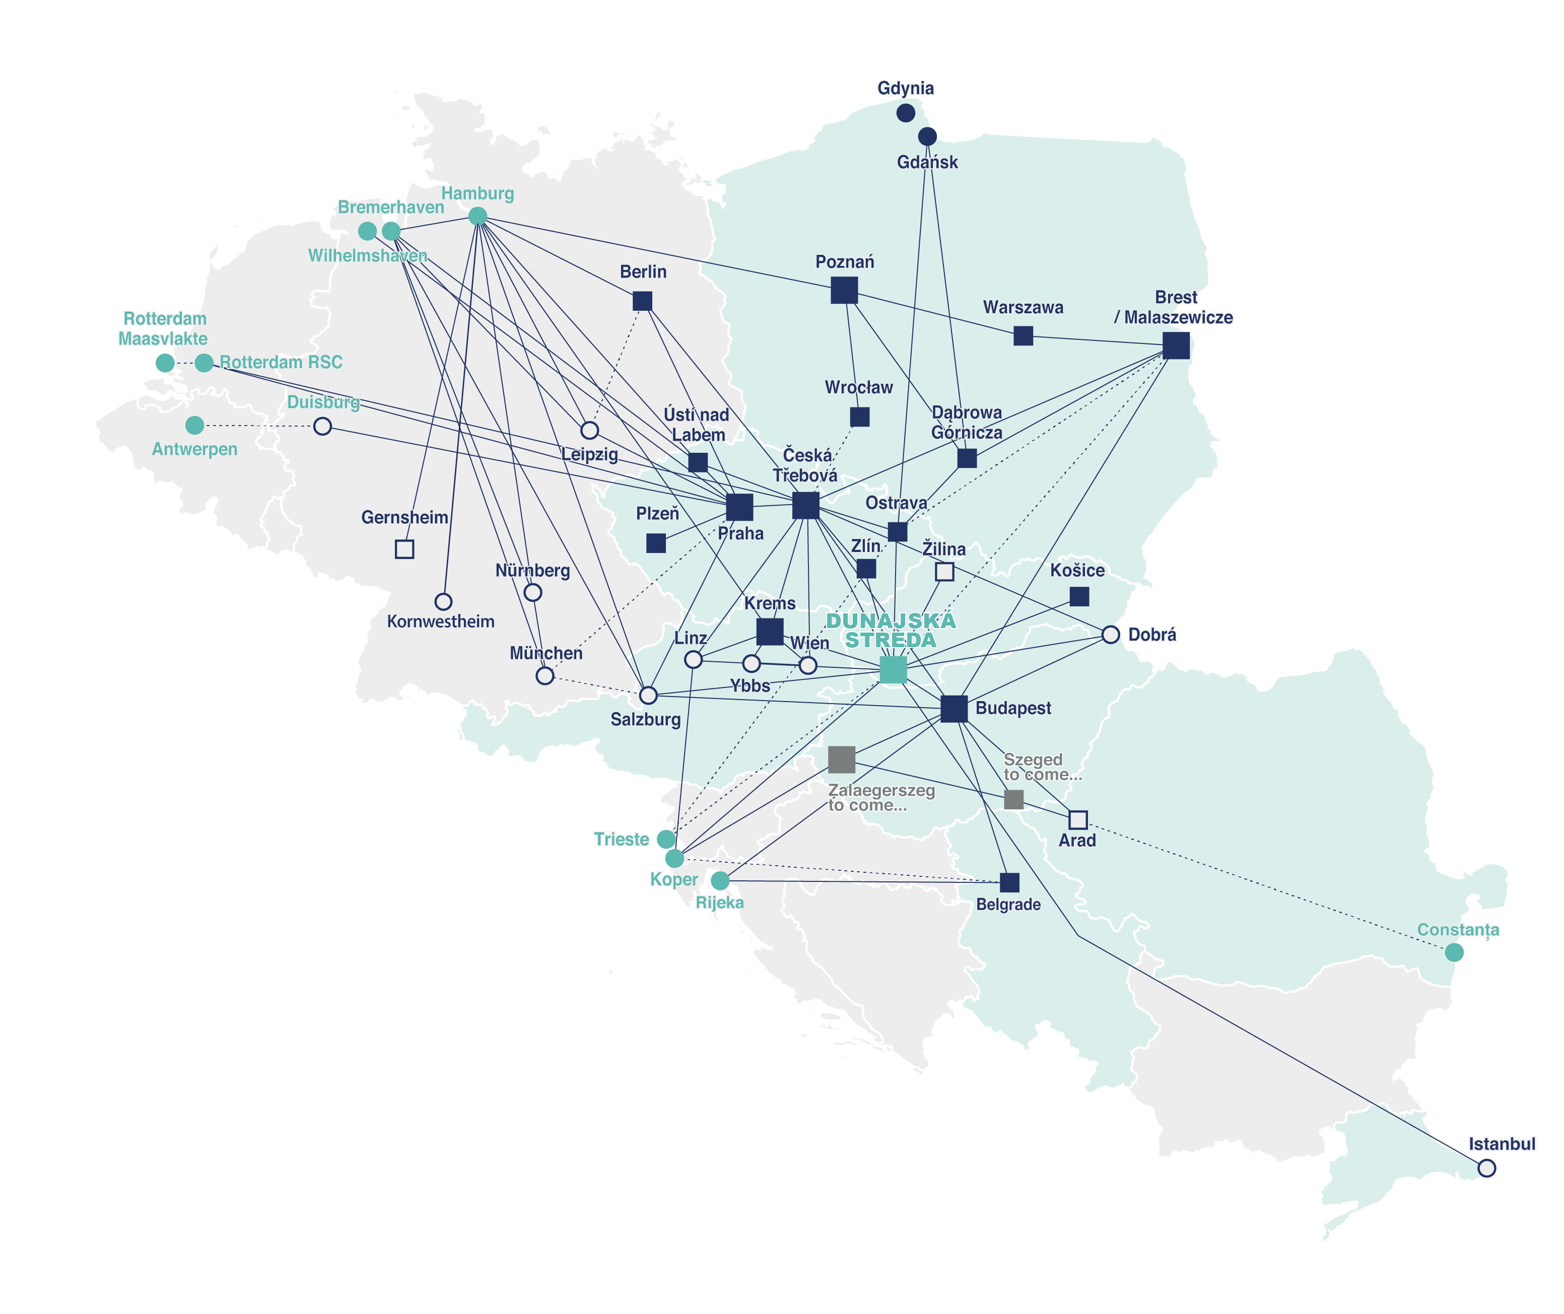
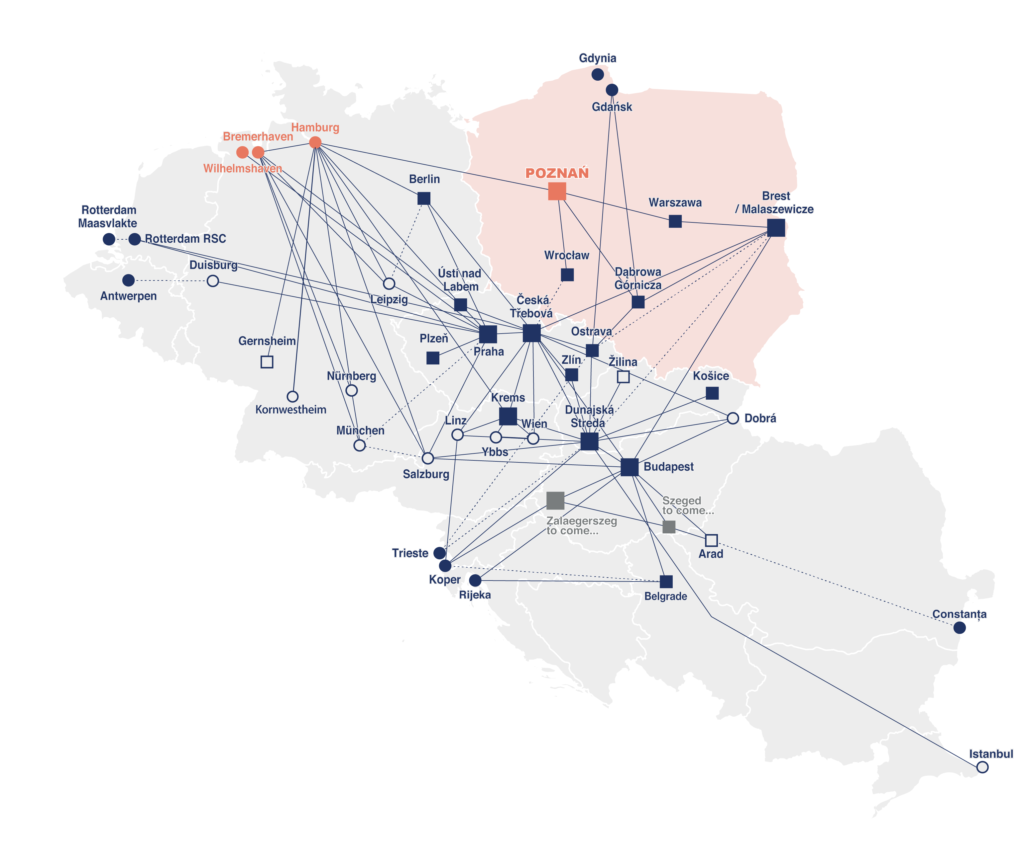
METRANS
Rail & terminal network
2024
KEY OPERATION OFFICES
PRAHA, CZ
DUNAJSKA STREDA, SK
POZNAN (GADKI), PL
METRANS, a.s. Head Quarter
Operation territory
Ports: BE, DE, NL
Countries: AT, CZ, DE
Operation territory
Ports: BE, DE, IT, NL, RO, SL
Countries: AT, CZ, HU, PL, RO, RS, SK, TR
Operation territory
Ports: DE
Countries: PL

Slide 10
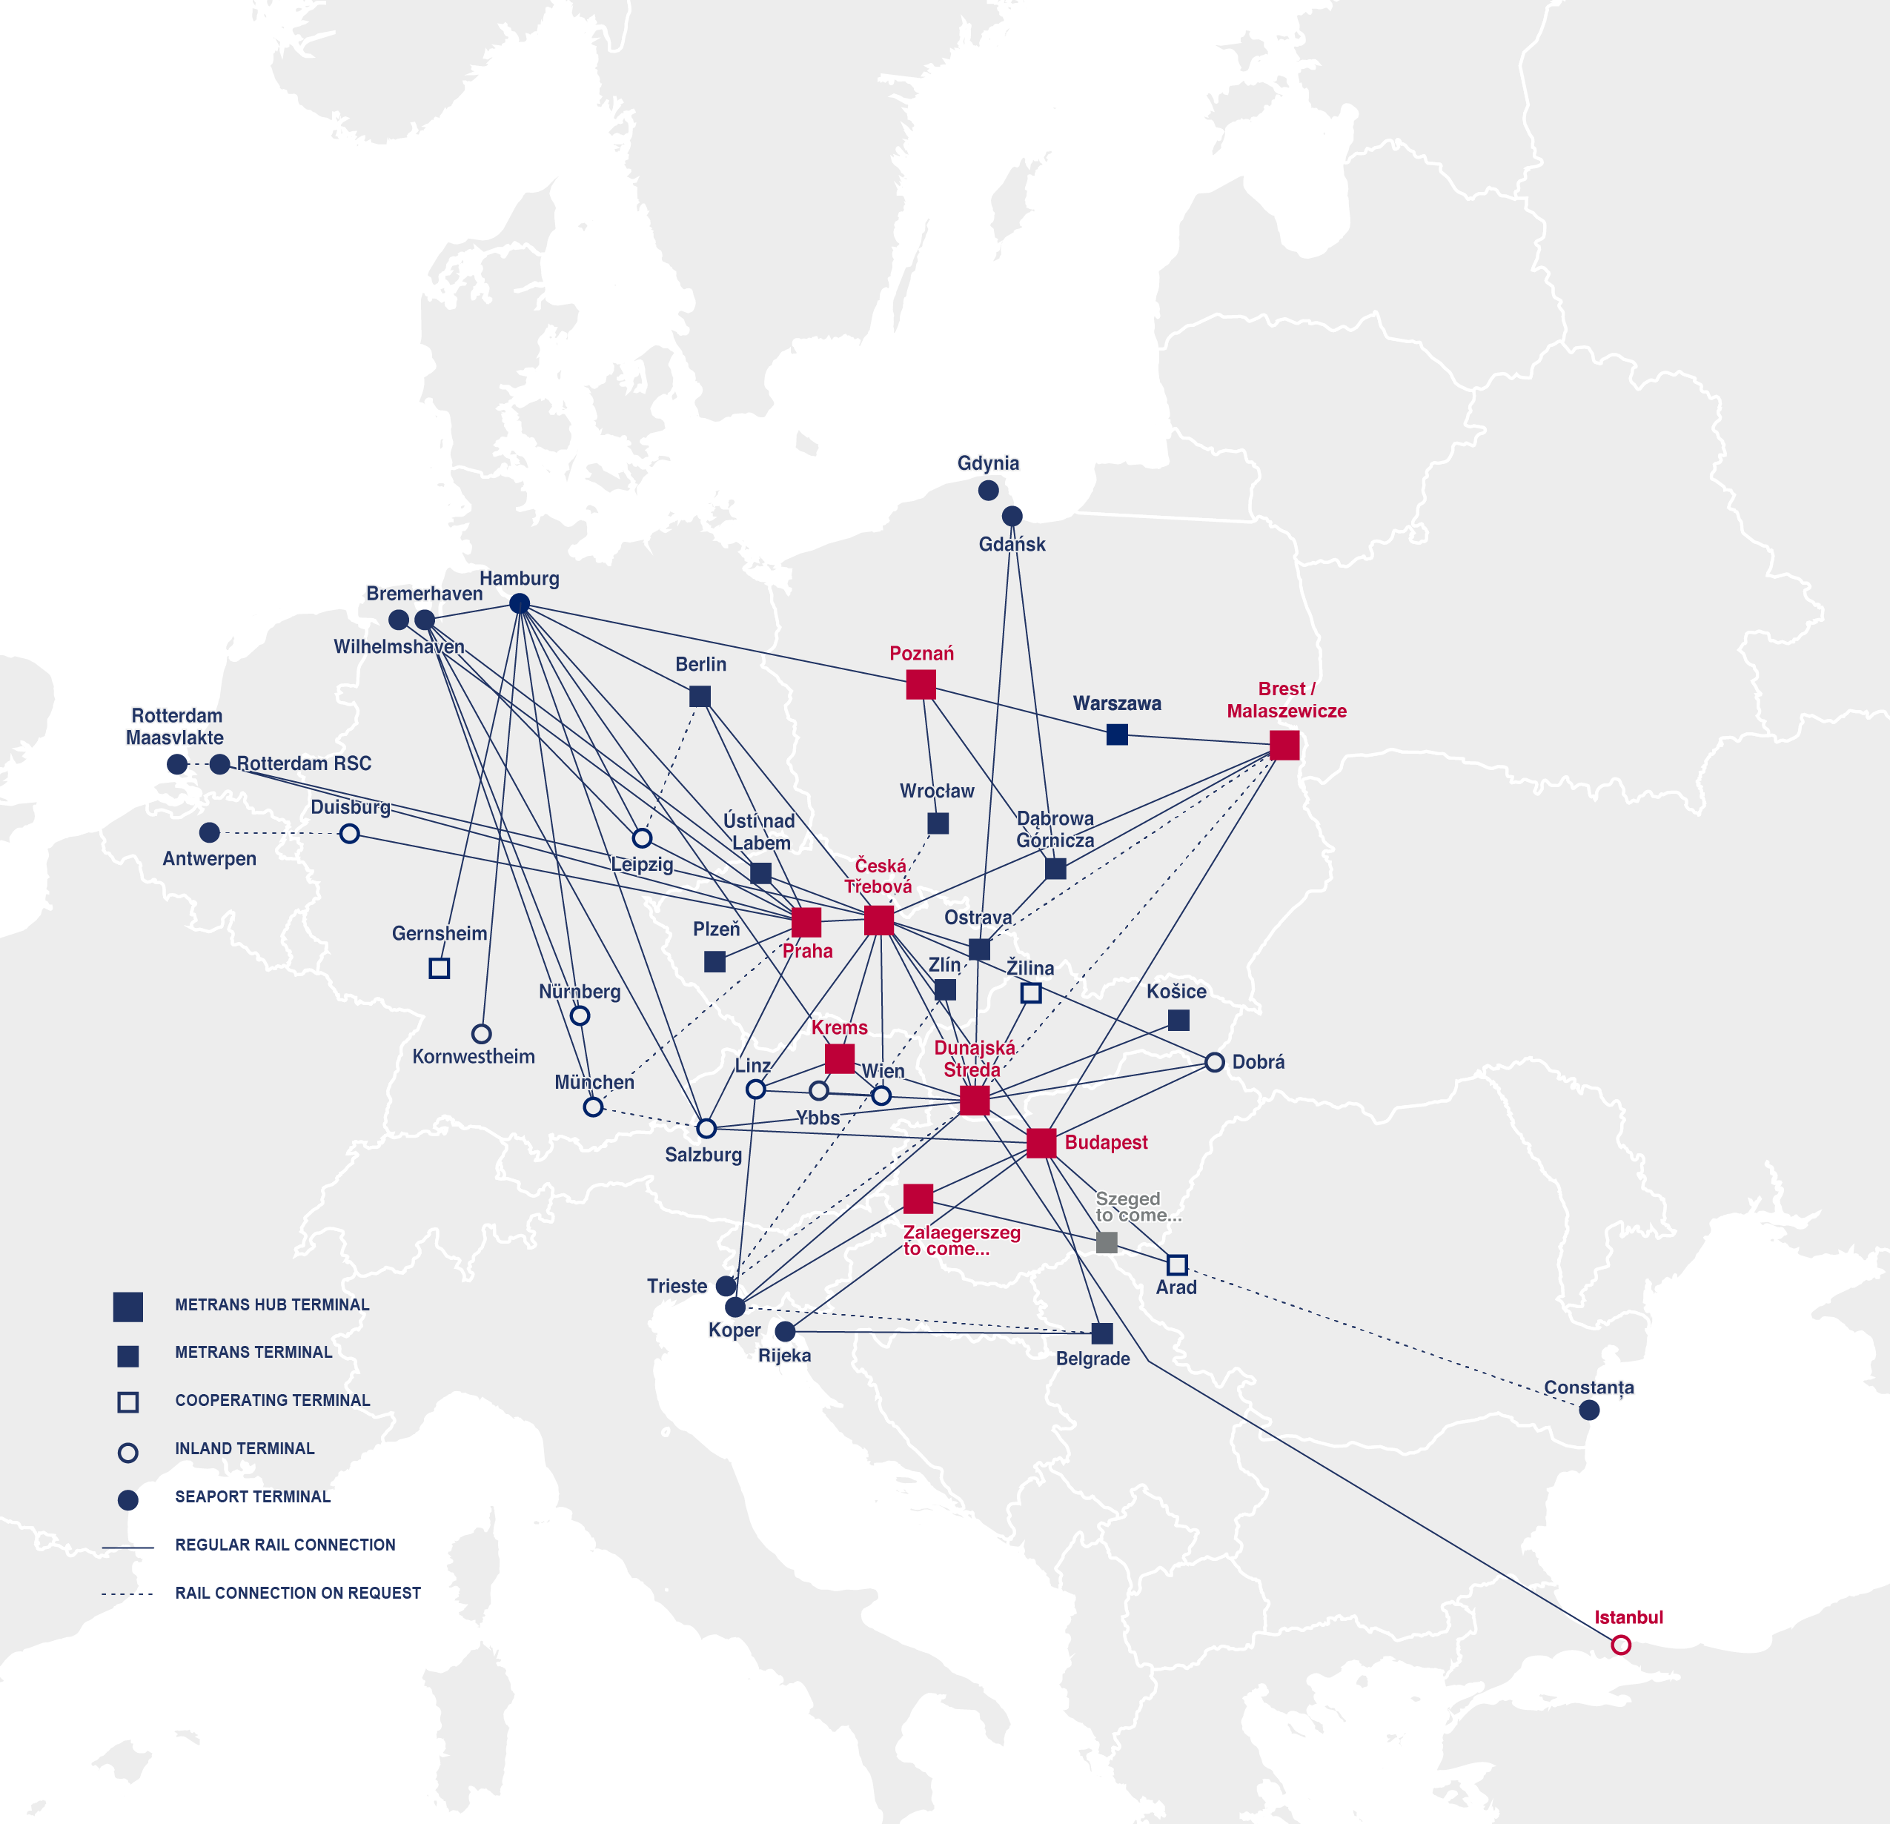
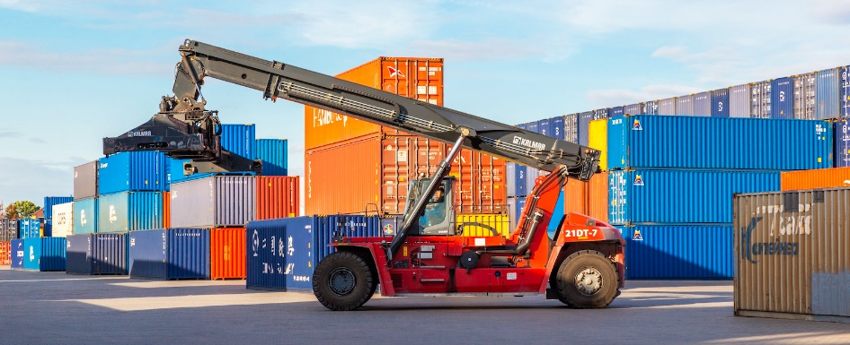
SILK ROAD
METRANS connections to the New Silk Road
2024
MALASZEWICZE/BREST TO
Warszawa
Poznan
Hamburg
Duisburg
Munich/Nuremberg via Hamburg
Ceska Trebova with daily connection to all METRANS terminals as shown
www.metrans.eu
SILK ROAD CONNECTION VIA ISTANBUL
FULL ACCES to the network of METRANS also on this routing.

Slide 11
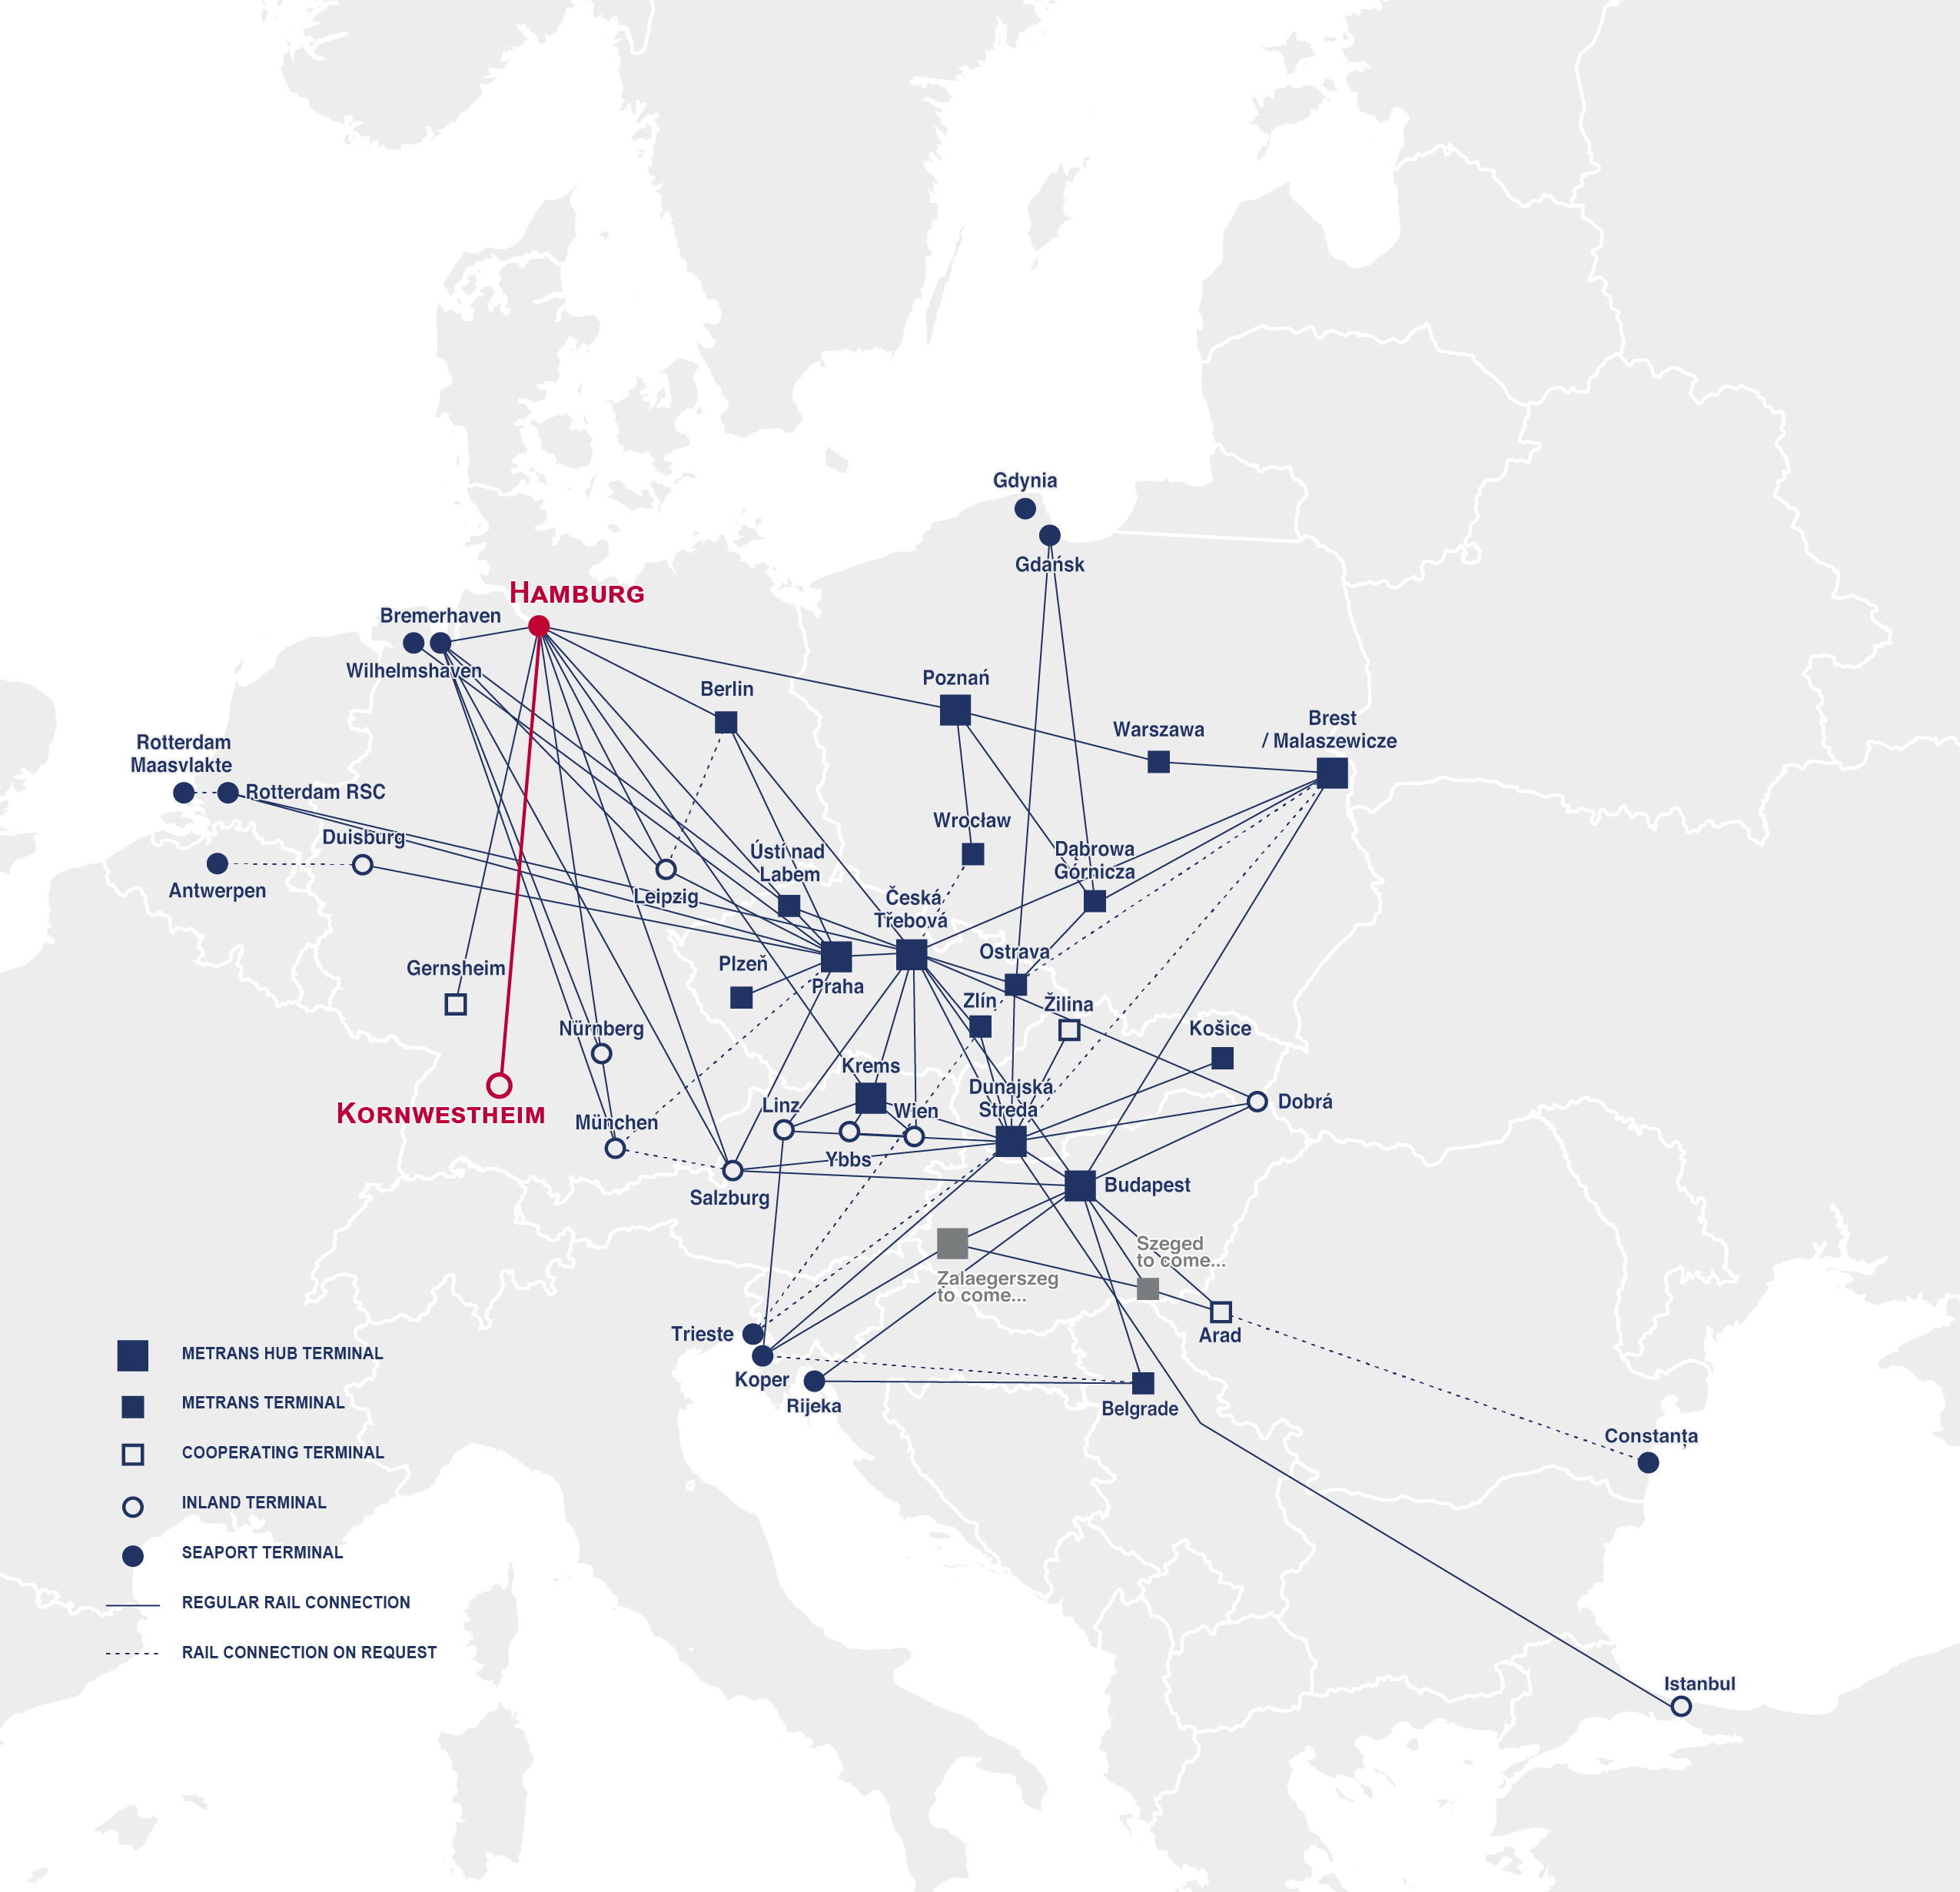
NEW CONNECTIONS TO/FROM KORNWESTHEIM
2024
Start from January 2024
Daily service Hamburg - Kornwestheim and v.v.
Gateway connection from Hamburg to Bremerhaven and Wilhelmshaven
CO₂ neutral with HHLA Pure
www.metrans.eu

Slide 12
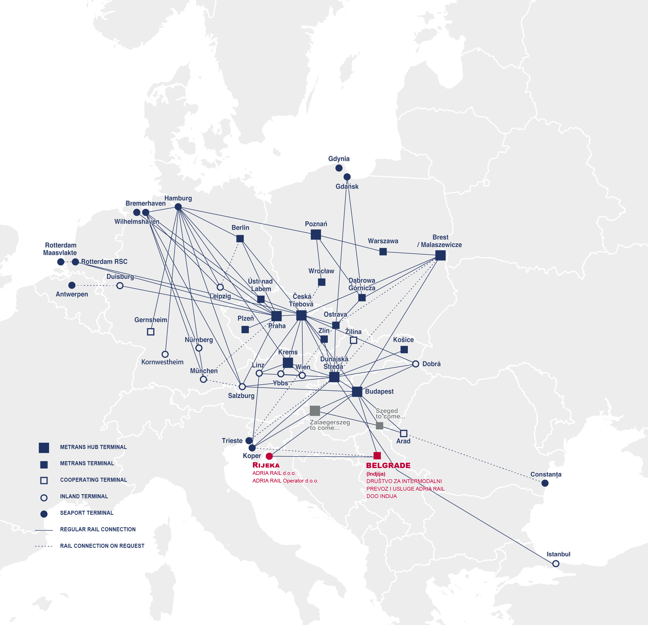
ADRIA RAIL
New member of the METRANS group
2024
THE GOAL
TERMINAL INTEGRATION
ADRIA RAIL organizes transportation to/from/ through Croatia. The goal is to create a regular and reliable rail connection between the Adriatic ports and the Indjija terminal.
We will integrate the Indjija terminal into the METRANS network through regular train connections to our terminal in Budapest.
GROWING NETWORK
QUALITY TRANSPORT
Through integration, Indjija terminal will become the terminal No. 20 in the METRANS network.
We are creating a rail connection that will enable regular service to almost all major seaports in Southern and Northern Europe.

Slide 13
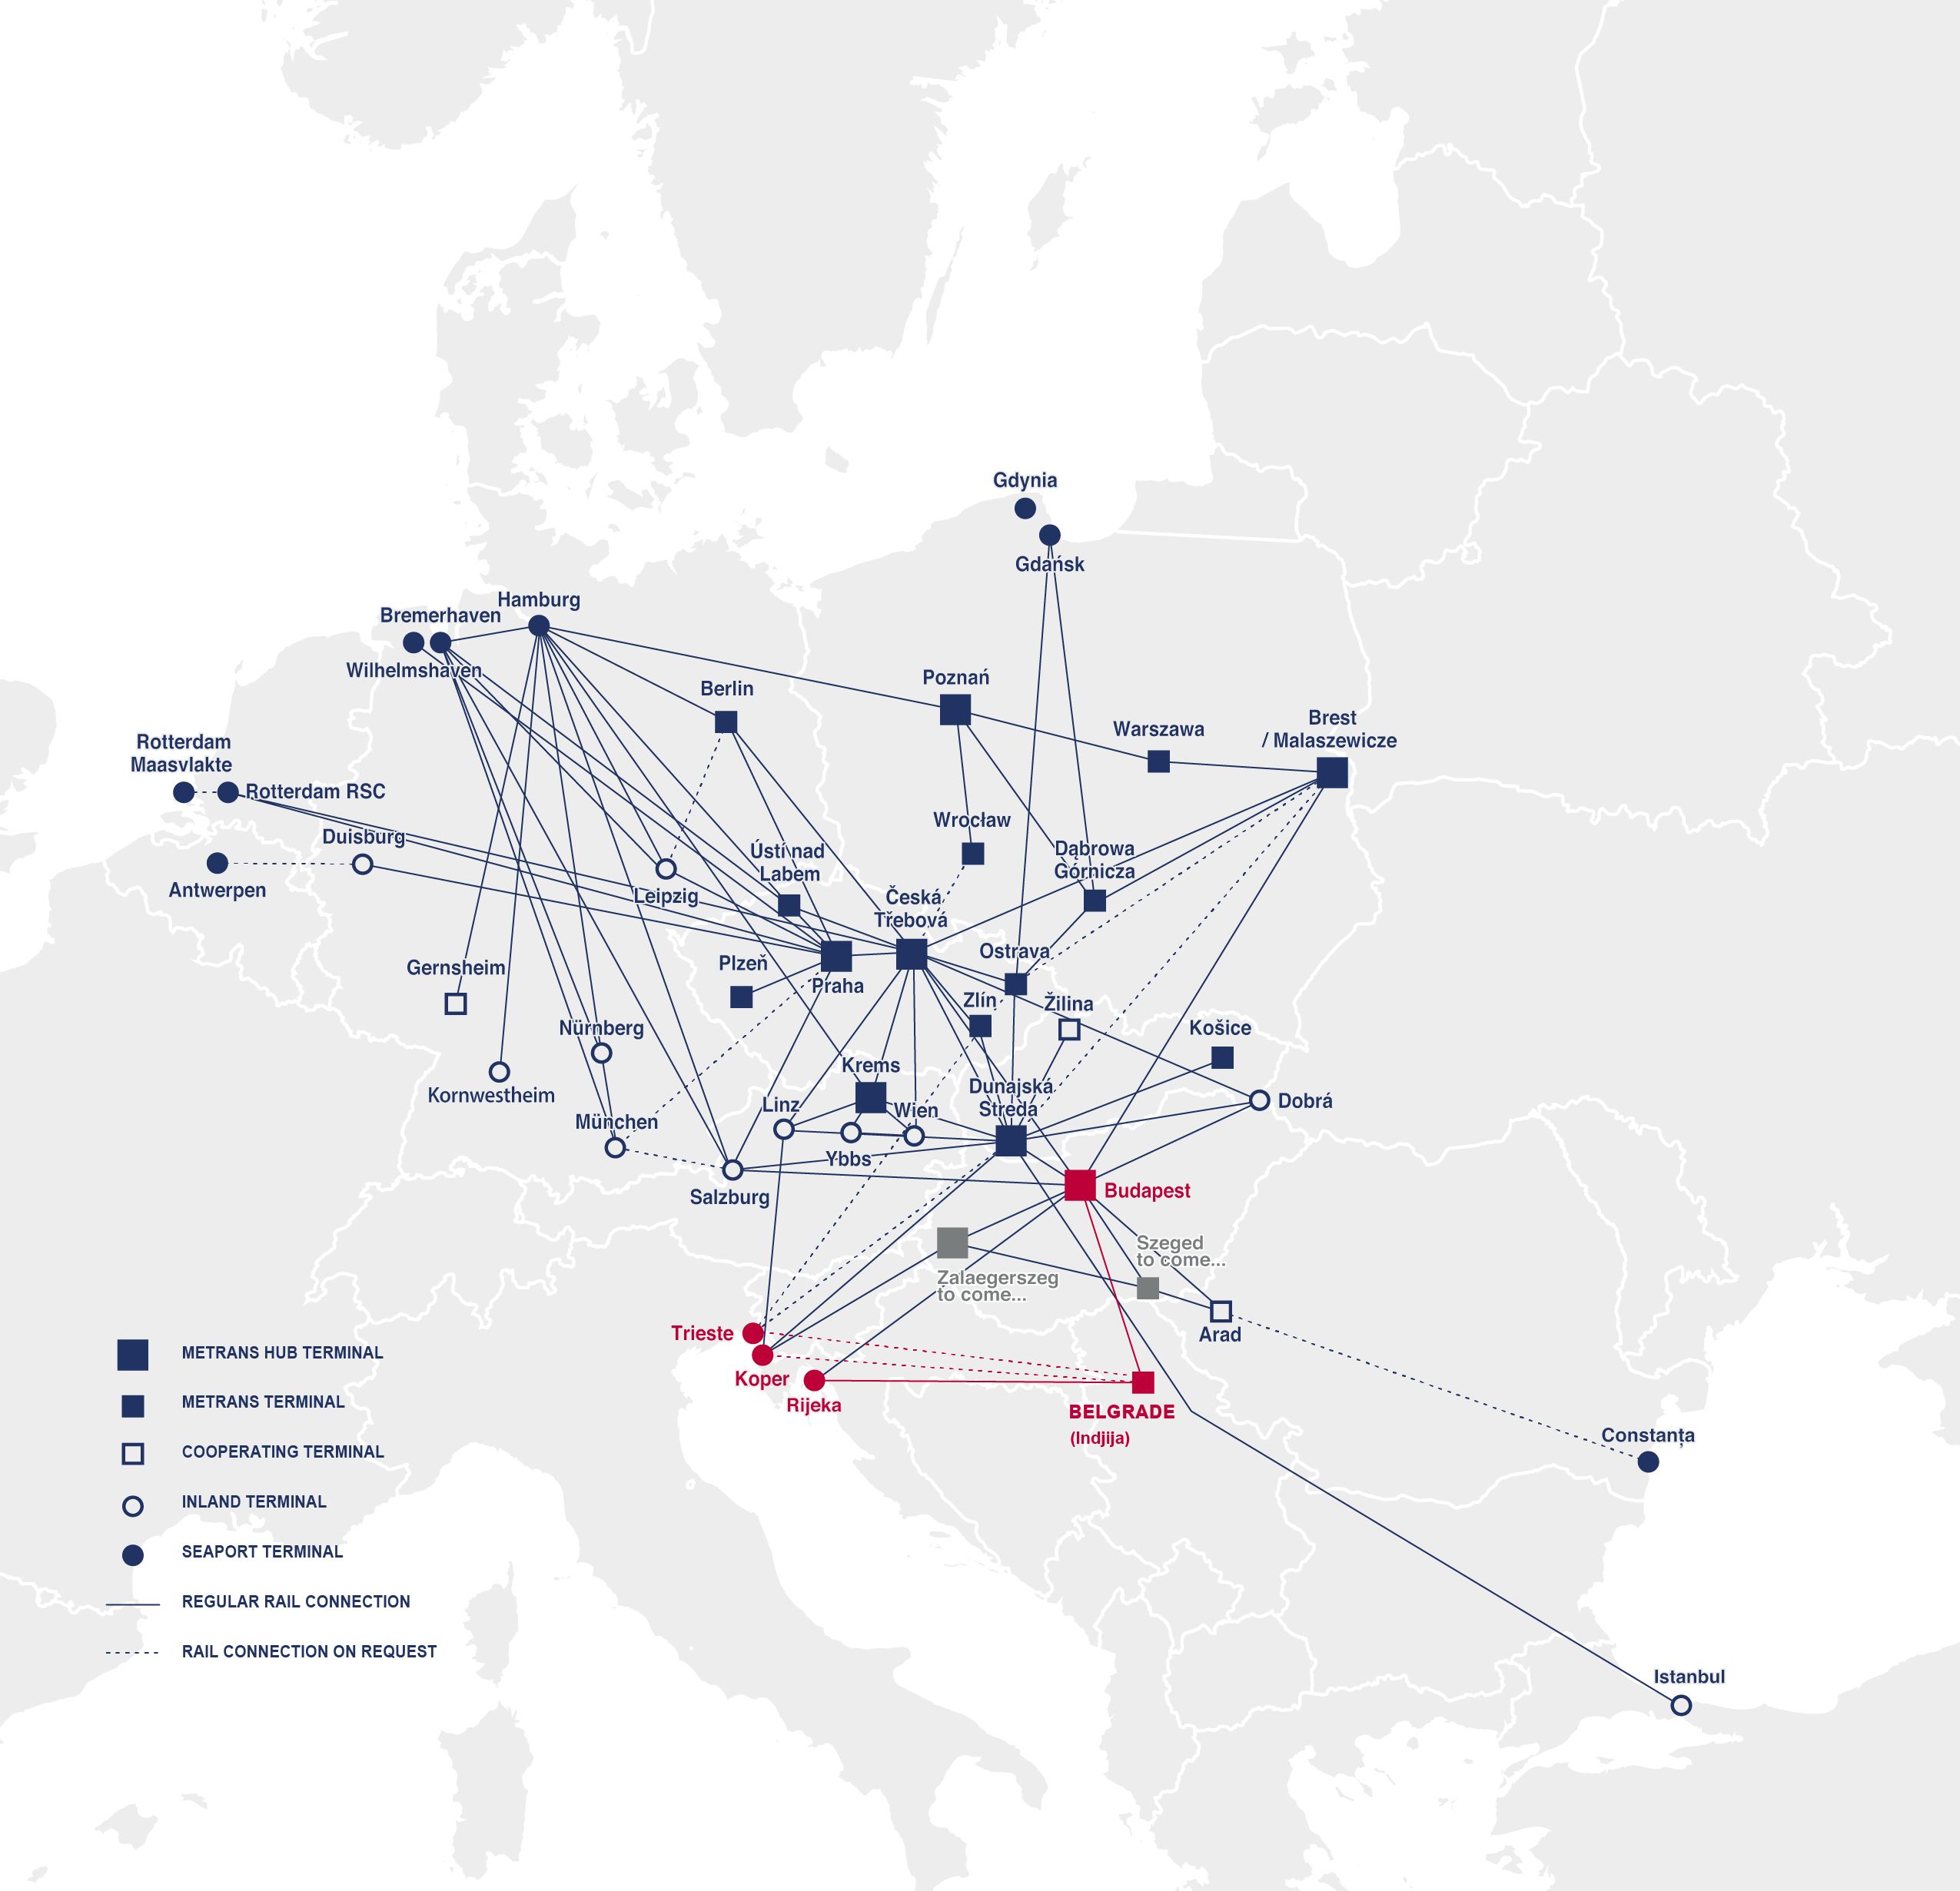
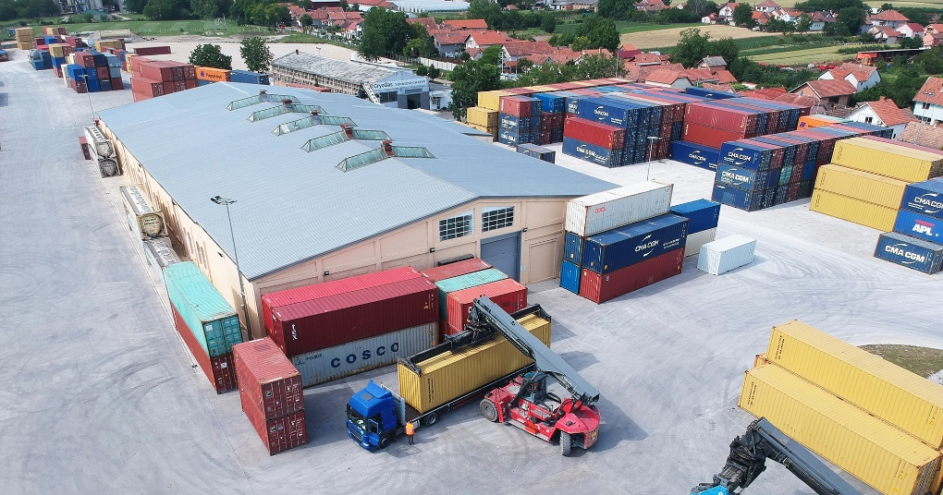
CONNECTIONS TO/FROM SERBIA
Container terminal Indjija near Belgrade
2024
Departures to/from Port of Rijeka and HUB terminal Budapest Csepel
Gateway solution through METRANS HUB Budapest Csepel terminal to reach North West Continent and Adriatic ports as well as hinterland terminals within METRANS network
On-request connection to/from Port of Koper
On-request connection to/from Port of Trieste
www.metrans.eu

Slide 14
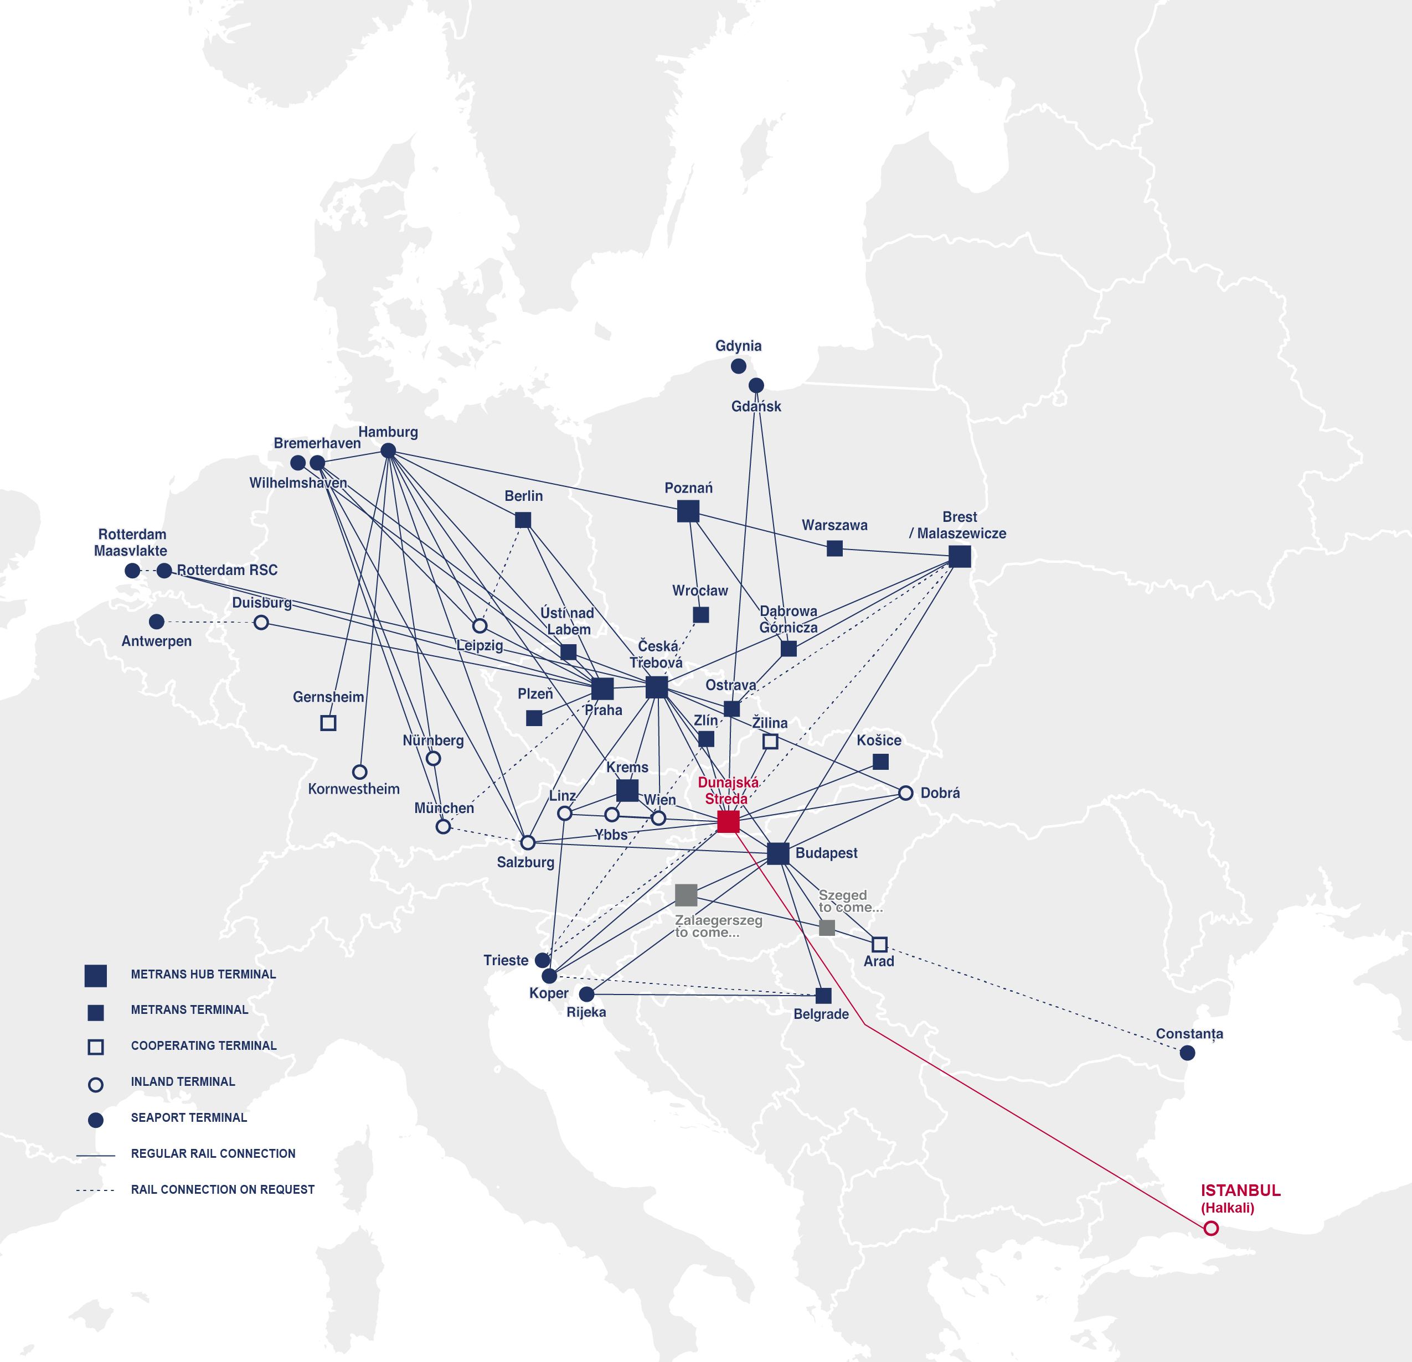
CONNECTIONS TO/FROM TURKEY
Container terminal Halkali (Istanbul)
2024
Weekly 2 departures
Connect METRANS HUB Terminal Dunajska Streda ↔ Halkali
METRANS 45’ PWHC available
Gateway solutions Germany, Poland, Slovakia, Hungary, Austria, Romania, Serbia, Czech Republic
www.metrans.eu

Slide 15
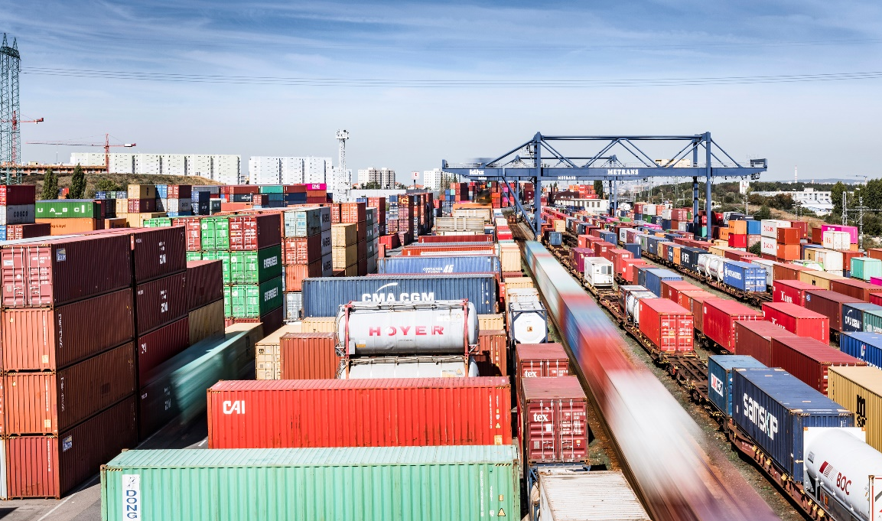
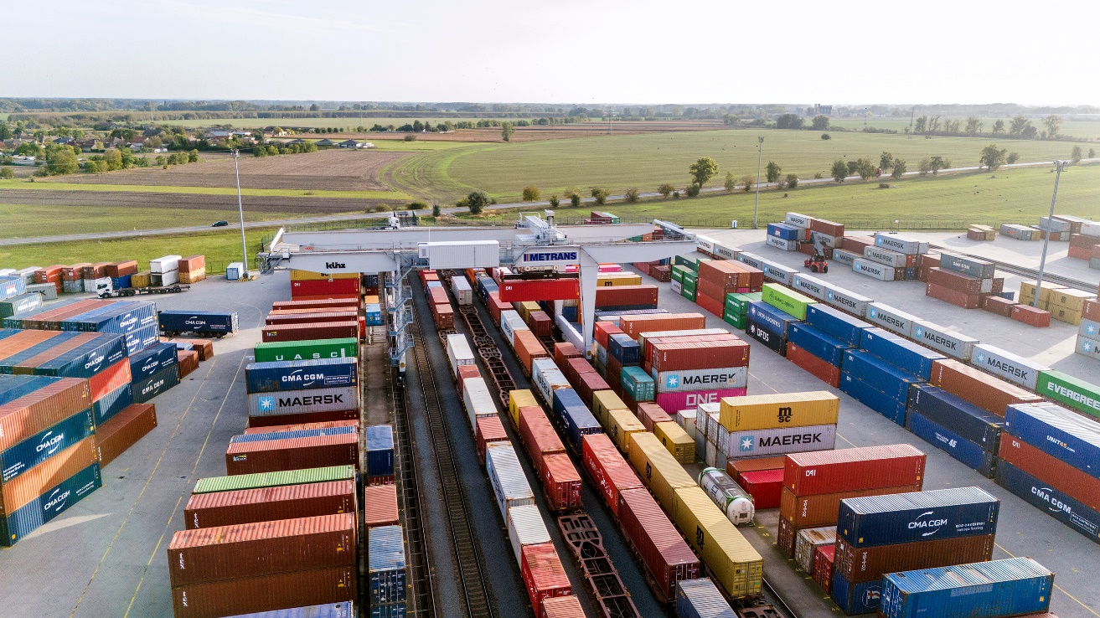
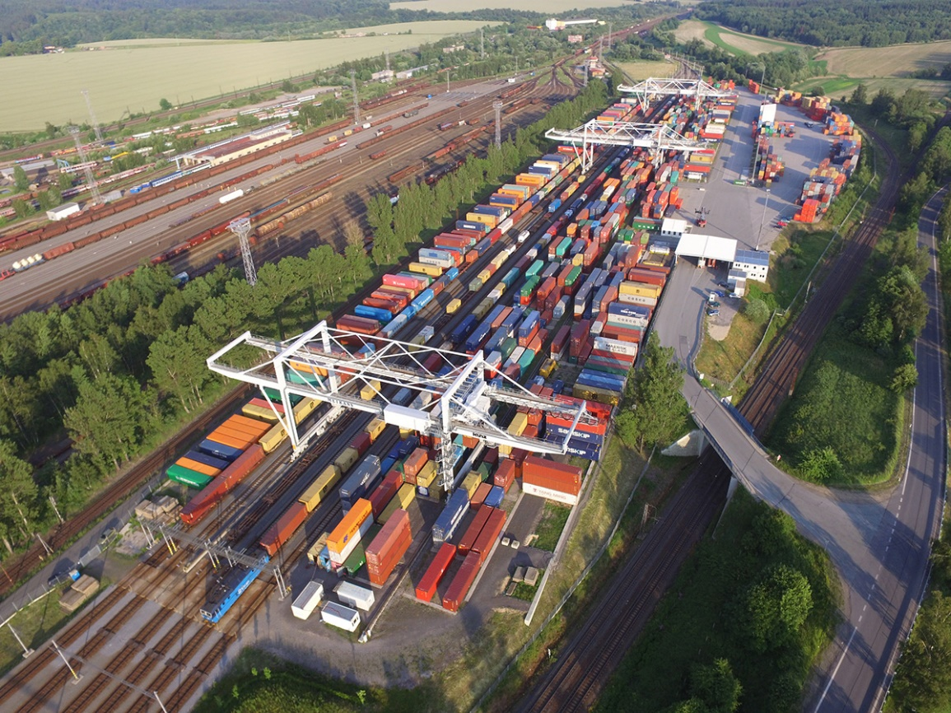
HUB TERMINALS
2024
PRAHA
since 1991
DUNAJSKA STREDA
since 1999
CESKA TREBOVA
since 2013
Size: 420,000 m²
Storage capacity: 15,000 TEU full + 10,000 TEU empty
7 sidings of 600 m, 2 sidings of 550 m, 6 sidings of 350 m
6 RMG (Rail Mounted Gantry Crane), 3 reachstackers (45t), 10 reachstackers (10/12t), 2 forklifts (16t), 4 shunters
10 trains can be handled at the same time
Repair facility for containers
On-site customs office
Operates 24/7/365
Size: 326,000 m²
Storage capacity: 25,000 TEU full + 15,000 TEU empty
5 sidings of 650 m, 4 sidings of 550 m
4 RMG (Rail Mounted Gantry Crane), 7 reachstackers (45t), 8 reachstackers (12t), 3 reachstackers (8t), 2 forklifts (16t, 8t)
9 trains can be handled at the same time
Repair facility for containers
On-site customs office
Operates 24/7/365
Size: 138,000 m²
Storage capacity: 4,500 TEU full + 4,200 TEU empty
6 sidings of 740 m
4 RMG (Rail Mounted Gantry Crane), 3 reachstackers (12t)
6 trains can be handled at the same time
On-site customs office
Repair facility for containers
Operates 24/7/365

Slide 16
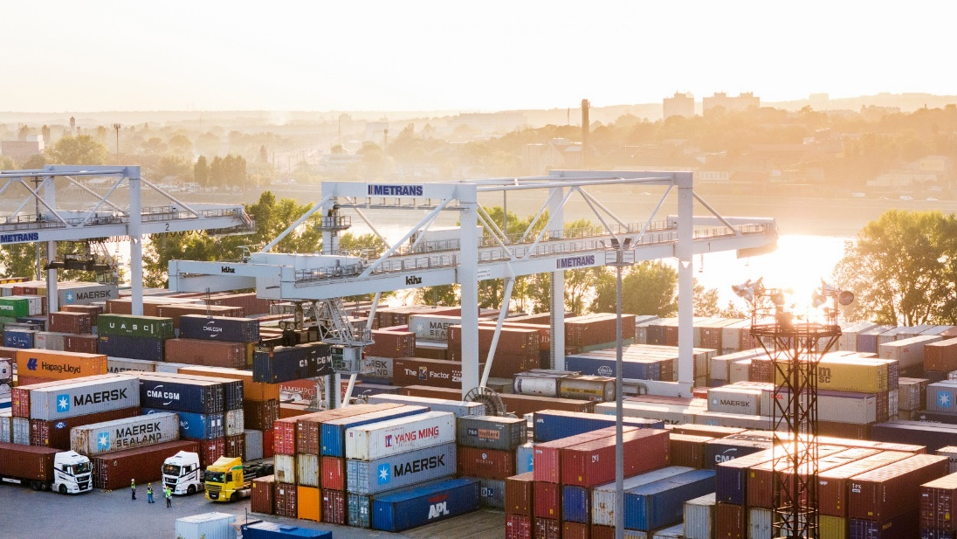
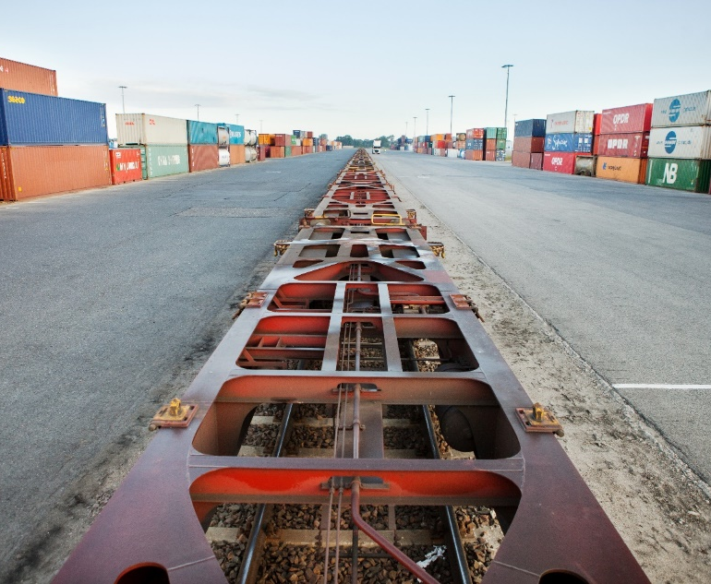
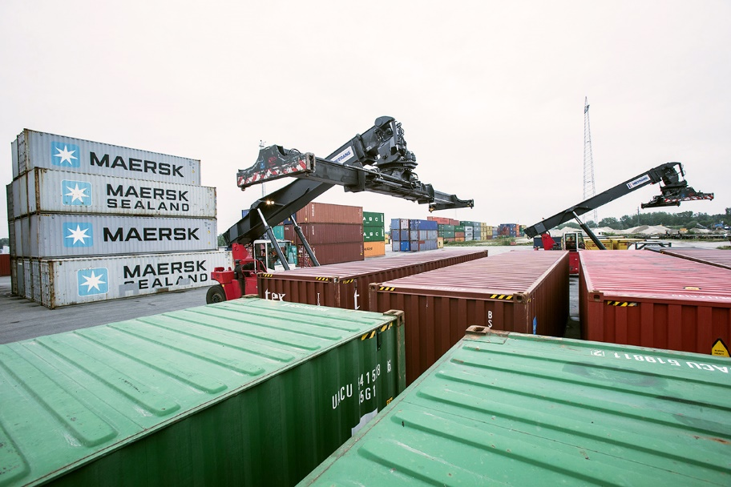
HUB TERMINALS
2024
BUDAPEST
since 2017
POZNAN
(GADKI)
since 2011
KREMS
AN DER DONAU
since 2012
Size: 163,500 m²
Storage capacity: 7,500 TEU
6 sidings of 650 m, 2 sidings of 500 m
4 RMG (Rail Mounted Gantry Crane), 6 reachstackers (45t), 4 reachstackers (12t), 3 forklifts (16t)
6 trains can be handled at the same time
Repair facility for containers
On-site customs office
Operates 24/7/365
Size: 175,000 m²
1 siding of 750 m, 3 sidings of 630 m
10 reachstackers with lifting capacity up to 45 tons
2 trains can be handled at the same time
On-site customs office
Handling of swap bodies and semi-trailers
Operates 24/7/365
Size: 40,000 m²
Storage capacity: 1,500 TEU full + 2,000 TEU empty
4 sidings of 680 m
3 reachstackers (45t), 2 reachstackers (12t)
On-site customs office
Repair facility for containers

Slide 17
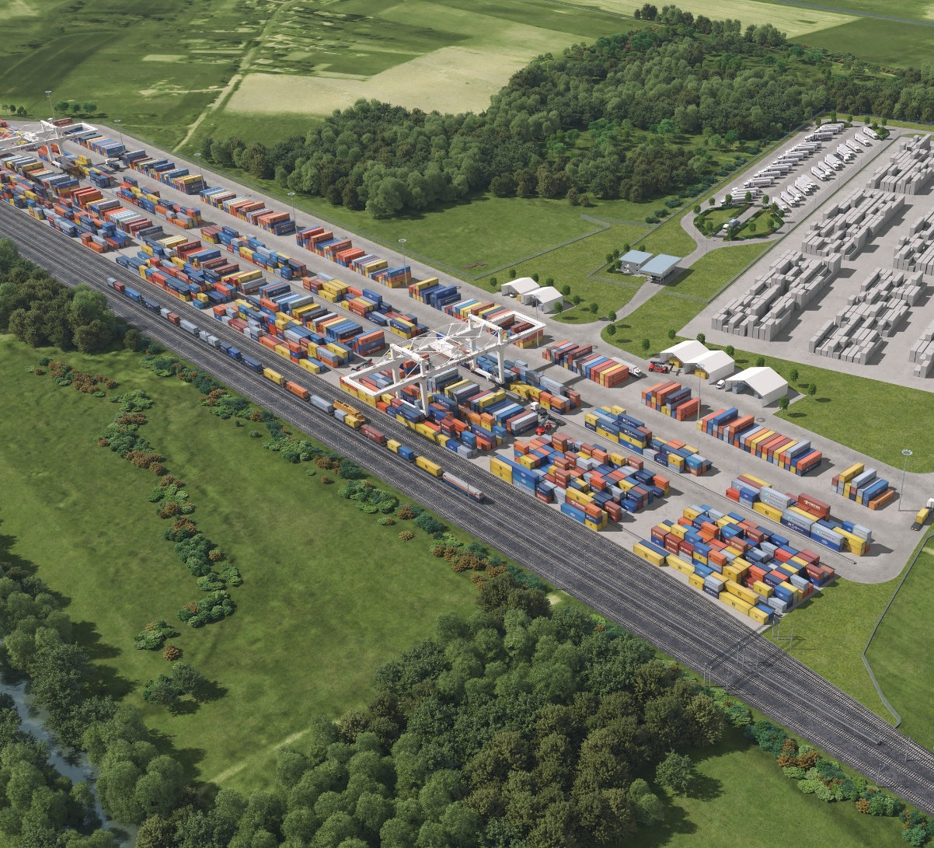
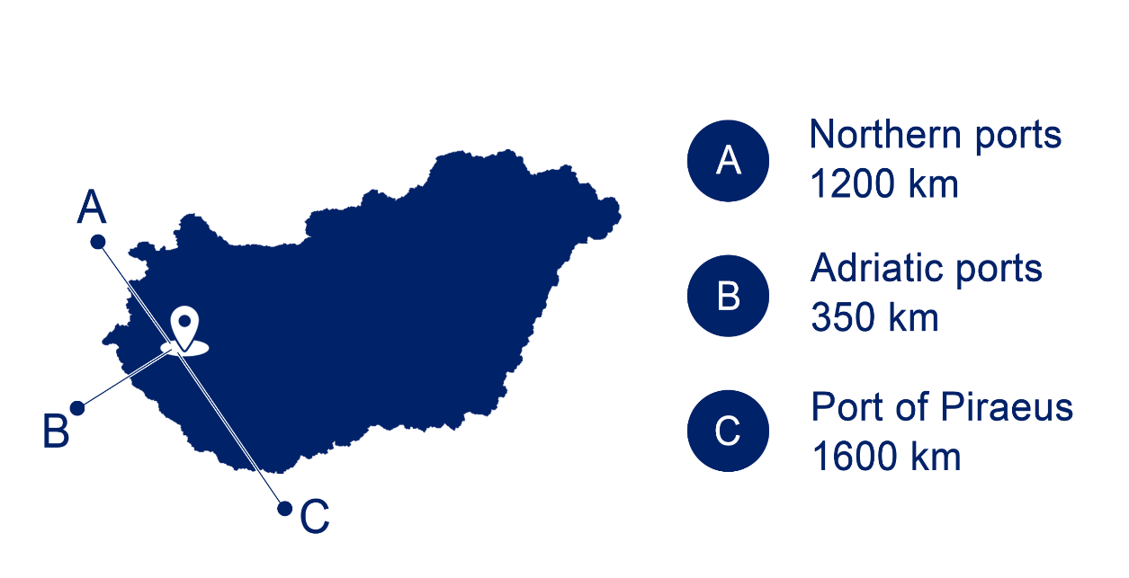
HUB TERMINALS
NEW METRANS CONTAINER TERMINAL IN HUNGARY TO COME...
2024
MALASZEWICZE
operated by CL Europort, since 2022
ZALAEGERSZEG
to come... 2025/2026
The new terminal to become a major international logistics hub for the Adriatics in the future.
The excellent geographical
location on the southern transport corridor, close to the Slovenian and Austrian borders, creates many logistical advantages and will also be able to serve as a buffer for
the southern ports.
METRANS member since: 2022
Size: 190,000 m²
Storage: 6000 TEU
Rail Tracks:
- 1435 mm - 6 tracks length of 3000 m - 1520 mm - 9 tracks length of 6000 m
1 RMG (Rail Mounted Gantry Crane), 4 reachstackers (45t), 1 reachstacker (10t)
Reefer plugs
Depot for empty containers
Size: 150,000 m²
Intermodal HUB terminal & logistics center in western Hungary for the Adriatic Corridor (Koper, Trieste, Rijeka)
Daily connection to Hamburg, Bremerhaven and the whole METRANS network
Operation start 2025/2026

Slide 18
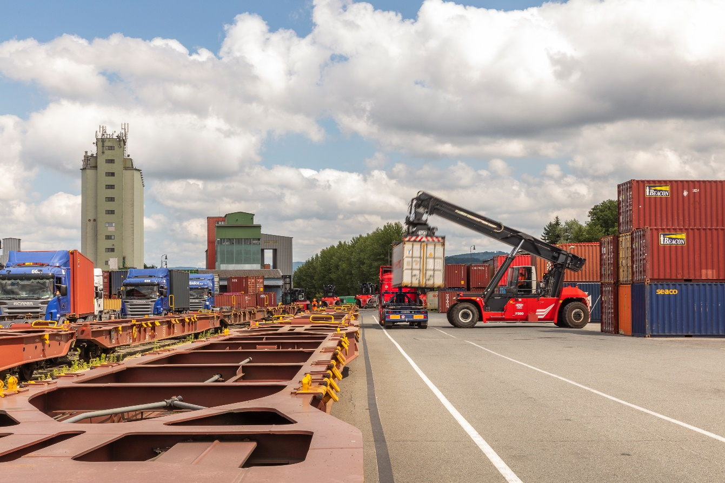
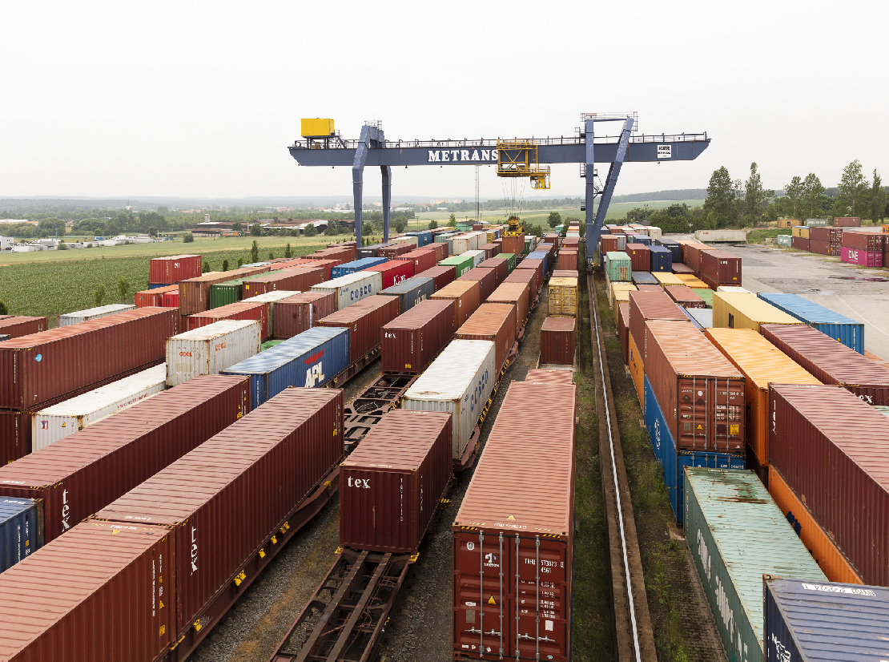
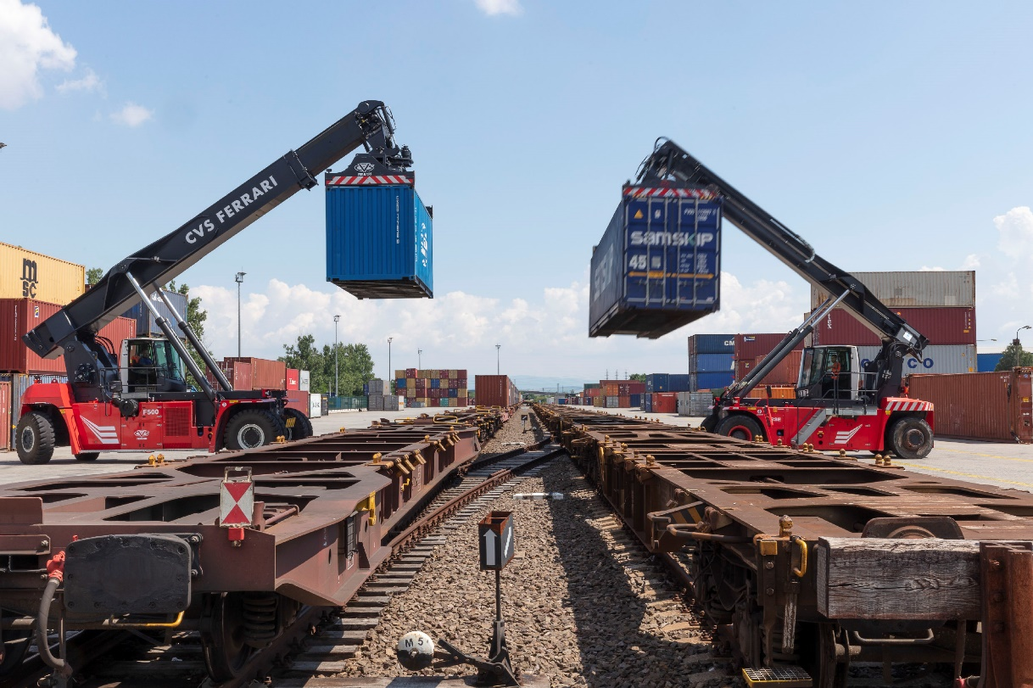
END TERMINALS
2024
ZLIN
since 1994
PLZEN
since 2007
KOSICE
since 2008
Size: 68,600 m²
Storage capacity: 1,300 TEU full + 1,200 TEU empty
3 sidings of 550 m, 1 siding of 400 m,
2 sidings of 350 m, 2 sidings of 300 m
4 reachstackers (45t), 4 reachstackers (12t)
On-site customs office
Repair facility for containers
Operates 24/7/365
Size: 50,000 m²
Storage capacity: 1,300 TEU full + 1,200 TEU empty
3 sidings of 400 m
1 RMG (Rail Mounted Gantry Crane) with multimodal spreader for handling trailers and swap bodies and Remote Operation Station control system, 2 reachstackers (10/12t)
Repair facility for containers
Operates 24/7/365
Size: 46,500 m²
Storage capacity: 3,000 TEU full + 3,000 TEU empty
2 sidings of 550 m
4 reachstackers (45t), 2 reachstackers (12t), 2 forklifts (16t)
On-site customs office
Repair facility for containers
Operates 24/7/365

Slide 19
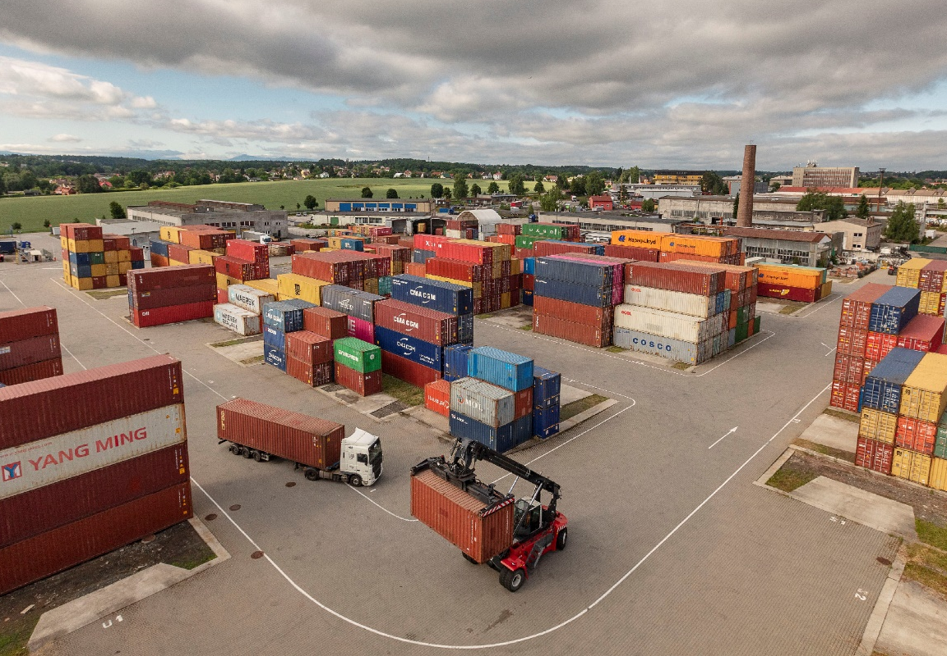
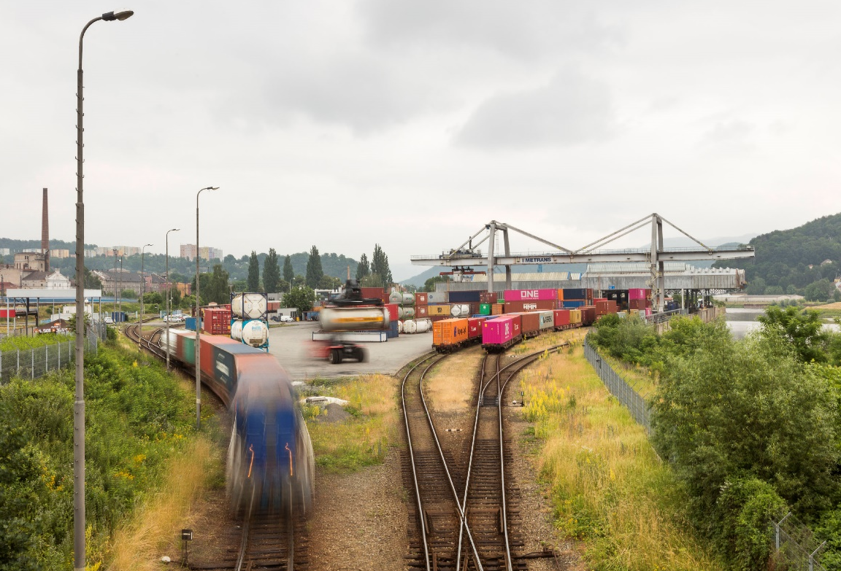
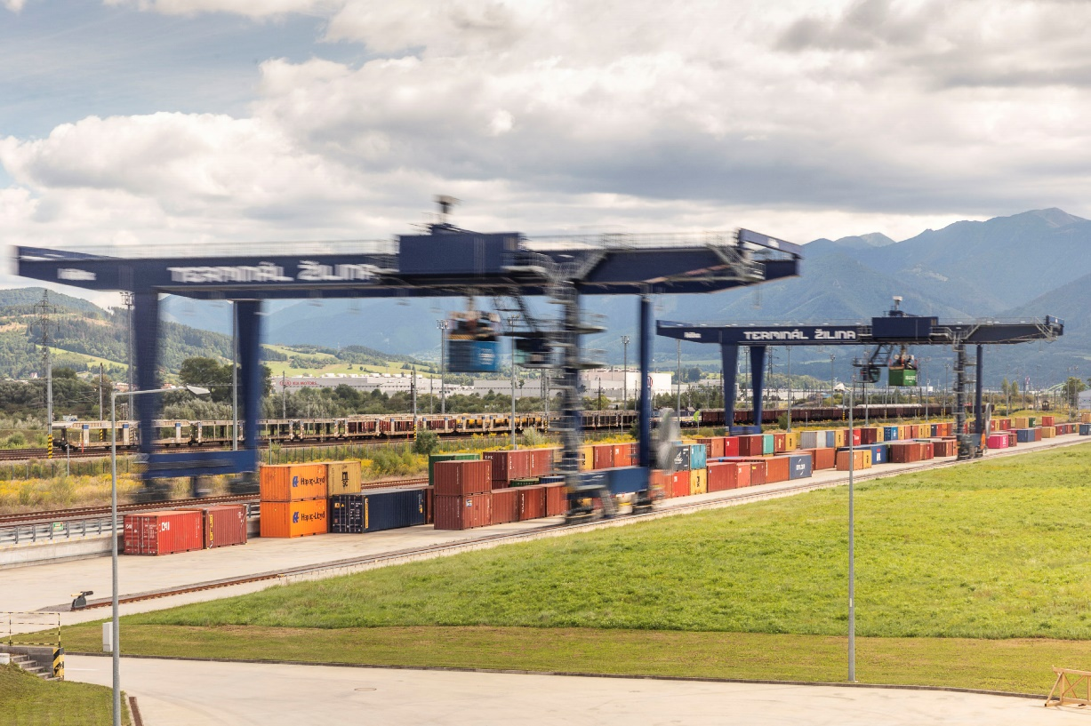
END TERMINALS
2024
OSTRAVA
since 2011
USTI NAD LABEM
since 2015
ZILINA
operated by TIP ZILINA
Size: 40,000 m² plus 60,000 m² depot
Storage capacity: 1,200 TEU full + 5,000 TEU empty
2 sidings of 250 m
1 RTG (Rubber Tyred Gantry Crane), 3 reachstackers (45t), 3 reachstackers (12t)
On-site customs office
Repair facility for containers
Operates 24/7/365
Size: 25,500 m²
Storage capacity: 1,500 TEU full + 2,000 TEU empty
1 siding of 185 m, 2 sidings of 160 m
1 RMG (Rail Mounted Gantry Crane), 3 reachstackers (45t), 2 reachstackers (12t)
On-site customs office
Repair facility for containers
Operates 24/7/365
Concession since 2019
Size: 150,000 m²
2 sidings of 750 m
2 RMG (Rail Mounted Gantry Crane), 2 reachstackers (12t)
Repair facility for containers
Handling of swap bodies and semi-trailers

Slide 20
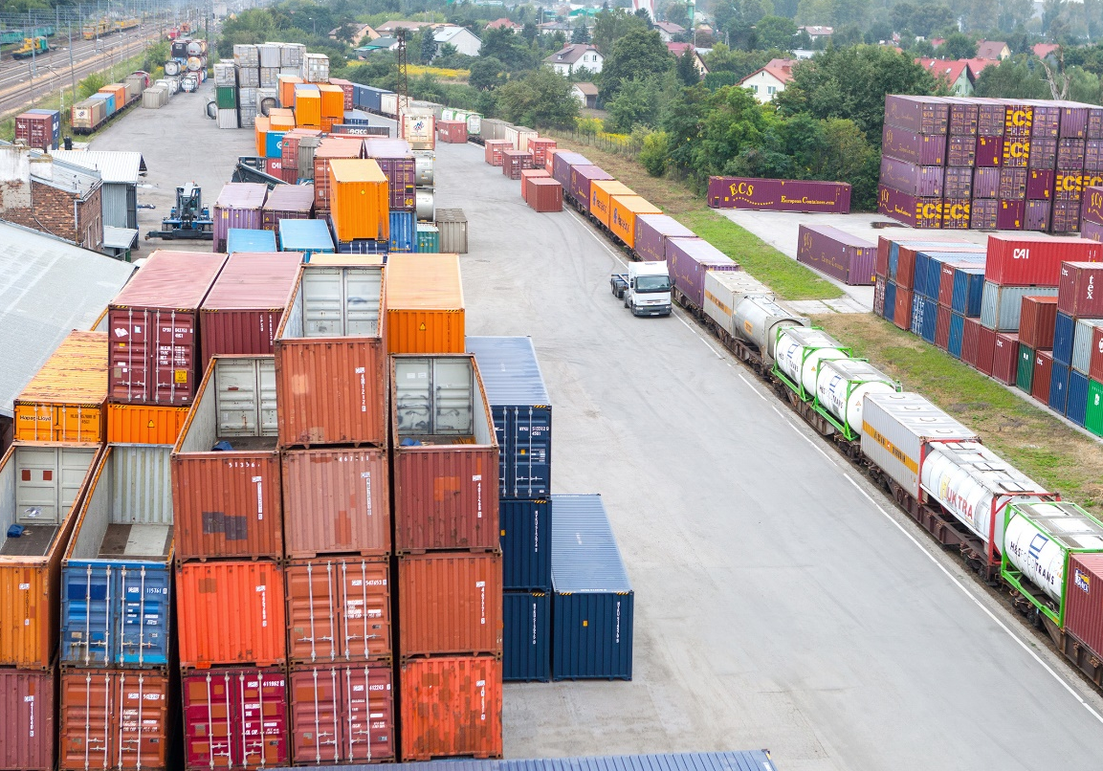
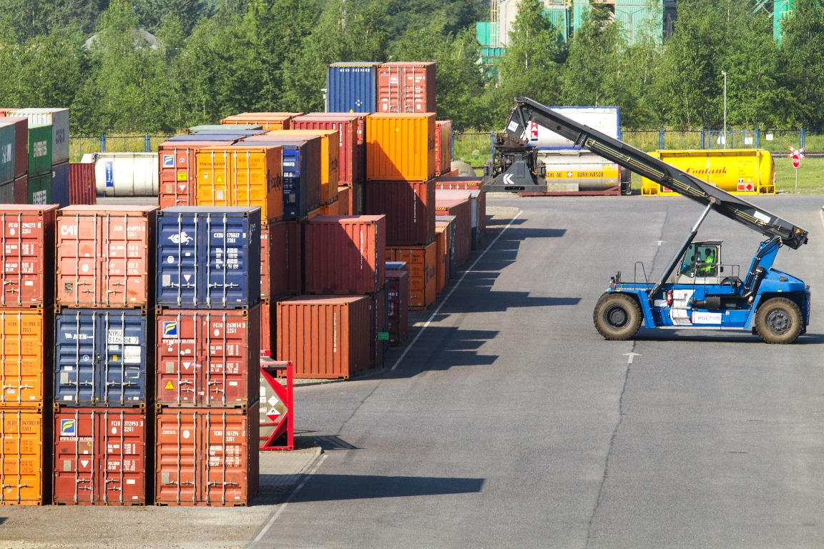
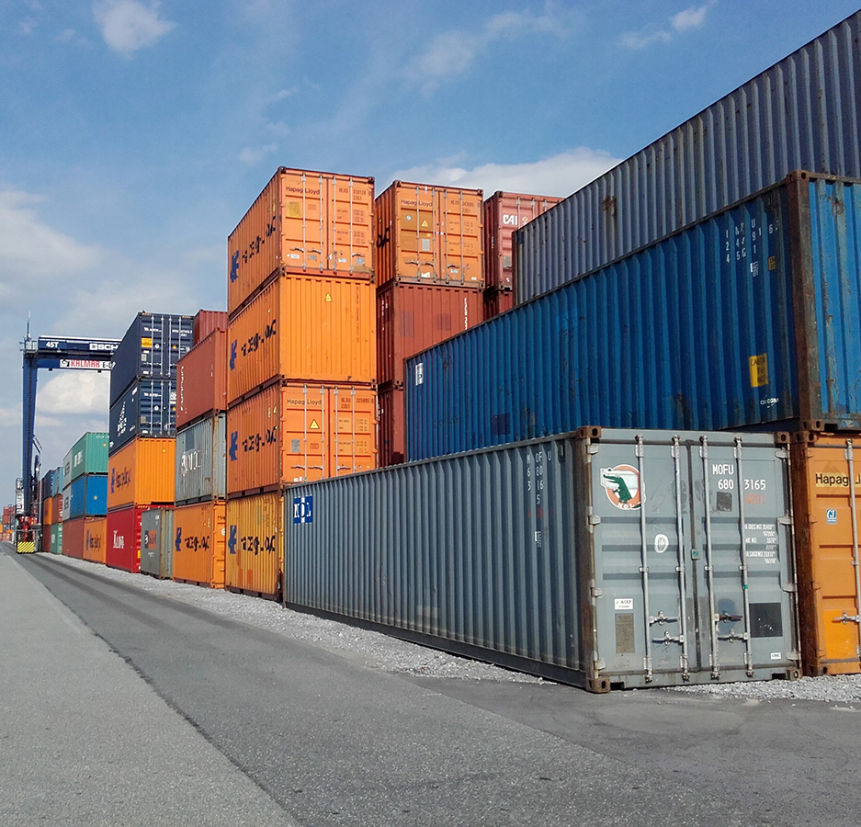
END TERMINALS
2024
WARSZAWA
(PRUSZKOW)
since 1993
DABROWA GORNICZA
since 2010
WROCLAW
(KATY WROCLAWSKIE)
since 2015
Size: 57,000 m²
2 sidings of 600 m, 1 siding of 350 m
7 reachstackers with lifting capacity up to 45 tons
Handling of swap bodies and semi-trailers
On-site customs office
Size: 170,000 m²
2 sidings of 625 m, 1 siding of 600 m,
1 siding of 500 m
3 reachstackers with lifting capacity up to 45 tons, 1 reachstacker (12t)
Reefer plugs – PTI incl. small repairs
Handling of swap bodies
On-site customs office
Size: 65,000 m²
2 sidings of 600 m
1 gantry crane, 5 reachstackers (45t)
Reefer plugs – PTI incl. small repairs
Handling of swap bodies and semi-trailers
On-site customs office

Slide 21
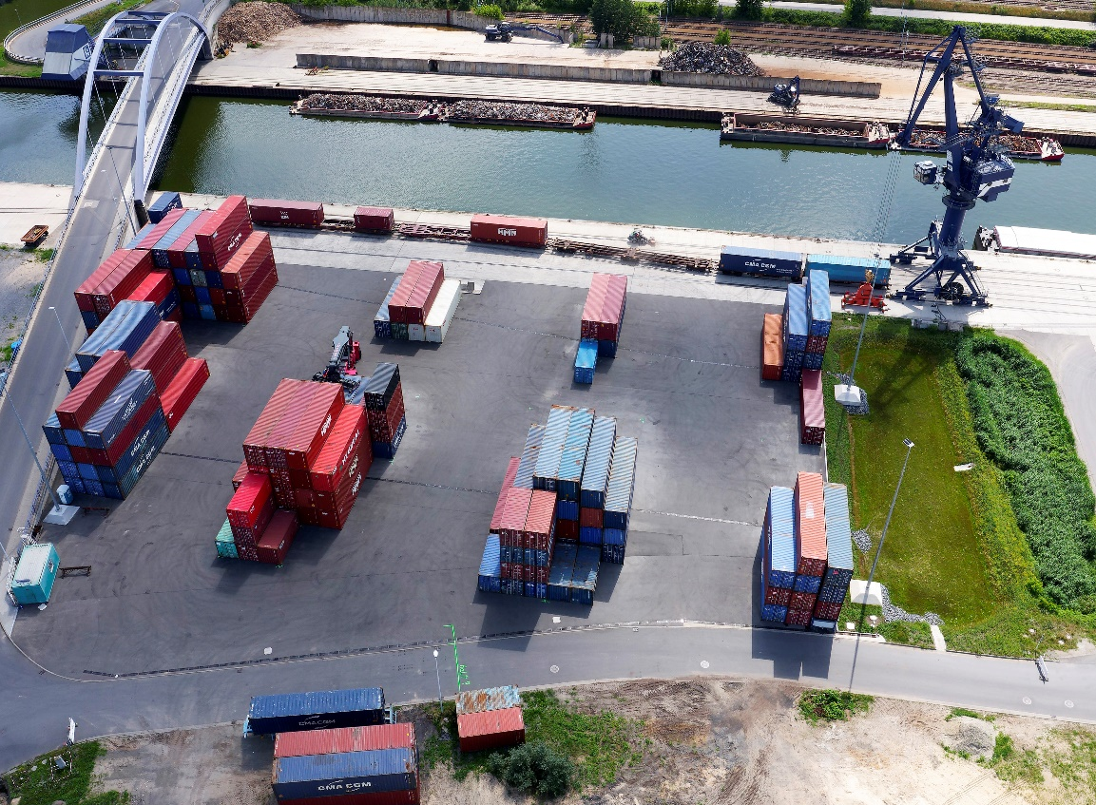
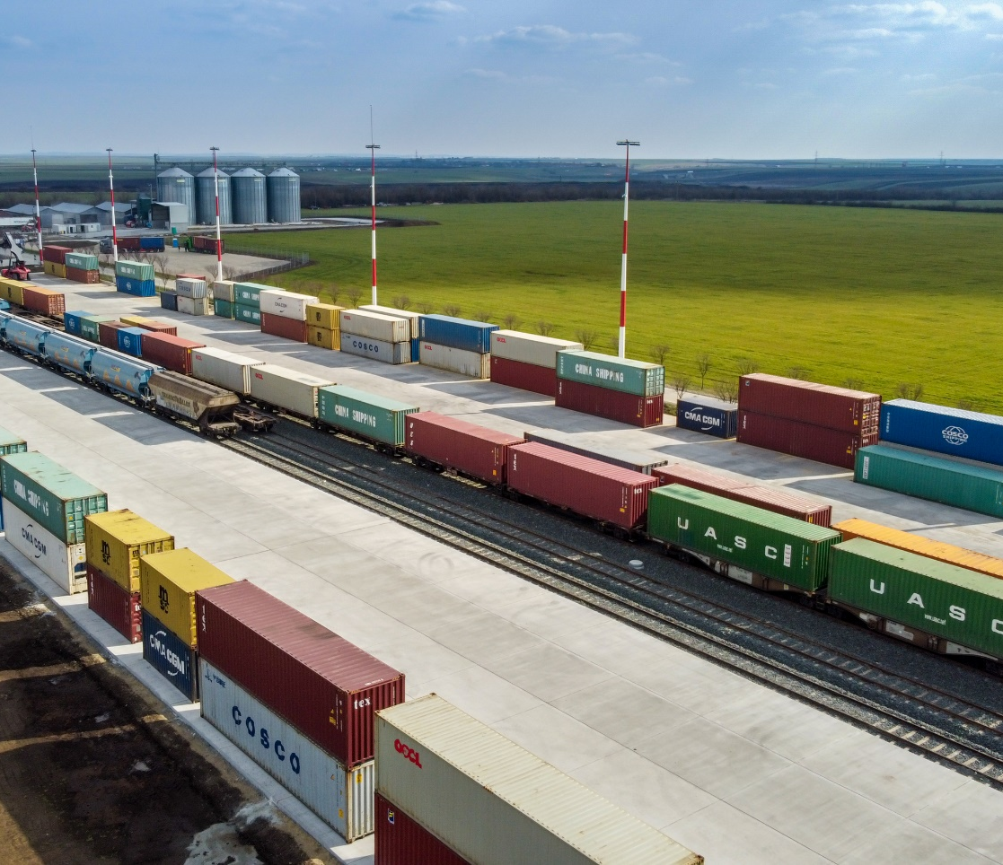
END TERMINALS
2024
GERNSHEIM GUT
since 2020
BERLIN KOWU
since 2019
ARAD
since 2021
Size: 54,000 m²
Sidings: 2 x 340 m
1 RMG (Rail Mounted Gantry Crane), 1 slewing jib crane, 2 reachstackers (45t)
Truck capacity: 30 trucks
(long term sub-contractors)
Size: 20,000 m²
1 siding of 800 m, 3 sidings of 500 m
1 RMG (Rail Mounted Gantry Crane), 2 reachstackers (45t), 1 reachstacker (12t)
Reefer plugs – PTI incl. small repairs
Depot for empty containers–capacity: 2,000 TEU
On-site customs office
Size: 75,000 m²
Sidings: 4 x 350 m length
Parking for 200 trucks
2 reachstackers (45t)
Own truck capacity: 10
A1 highway - 3 km from the terminal

Slide 22
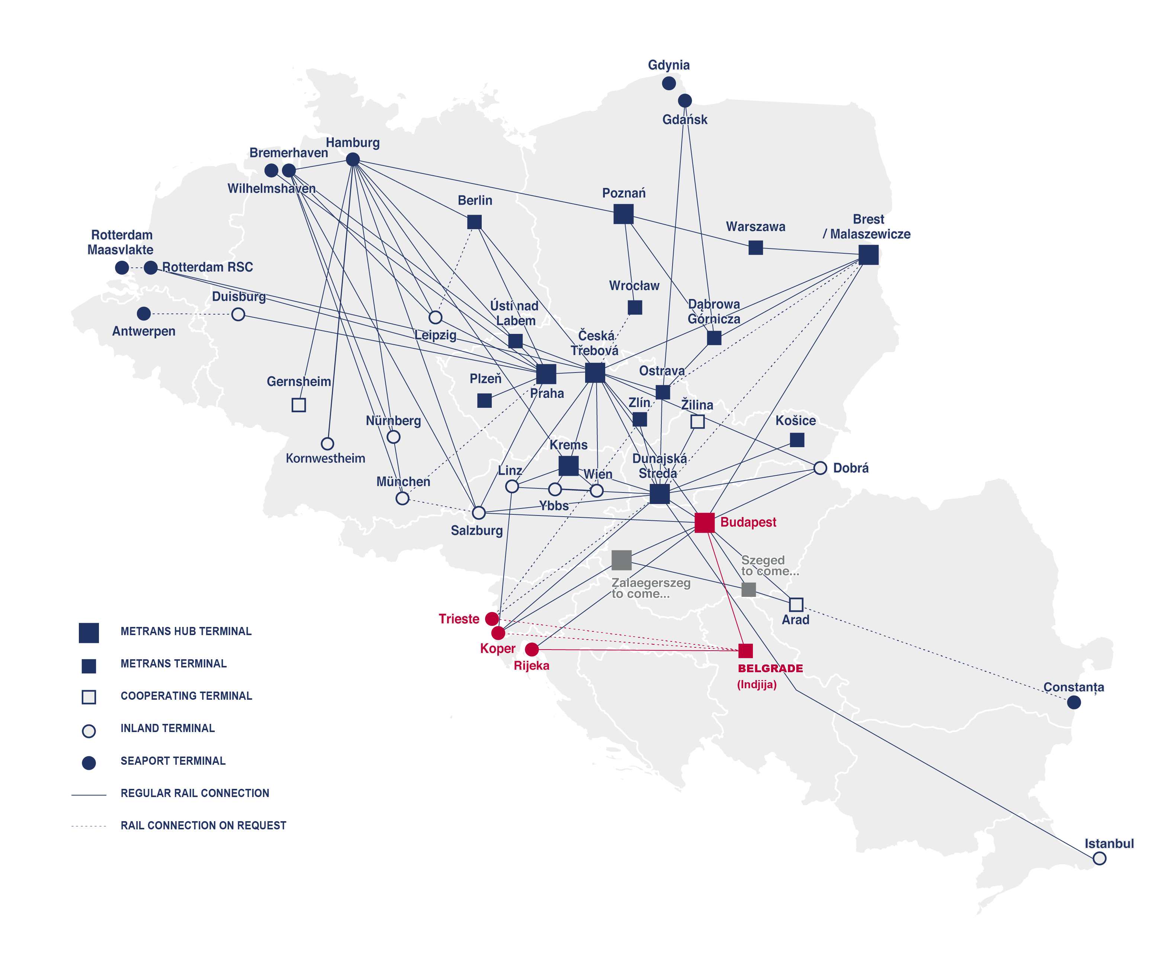
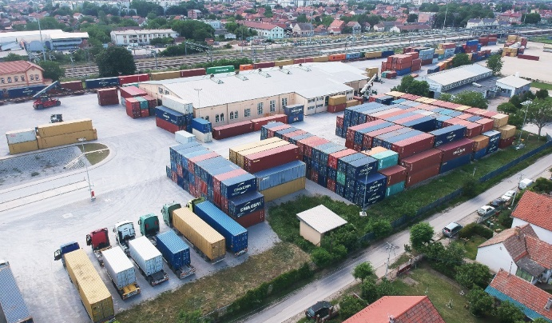
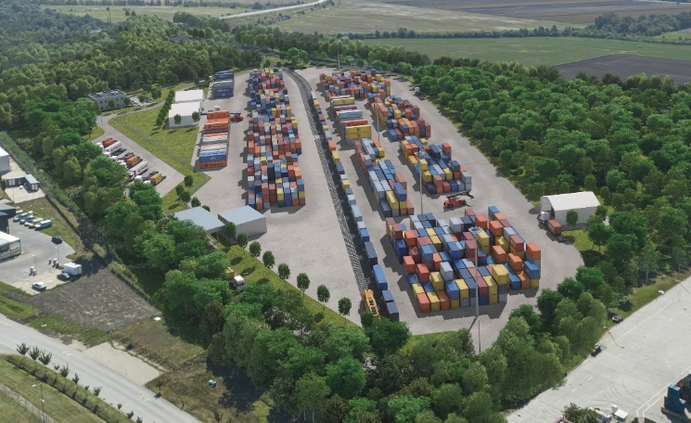
NEW END TERMINALS
2024
BELGRADE
(INDJIJA)
since 2023
SZEGED
to come... 2026
Size: 35,000 m²
Sidings: 2 x 250 m
2 reachstackers (45t)
Forklifts 12t, 3t, 2t
Regular connection Adriatic ports ↔ Belgrade (Indjija)
Operates 24/7
Size: 100,000 m²
Annual capacity: ~ 50.000 TEU
Sidings: 2 x 335 m
Intermodal terminal in southern Hungary
Construction completion by 2026
Highway connection to HU, RS, RO
Connection to the main railway track to the south via Roszke crossing

Slide 23
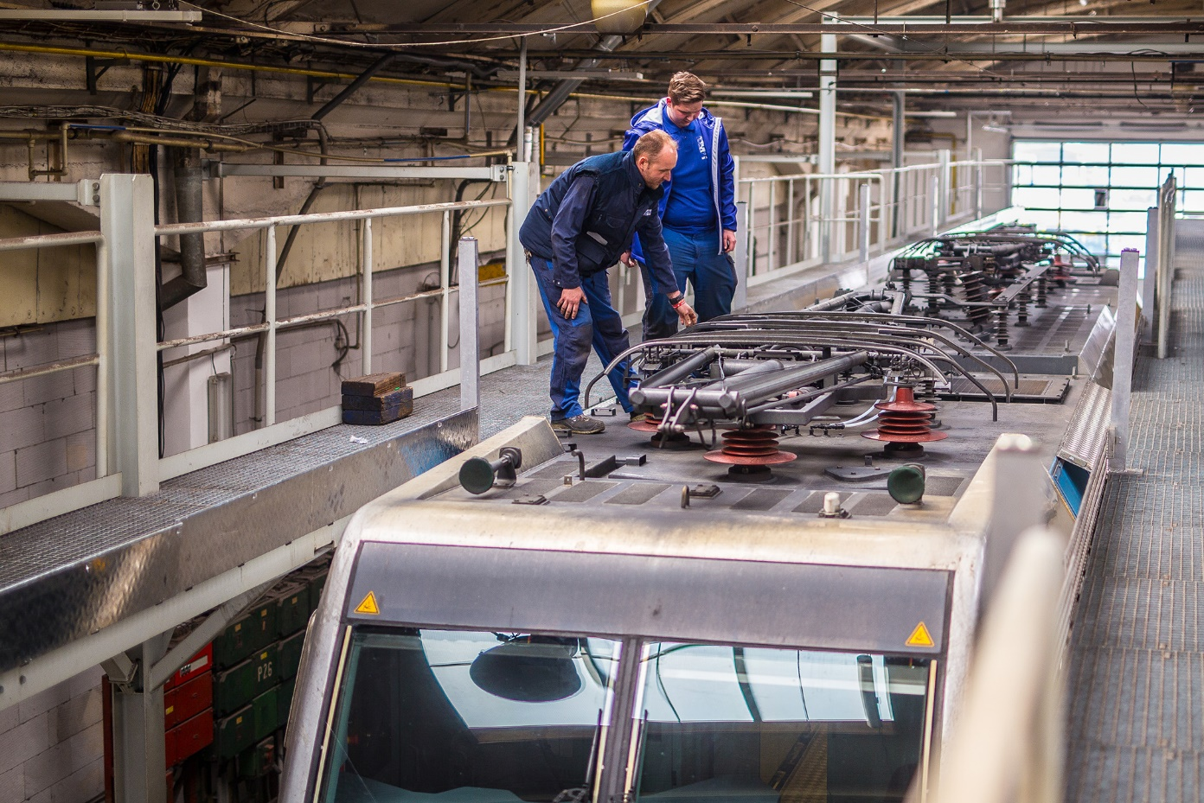
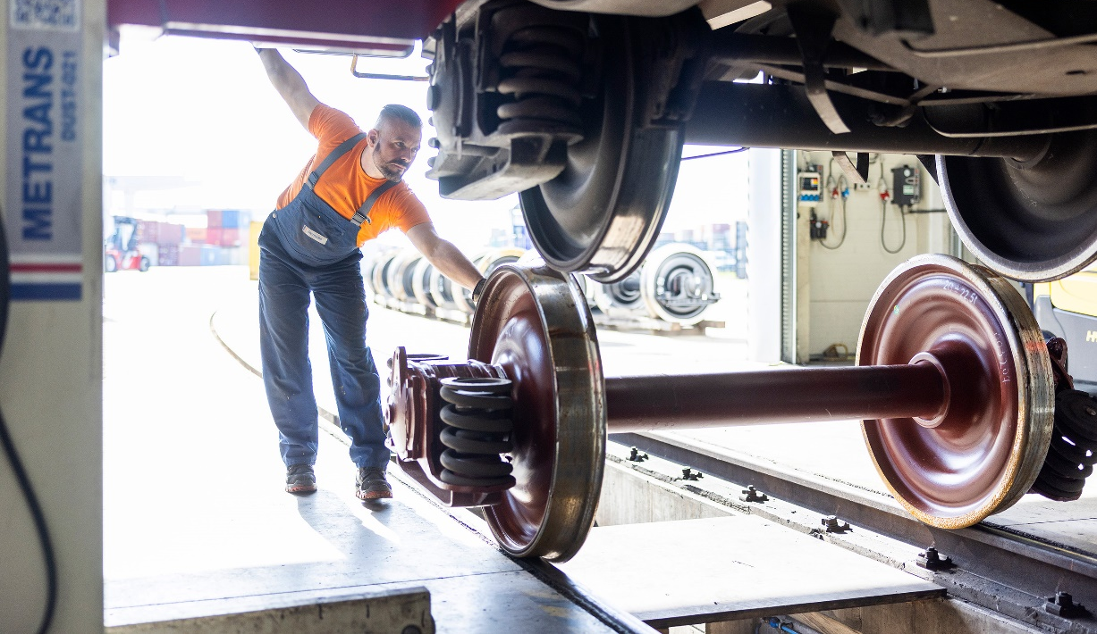
METRANS RAIL REPAIR SHOPS
2024
RAIL & REACHSTACKER REPAIR SHOP
Dunajska Streda, Slovak Republic
DYKO RAIL REPAIR SHOP
Kolin, Czech Republic
Established in 1940
Acquired by METRANS in 2007
Licensed to repair Siemens and Bombardier locomotives
Repairs:
- container wagons
- running gear for passenger carriages
locomotives and wheelsets
Repairs within free capacities available also for external clients
Established in 2019
Repairs:
- container wagons
- locomotives
- reach stackers

Slide 24
2024
HHLA PURE
CO₂-neutral Container handling & transport
With the HHLA Pure product METRANS offers our clients a CO₂-free handling and also transport, and thus, together we make a real contribution towards climate protection.
HHLA and METRANS course of action
Modern hybrid and electric locomotives
Electrification at the port container terminal with electric storage crane system, electric vehicles

Slide 25
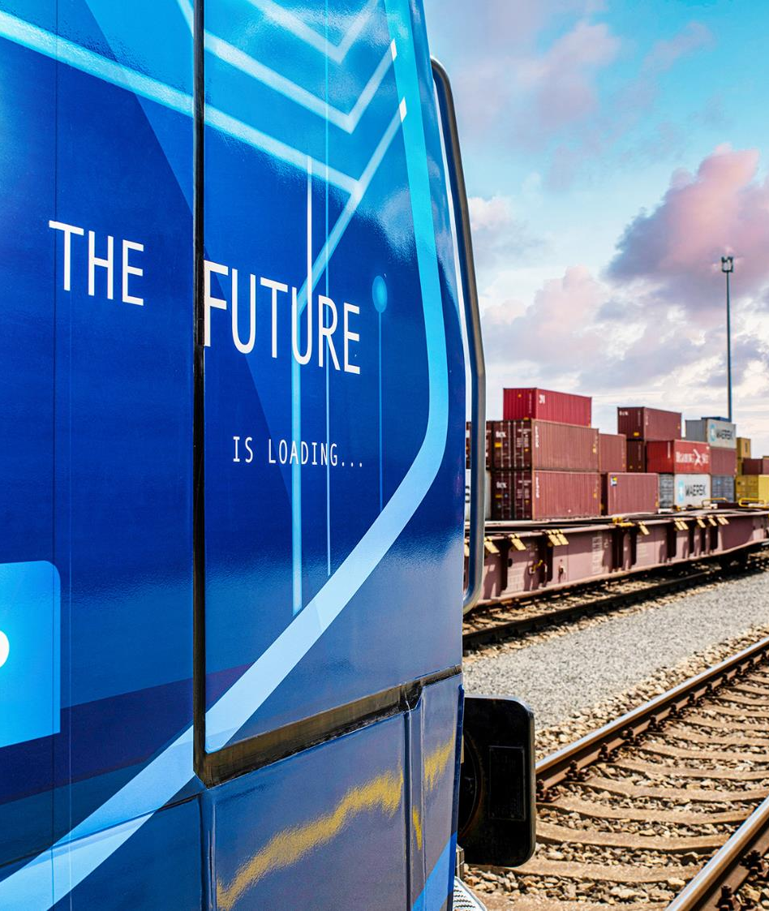
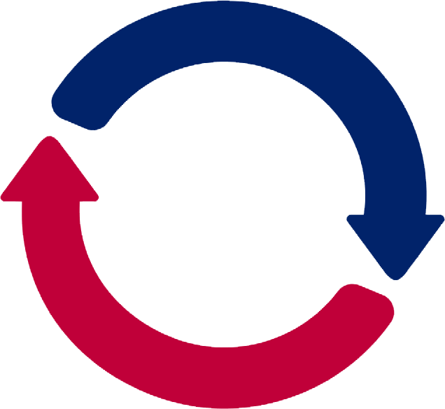
2024
HOW DOES THE CO₂ COMPENSATION WORK?
COMPENSATION IS STILL WORTHWILE,
EVEN WHEN LARGE DISTANCE ARE INVOLVED
Burning fossil fuels releases CO₂ emissions into the atmosphere.
As the atmosphere has no borders, it makes no difference where in the world the CO₂ emissions are produced; the impact is the same the world over.
THE SOLUTIONS – with the course of action we solve CO₂ emissions – for remaining emission we buy Certificates for environmental projects.

Slide 26
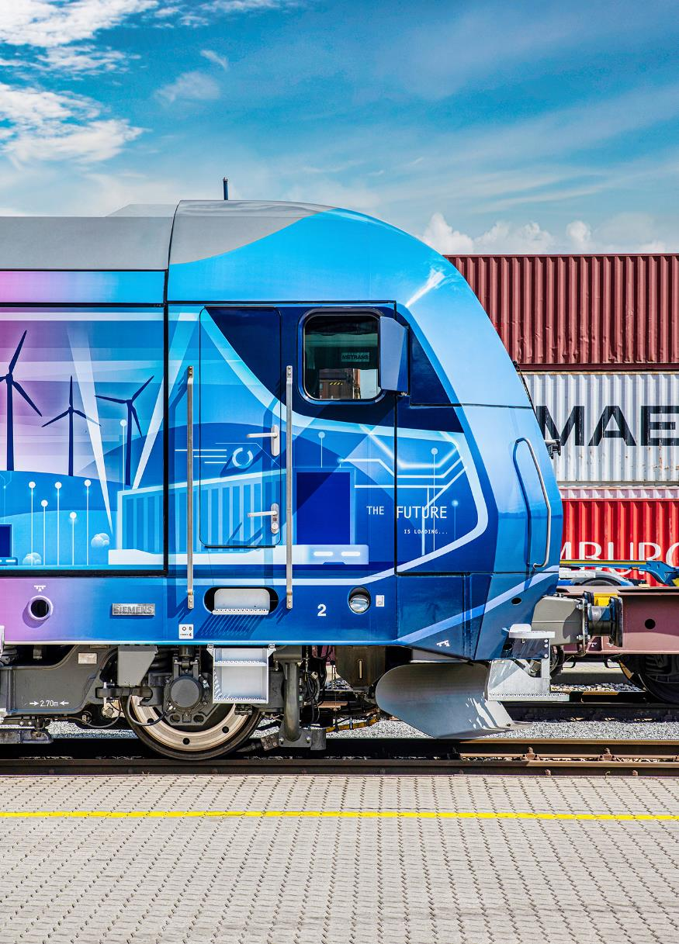
OUR PRODUCT
Green handling & green transport
2024
CERTIFIED CO₂ NEUTRALITY FOR TRANSPORTATION FROM THE PORT ALL THE WAY TO EUROPE‘S HINTERLAND
Handling at the HHLA container terminal with widely electrified processes
Transport and collection via METRANS with CO₂ optimized trains and wagons
Any currently unavoidable CO₂ emissions are offset through certified development projects to the highest international standard (Gold)
Confirmation of climate-neutral transports for customers
METRANS energy-efficient electric trains are travelling only with green energy in Austria and Germany
PROCESS
Certification of HHLA Pure TÜV Nord
Receiving customer-specific transport (volume/route)
Offsetting and monitoring by TÜV Nord

Slide 27
PILLARS OF SUCCESS
2024
1
One of the leaders of intermodal transport
We are the largest Central European operator of intermodal transport with more than 30 years of container shipping tradition.
Own network of 20 terminals
2
We operate 20 intermodal terminals in Czech Republic, Slovakia, Poland, Hungary, Austria, Germany, Serbia, Romania and today we have further under construction.
3
Stable employer
We have a highly qualified team of employees with many years of experience.
Climate protection
4
Using modern hybrid and electric locomotives and with our HHLA Pure service we are offering a CO₂ free container handling and transport.
5
Own hardware and software

Slide 28
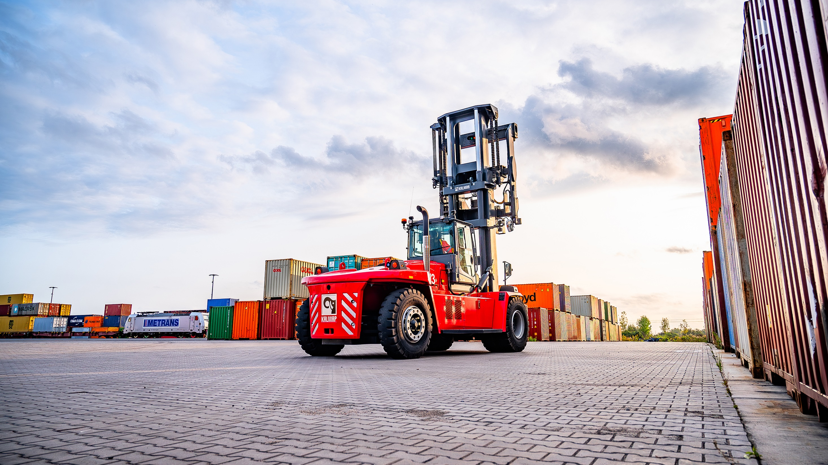
THANK YOU!
Find us on metrans.eu and

