Slide 1
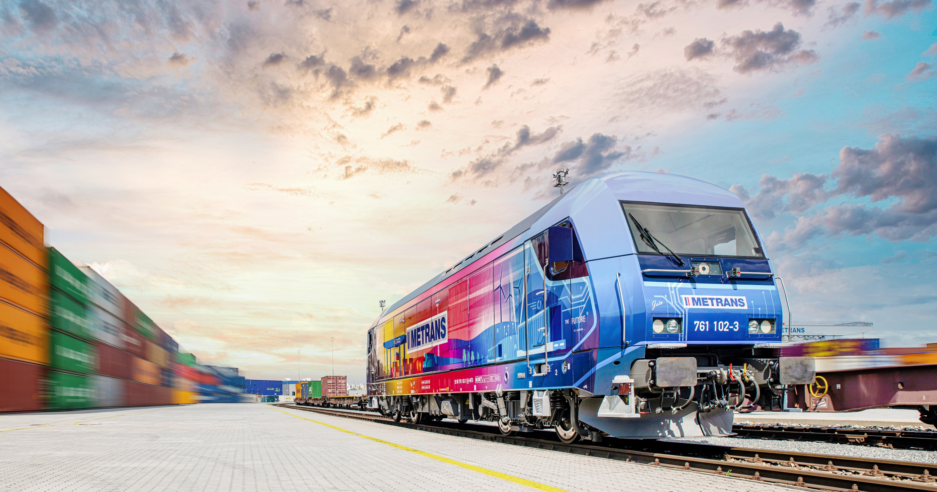
THE SUSTAINABLE INTERMODAL SOLUTION
THE HHLA PURE

Slide 2
2025
METRANS –
THE HHLA PURE
CO₂-neutral transport chains from the port to the hinterland
Hamburger Hafen und Logistik AG (HHLA) and METRANS are increasing its efforts to protect the climate and conserve resources. The aim is to make the entire Group climate neutral by 2040. The already successfully implemented sustainability strategy will now be realized under the “Balanced Logistics” brand. HHLA and METRANS hereby underscore the commitment to be both, economically successful as well as socially and ecologically responsible.
We have developed The HHLA Pure, a product that can ensure climate neutral transport chains from the port into the European hinterland, making an important contribution to lowering transport-related CO₂ emissions. This product allows our clients to combine the strength of Hamburg as the largest European rail port with the environmentally friendly rail transport offered by the intermodal solution of METRANS.

Slide 3
2025
We as METRANS are using energy efficient electric trains and lightweight flat wagons, which can transport more containers with the same train length. This offer enables You, our customers, to make Your container transport climate friendly and increases competitiveness at the same time.
In the 2019 we have successfully managed a pilot and in the 2020 the product was ready for rollout. In the first phase we offered routing from/to Hamburg, then we have extended the offer also from/to Bremerhaven and Koper.
In 2021 we started to use only green energy in Germany as well as in Austria and reduced the CO₂ for further 60%. During 2021 – 2022 we transported more than 900 tsd TEU per year with Zero Emission and more and more forwarding companies and shipping lines ask for certificates.
From 1.9.2023 a next milestone was set and also following ports become part of our CO₂ free transportation system: Wilhelmshaven, Gdansk, Rotterdam, Trieste and Rijeka. Furthermore, we integrated the inland terminals Duisburg in Germany and Indija in Serbia into the HHLA Pure network.
We took the next step in 2024. The Silk Road transports from Malaszewicze to all METRANS hinterland terminals and vice versa were included in HHLA Pure and can now also be handled CO₂-free. Since 2024, we also purchase only green energy for rail transport in the Netherlands, further expanding our commitment to sustainable logistics.
We have also put a state-of-the-art photovoltaic system into operation in northern Germany in partnership with Enerparc, from which we now generate some of the green electricity.

Slide 4
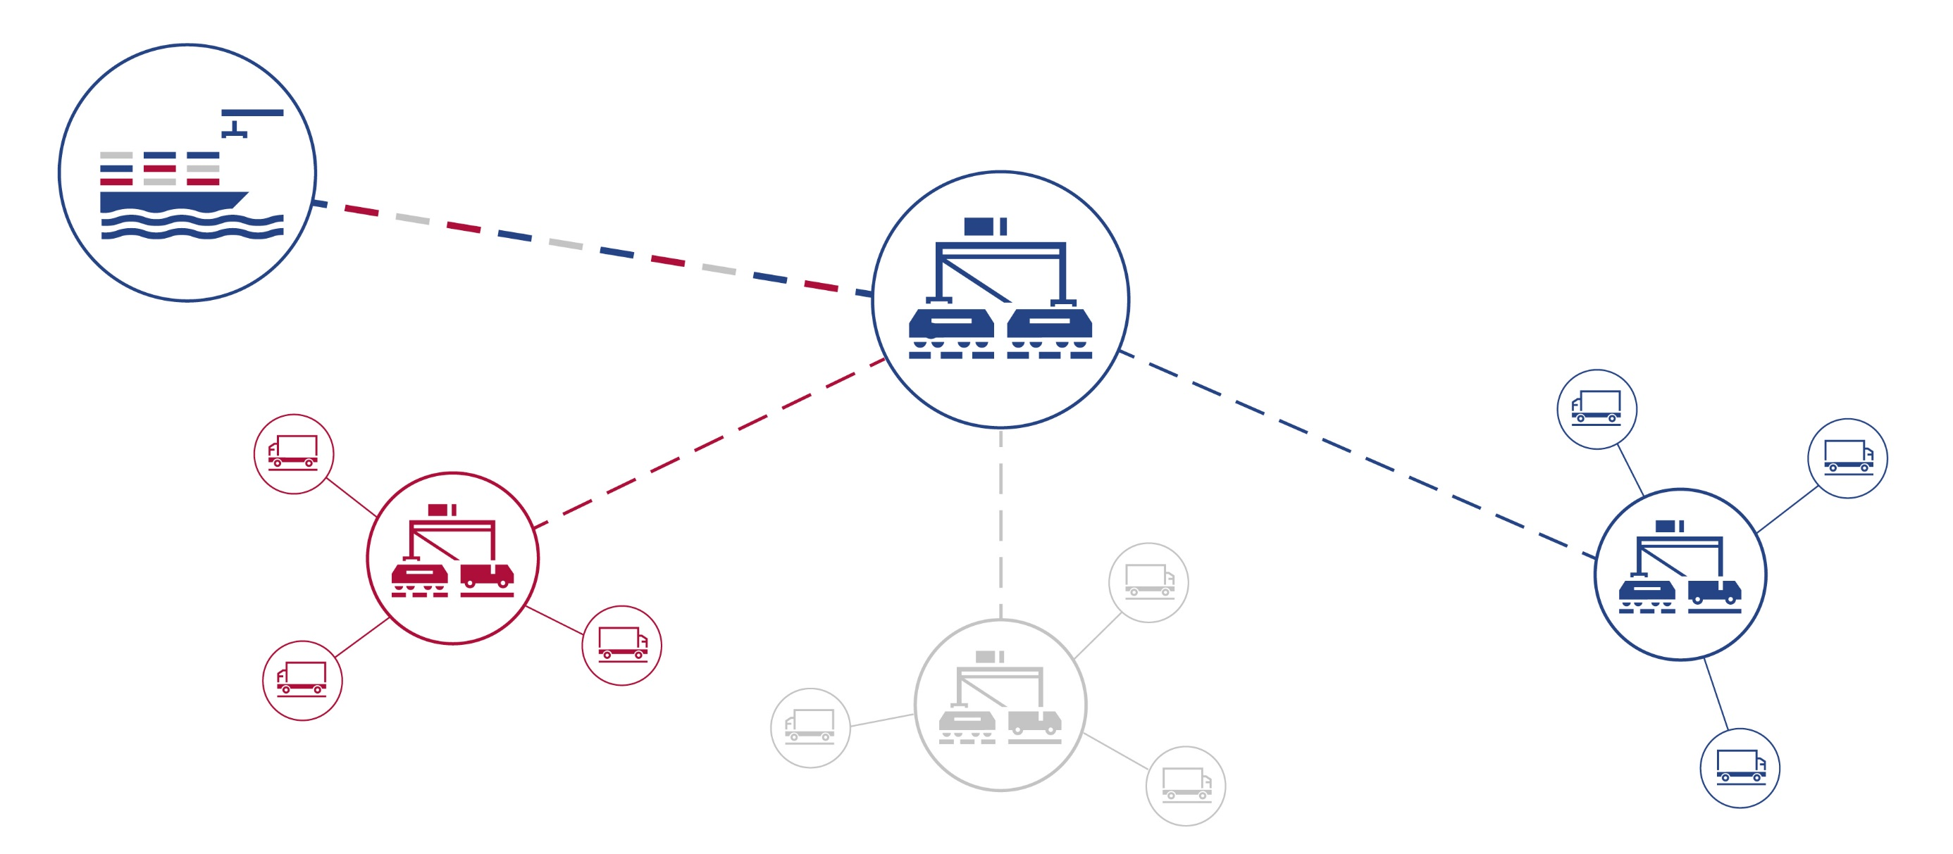
THE HUB & SHUTTLE SYSTEM
The Ports are linked with a Network of HUB and Inland Terminals
2025
www.metrans.eu

Slide 5
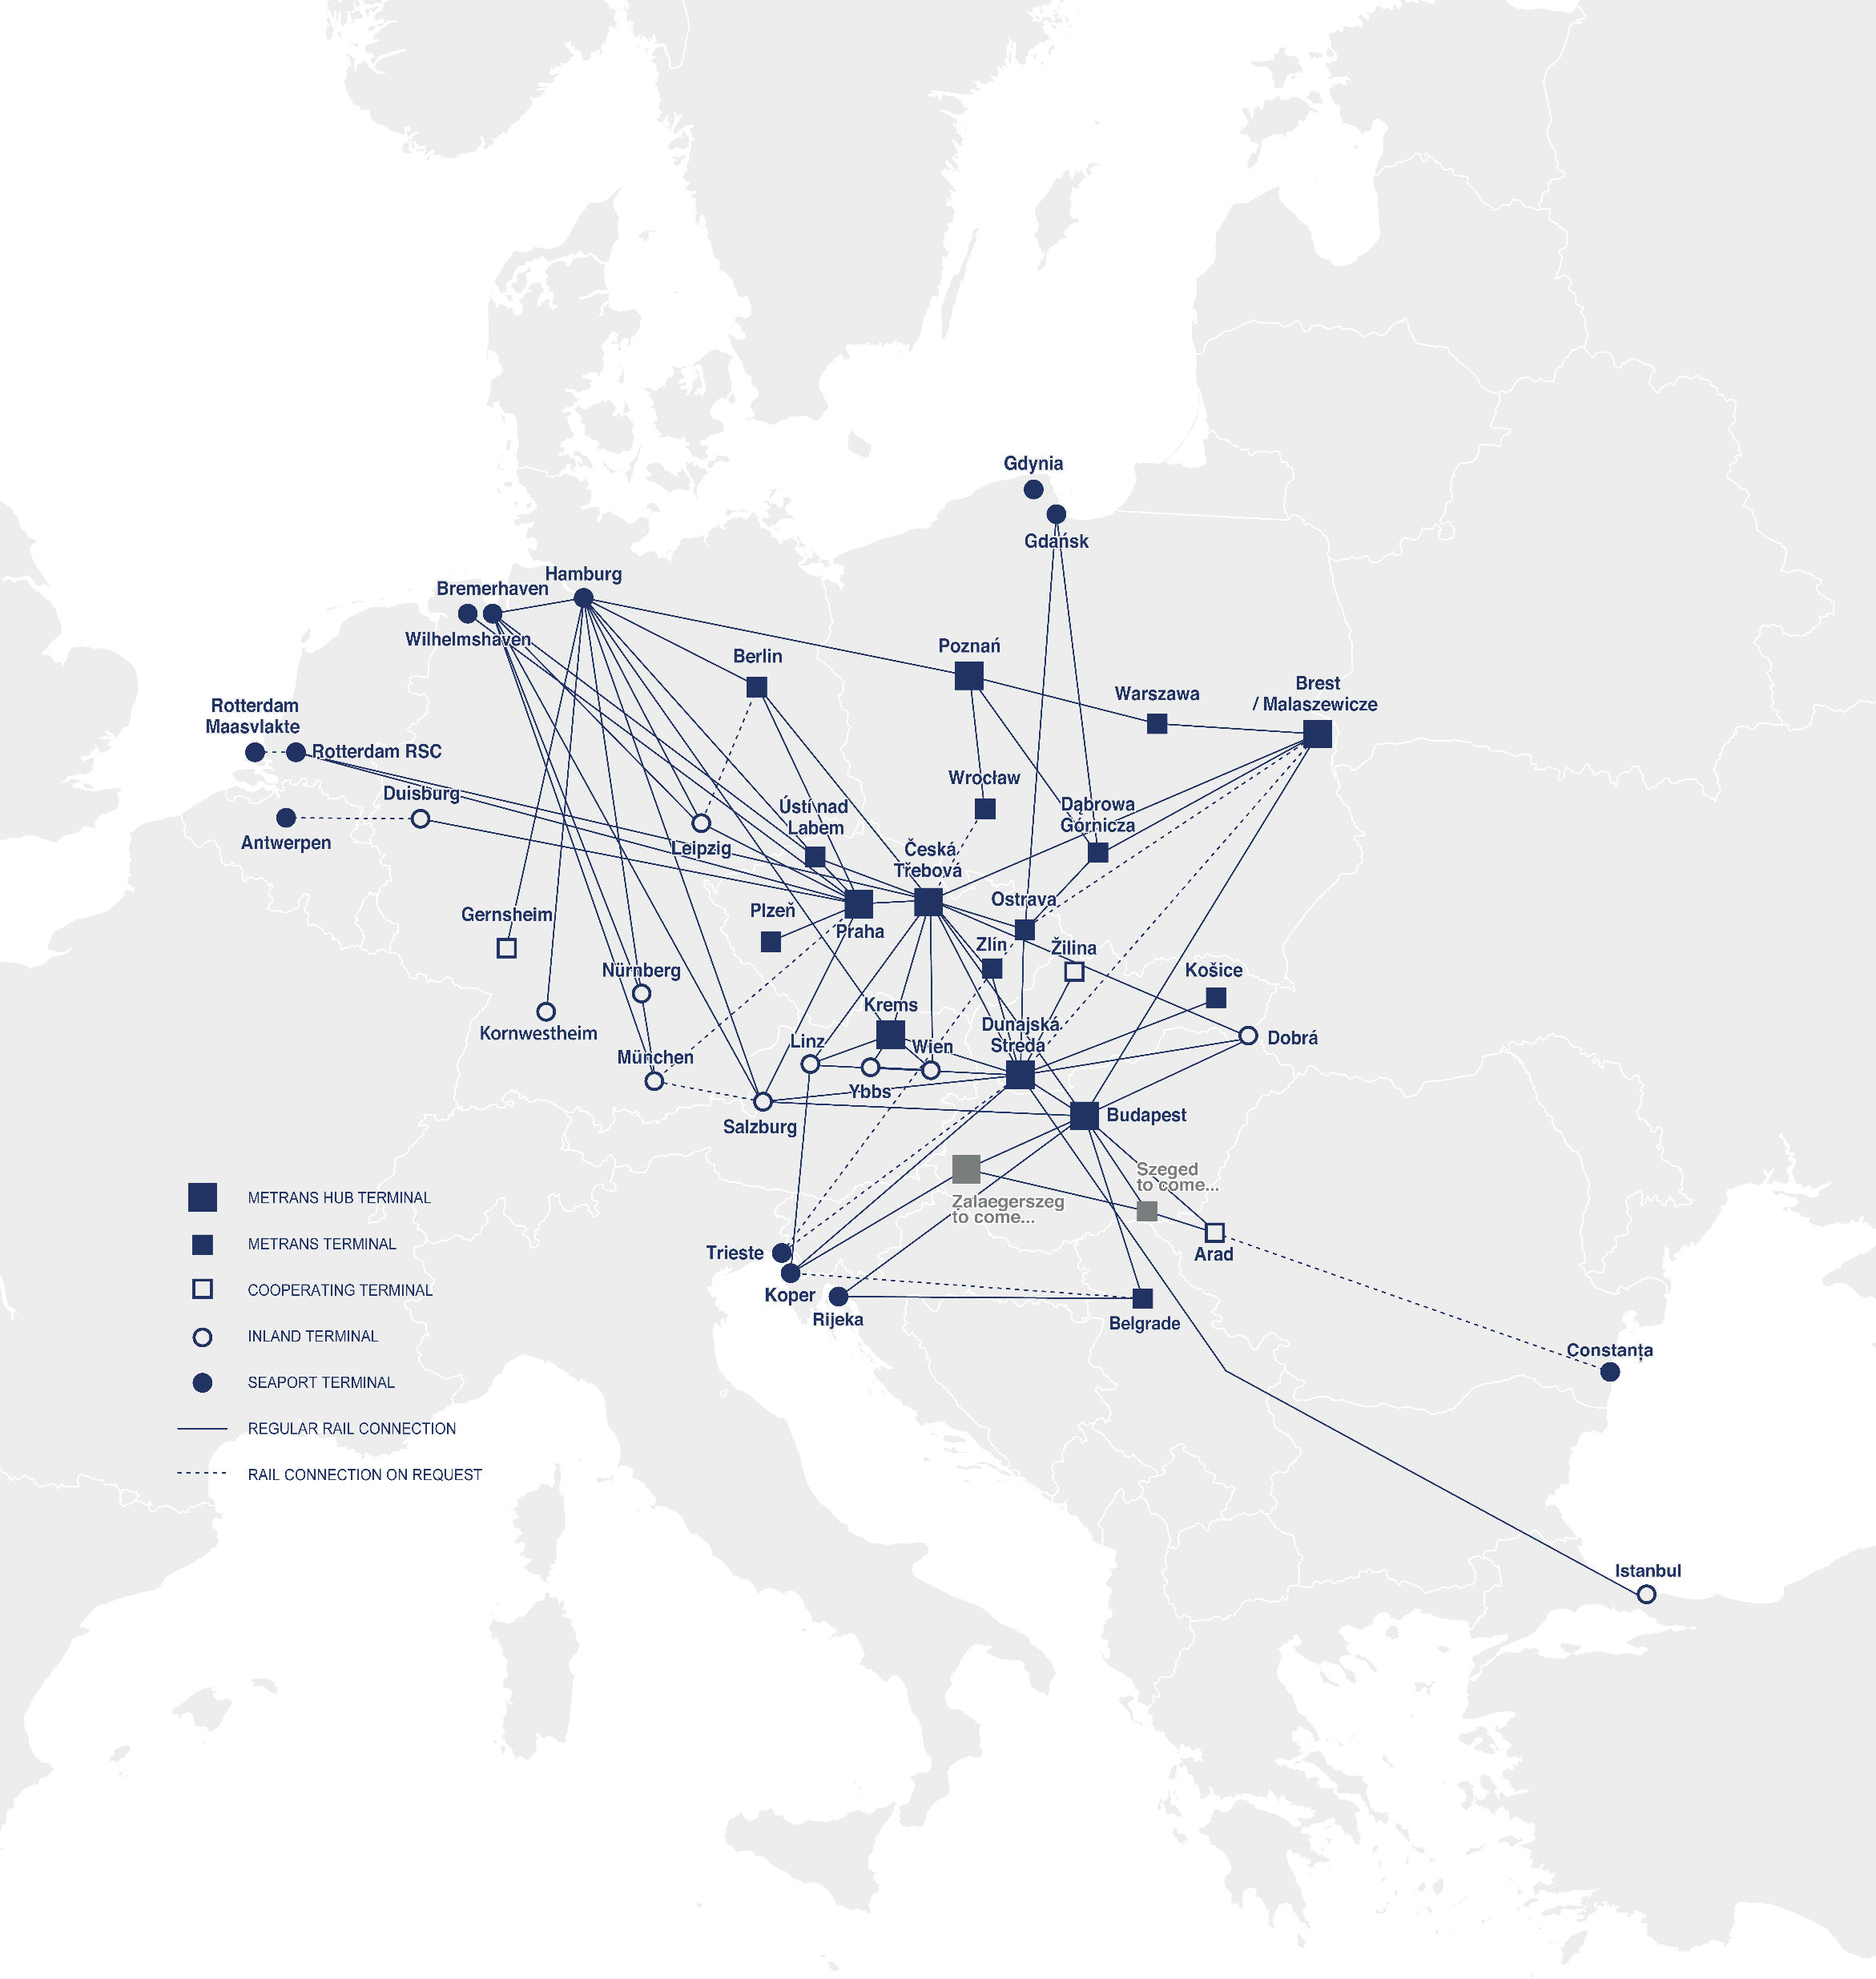
METRANS
Over 650 regular train connections per week
2025
TRAINS PER WEEK
TRAINS PER WEEK
FROM ↔ TO
FROM ↔ TO
Budapest ↔ Arad
up to 3
Hamburg ↔ Berlin
6
Budapest ↔ Belgrade (Indjija)
up to 3
Hamburg ↔ Ceska Trebova
up to 38
Bremerhaven ↔ Ceska Trebova
11
Hamburg ↔ Dunajska Streda
14
Bremerhaven ↔ Dunajska Streda
6
Hamburg ↔ Gadki
22
Bremerhaven ↔ Gadki
up to 13
Hamburg ↔ Gernsheim
6
Bremerhaven ↔ München
6
Hamburg ↔ Kornwestheim
10
Bremerhaven ↔ Nürnberg
6
Hamburg ↔ Krems
3
Bremerhaven ↔ Praha
9
Hamburg ↔ Leipzig
up to 14
Bremerhaven ↔ Leipzig
3
Hamburg ↔ München
18
Ceska Trebova ↔ Budapest
4
Hamburg ↔ Nürnberg
18
Ceska Trebova ↔ Dunajska Streda
36
Hamburg ↔ Praha
47
Ceska Trebova ↔ Krems
2
Koper ↔ Budapest
28
Ceska Trebova ↔ Linz
up to 2
Koper ↔ Dunajska Streda
35
Ceska Trebova ↔ Malaszewice
up to 4
Malaszewice ↔ Budapest
up to 2
Ceska Trebova ↔ Ostrava
12
Malaszewice ↔ Hamburg
up to 2
Ceska Trebova ↔ Zlin
14
Nürnberg → München
6
Duisburg ↔ Praha
6
Ostrava ↔ Dabrowa Gornicza
12
Dunajska Streda ↔ Budapest
24
Praha ↔ Ceska Trebova
28
Dunajska Streda ↔ Halkali
up to 3
Praha → Leipzig
1
Dunajska Streda ↔ Kosice
12
Praha ↔ Plzeň
12
Dunajska Streda ↔ Krems
6
Praha ↔ Salzburg
9
Dunajska Streda ↔ Zilina
12
Praha ↔ Wilhelmshaven
8
Gadki ↔ Dabrowa Gornicza
6
Rijeka ↔ Belgrade (Indjija)
up to 4
Gadki ↔ Katy Wroclawskie
6
Rijeka ↔ Budapest
up to 3
Gadki ↔ Pruszkow
up to 8
Rotterdam ↔ Ceska Trebova
up to 8
Gdansk ↔ Dabrowa Gornicza
12
Rotterdam ↔ Praha
12
Gdansk ↔ Ostrava
12
Salzburg → Hamburg
3

Slide 6
2025
HHLA PURE
CO2-neutral container handling and transport
With the HHLA Pure product METRANS offers our clients a CO₂-free handling and also transport, and thus, together we make a real contribution towards climate protection.
HHLA and METRANS course of action
Modern hybrid and electric locomotives
Electrification at the port container terminal with electric storage crane system, electric vehicles

Slide 7
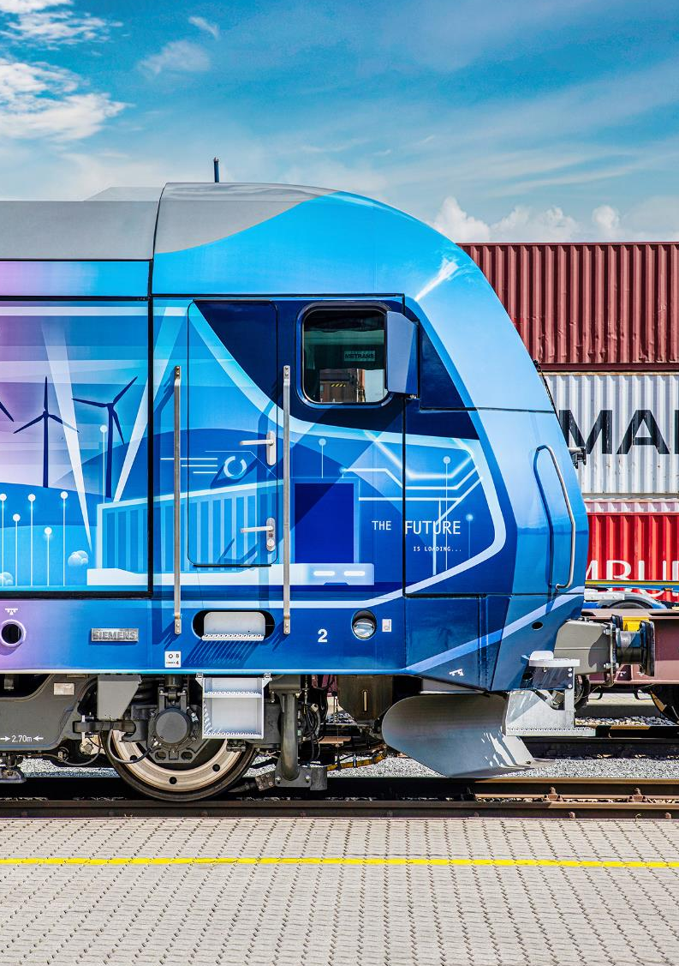
2025
HOW DOES THE CO₂ COMPENSATION WORK?
COMPENSATION IS STILL WORTHWILE, EVEN WHEN LARGE DISTANCE ARE INVOLVED
Burning fossil fuels releases CO₂ emissions into the atmosphere.
As the atmosphere has no borders, it makes no difference where in the world the CO₂ emissions are produced; the impact is the same the world over.
THE SOLUTIONS – with the course of action we solve CO₂ emissions – for remaining emission we buy Gold Standard Certificates for environmental projects.

Slide 8
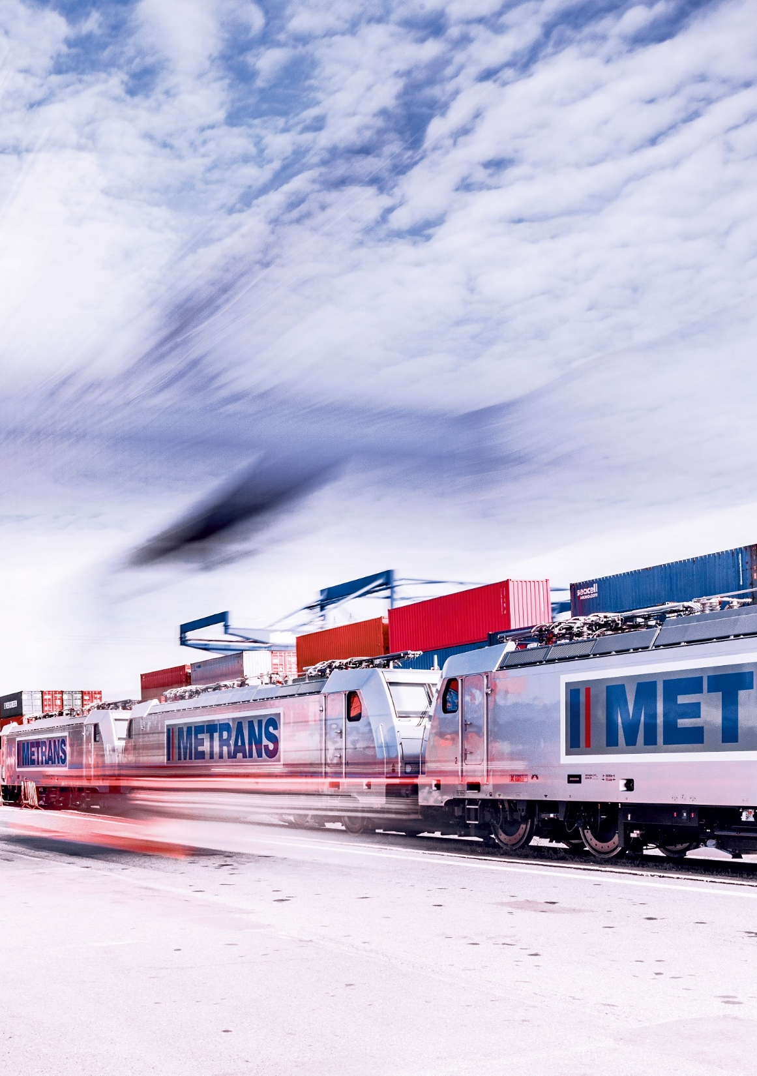
OUR PRODUCT
Green handling & green transport
2025
CERTIFIED CO₂ NEUTRALITY FOR TRANSPORTATION FROM THE PORT ALL THE WAY TO EUROPE‘S HINTERLAND
Handling at the HHLA container terminal with widely electrified processes
Transport and collection via METRANS with CO₂ optimized trains and wagons
Any currently unavoidable CO₂ emissions are offset through certified development projects to the highest international standard (Gold)
Confirmation of climate-neutral transports for customers
METRANS energy-efficient electric trains are travelling only with green energy in Austria and Germany
PROCESS
Certification of HHLA Pure TÜV Nord
Receiving customer-specific transport (volume/route)
Offsetting and monitoring by TÜV Nord

Slide 9
CONTACT DETAILS
2025
MERVART Miloš
Chief Commercial Officer
METRANS Group
GROISS Robert
Business Development Manager METRANS Group
mervart@metrans.sk
+421 907 848 981
rgroiss@metrans.sk
+43 676 837 871 04

Slide 10
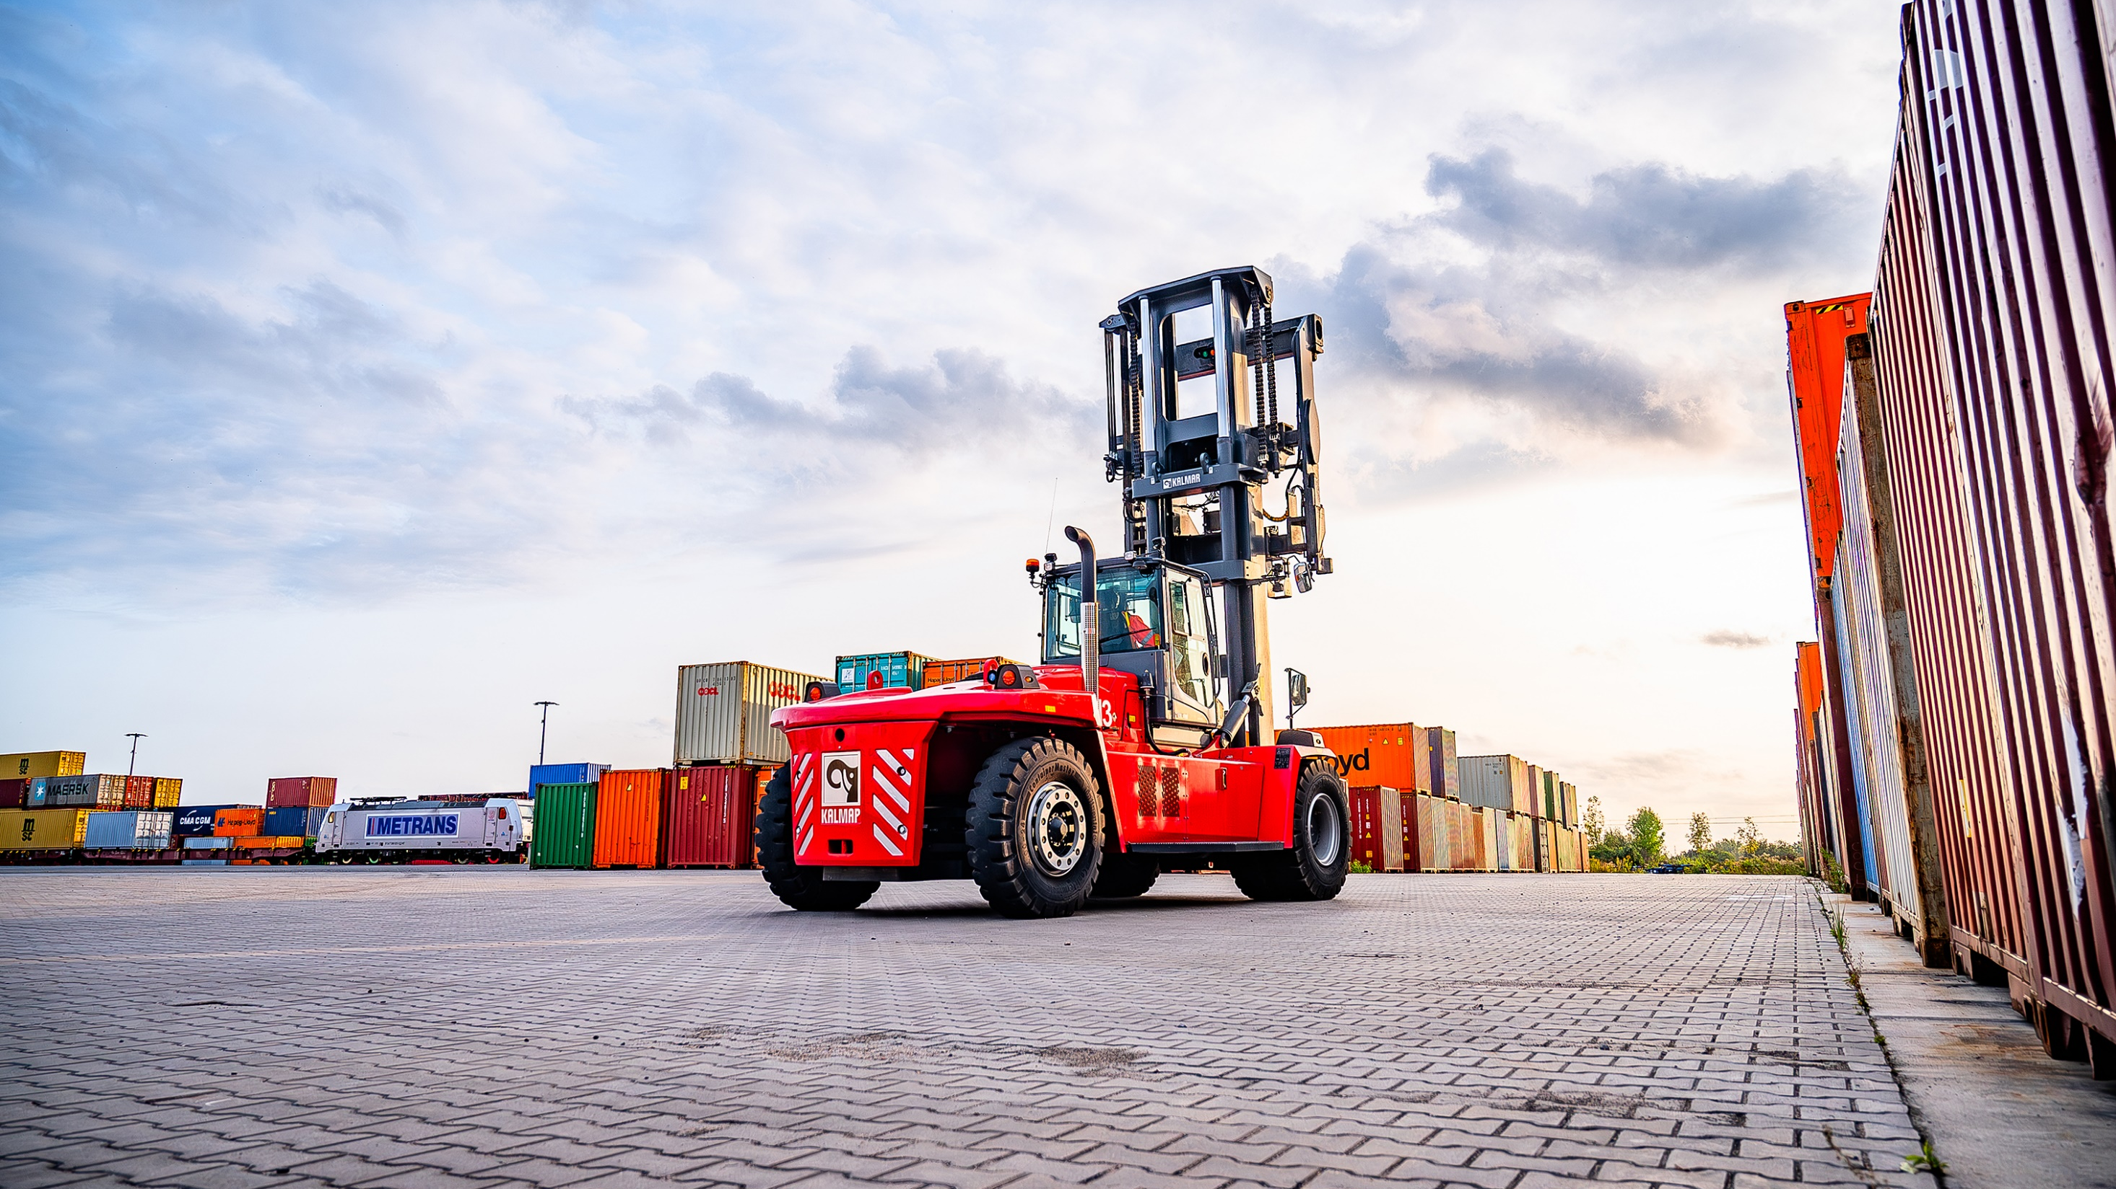
THANK YOU!
Find us on metrans.eu and

