Slide 1
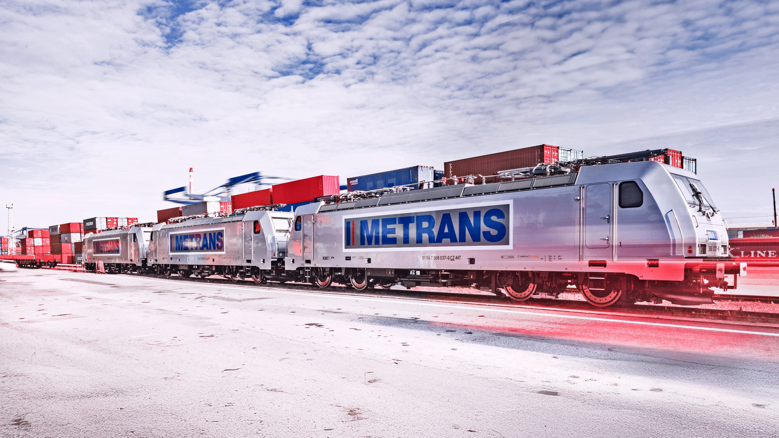
The Power of Networks
HHLA Pure

Slide 2
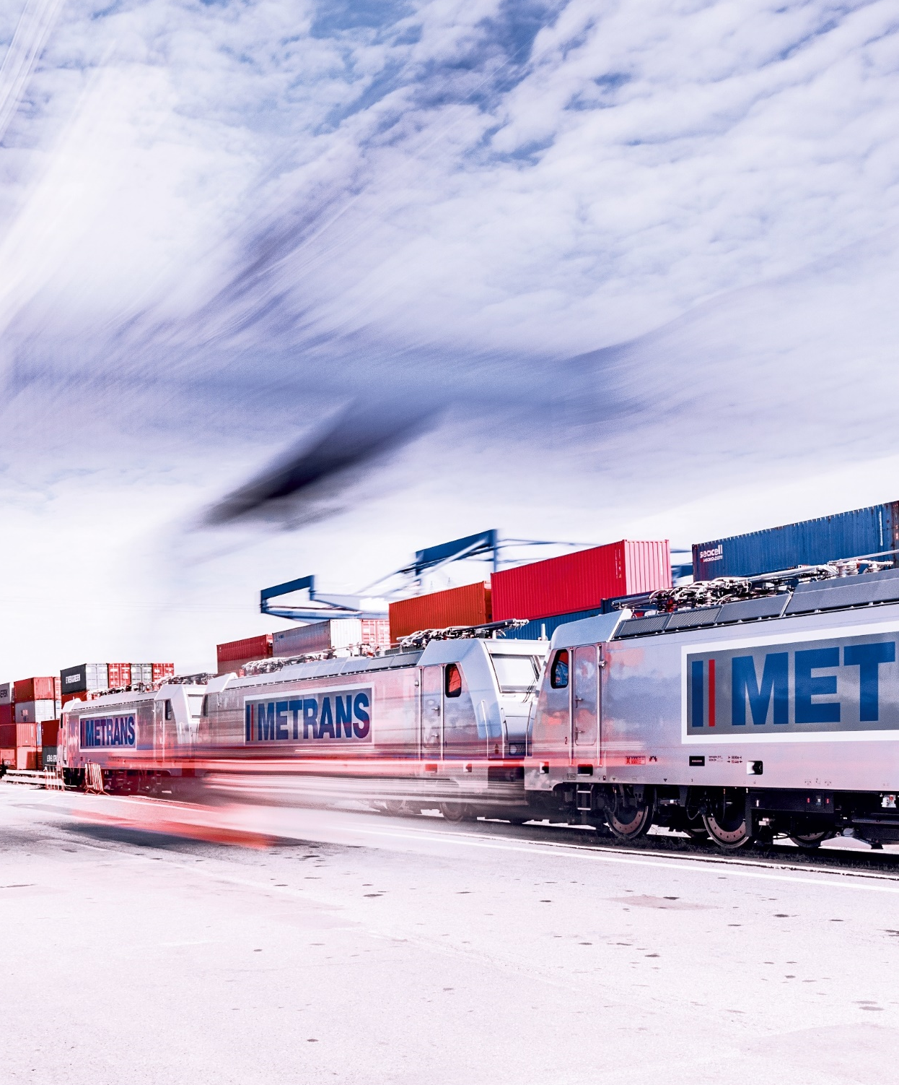
HHLA Pure
Verified CO₂ footprint and financial climate contribution
2025
Hamburger Hafen und Logistik AG (HHLA) and METRANS are intensifying their efforts to reduce CO₂ emissions and use resources more responsibly. With a target to achieve a significantly lower carbon footprint across the Group by 2040, HHLA and METRANS are pursuing a comprehensive sustainability strategy under the “Balanced Logistics” brand. This reflects our commitment to long-term economic success while also upholding our social and ecological responsibilities.
We have developed HHLA Pure, a product based on verified carbon performance, designed to significantly reduce the transport-related CO₂ footprint from port operations into the European hinterland. It allows our clients to leverage Hamburg’s position as the leading European rail port while using METRANS’ efficient intermodal rail network.

Slide 3
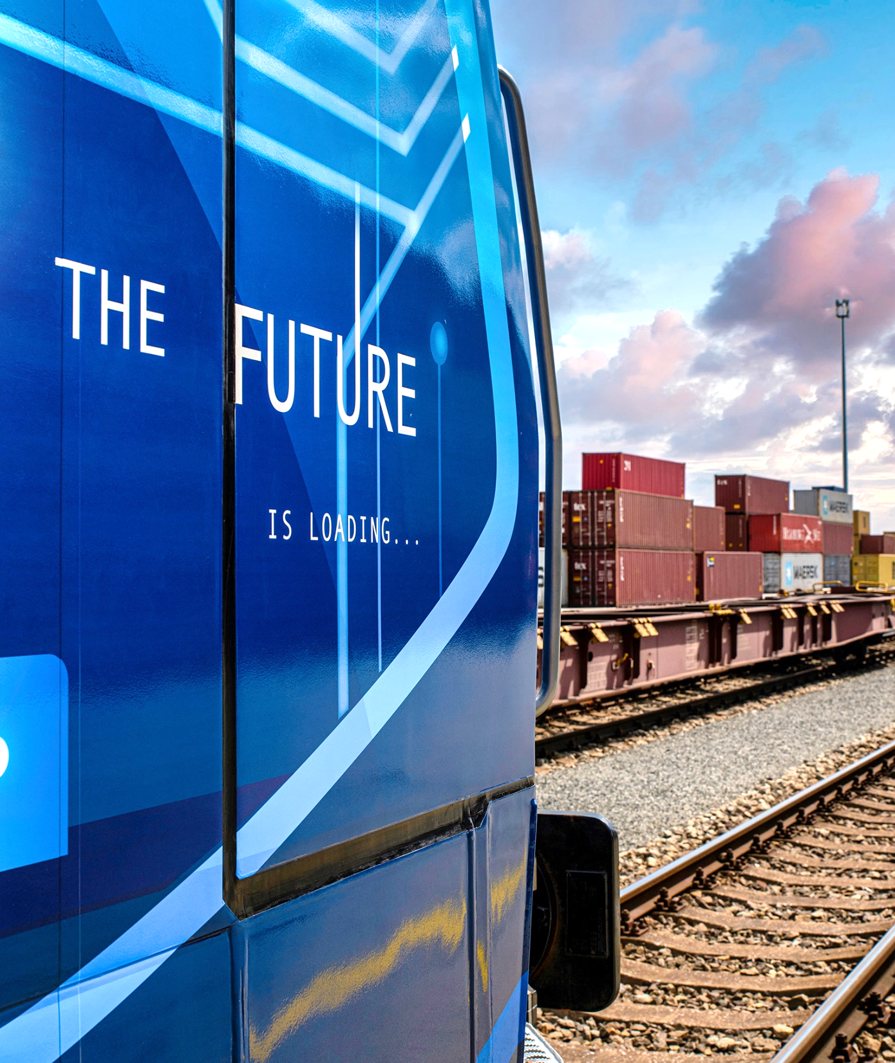
2025
METRANS operates energy-efficient electric trains and lightweight flat wagons, increasing load capacity without extending train length. This enables you, our customers, to minimize the carbon footprint of your container transports, while remaining cost-efficient and competitive.
Following a successful pilot in 2019, the product was launched in 2020 with routes from/to Hamburg, later expanding to Bremerhaven and Koper.
Since 2021, we have powered our rail operations in Germany and Austria entirely with certified green electricity, reducing emissions by an additional 60%. Between 2021 and 2022, we transported more than 900,000 TEU annually with zero direct emissions from traction energy, with many forwarding agents and shipping lines now requesting certified carbon performance documentation.
As of September 1, 2023, our low-emission rail transport offering now includes Wilhelmshaven, Gdansk, Rotterdam, Trieste, and Rijeka. Inland terminals in Duisburg (Germany) and Indija (Serbia) have also been integrated into the HHLA Pure network.

Slide 4
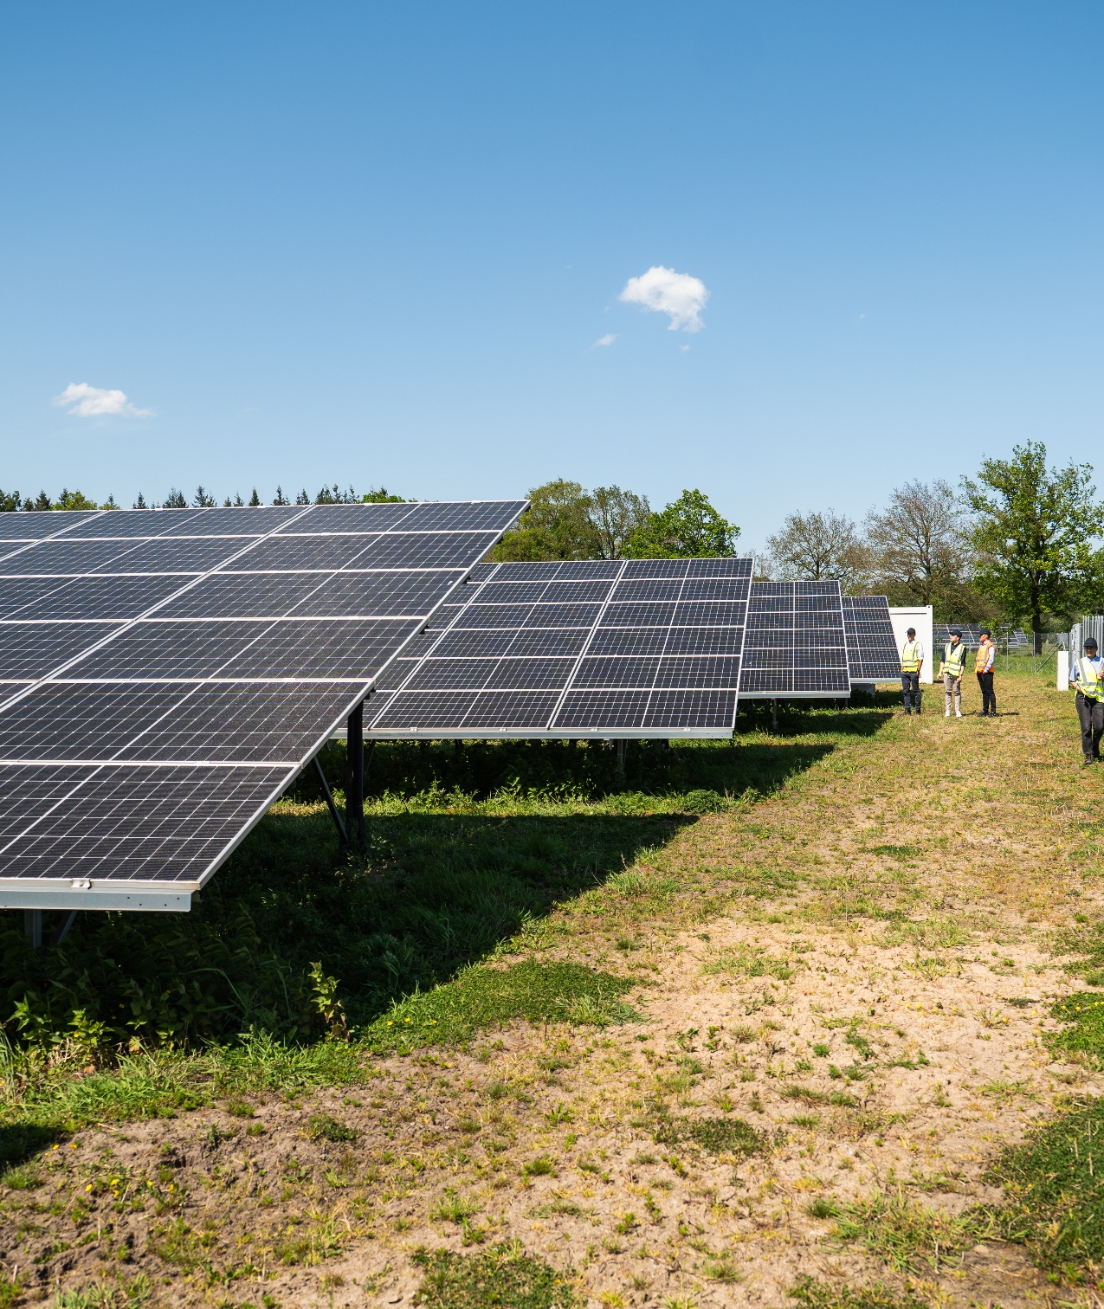
2025
In 2024, we extended our offer along the Silk Road corridor. Transport from Malaszewicze to all METRANS hinterland terminals—and vice versa—can now be handled with certified low-emission energy sources. We also began sourcing certified renewable energy for rail operations in the Netherlands.
Together with Enerparc, we have commissioned a state-of-the-art photovoltaic installation in northern Germany to supply part of our energy needs with solar power.
By mid-2025, we will complete our current CO₂ compensation programs and continue by investing in certified Gold Standard wind energy projects—ensuring that every tonne of residual emissions is matched with a credible financial climate contribution.
In 2025, we are also extending HHLA Pure to include all Istanbul destinations, further expanding our sustainable transport offer.
With HHLA Pure, METRANS provides clients with rail transport and handling services that come with documented CO₂ performance data—allowing them to make an accountable and measurable contribution to climate goals.

Slide 5
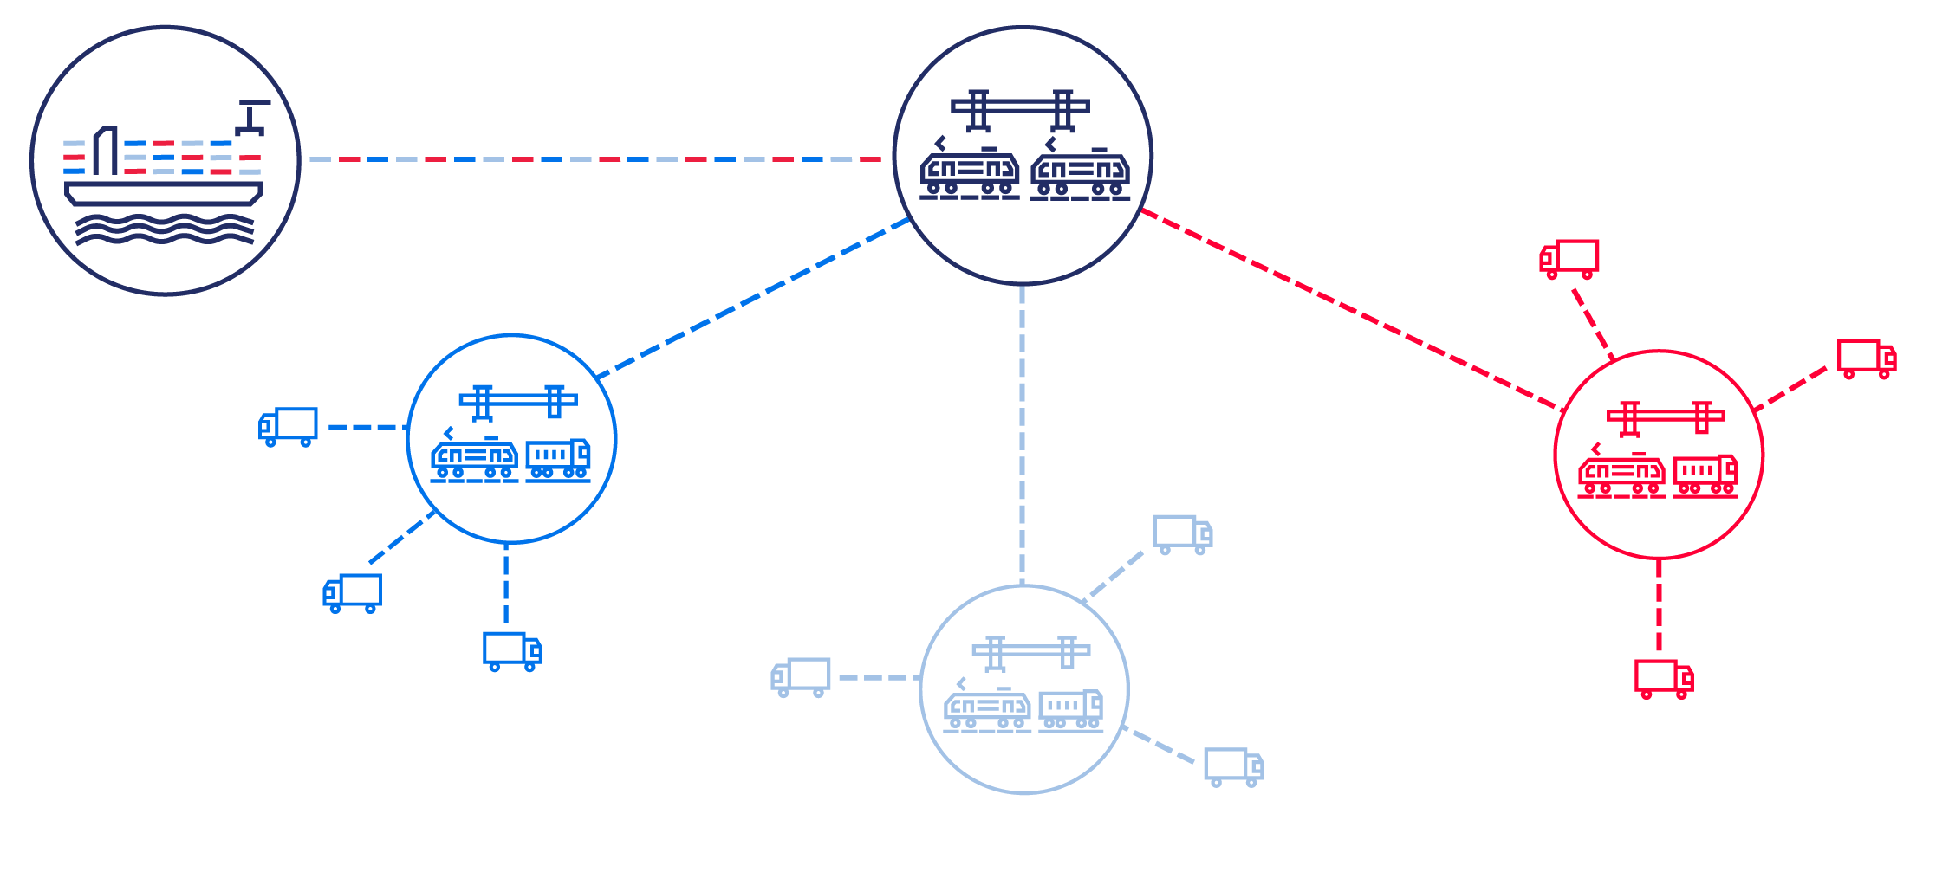
The hub & shuttle system
The ports are linked with a network of hub and inland terminals
2025

Slide 6
METRANS /Danubia/, a.s., SK
METRANS Danubia Kft., HU
METRANS Rail Slovakia, s.r.o., SK
METRANS Konténer Kft., HU
2025
METRANS /Danubia/ Krems GmbH, AT
METRANS d.o.o., HR
METRANS Group
Company structure
METRANS Railprofi Austria GmbH, AT
METRANS ADRIA d.o.o., SI
METRANS DYKO Rail Repair Shop, s.r.o., CZ
METRANS Rail, s.r.o., CZ
UniverTrans Kft., HU
METRANS Rail /Deutschland/ GmbH, DE
TIP Žilina, s.r.o., SK
METRANS Umschlagsgesellschaft mbH, DE
METRANS /Polonia/ Sp. z o.o., PL
METRANS Rail Sp. z o.o., PL
CL EUROPORT Sp. z o.o., PL
METRANS Zalaegerszeg Kft., HU
METRANS Szeged Kft., HU
METRANS Istanbul STI, TR
METRANS, a.s.
Prague, Czech Republic
ADRIA RAIL d.o.o., HR
METRANS Panonija d.o.o., RS
ADRIA RAIL Operator d.o.o., HR
METRANS Rail Netherlands B.V., NL
METRANS Rail Belgium B.V., BE
Umschlagsgesellschaft Königs Wusterhausen GmbH (50%), DE
TIP Košice, s.r.o. (50%), SK
EMA RAIL S.R.L. (33,3%), RO
M-RAIL doo za železnički prevoz robe Krnješevci (33,3%), RS

Slide 7
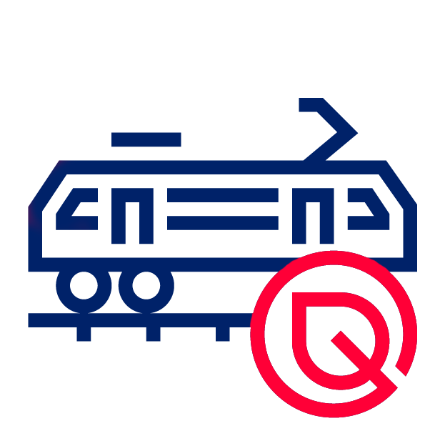
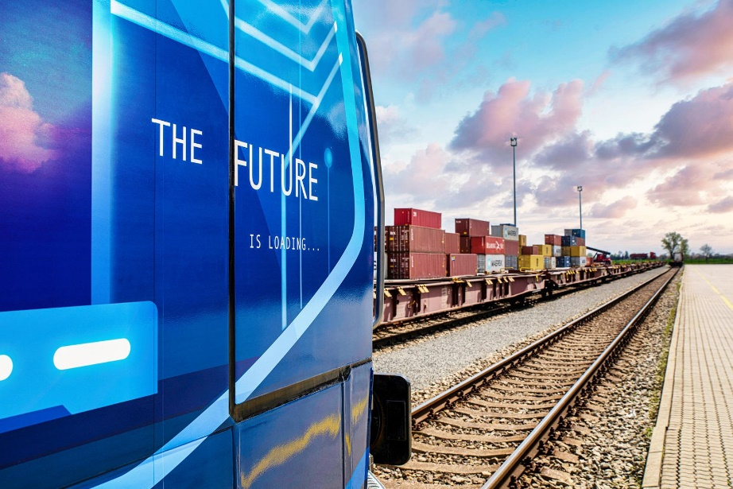
HHLA Pure
Verified CO₂ footprint and financial climate contribution
2025
With HHLA Pure we ensure handling and transport with a reduced CO₂ footprint, which has a real impact on climate protection.
Our approach
Modern hybrid & electric locomotives
Electrified port terminals with storage cranes & electric vehicles
Even for long distances, compensation matters. Since CO₂ emissions affect the entire planet, we offset any unavoidable emissions through certified environmental projects.
Till now we have already offset over
230.000
tonnes of CO₂

Slide 8
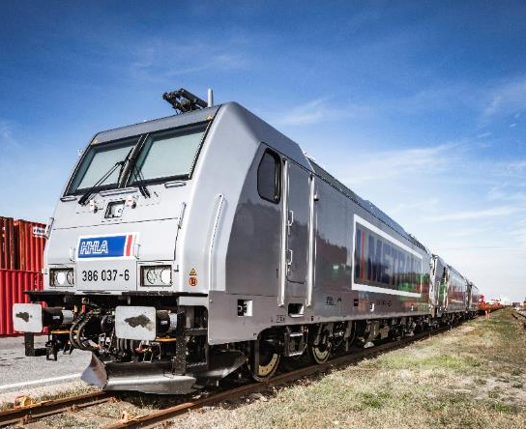
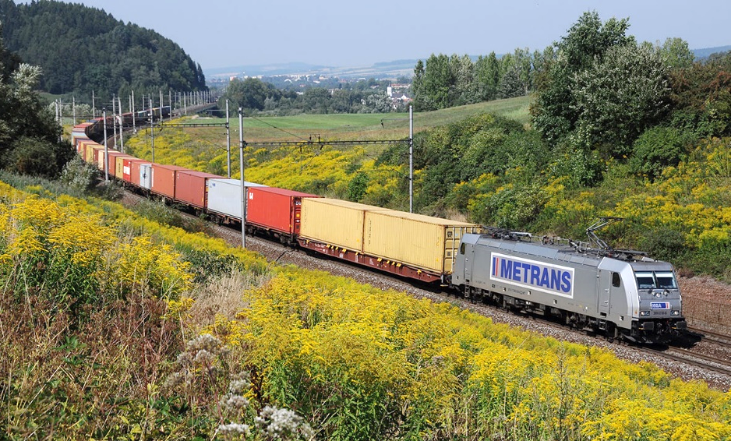
HHLA Pure
Verified CO₂ footprint and financial climate contribution
2025
Designed to reduce the transport-related CO₂ footprint from port operations into the European hinterland.
Our product
Low-impact cargo handling and transport
Electrified operations across HHLA terminals
CO₂-efficient METRANS locomotives and rolling stock
Unavoidable emissions are compensated through Gold Standard-certified projects
Customers receive confirmation of carbon-balanced transport
In Austria, Germany and the Netherlands, METRANS electric trains run on renewable power
Process
Certification of HHLA Pure TÜV Nord
Receiving customer-specific transport (volume/route)
Offsetting and monitoring by TÜV Nord

Slide 9
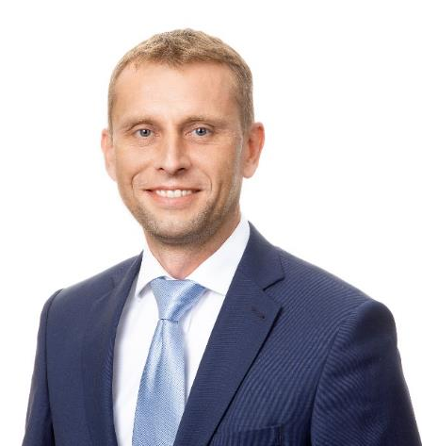
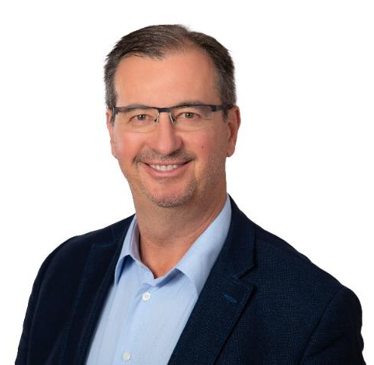
Contact details
2025
MERVART Miloš
Chief Commercial Officer
METRANS Group
GROISS Robert
Business Development Manager METRANS Group
mervart@metrans.sk
+421 907 848 981
rgroiss@metrans.sk
+43 676 837 871 04

Slide 10
Thank you.
www.metrans.eu

