Slide 1
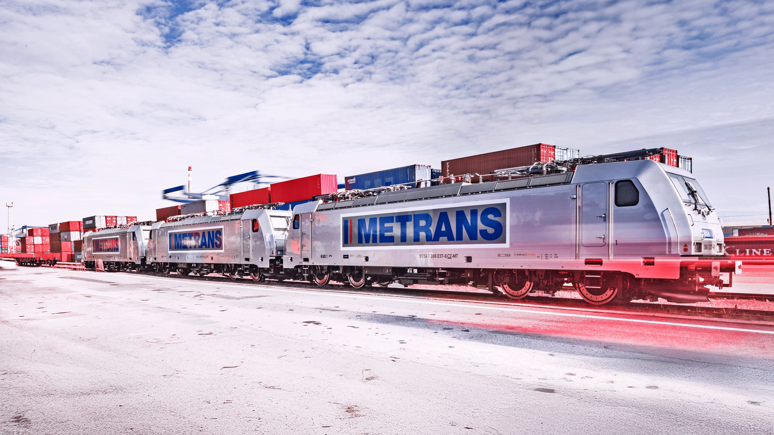


The Power of Networks
METRANS Company Presentation

Slide 2






2025
Container
Container handling
Container-related services (e.g. repair and maintenance)
HHLA
Corporate structure
Intermodal
Rail & road transport services in the ports’ hinterland
Operation of hinterland terminals
Port logistics subgroup
Logistics
Specialist handling – dry bulk, fruit, ro-ro, etc.
Consultancy
Real Estate
Speicherstadt, the historical warehouse district
Port real estate
Fischmarkt Hamburg-Altona

Slide 3








METRANS
Facts and key figures (2024)
2025
2 new terminals in plan for Hungary
Development of the present network
20
> 150
Founded 1991
100% HHLA
rail terminals in the hinterland
electric and hybrid locomotives
640 million
1.45 million
1.2 million
EUR annual revenue
TEU intermodal
TEU depots
> 4000
2.750
> 650
company-owned wagons
employees in 10 countries
train connections per week

Slide 4
METRANS /Danubia/, a.s., SK
METRANS Danubia Kft., HU
METRANS Rail Slovakia, s.r.o., SK
METRANS Konténer Kft., HU
2025
METRANS /Danubia/ Krems GmbH, AT
METRANS d.o.o., HR
METRANS Group
Company structure
METRANS Railprofi Austria GmbH, AT
METRANS ADRIA d.o.o., SI
METRANS DYKO Rail Repair Shop, s.r.o., CZ
METRANS Rail, s.r.o., CZ
UniverTrans Kft., HU
METRANS Rail /Deutschland/ GmbH, DE
TIP Žilina, s.r.o., SK
METRANS Deutschland GmbH, DE
METRANS /Polonia/ Sp. z o.o., PL
METRANS Rail Sp. z o.o., PL
CL EUROPORT Sp. z o.o., PL
METRANS Zalaegerszeg Kft., HU
METRANS Szeged Kft., HU
METRANS Istanbul STI, TR
METRANS, a.s.
Prague, Czech Republic
METRANS Adria d.o.o. Rijeka, HR
METRANS Panonija d.o.o., RS
METRANS Adria Rail d.o.o., HR
METRANS Rail Netherlands B.V., NL
METRANS Rail Belgium B.V., BE
Umschlagsgesellschaft Königs Wusterhausen GmbH (50%), DE
TIP Košice, s.r.o. (50%), SK
EMA RAIL S.R.L. (33,3%), RO
M-RAIL doo za železnički prevoz robe Krnješevci (33,3%), RS

Slide 5
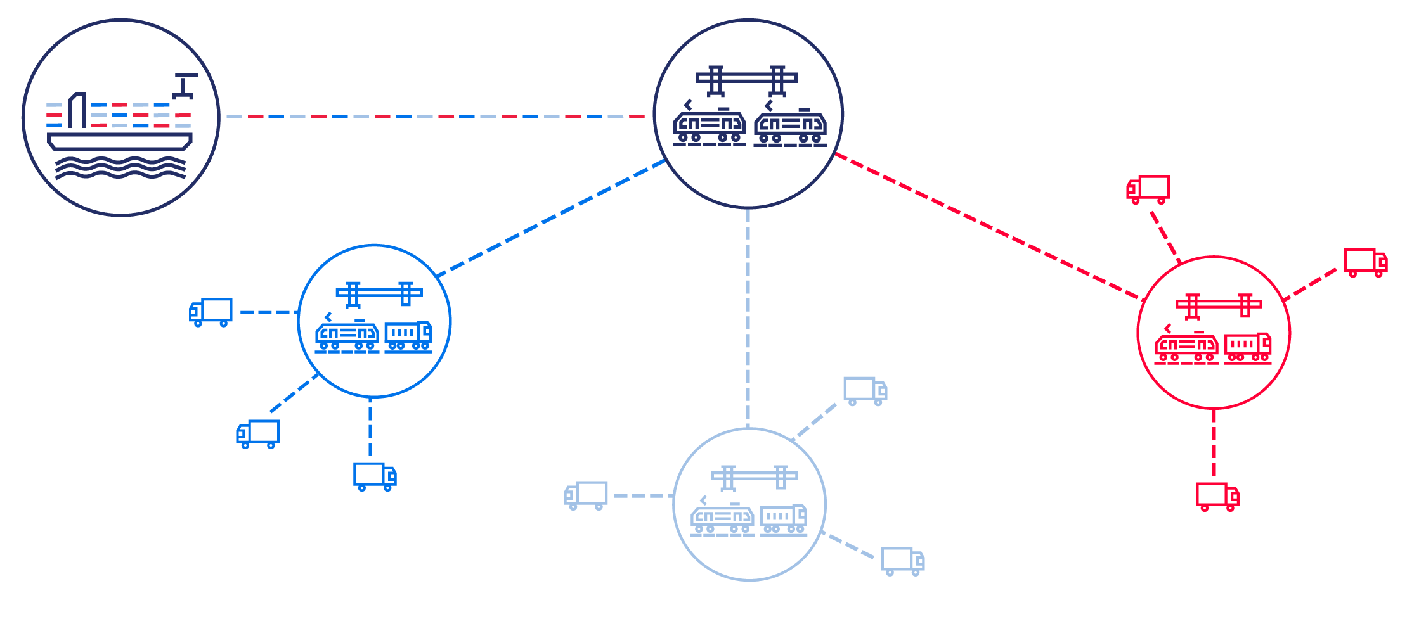
The hub & shuttle system
The ports are linked with a network of hub and inland terminals
2025

Slide 6
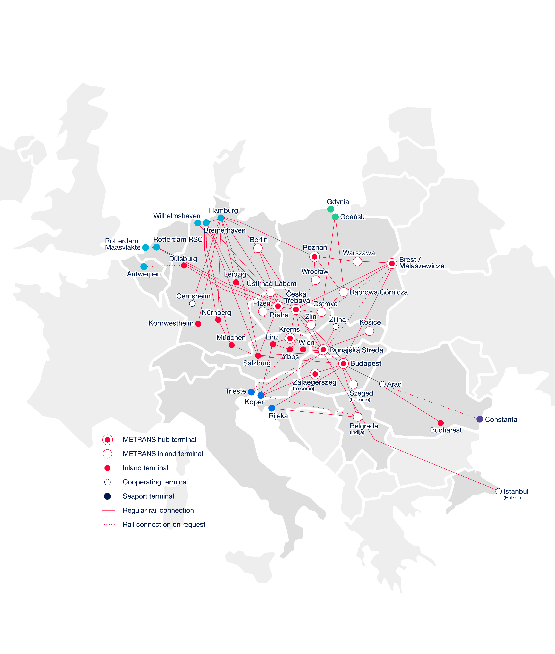
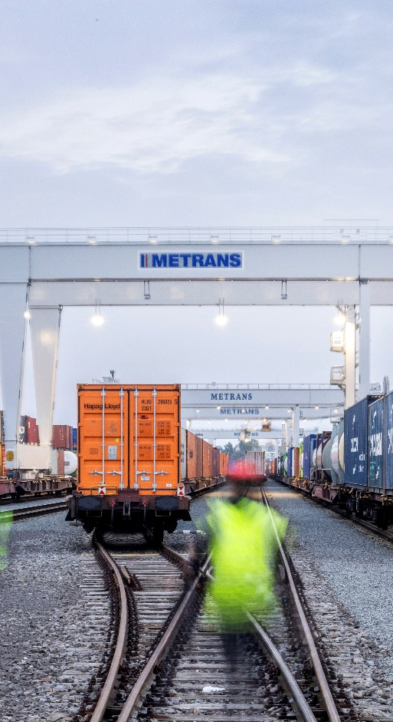
METRANS
The European intermodal rail bridge
2025
7 hub terminals
Praha & Ceska Trebova (CZ), Krems (AT), Dunajska Streda (SK), Poznan & Malaszewicze (PL), Budapest & Zalaegerszeg to come (HU)
13 end terminals
in Czech Republic, Germany, Poland, Romania, Serbia, Slovakia
Seaports
North Sea
Hamburg, Bremerhaven, Wilhelmshaven
Rotterdam
Antwerpen
Adriatic Sea
Baltic Sea
Black Sea
Rijeka
Koper
Trieste
Gdansk, Gdynia
Constanta

Slide 7
From ↔ to
Trains
per week
From ↔ to
Trains
per week
METRANS
Over 650 regular train connections per week
2025
Arad ↔ Bucharest
up to 3
Hamburg ↔ Berlin
6
Budapest ↔ Arad
up to 3
Hamburg ↔ Ceska Trebova
37
Budapest ↔ Belgrade (Indjija)
up to 3
Hamburg ↔ Dunajska Streda
11
Bremerhaven ↔ Ceska Trebova
13
Hamburg ↔ Gadki
22
Bremerhaven ↔ Dunajska Streda
6
Hamburg ↔ Gernsheim
8
Bremerhaven ↔ Gadki
up to 13
Hamburg ↔ Kornwestheim
10
Bremerhaven ↔ München
6
Hamburg ↔ Krems
3
Bremerhaven ↔ Nürnberg
6
Hamburg ↔ Leipzig
13
Bremerhaven ↔ Praha
11
Hamburg ↔ München
20
Bremerhaven ↔ Leipzig
6
Hamburg ↔ Nürnberg
10
Ceska Trebova ↔ Budapest
4
Hamburg ↔ Praha
49
Ceska Trebova ↔ Dunajska Streda
39
Koper ↔ Budapest
28
Ceska Trebova ↔ Krems
2
Koper ↔ Dunajska Streda
35
Ceska Trebova ↔ Linz
up to 2
Linz ↔ Krems
3
Ceska Trebova ↔ Malaszewice
up to 4
Malaszewice ↔ Budapest
up to 2
Ceska Trebova ↔ Ostrava
12
Malaszewice ↔ Hamburg
up to 2
Ceska Trebova ↔ Wilhelmshaven
3
Nürnberg → München
6
Ceska Trebova ↔ Zlin
14
Ostrava ↔ Dabrowa Gornicza
6
Duisburg ↔ Praha
6
Praha ↔ Ceska Trebova
28
Dunajska Streda ↔ Budapest
24
Praha → Leipzig
1
Dunajska Streda ↔ Halkali
up to 3
Praha ↔ Plzeň
12
Dunajska Streda ↔ Kosice
12
Praha ↔ Salzburg
9
Dunajska Streda ↔ Krems
6
Praha ↔ Wilhelmshaven
7
Dunajska Streda ↔ Zilina
12
Rijeka ↔ Belgrade (Indjija)
up to 3
Gadki ↔ Dabrowa Gornicza
6
Rijeka ↔ Budapest
up to 3
Gadki ↔ Katy Wroclawskie
6
Rotterdam ↔ Ceska Trebova
8
Gadki ↔ Pruszkow
up to 8
Rotterdam ↔ Praha
12
Gdansk ↔ Dabrowa Gornicza
6
Salzburg → Hamburg
3
Gdansk ↔ Ostrava
6

Slide 8
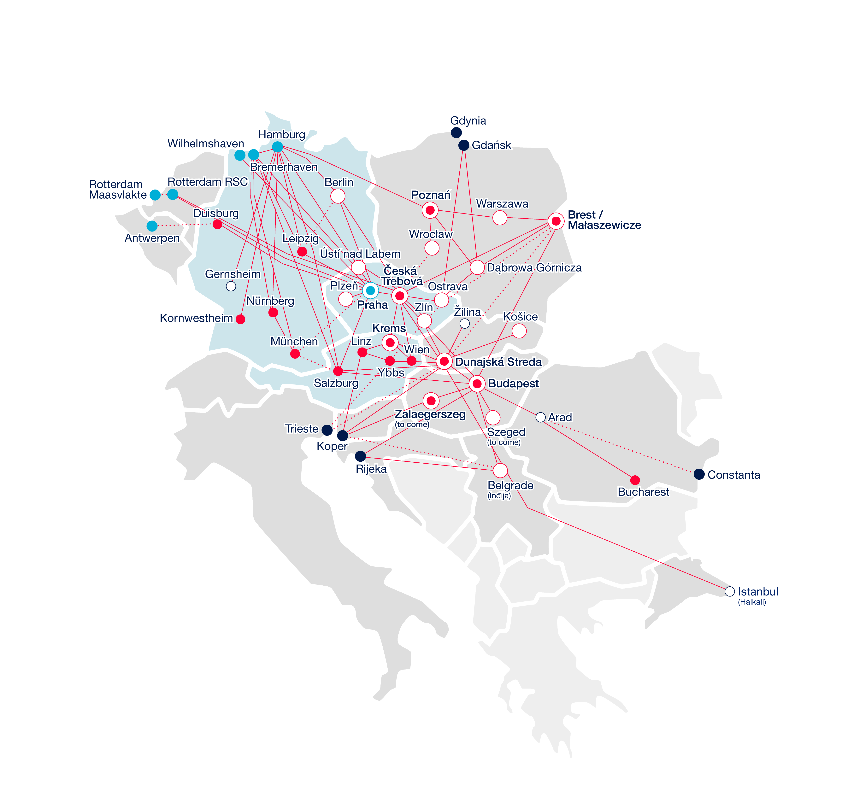
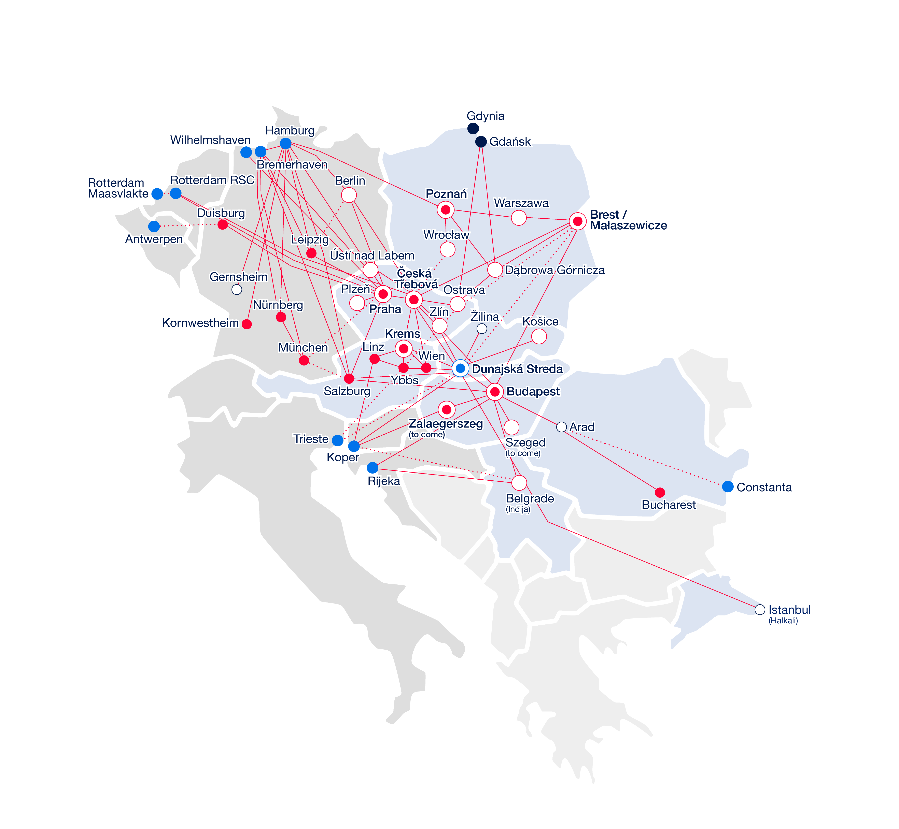
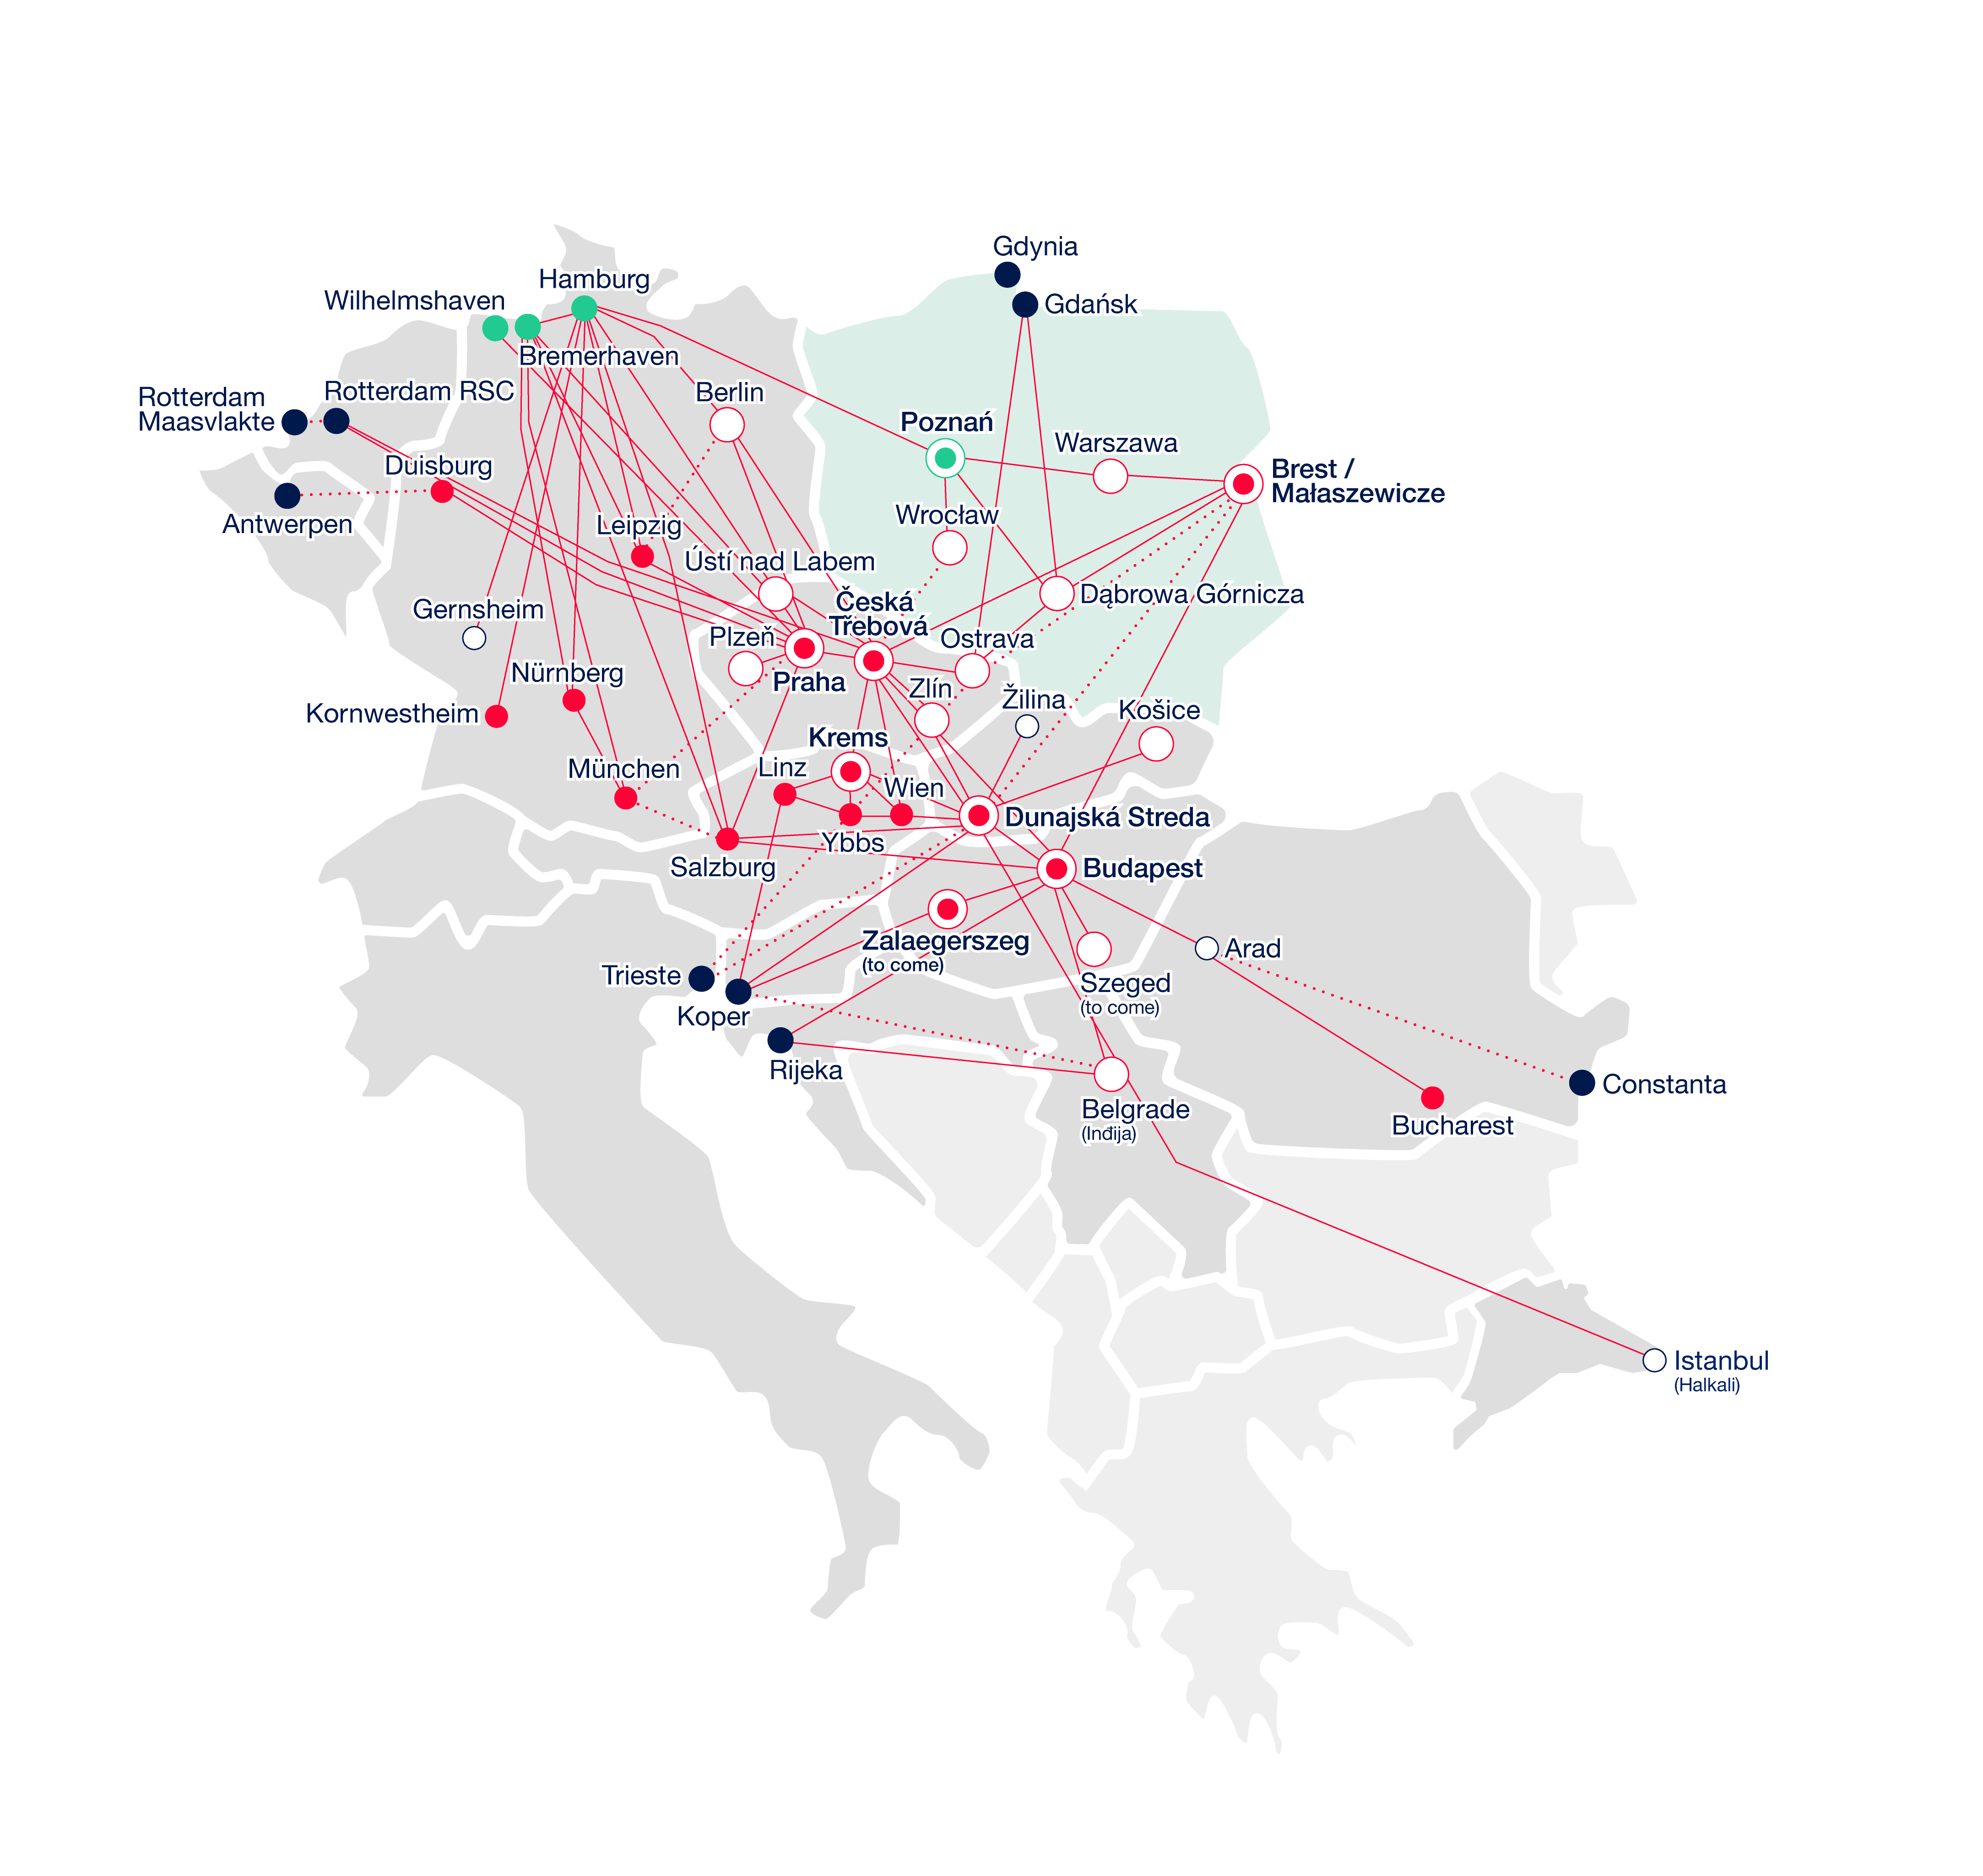
METRANS
Key operation offices
2025
PRAHA, CZ
DUNAJSKA STREDA, SK
POZNAN (GADKI), PL
METRANS, a.s. Head Quarter
Operation territory
Ports: BE, DE, NL
Countries: AT, CZ, DE
Operation territory
Ports: BE, DE, IT, NL, RO, SL
Countries: AT, CZ, HU, PL, RO, RS, SK, TR
Operation territory
Ports: DE
Countries: PL

Slide 9
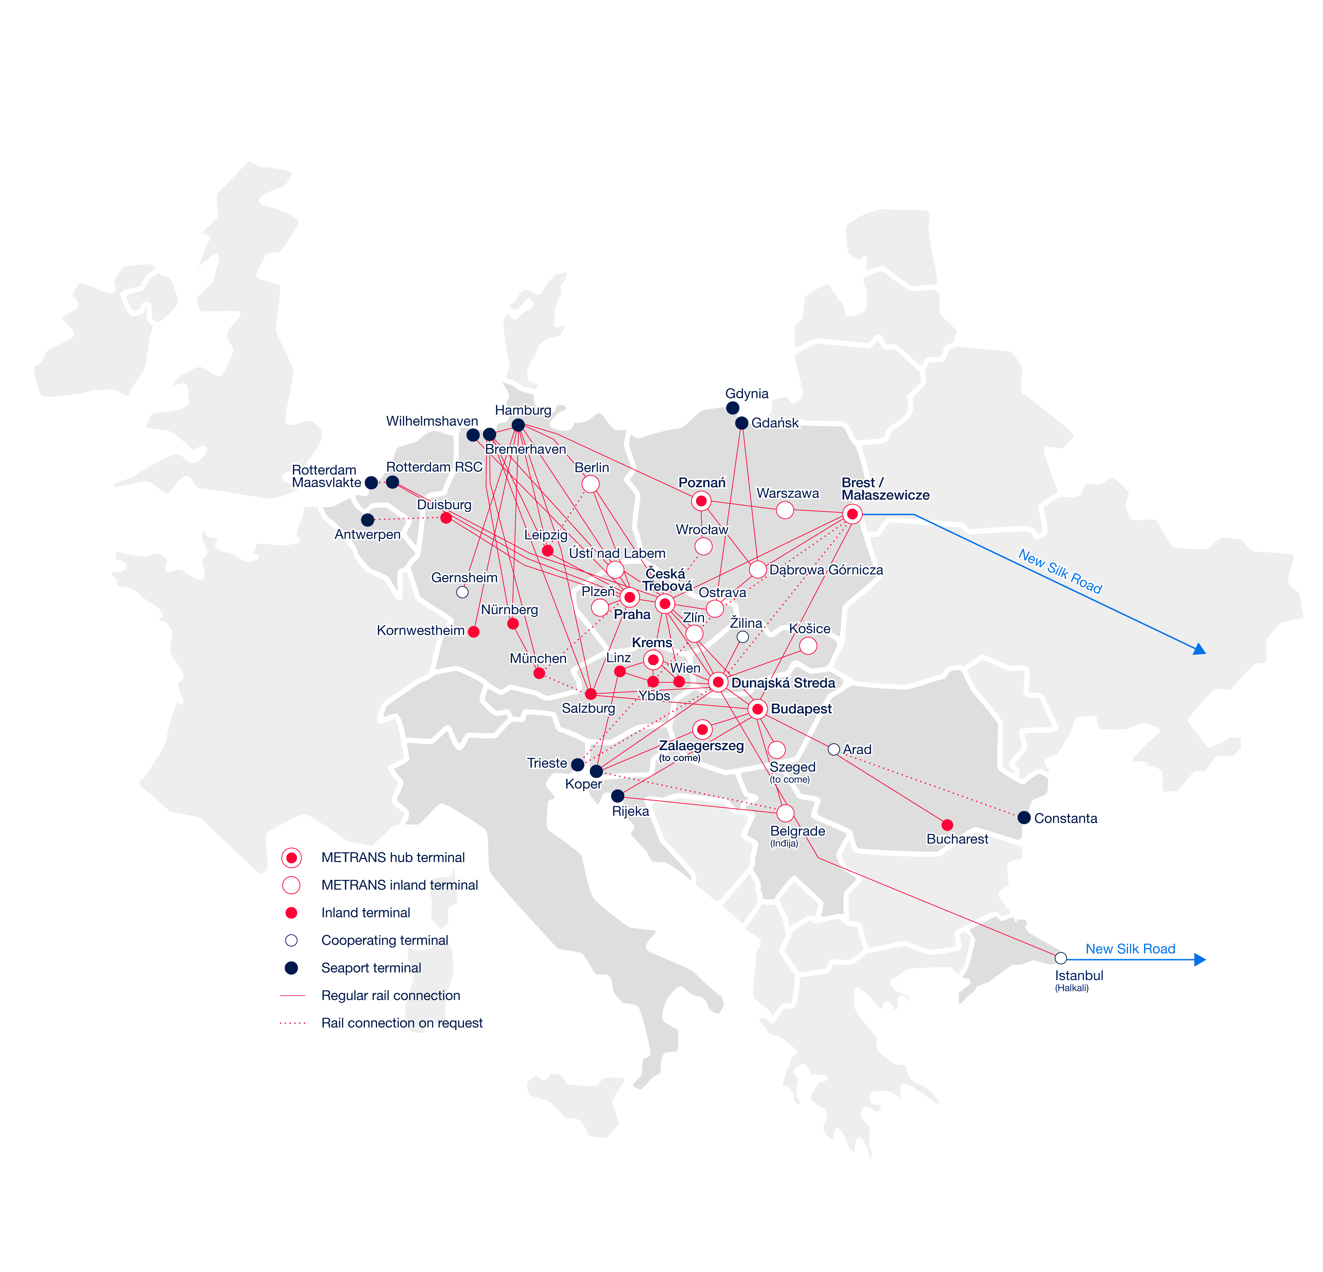
New Silk Road
Gateway to the Future
2025
Via Brest/Małaszewicze Gateway to Europe
METRANS provides strong connections to the New Silk Road through the Brest/Małaszewicze hub terminal, linking major destinations such as Warszawa, Poznan, Hamburg, Duisburg, and Munich/Nuremberg via Hamburg and Ceska Trebova. These routes ensure a daily connection to all METRANS terminals.
Via Istanbul
Expanding Access to the Silk Road
The New Silk Road connection via Istanbul offers full access to the entire METRANS network, providing seamless transport solutions and extending connectivity along this strategic route.
www.metrans.eu

Slide 10
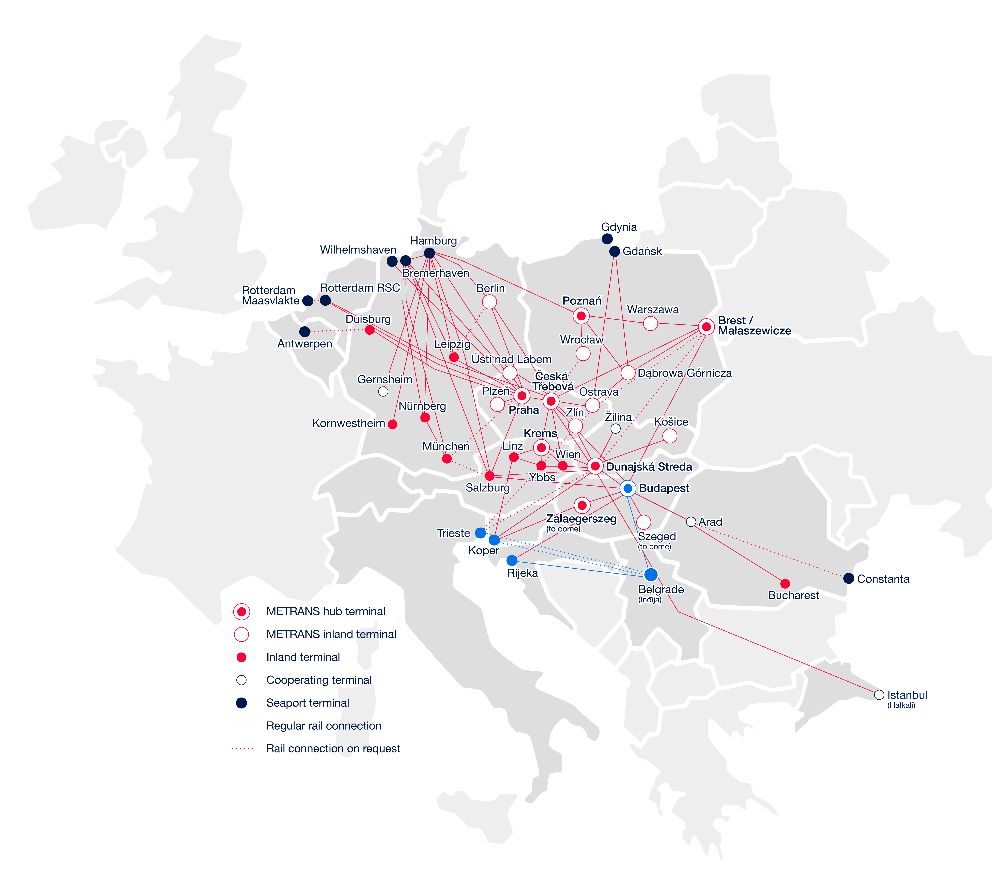
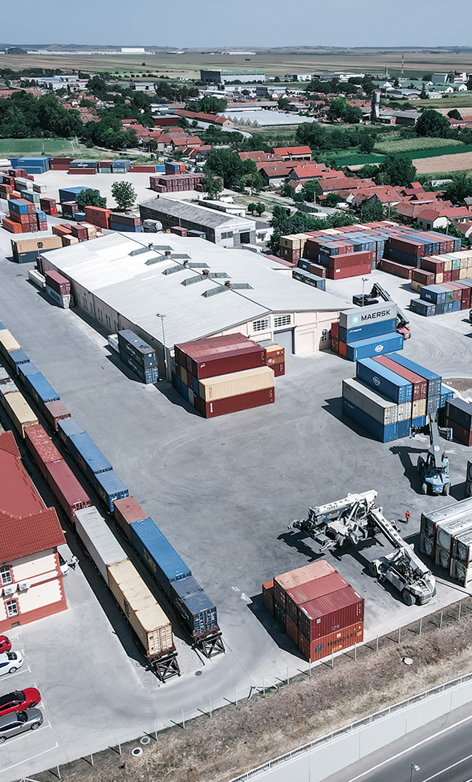
Connections to Serbia
METRANS Panonija
2025
METRANS Panonija ensures reliable rail transport to, from, and through Croatia, connecting Adriatic ports with the Indija terminal.
Indija is the 20th terminal in the METRANS network, linked via regular trains to Budapest, providing access to major seaports in Southern and Northern Europe.
Connections to/from Serbia
Container terminal Indjija (near Belgrade)
Regular departures to/from port of Rijeka & hub Budapest
Gateway via Budapest to NW Continent, Adriatic ports & hinterland
On-request connections to Port of Koper & Port of Trieste
www.metrans.eu

Slide 11
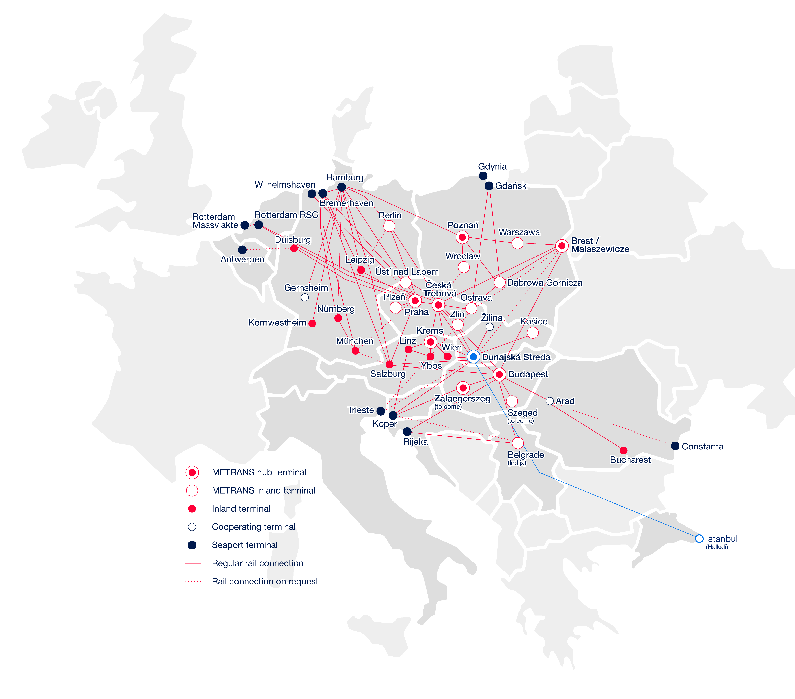
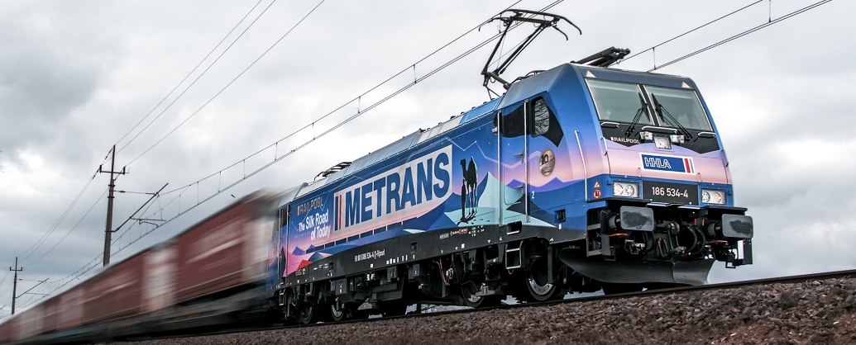
Connections to Turkey
Container terminal Halkali (Istanbul)
2025
The Halkali terminal in Istanbul is part of the METRANS network, ensuring seamless transport solutions.
We offer two weekly departures, connecting the METRANS hub terminal in Dunajska Streda with Halkali.
Our 45' PWHC containers are available for efficient cargo transport.
Through our gateway solutions, we provide access to Germany, Poland, Slovakia, Hungary, Austria, Romania, Serbia, and the Czech Republic.
www.metrans.eu

Slide 12
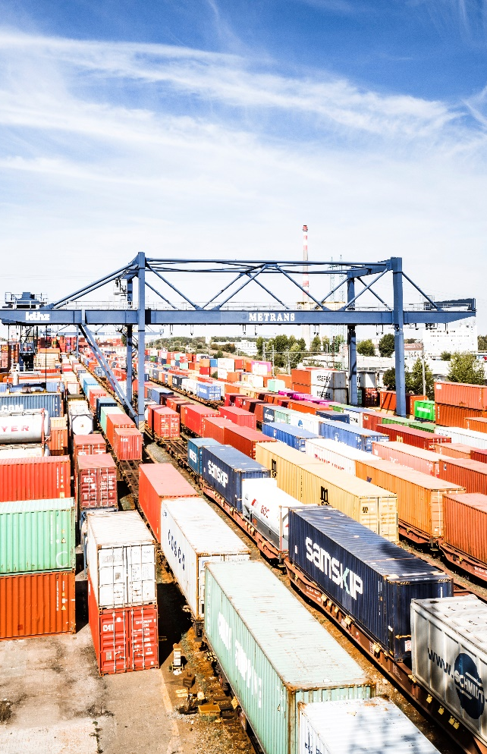
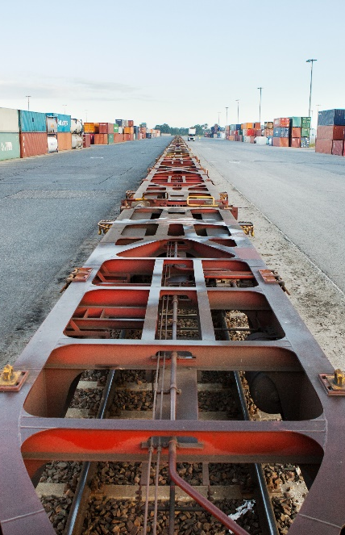
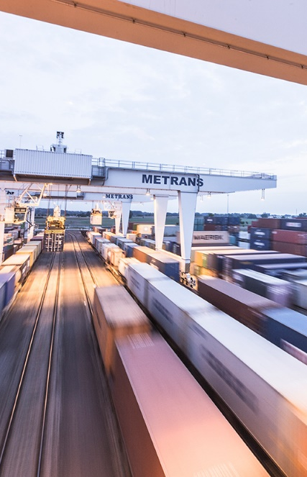
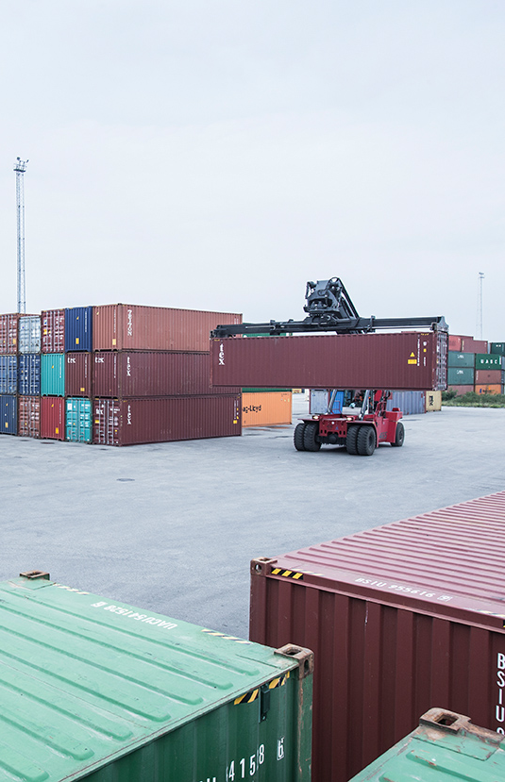
2025
Praha (since 1991)
Poznan – Gadki
(since 2011)
Terminal area: 420,000 m²
Storage capacity: 7,500 TEU full and 10,000 TEU empty
Trucking fleet: 263 trucks
Sidings – 7x600 m, 2x550 m, 6x350 m
6 Rail Mounted Gantry Cranes,
13 reachstackers, 2 forklifts, 4 shunters
10 trains can be handled at the same time
Repair facility for containers
On-site customs office
Operates 24/7/365
Terminal area: 175,000 m²
Storage capacity: 8,800 TEU
Trucking fleet: 42 trucks
Sidings – 1x750 m, 3x630 m
10 reachstackers
2 trains can be handled at the same time
On-site customs office
Handling of swap bodies and semi-trailers
Operates 24/7/365
Dunajska Streda (since 1999)
Krems an der Donau
(since 2012)
Terminal area: 326,000 m²
Storage capacity: 25,000 TEU full and 15,000 TEU empty
Trucking fleet: 223 trucks
Sidings – 5x650 m, 4x550 m
4 Rail Mounted Gantry Cranes,
18 reachstackers, 3 forklifts
9 trains can be handled at the same time
Repair facility for containers
On-site customs office
Operates 24/7/365
Terminal area: 45,000 m²
Storage capacity: 1,800 TEU full and 2,500 TEU empty
Trucking fleet: 15 trucks
Sidings: 4x680 m
6 reachstackers
Repair facility for containers
On-site customs office
Hub terminals

Slide 13
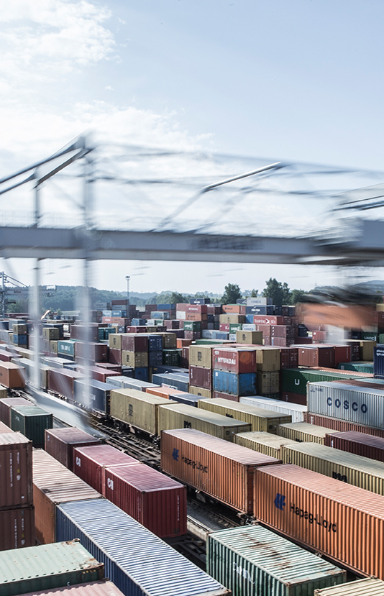
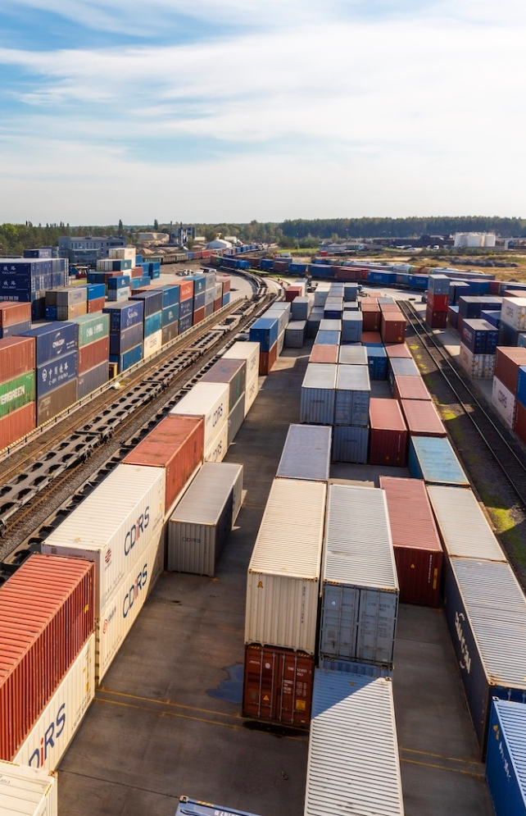
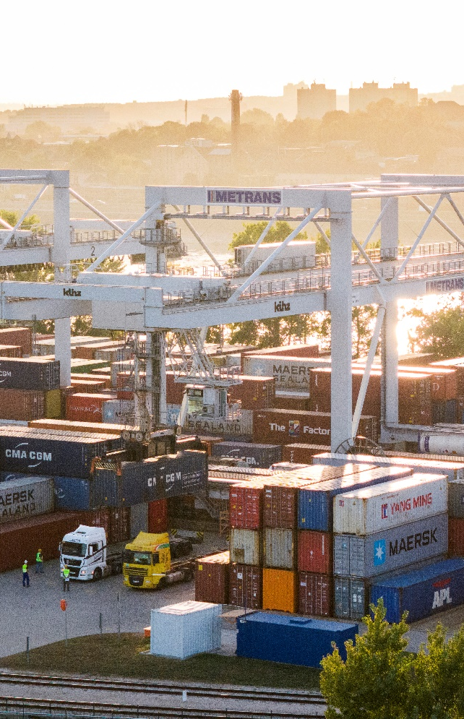
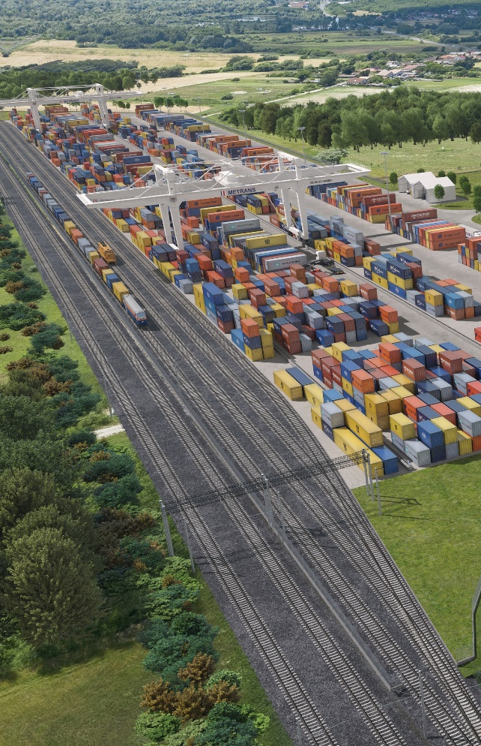
2025
Ceska Trebova (since 2013)
Malaszewicze (since 2022)
Operated by CL Europort
Terminal area: 138,000 m²
Storage capacity: 4,500 TEU full and 4,200 TEU empty
Trucking fleet: 157 trucks
Sidings – 6x740 m
4 Rail Mounted Gantry Cranes,
3 reachstackers
6 trains can be handled at the same time
Repair facility for containers
On-site customs office
Operates 24/7/365
Terminal area: 190,000 m²
Storage capacity: 6,000 TEU
Trucking fleet: 5 trucks
Sidings – 6x3,000 m, 9x6,000m
1 Rail Mounted Gantry Crane,
5 reachstackers
Reefer plugs
Depot for empty containers
Operates 24/7/365
Budapest (since 2017)
Zalaegerszeg (...2025/2026)
Terminal area: 163,500 m²
Storage capacity: 8,500 TEU
Trucking fleet: 137 trucks
Sidings – 6x650 m, 2x500 m
4 Rail Mounted Gantry Cranes,
14 reachstackers, 3 forklifts
7 trains can be handled at the same time
Repair facility for containers
On-site customs office
Operates 24/7/365
New hub terminal in Hungary under construction.
Terminal area: 150,000 m²
Intermodal hub terminal & logistics center in western Hungary for the Adriatic Corridor (Koper, Trieste, Rijeka)
Daily connection to Hamburg, Bremerhaven and the whole METRANS network
Operation start 2025/2026
Hub terminals

Slide 14
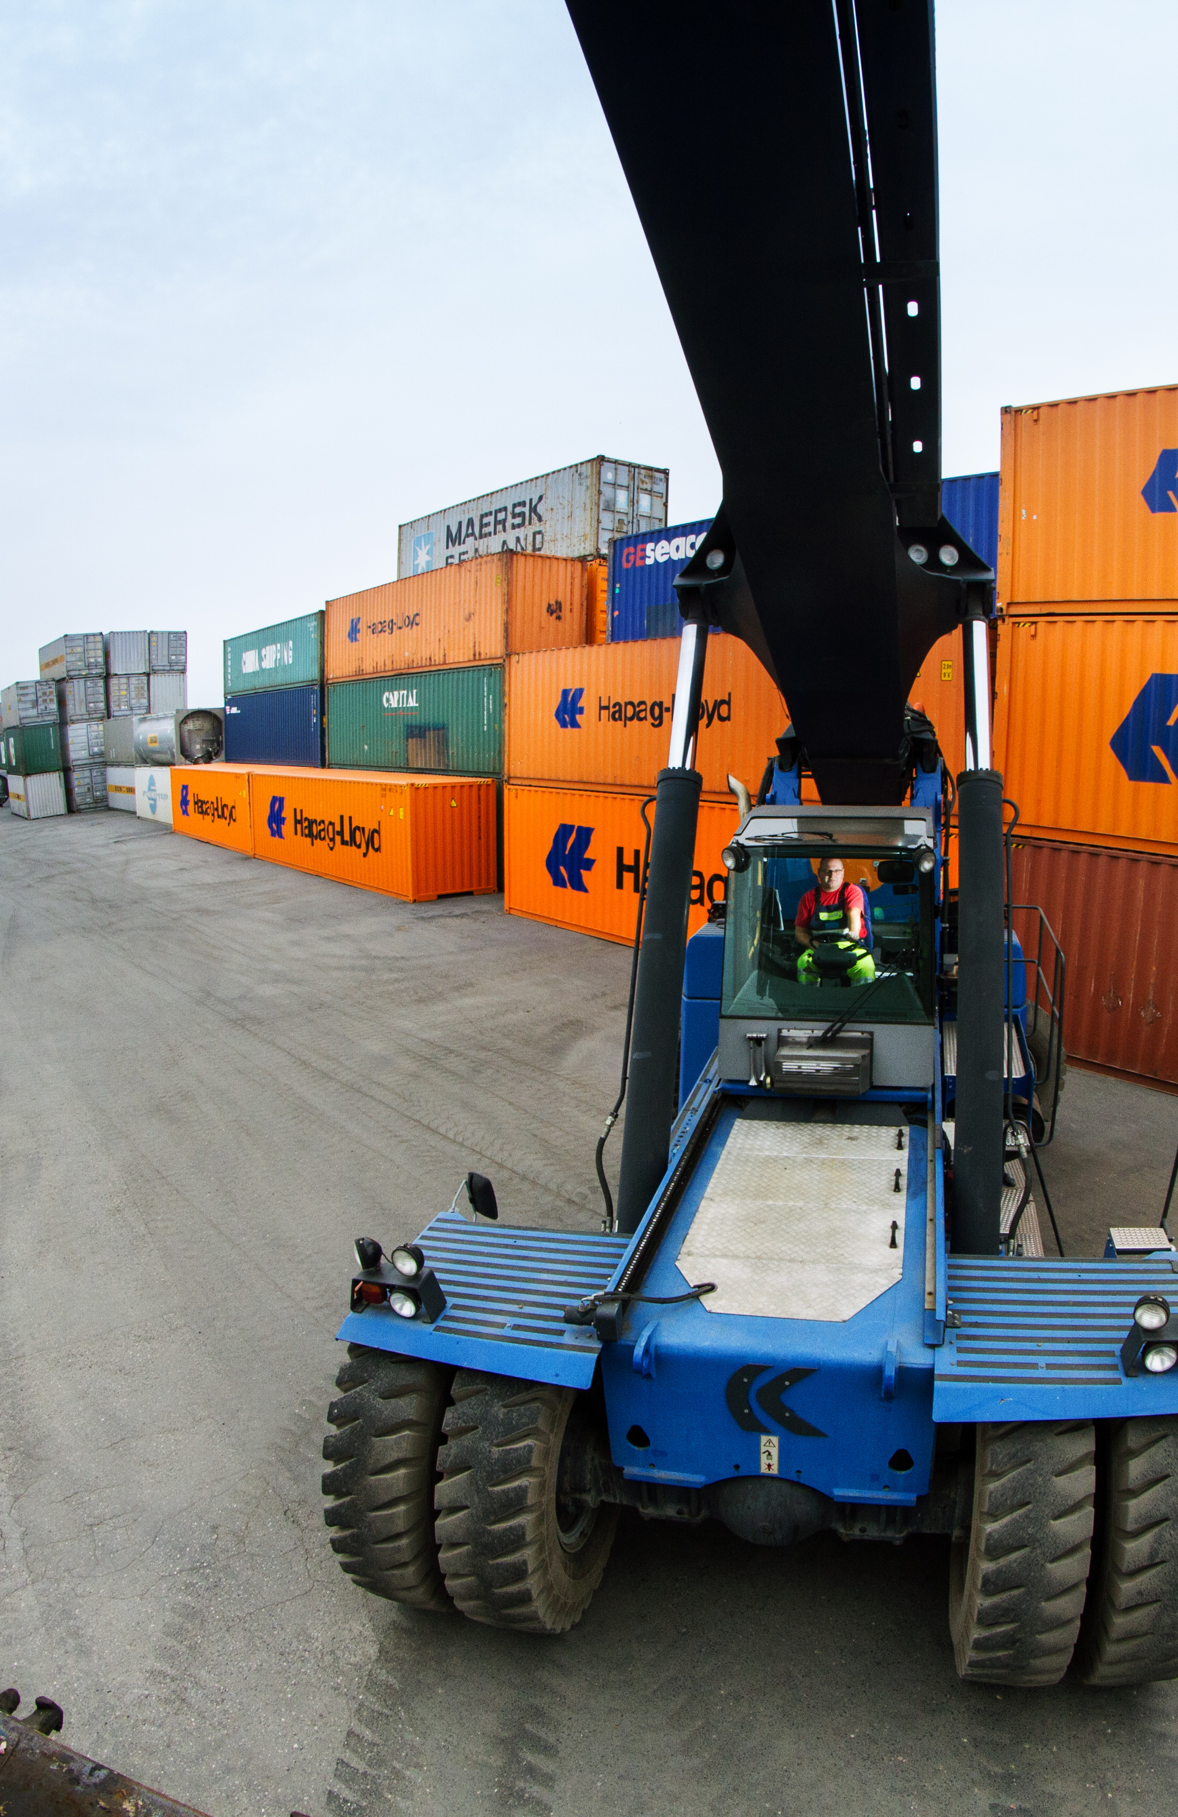
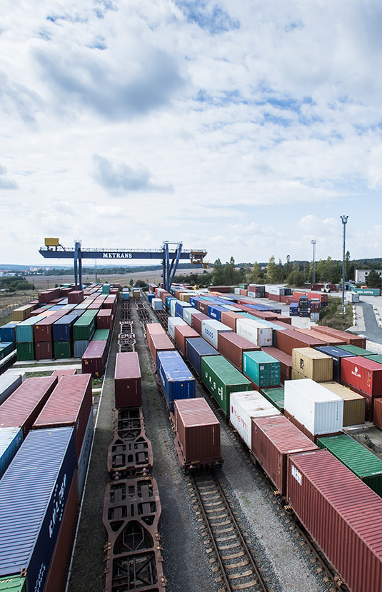
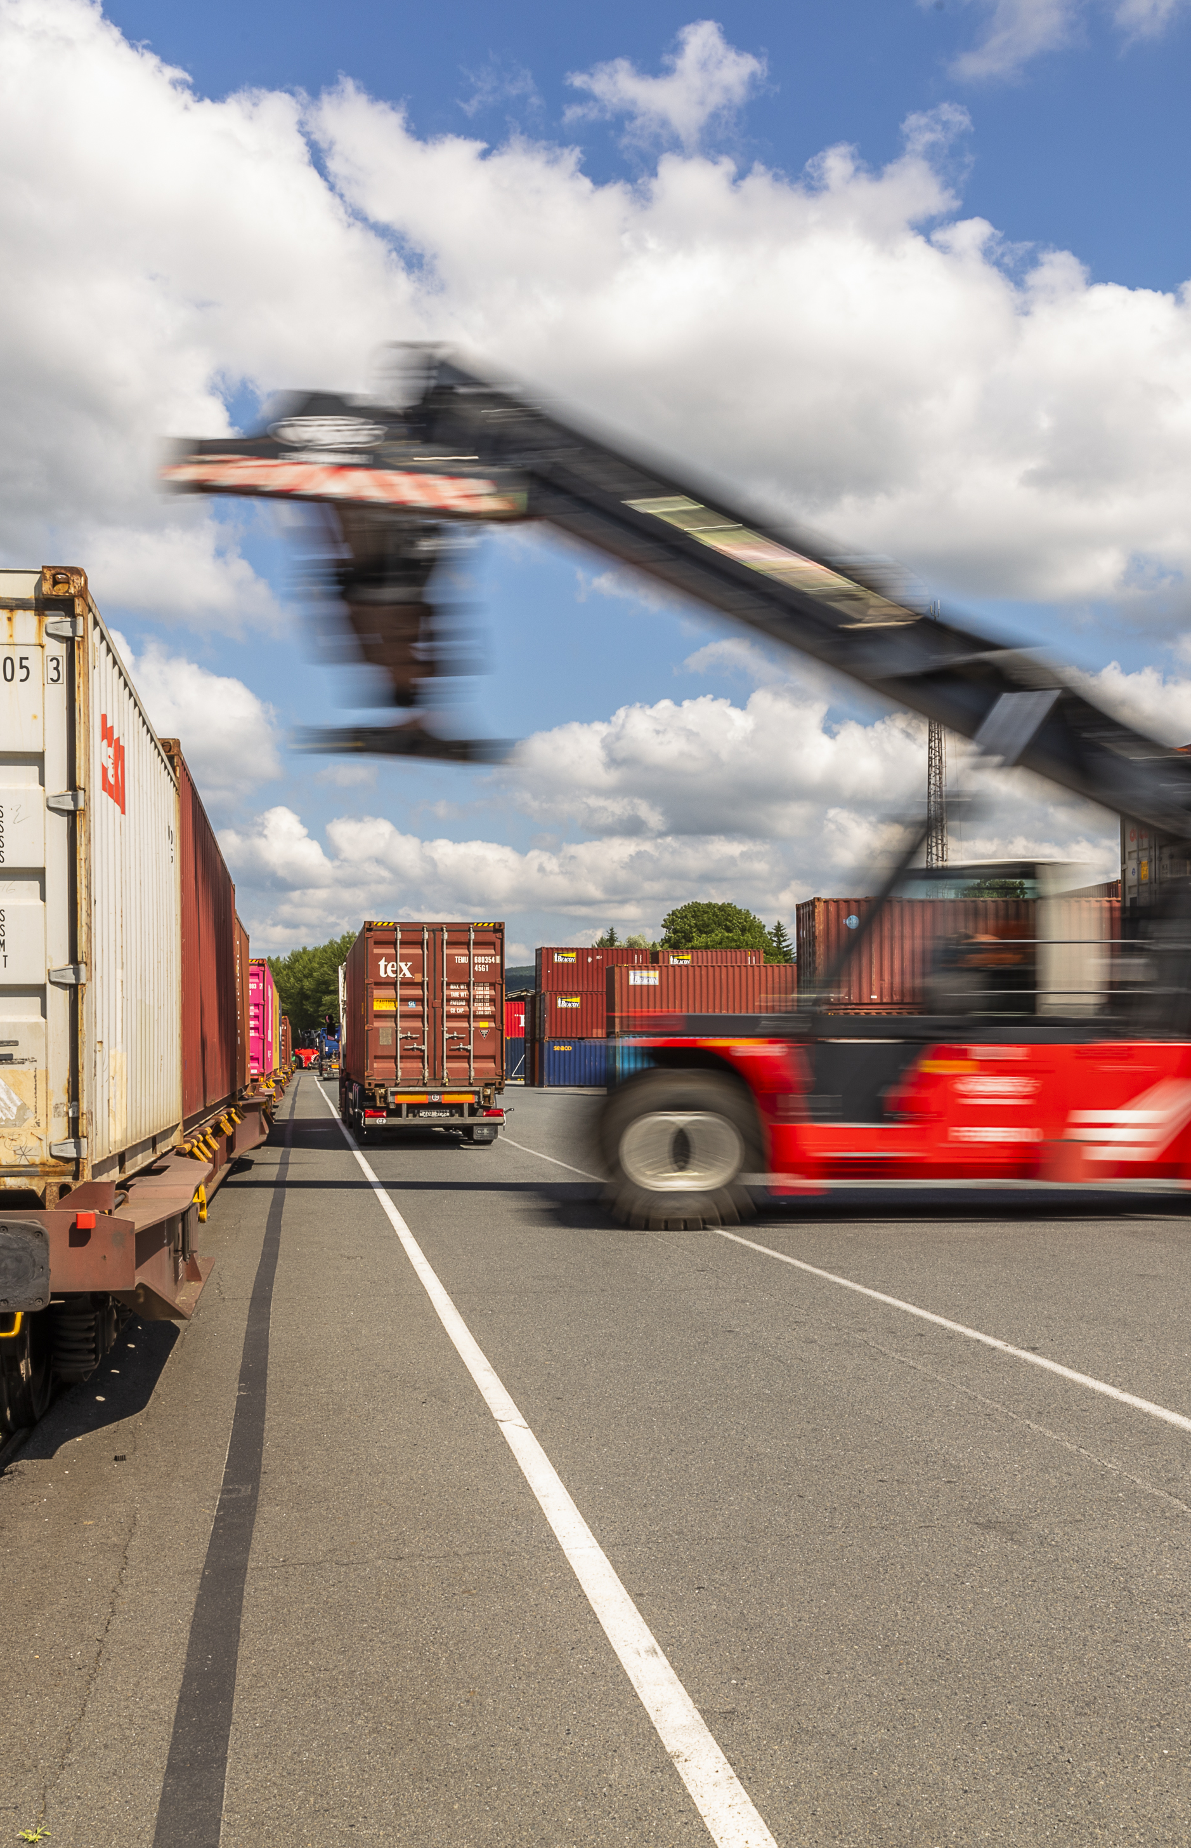
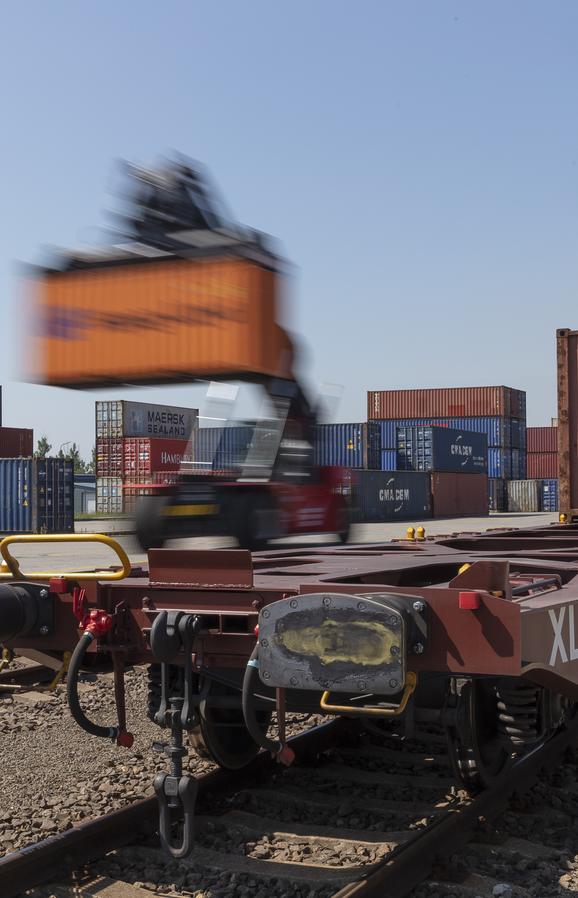
2025
Warszawa – Pruszkow
(since 1993)
Plzen (since 2007)
Terminal area: 50,000 m²
Storage capacity: 1,700 TEU empty
Trucking fleet: 31 trucks
Sidings – 3x400 m
1 Rail Mounted Gantry Crane with multimodal spreader for handling trailers and swap bodies and Remote Operation Station control system, 2 reachstackers
Repair facility for containers
Operates 24/7/365
Terminal area: 57,000 m²
Trucking fleet: 39 trucks
Sidings – 2x600 m, 1x350 m
7 reachstackers
Handling of swap bodies and semi-trailers
On-site customs office
Zlin (since 1994)
Kosice (since 2008)
Terminal area: 68,600 m²
Storage capacity: 1,300 TEU full and 1,200 TEU empty
Trucking fleet: 100 trucks
Sidings: 3x550 m, 1x400 m, 2x350 m, 2x300 m
8 reachstackers
Repair facility for containers
On-site customs office
Operates 24/7/365
Terminal area: 46,500 m²
Storage capacity: 3,000 TEU full and 2,000 TEU empty
Trucking fleet: 53 trucks
Sidings – 2x550 m
6 reachstackers, 2 forklifts
Repair facility for containers
On-site customs office
Operates 24/7/365
End terminals

Slide 15
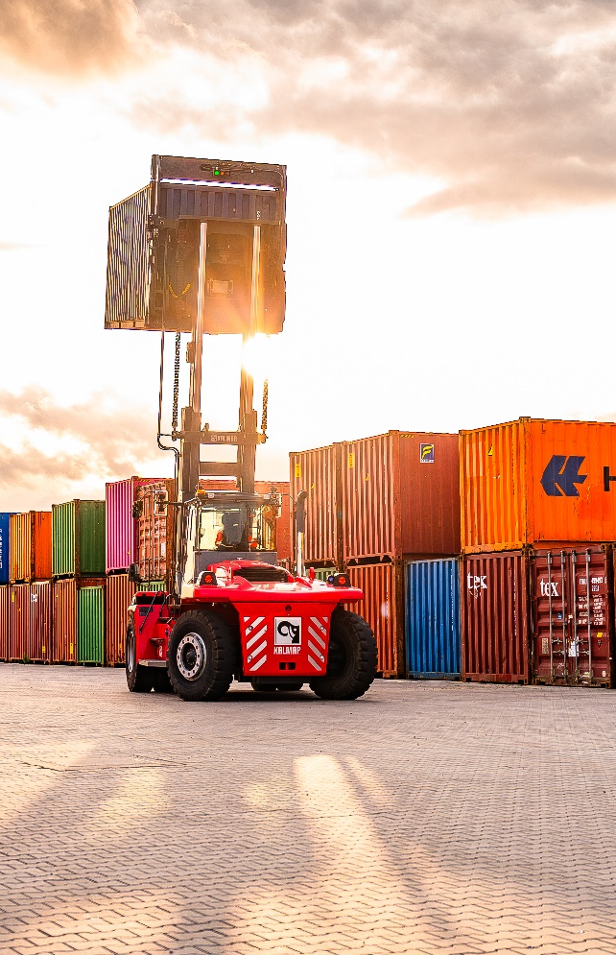
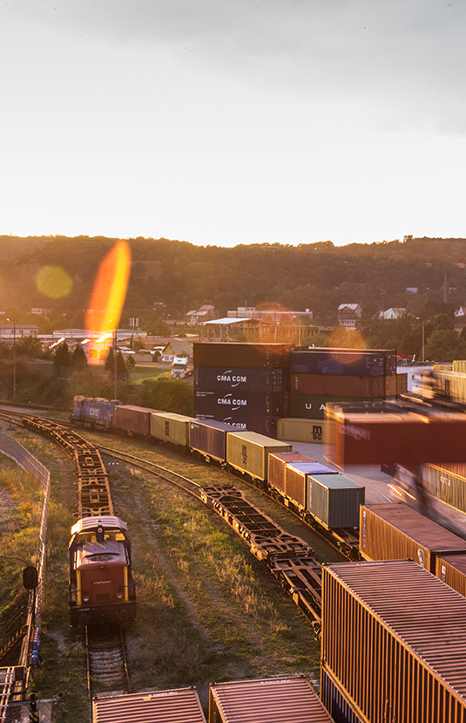
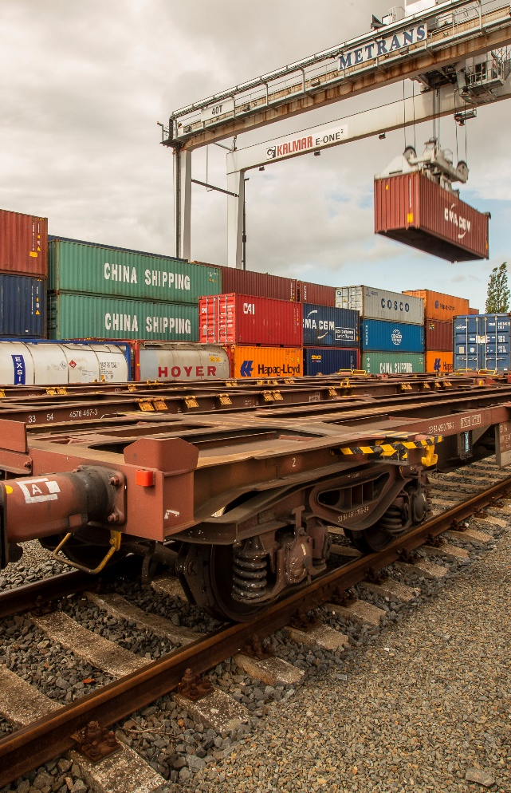
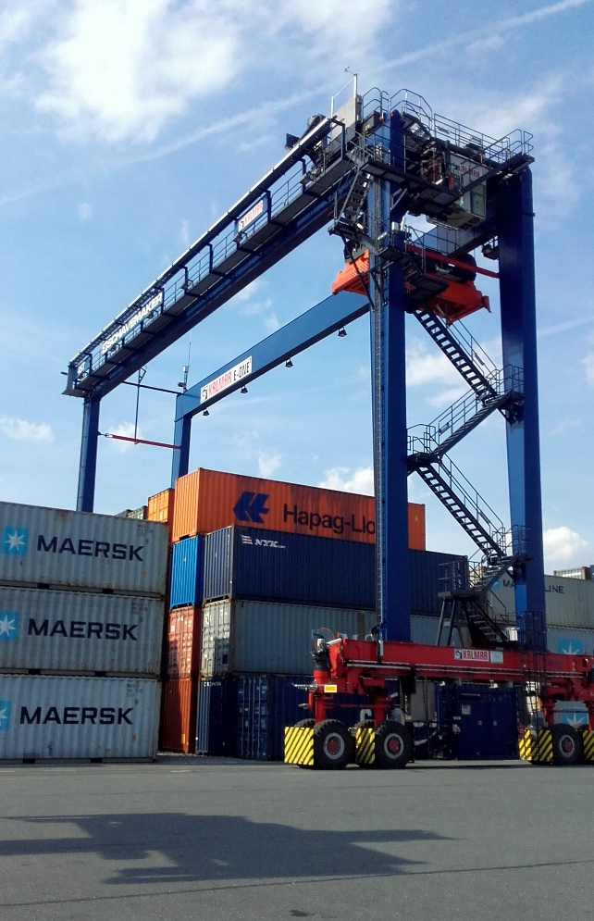
2025
Dabrowa Gornicza
(since 2010)
Usti nad Labem (since 2015)
Terminal area: 25,500 m²
Storage capacity: 1,500 TEU full and 2,000 TEU empty
Trucking fleet: 69 trucks
Sidings – 1x185 m, 2x160 m
1 Rail Mounted Gantry Crane,
5 reachstackers
Repair facility for containers
On-site customs office
Operates 24/7/365
Terminal area: 170,000 m²
Trucking fleet: 26 trucks
Sidings – 2x625 m, 1x600 m, 1x500 m
4 reachstackers
Reefer plugs – PTI incl. small repairs
Handling of swap bodies
On-site customs office
Ostrava (since 2011)
Wroclaw – Katy Wroclawskie (since 2015)
Terminal area: 100,000 m²
Storage capacity: 1,200 TEU full and 5,000 TEU empty
Trucking fleet: 80 trucks
Sidings – 2x250 m
1 Rubber Tyred Gantry Crane,
6 reachstackers
Repair facility for containers
On-site customs office
Operates 24/7/365
Terminal area: 65,000 m²
Storage capacity: 1.500 TEU empty
Trucking fleet: 15 trucks
Sidings – 2x600 m
1 gantry crane, 5 reachstackers
Reefer plugs – PTI incl. small repairs
Handling of swap bodies and semi-trailers
On-site customs office
End terminals

Slide 16
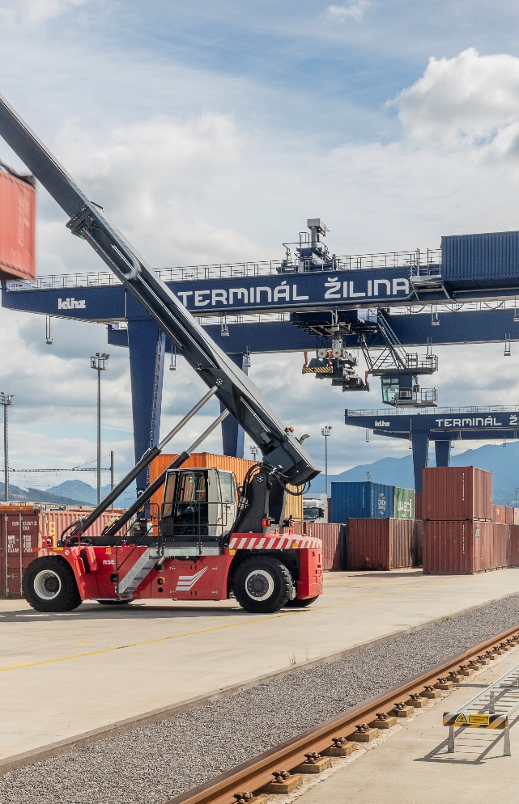
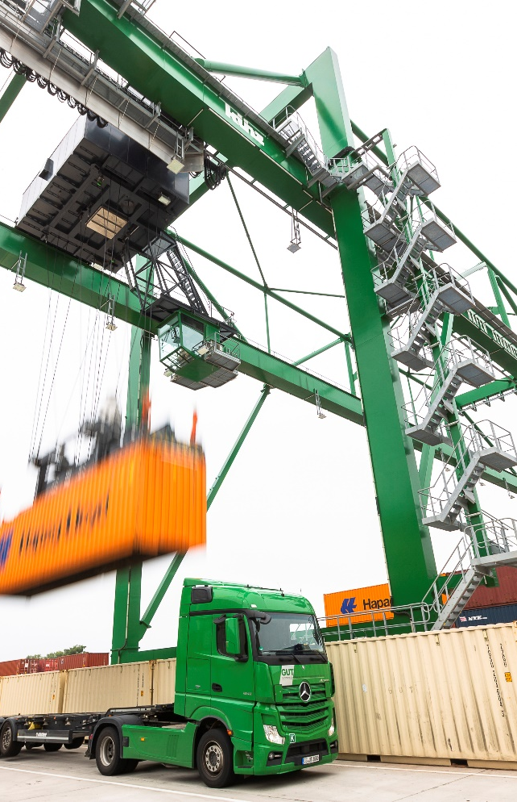
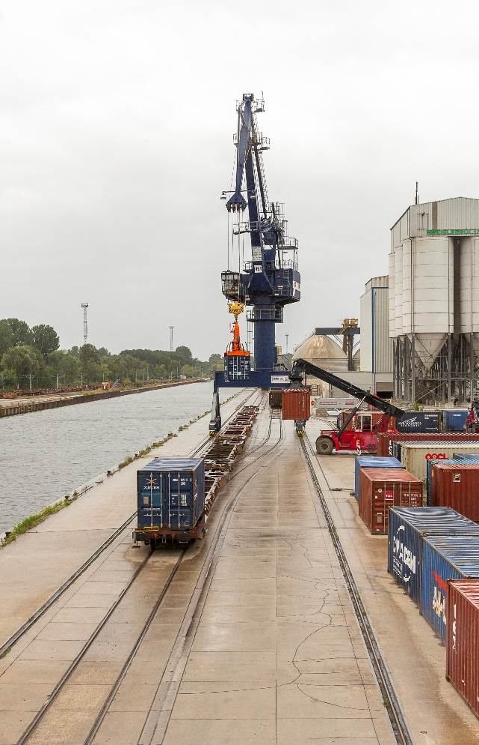
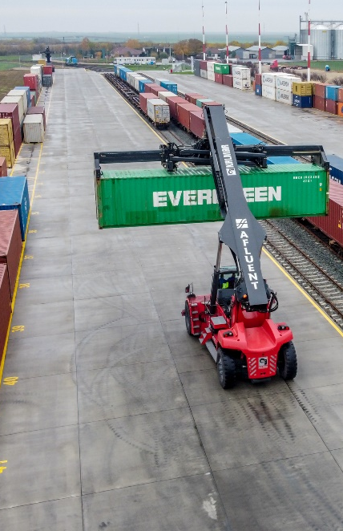
2025
Zilina (since 2019)
Operated by TIP Zilina
Gernsheim GUT (since 2020)
Terminal area: 54,000 m²
Trucking fleet: 30 trucks
Sidings – 2x340 m
1 Rail Mounted Gantry Crane,
1 slewing jib crane, 2 reachstackers
Stuffing/stripping dangerous goods storage
Reefer plugs, maintenance and repair, reefer service
Terminal area: 150,000 m²
Trucking fleet: 37 trucks
Sidings – 2x750 m
2 Rail Mounted Gantry Crane,
2 reachstackers
Repair facility for containers
Handling of swap bodies and semi-trailers
Berlin Kowu (since 2019)
Arad
(since 2021)
Terminal area: 20,000 m²
Storage capacity: 2,000 TEU empty
Trucking fleet: 15 trucks
Sidings – 1x800 m, 3x500 m
1 Rail Mounted Gantry Crane,
3 reachstackers
Reefer plugs – PTI incl. small repairs
On-site customs office
Terminal area: 75,000 m²
Storage capacity: 750 TEU
Sidings – 4x350 m
2 reachstackers
A1 highway – 3 km from the terminal
Parking capacity for 200 trucks, with in-house locomotive
Power outlets/sockets for reefer containers
Truck capacity: 30 chassis
(20’, 30’, 40’, 45’)
End terminals

Slide 17

2025
Belgrade – Indjija
(since 2023)
Terminal area: 47,450 m²
Trucking fleet: 25 trucks
Sidings – 2x250 m
4 reachstackers, 2 forklifts
Regular connections to/from port of Rijeka and METRANS terminal Budapest as gateway solution to reach northern and Adriatic ports
Container repairs, reefer plugs, heating of TK containers, PTI test
On-site customs office
Operates 24/6
End terminals

Slide 18
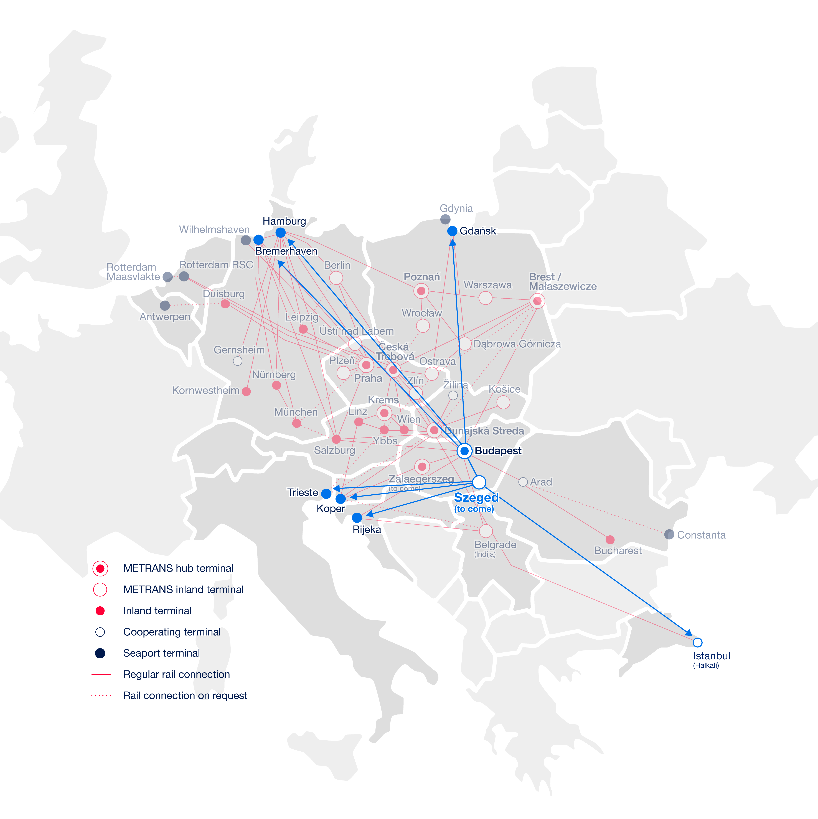
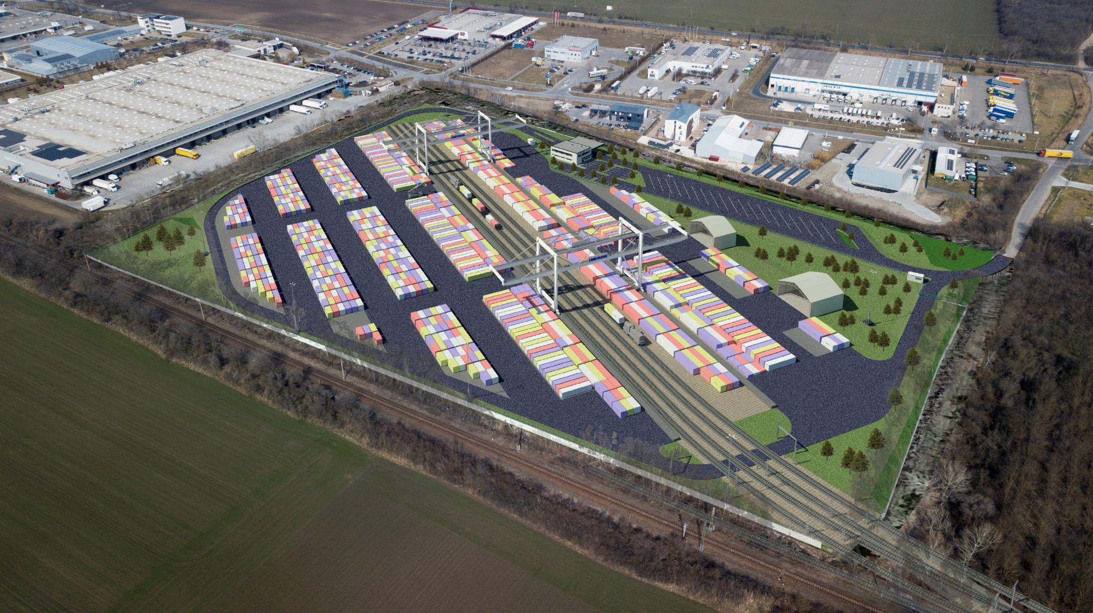
New terminal in Szeged, Hungary
Coming in 2027
2025
Terminal area: 100,000 m²
Annual capacity: ~ 300.000 TEU
Sidings: 4
Gantry cranes: 2
METRANS intermodal terminal in southern Hungary
Beginning of the construction works in 2025, completion in 2027
Connection to the highway to HU, RS, RO
Connection to the main railway track to the south via the Roszke crossing

Slide 19
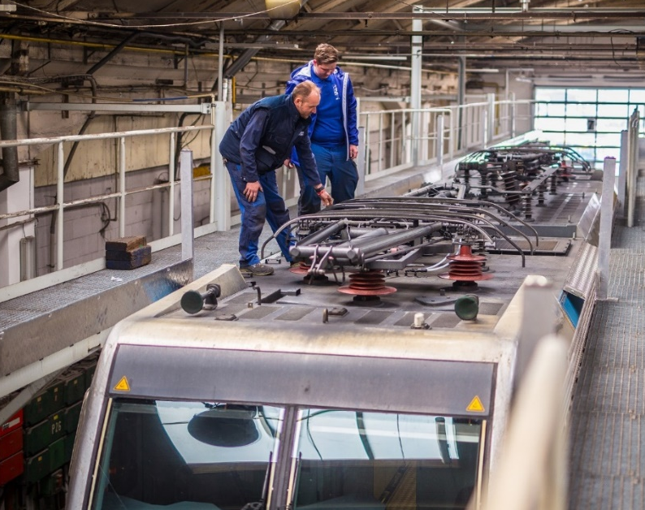
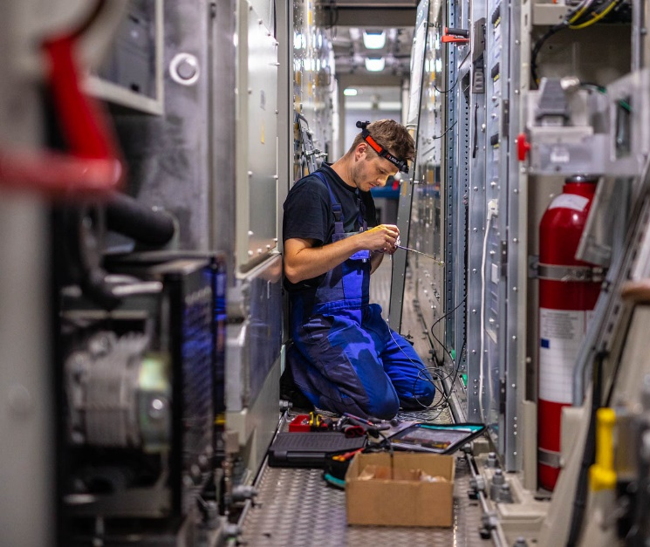
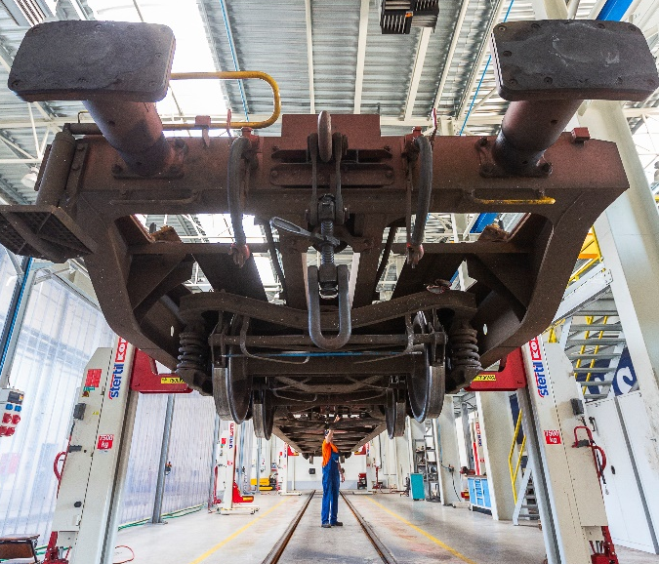
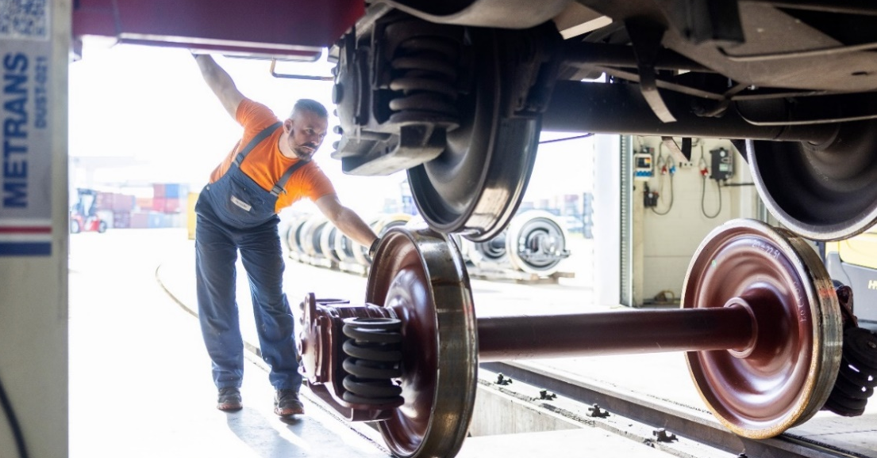
METRANS rail repair shops
2025
DYKO Rail Repair Shop
Kolin, Czech Republic
Established in 1940
Aquired by METRANS in 2007
Licensed to repair Siemens and Alstom (Bombardier) locomotives
Repairs: container wagons, running gear for passenger carriages, locomotives and wheelsets
Repairs within free capacities available also for external clients
Rail & Reachstacker Repair Shop
Dunajska Streda, Slovakia
Established in 2019
Repairs:
container wagons
locomotives
reachstackers

Slide 20
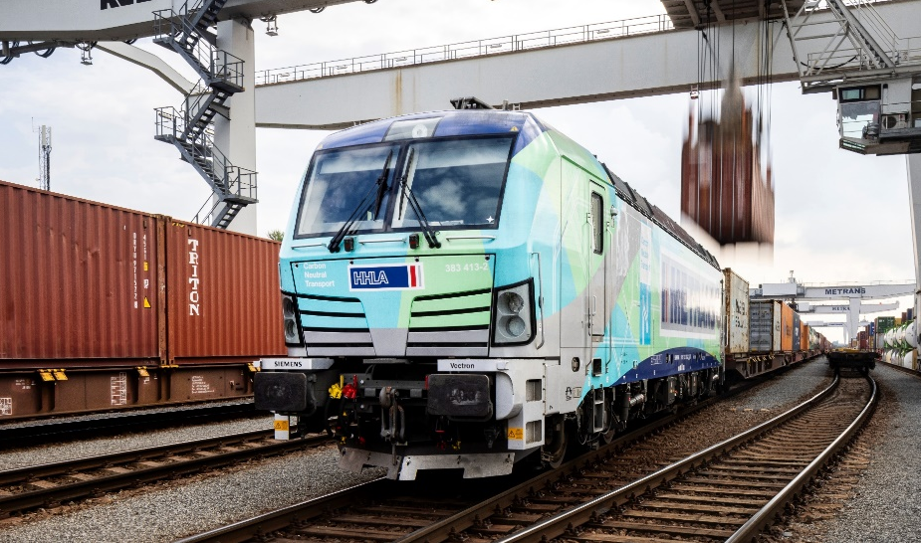
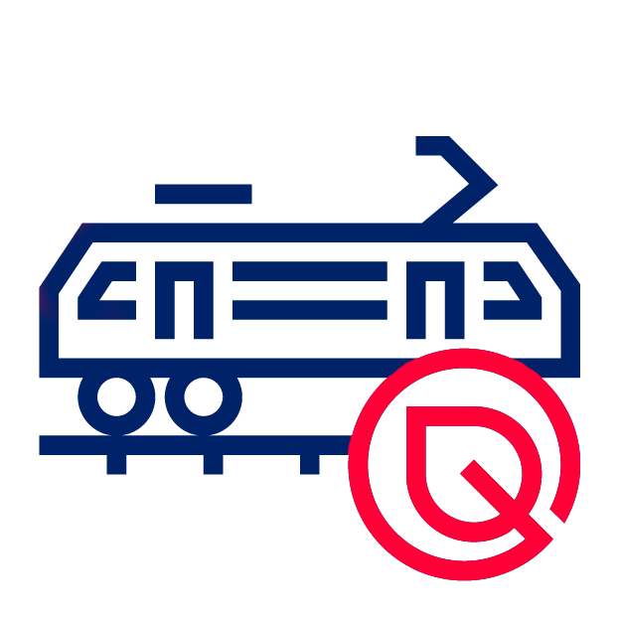
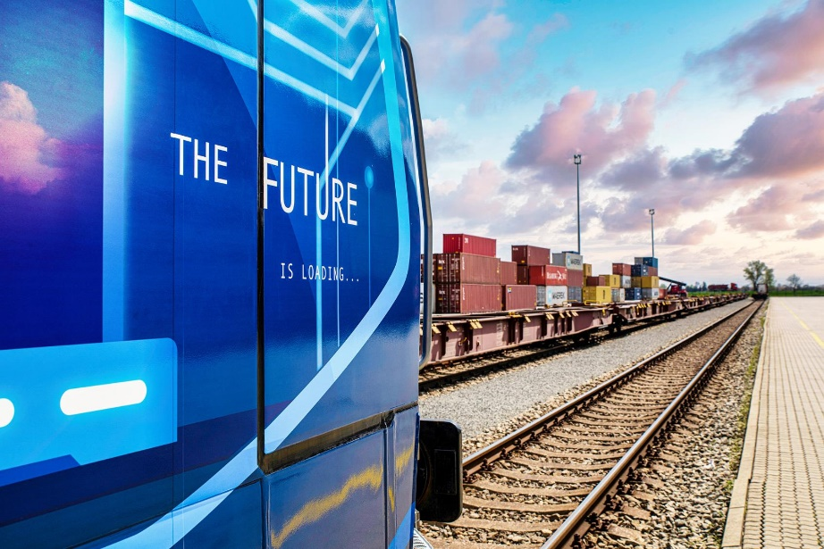
HHLA Pure
Verified CO₂ footprint and financial climate contribution
2025
With HHLA Pure we ensure handling and transport with a reduced CO₂ footprint, which has a real impact on climate protection.
Our approach
Modern hybrid & electric locomotives
Electrified port terminals with storage cranes & electric vehicles
Even for long distances, compensation matters. Since CO₂ emissions affect the entire planet, we offset any unavoidable emissions through certified environmental projects.
Till now we have already offset over
230.000
tonnes of CO₂

Slide 21
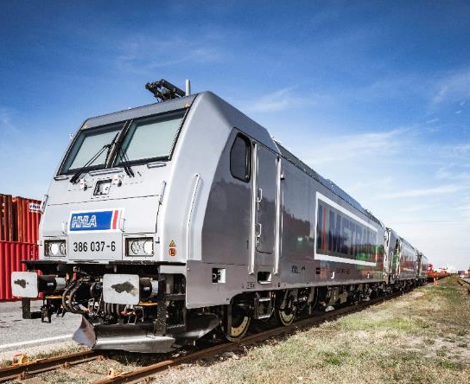
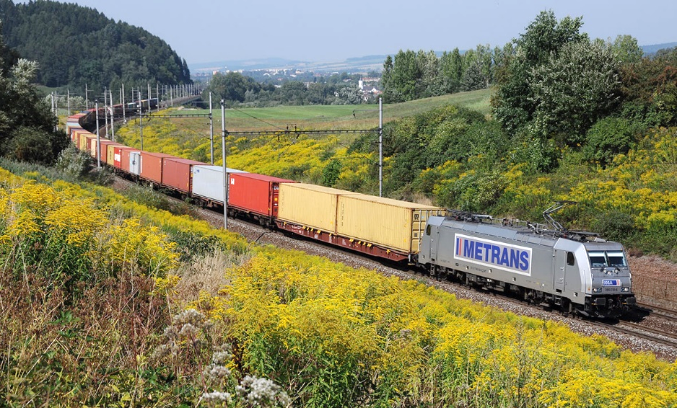
HHLA Pure
Verified CO₂ footprint and financial climate contribution
2025
Designed to reduce the transport-related CO₂ footprint from port operations into the European hinterland.
Our product
Low-impact cargo handling and transport
Electrified operations across HHLA terminals
CO₂-efficient METRANS locomotives and rolling stock
Unavoidable emissions are compensated through Gold Standard-certified projects
Customers receive confirmation of carbon-balanced transport
In Austria and Germany, METRANS electric trains run on renewable power
Process
Certification of HHLA Pure TÜV Nord
Receiving customer-specific transport (volume/route)
Offsetting and monitoring by TÜV Nord

Slide 22
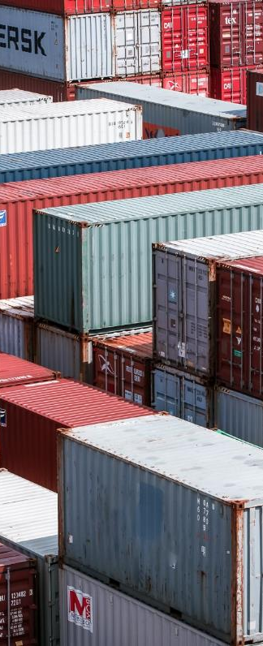




Pillars of our success
2025
One of the leaders of intermodal transport
Own network of 20 terminals
We are the largest Central European operator of intermodal transport with more than 30 years of container shipping tradition.
We operate 20 intermodal terminals in Czech Republic, Slovakia, Poland, Hungary, Austria, Germany, Serbia, Romania and we have further under construction.
Stable employer
Climate protection
We have a highly qualified team of employees with many years of experience.
Own hardware and software
Using modern hybrid and electric locomotives and with our HHLA Pure service we offer handling and transport with reduced CO₂ footprint.

Slide 23
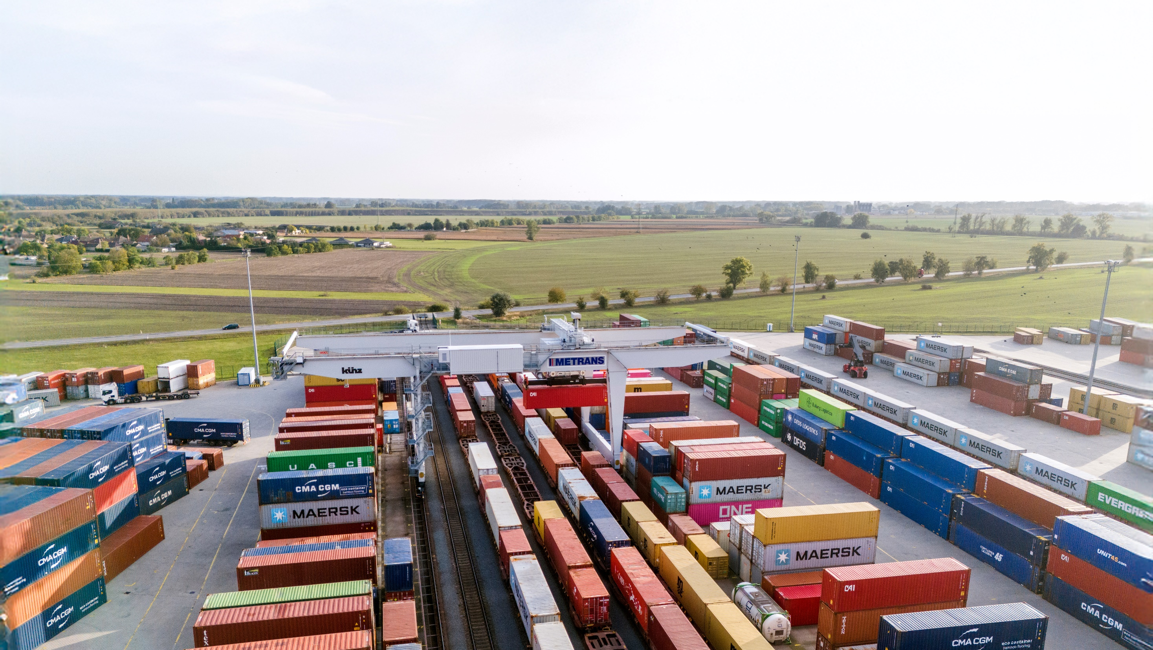


Thank you.
www.metrans.eu

