Slide 1


China-Europe Railway Express Services
METRANS Company Presentation

Slide 2











METRANS
Facts and key figures (2025)
2026
2 new terminals in plan for Hungary
Development of the present network
20+
190+
Founded 1991
100% HHLA
rail terminals in the hinterland
electric and hybrid locomotives
700+ million
1.6+ million
1.2+ million
EUR annual revenue
TEU intermodal
TEU depots
4000+
3000+
650+
company-owned wagons
employees in 10 countries
train connections per week

Slide 3
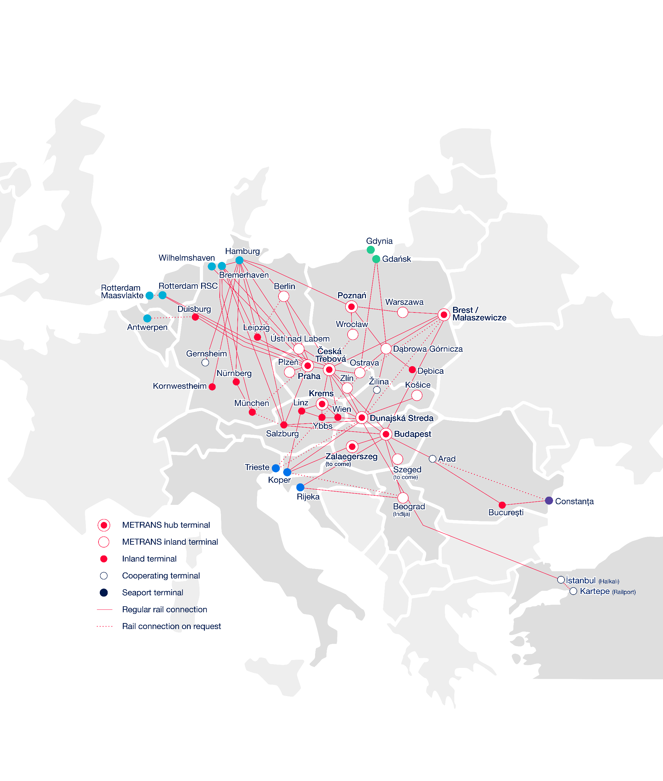
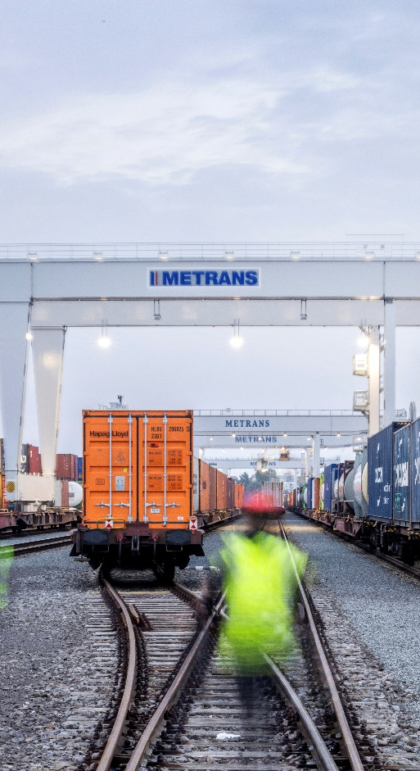
METRANS
The European intermodal rail bridge
2026
7 hub terminals
Praha & Česká Třebová (CZ), Krems (AT), Dunajská Streda (SK), Poznań & Małaszewicze (PL), Budapest & Zalaegerszeg to come (HU)
13 end terminals
in Czech Republic, Germany, Poland, Romania, Serbia, Slovakia
Seaports
North Sea
Hamburg, Bremerhaven, Wilhelmshaven
Rotterdam
Antwerpen
Adriatic Sea
Baltic Sea
Black Sea
Rijeka
Koper
Trieste
Gdańsk, Gdynia
Constanța

Slide 4
METRANS /Danubia/, a.s., SK
METRANS Danubia Kft., HU
METRANS Rail Slovakia, s.r.o., SK
METRANS Konténer Kft., HU
2026
METRANS /Danubia/ Krems GmbH, AT
METRANS d.o.o., HR
METRANS Group
Company structure
METRANS Railprofi Austria GmbH, AT
METRANS ADRIA d.o.o., SI
METRANS DYKO Rail Repair Shop, s.r.o., CZ
METRANS Rail, s.r.o., CZ
UniverTrans Kft., HU
METRANS Rail /Deutschland/ GmbH, DE
TIP Žilina, s.r.o., SK
METRANS Deutschland GmbH, DE
METRANS /Polonia/ Sp. z o.o., PL
METRANS Rail Sp. z o.o., PL
CL EUROPORT Sp. z o.o., PL
EUROTRANS Sp. z o.o., PL
METRANS Zalaegerszeg Kft., HU
METRANS Szeged Kft., HU
METRANS, a.s.
Prague, Czech Republic
METRANS Istanbul STI, TR
METRANS Adria d.o.o. Rijeka, HR
METRANS Panonija d.o.o., RS
METRANS Adria Rail d.o.o., HR
METRANS Rail Netherlands B.V., NL
METRANS Rail Belgium B.V., BE
Umschlagsgesellschaft Königs Wusterhausen GmbH (50%), DE
TIP Košice, s.r.o. (50%), SK
EMA RAIL S.R.L. (33,3%), RO
M-RAIL doo za železnički prevoz robe Krnješevci (33,3%), RS

Slide 5
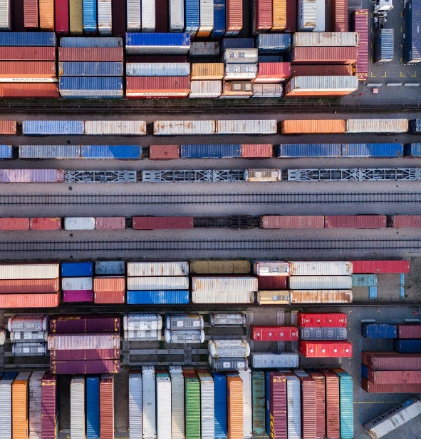
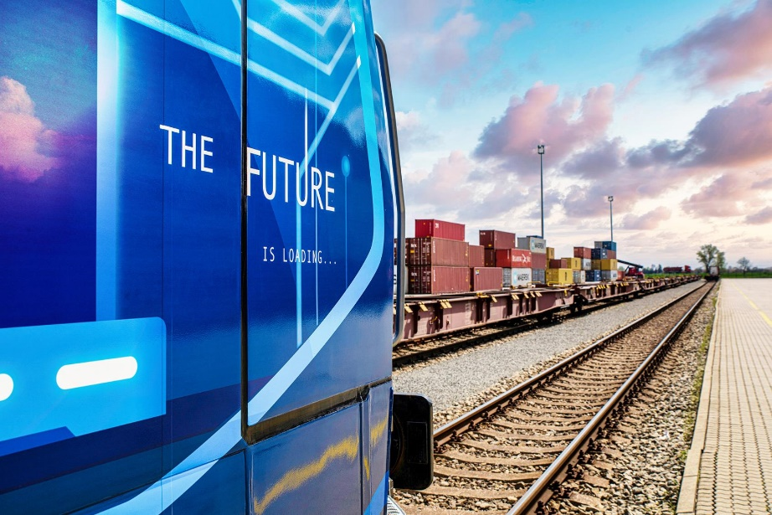
2026
The Largest European Network
We provide all-inclusive just-in-time intermodal rail-road transportation service.
METRANS operates own shuttle trains with cargo in maritime deep sea and short sea and for long haul trains.
Transport of standard equipment, reefers, tank and special containers to/from:
  Czech Republic
  Slovakia
  Hungary
  Germany
  Austria
  The Netherlands Belgium
  Slovenia
  Poland
  Italy
We connect these countries by rail with major European ports:
Hamburg, Bremerhaven, Rotterdam, Duisburg
Or southbound rail connection to:
Koper, Trieste, Rijeka

Slide 6
From ↔ to
Trains
per week
From ↔ to
Trains
per week
Gdańsk ↔ Ostrava
6
METRANS
Over 650 regular train connections per week
2026
Arad ↔ București
up to 3
Budapest ↔ Arad
up to 3
Hamburg ↔ Berlin
6
Budapest ↔ Belgrade (Inđija)
up to 3
Hamburg ↔ Česká Třebová
37
Bremerhaven ↔ Česká Třebová
13
Hamburg ↔ Dunajská Streda
11
Bremerhaven ↔ Dunajská Streda
6
Hamburg ↔ Gądki
22
Bremerhaven ↔ Gądki
up to 13
Hamburg ↔ Gernsheim
8
Bremerhaven ↔ München
6
Hamburg ↔ Kornwestheim
10
Bremerhaven ↔ Nürnberg
6
Hamburg ↔ Krems
3
Bremerhaven ↔ Praha
11
Hamburg ↔ Leipzig
13
Bremerhaven ↔ Leipzig
6
Hamburg ↔ München
20
Česká Třebová ↔ Budapest
4
Hamburg ↔ Nürnberg
10
Česká Třebová ↔ Dunajská Streda
39
Hamburg ↔ Praha
49
Česká Třebová ↔ Krems
2
Koper ↔ Budapest
28
Česká Třebová ↔ Linz
up to 2
Koper ↔ Dunajská Streda
35
Česká Třebová ↔ Małaszewicze
up to 4
Linz ↔ Krems
3
Česká Třebová ↔ Ostrava
12
Małaszewicze ↔ Budapest
up to 2
Česká Třebová ↔ Wilhelmshaven
3
Małaszewicze ↔ Hamburg
up to 2
Česká Třebová ↔ Zlín
14
Nürnberg → München
6
Dąbrowa Górnicza ↔ Dębica
6
Ostrava ↔ Dąbrowa Górnicza
6
Dąbrowa Górnicza ↔ Žilina
4
Praha ↔ Česká Třebová
28
Duisburg ↔ Praha
up to 8
Praha → Leipzig
1
Dunajská Streda ↔ Budapest
24
Praha ↔ Plzeň
12
Dunajská Streda ↔ Halkali
4
Praha ↔ Salzburg
9
Dunajská Streda ↔ Košice
12
Praha ↔ Wilhelmshaven
7
Dunajská Streda ↔ Krems
6
Rijeka ↔ Beograd (Inđija)
up to 3
Dunajská Streda ↔ Žilina
12
Rijeka ↔ Budapest
up to 3
Gądki ↔ Dąbrowa Górnicza
6
Rotterdam ↔ Česká Třebová
up to 10
Gądki ↔ Kąty Wrocławskie
6
Rotterdam ↔ Praha
up to 14
Gądki ↔ Pruszków
up to 8
Salzburg → Hamburg
3
Gdańsk ↔ Dąbrowa Górnicza
6

Slide 7
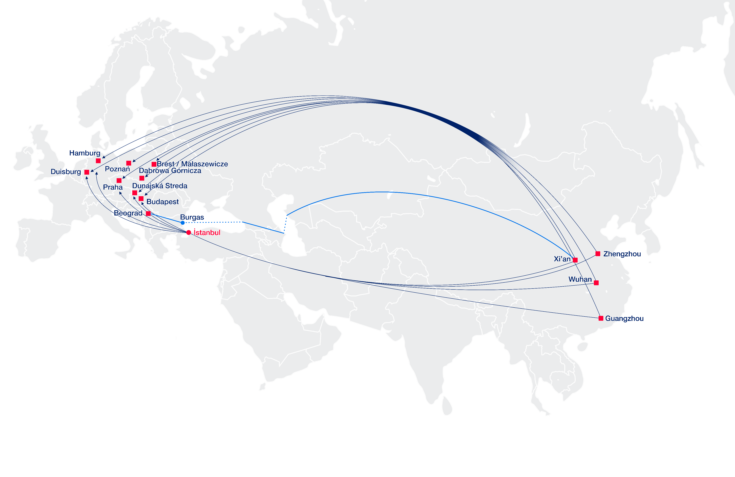
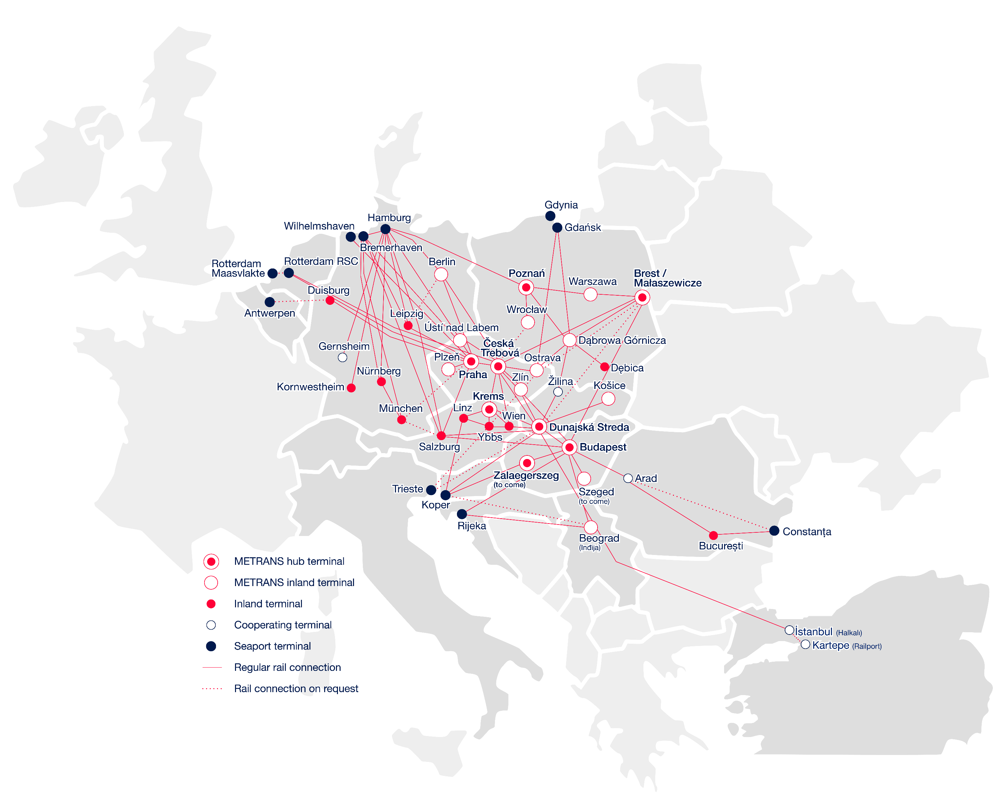
METRANS Connections
New Silk Road
2026
20 terminal & depots in AT, CZ, DE, HU, PL, RO, RS, SK
Over 2 million sqm Depot & Terminal capacities
Over 190 locomotives & 4000 wagons
2 repair shops for locomotives & wagons
Offices in the ports of Hamburg, Bremerhaven & Koper
METRANS also maintains neutrality on the Silk Road connections
Wide range of benefits to our customers:
Customs clearance directly at the terminal
Chinese speaking employee
Dedicated customer service desk for shipments
Local trucking

Slide 8
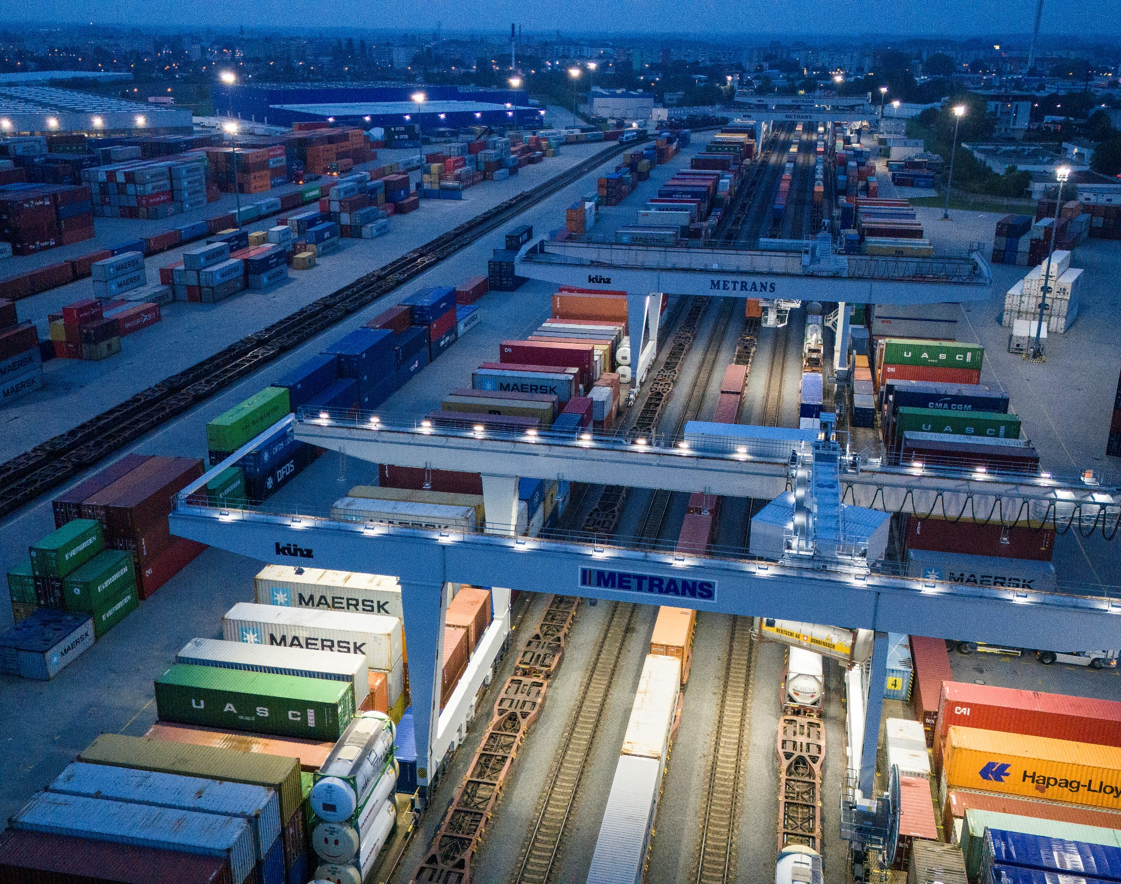
2026
Why METRANS Network & Solution?
We connect The Belt and Road initiative to the Europe via Małaszewice / Brest (PL / BY).
We are owner of the terminal in Malaszewicze (CL EUROPORT ) and Railway carrier which has 1520mm locomotives for border crossing from Brest to Mala (EUROTRANS). All your trains are therefore under our control after arrival to Brest.
With our network of own, high sophisticated container terminals & depots and modern railway hubs in Praha (CZ), Česka Třebova (CZ), Dunajská Streda (SK), Budapest (HU), Poznań (PL).

Slide 9
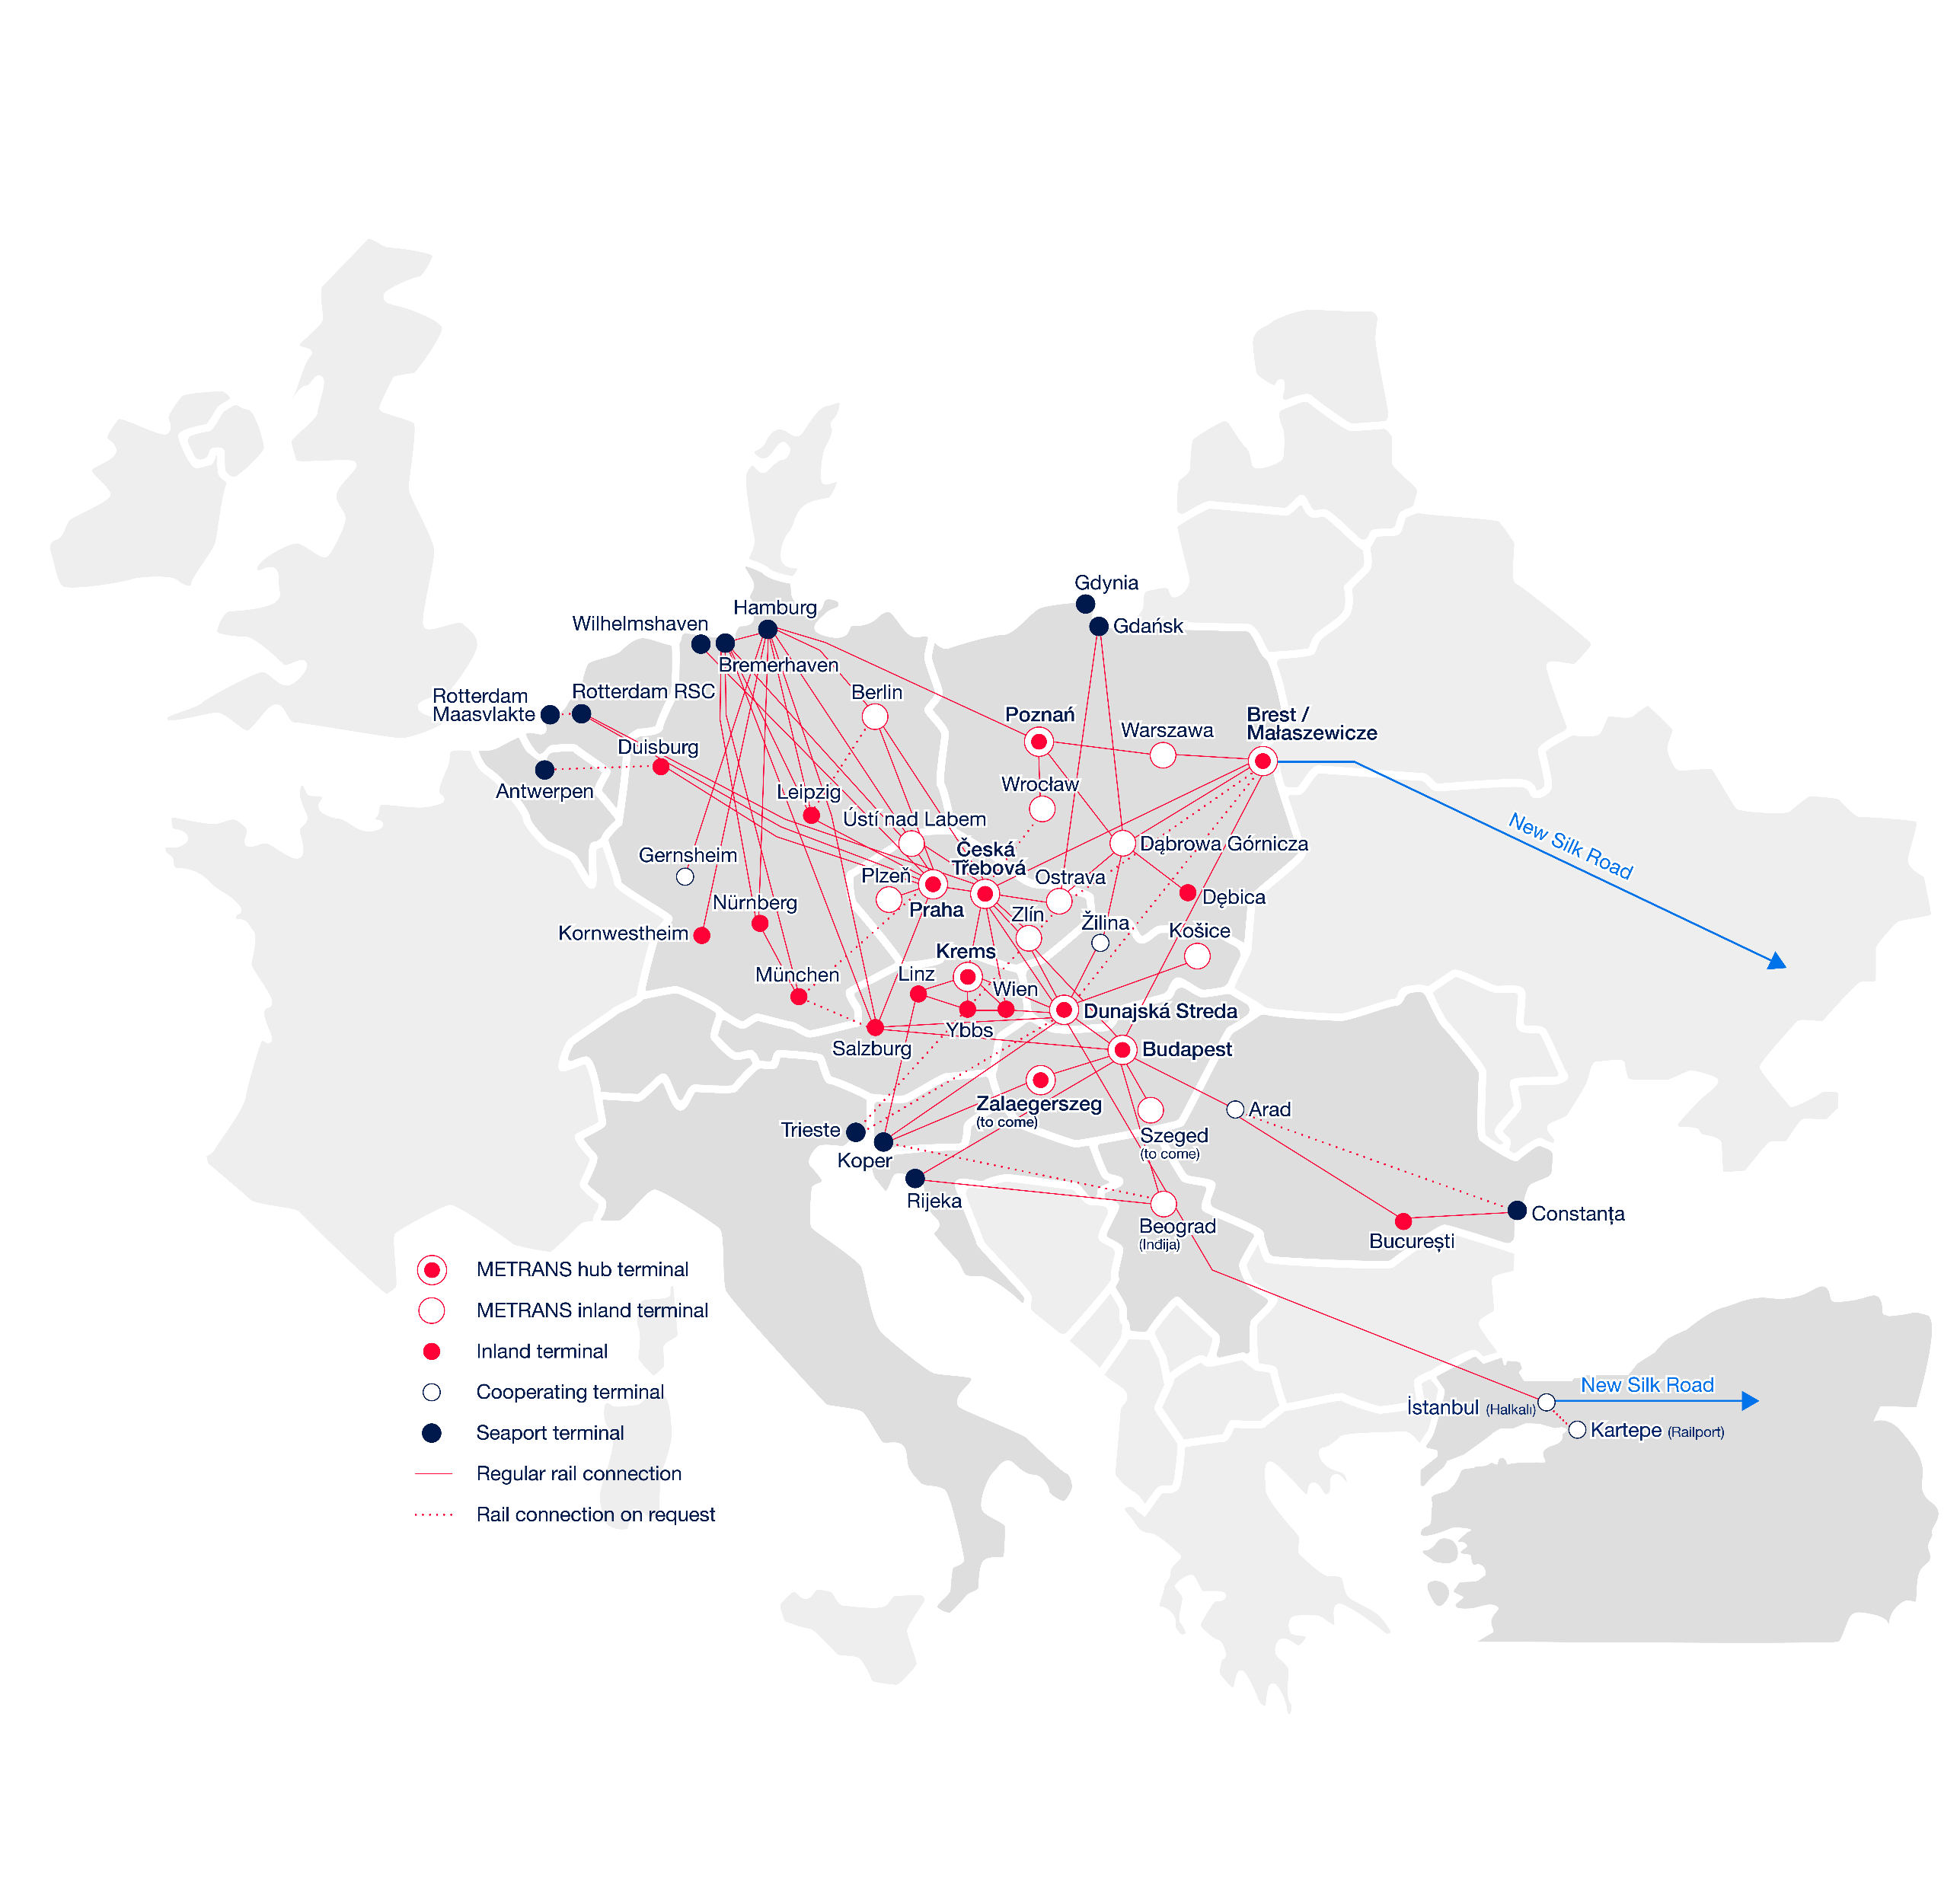
Connection to New Silk Road
2026
Xian & Wuhan – Česka Třebova(CZ)
  2 x Trains ex Xian per week incl. Full Schedule Trains (~ 12 days)
    Routing via Małaszewicze
    Hub concept to METRANS Network connection to Praha, Dunajská Streda, Krems, Salzburg, Košice, Budapest, Hamburg, Duisburg
Xian – Budapest (HU)
  3 x Train per week
  Full Schedule Trains (~13 days)
Zhengzhou – Hamburg/Duisburg (DE)
  2 x Trains per week
  - Direct connection to Hamburg/Duisburg
Zhengzhou – Beograd (RS)
Xian – Beograd (RS)
  1 x Train per week
  1 x Train per week
www.metrans.eu

Slide 10
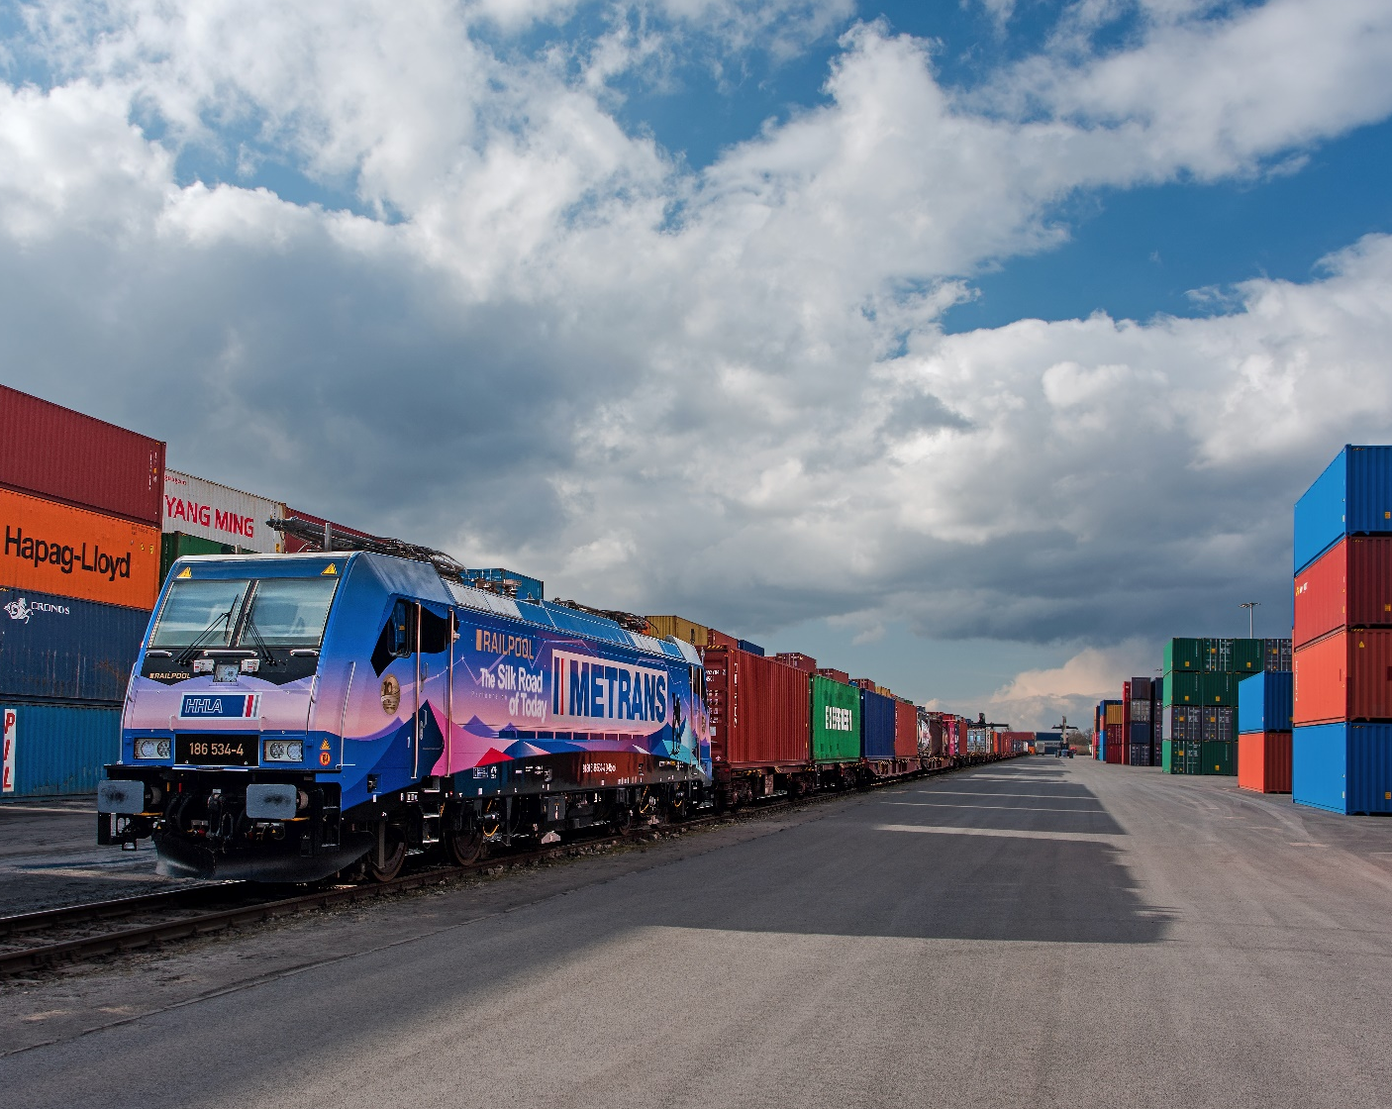
2026
Why to Choose Our Network for Cargo from/to Asia?
Connect your cargo
to METRANS Network!
METRANS operates regular weekly trains and supports partners from several Chinese origins as well as destinations and connecting them with our network
Only last / first mile from / to “HUB“ or “END“ terminal is arranged by trucks
By using of latest technologies and innovations on the field of transport and handling we are reducing CO₂ emissions as much as possible.
Possibility to connect with terminals of other operators using METRANS network within the whole Europe – neutrality guaranteed
Rail connection from/to Ukraine
Małaszewicze/Brest terminals connected

Slide 11
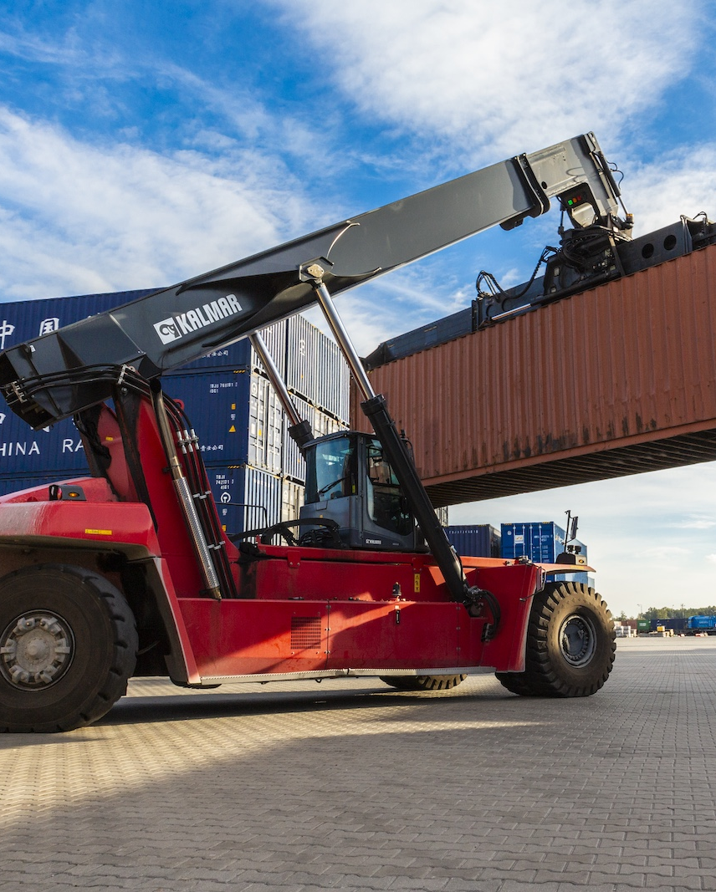
Why to choose our network for cargo
from/to Asia?
2026
Strong and fast-growing network of METRANS allows to find the most efficient way for your cargo
Ability to combine export cargo from different European countries and choose the nearest HUB terminal (Česká Třebová, Dunajská Streda or Budapest)
Alternative solutions (i.e. via Turkey / Azerbaijan / Burgas to EU)
METRANS keeps neutrality also on connections to Silk Road
High quality service – METRANS keeps on all his service's highest standards
Cargo connected to Europe largest rail & terminal network
Wide range of benefits to our customers
Customs clearance directly at the terminal
Chinese speaking employee
Dedicated customer service desk for shipments to Silk Road

Slide 12
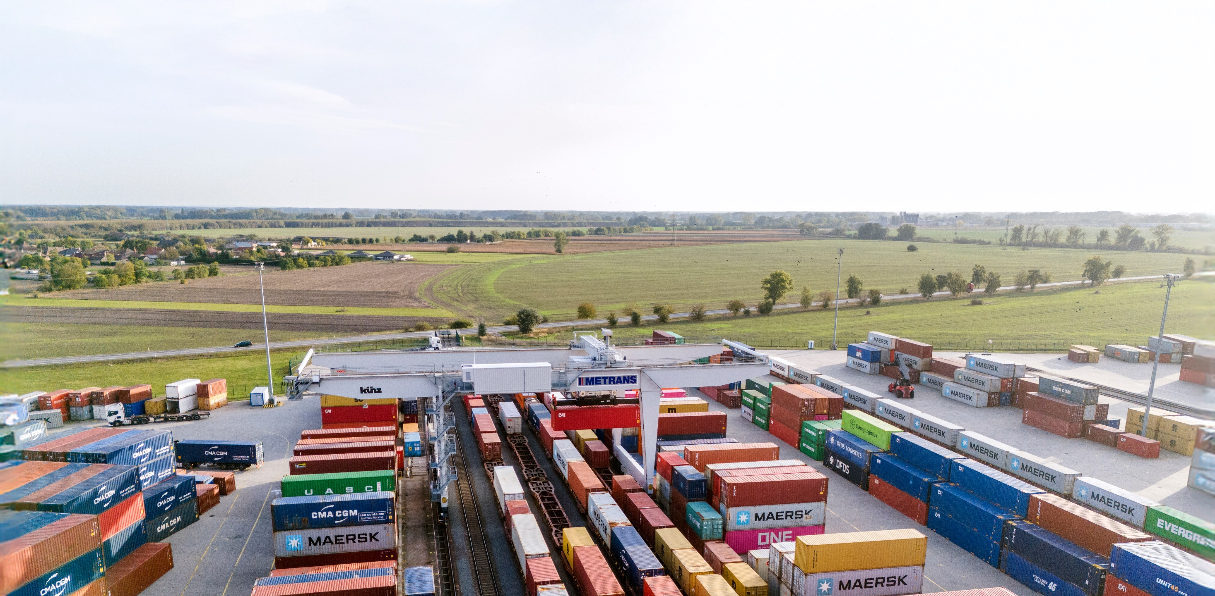

Thank you.
www.metrans.eu

