Slide 1
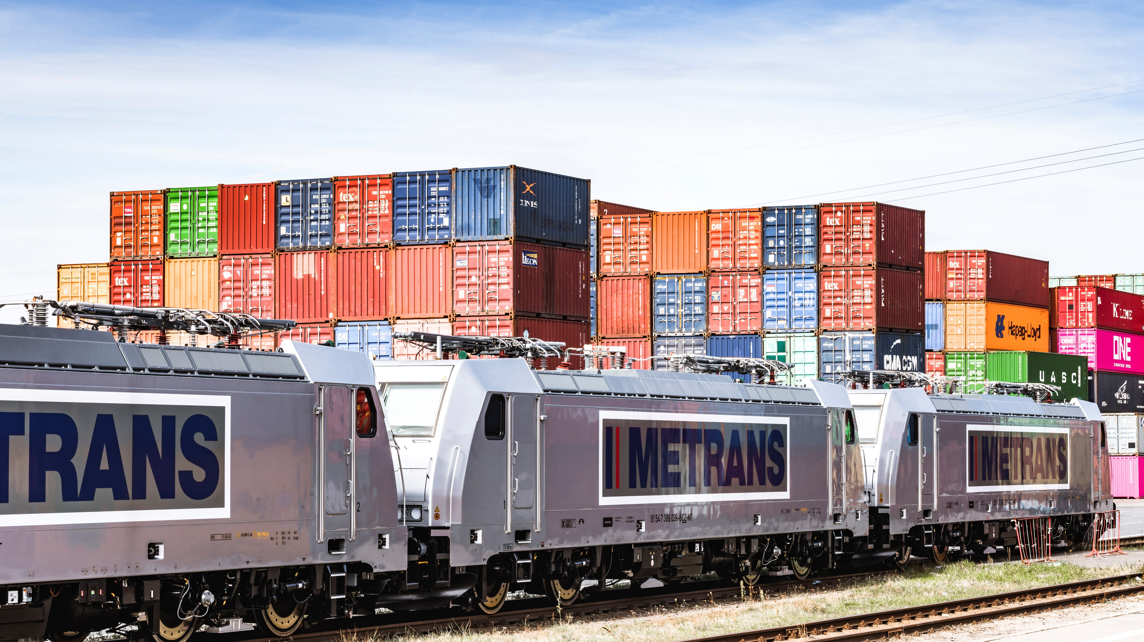


The Power of Networks
METRANS Company Presentation

Slide 2





2026
Container
Container handling
Container-related services (e.g. repair and maintenance)
HHLA
Corporate structure
Intermodal
Rail & road transport services in the ports’ hinterland
Operation of hinterland terminals
Port logistics subgroup
Logistics
Specialist handling – dry bulk, fruit, ro-ro, etc.
Consultancy
Real Estate
Speicherstadt, the historical warehouse district
Port real estate
Fischmarkt Hamburg-Altona

Slide 3








METRANS
Facts and key figures (2025)
2026
2 new terminals in plan for Hungary
Development of the present network
20+
190+
Founded 1991
100% HHLA
rail terminals in the hinterland
locomotives
700+ million
1.6+ million
1.2+ million
EUR annual revenue
TEU intermodal
TEU depots
4000+
3000+
650+
company-owned wagons
employees in 11 countries
train connections per week

Slide 4
METRANS /Danubia/, a.s., SK
METRANS Danubia Kft., HU
METRANS Rail Slovakia, s.r.o., SK
METRANS Konténer Kft., HU
2026
METRANS /Danubia/ Krems GmbH, AT
METRANS ADRIA d.o.o., SI
METRANS Group
Company structure
METRANS Railprofi Austria GmbH, AT
UniverTrans Kft., HU
METRANS DYKO Rail Repair Shop, s.r.o., CZ
METRANS Rail, s.r.o., CZ
TIP Žilina, s.r.o., SK
METRANS Rail /Deutschland/ GmbH, DE
METRANS Deutschland GmbH, DE
METRANS /Polonia/ Sp. z o.o., PL
METRANS Rail Sp. z o.o., PL
METRANS Malaszewicze Sp. z o.o., PL
EUROTRANS Sp. z o.o., PL
METRANS Zalaegerszeg Kft., HU
METRANS Szeged Kft., HU
METRANS, a.s.
Prague, Czech Republic
METRANS Istanbul STI, TR
METRANS Adria d.o.o. Rijeka, HR
METRANS Panonija d.o.o., RS
METRANS Adria Rail d.o.o., HR
METRANS Rail Netherlands B.V., NL
METRANS Rail Belgium B.V., BE
Umschlagsgesellschaft Königs Wusterhausen GmbH (50%), DE
TIP Košice, s.r.o. (50%), SK
EMA RAIL S.R.L. (33,3%), RO
M-RAIL doo za železnički prevoz robe Krnješevci (33,3%), RS

Slide 5
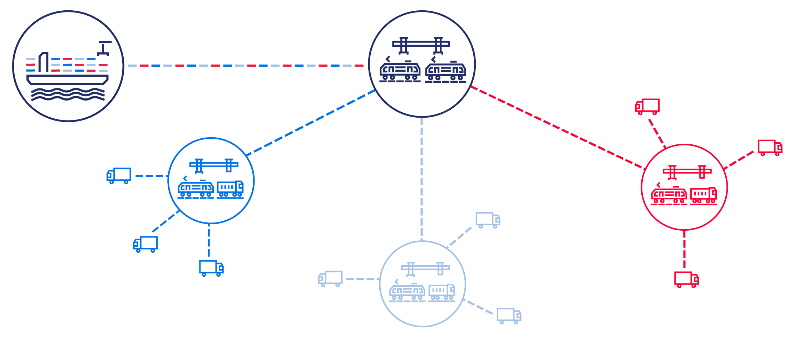
The hub & shuttle system
The ports are linked with a network of hub and inland terminals
2026

Slide 6
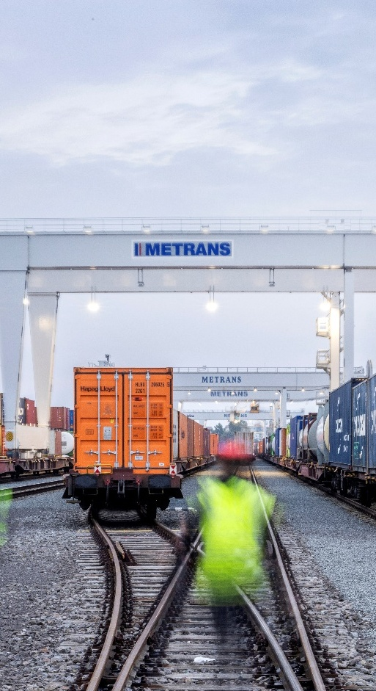
METRANS
The European intermodal rail bridge
2026
7 hub terminals
Praha & Česká Třebová (CZ), Krems (AT), Dunajská Streda (SK), Poznań & Małaszewicze (PL), Budapest & Zalaegerszeg to come (HU)
13 end terminals
in Czech Republic, Germany, Poland, Romania, Serbia, Slovakia
Seaports
North Sea
Hamburg, Bremerhaven, Wilhelmshaven
Rotterdam
Antwerpen
Adriatic Sea
Baltic Sea
Black Sea
Rijeka
Koper
Trieste
Gdańsk, Gdynia
Constanța

Slide 7
From ↔ to
Trains
per week
From ↔ to
Trains
per week
Gdańsk ↔ Ostrava
6
METRANS
Over 650 regular train connections per week
2026
Arad ↔ București
up to 3
Budapest ↔ Arad
up to 3
Hamburg ↔ Berlin
6
Budapest ↔ Belgrade (Inđija)
up to 3
Hamburg ↔ Česká Třebová
37
Bremerhaven ↔ Česká Třebová
13
Hamburg ↔ Dunajská Streda
11
Bremerhaven ↔ Dunajská Streda
6
Hamburg ↔ Gądki
22
Bremerhaven ↔ Gądki
up to 13
Hamburg ↔ Gernsheim
8
Bremerhaven ↔ München
6
Hamburg ↔ Kornwestheim
10
Bremerhaven ↔ Nürnberg
6
Hamburg ↔ Krems
3
Bremerhaven ↔ Praha
11
Hamburg ↔ Leipzig
13
Bremerhaven ↔ Leipzig
6
Hamburg ↔ München
20
Česká Třebová ↔ Budapest
4
Hamburg ↔ Nürnberg
10
Česká Třebová ↔ Dunajská Streda
39
Hamburg ↔ Praha
49
Česká Třebová ↔ Krems
2
Koper ↔ Budapest
28
Česká Třebová ↔ Linz
up to 2
Koper ↔ Dunajská Streda
35
Česká Třebová ↔ Małaszewicze
up to 4
Linz ↔ Krems
3
Česká Třebová ↔ Ostrava
12
Małaszewicze ↔ Budapest
up to 2
Česká Třebová ↔ Wilhelmshaven
3
Małaszewicze ↔ Hamburg
up to 2
Česká Třebová ↔ Zlín
14
Nürnberg → München
6
Dąbrowa Górnicza ↔ Dębica
6
Ostrava ↔ Dąbrowa Górnicza
6
Dąbrowa Górnicza ↔ Žilina
4
Praha ↔ Česká Třebová
28
Duisburg ↔ Praha
up to 8
Praha → Leipzig
1
Dunajská Streda ↔ Budapest
24
Praha ↔ Plzeň
12
Dunajská Streda ↔ Halkali
4
Praha ↔ Salzburg
9
Dunajská Streda ↔ Košice
12
Praha ↔ Wilhelmshaven
7
Dunajská Streda ↔ Krems
6
Rijeka ↔ Beograd (Inđija)
up to 3
Dunajská Streda ↔ Žilina
12
Rijeka ↔ Budapest
up to 3
Gądki ↔ Dąbrowa Górnicza
6
Rotterdam ↔ Česká Třebová
up to 10
Gądki ↔ Kąty Wrocławskie
6
Rotterdam ↔ Praha
up to 14
Gądki ↔ Pruszków
up to 8
Salzburg → Hamburg
3
Gdańsk ↔ Dąbrowa Górnicza
6

Slide 8
METRANS
Key operation offices
2026
PRAHA, CZ
DUNAJSKÁ STREDA, SK
POZNAŃ (GĄDKI), PL
METRANS, a.s. Head Quarter
Operation territory
Ports: BE, DE, NL, PL
Countries: AT, CZ, DE, SK
Operation territory
Ports: BE, DE, IT, NL, RO, SL
Countries: AT, CZ, HU, PL, RO, RS, SK, TR
Operation territory
Ports: DE
Countries: PL

Slide 9
New Silk Road
Gateway to the Future
2026
Via Brest/Małaszewicze Gateway to Europe
METRANS provides strong connections to the New Silk Road through the Brest/Małaszewicze hub terminal, linking major destinations such as Warszawa, Poznań, Hamburg, Duisburg, and München/Nürnberg via Hamburg and Česká Třebová. These routes ensure a daily connection to all METRANS terminals.
Via İstanbul
Expanding Access to the Silk Road
The New Silk Road connection via İstanbul offers full access to the entire METRANS network, providing seamless transport solutions and extending connectivity along this strategic route.
www.metrans.eu

Slide 10
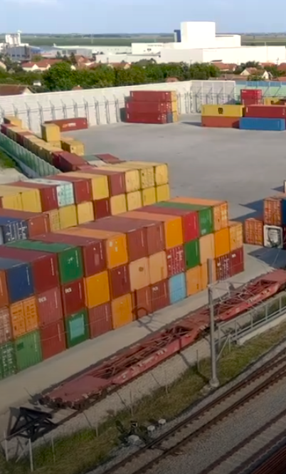
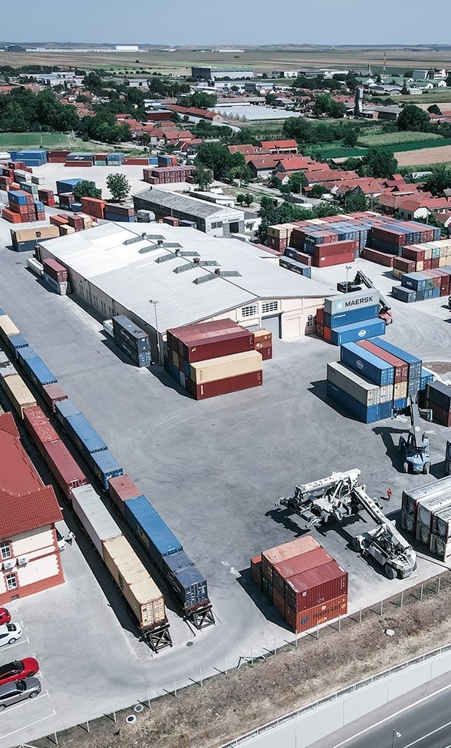
Connections to Serbia
METRANS Panonija
2026
METRANS Panonija ensures reliable rail transport to, from, and through Croatia, connecting Adriatic ports with the Inđija terminal.
Inđija is the 20th terminal in the METRANS network, linked via regular trains to Budapest, providing access to major seaports in Southern and Northern Europe.
Connections to/from Serbia
Container terminal Inđija (near Beograd)
Regular departures to/from port of Rijeka & hub Budapest
Gateway via Budapest to NW Continent, Adriatic ports & hinterland
On-request connections to Port of Koper & Port of Trieste
www.metrans.eu

Slide 11
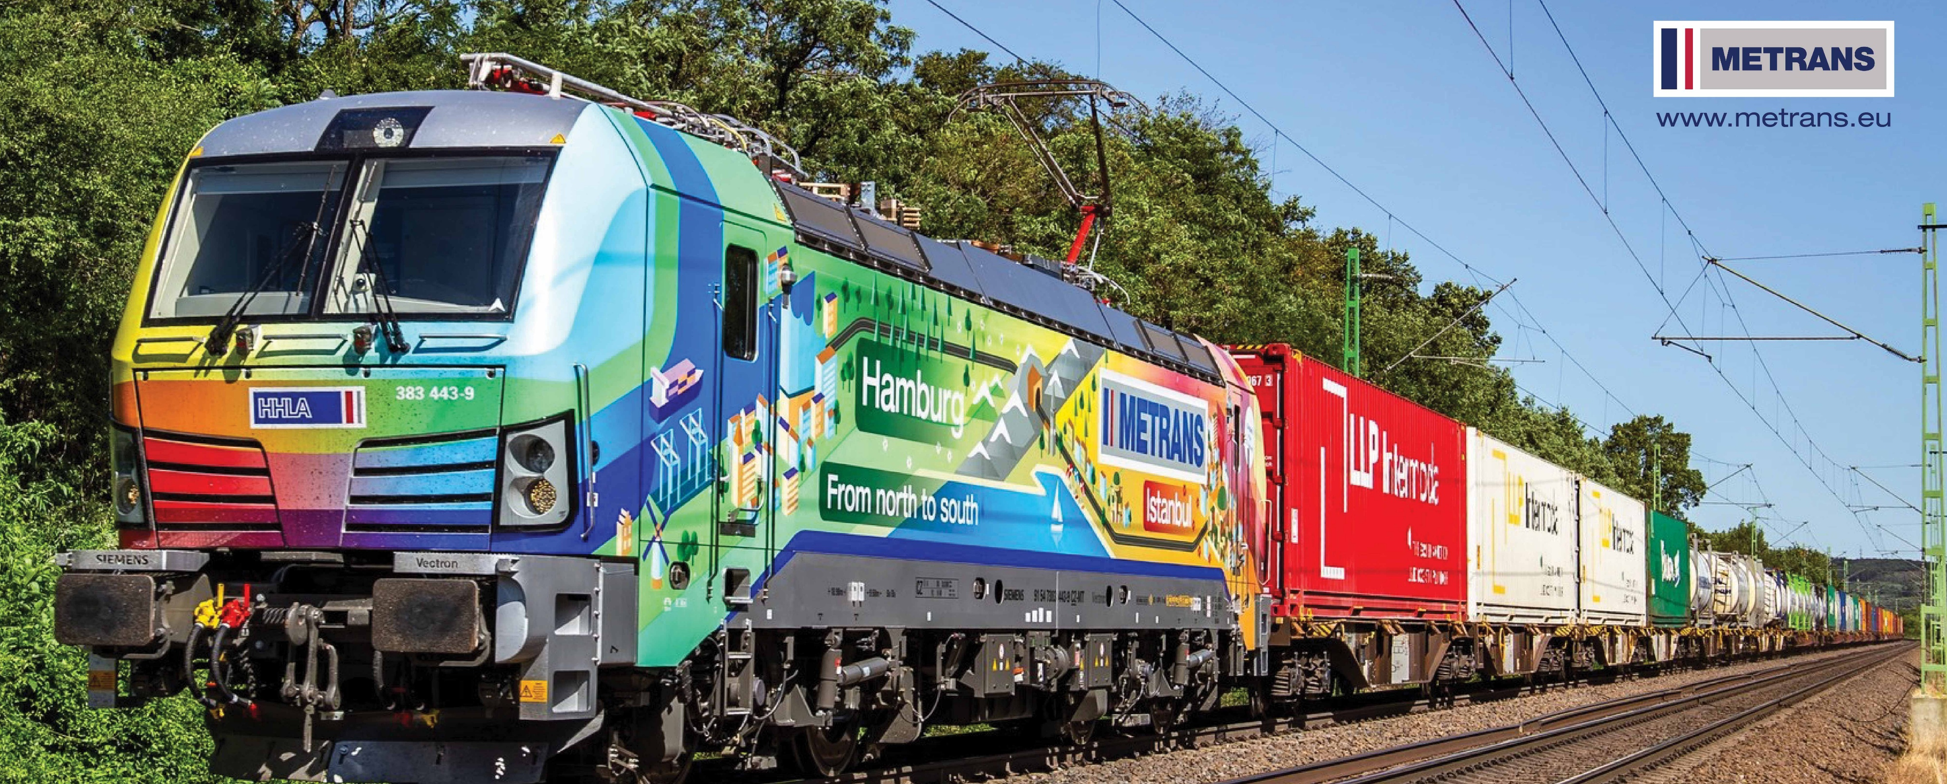
Connections to Turkey
Container terminal Halkalı (İstanbul)
2026
The Halkalı terminal in İstanbul is part of the METRANS network, ensuring seamless transport solutions.
We offer four weekly departures, connecting the METRANS hub terminal in Dunajská Streda with Halkalı.
Our 45' PWHC containers are available for efficient cargo transport.
Through our gateway solutions, we provide access to Germany, Poland, Slovakia, Hungary, Austria, Romania, Serbia, and the Czech Republic.
www.metrans.eu

Slide 12
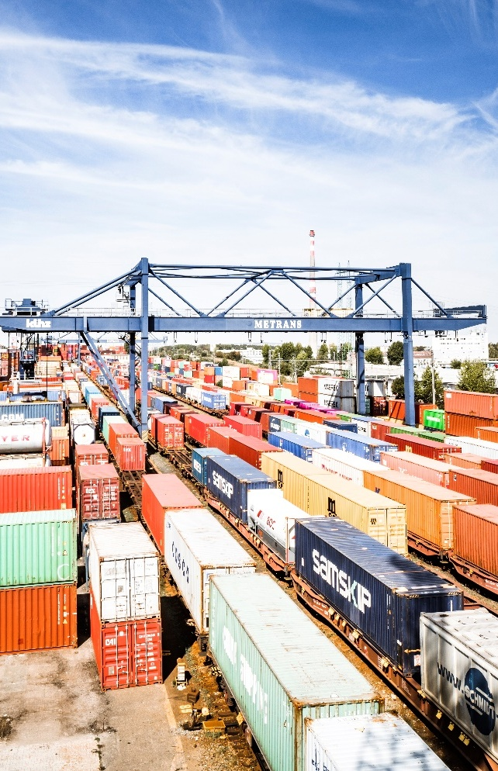
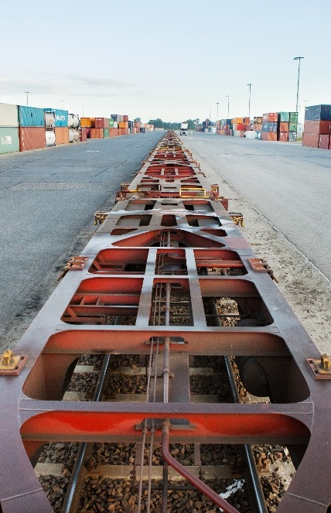
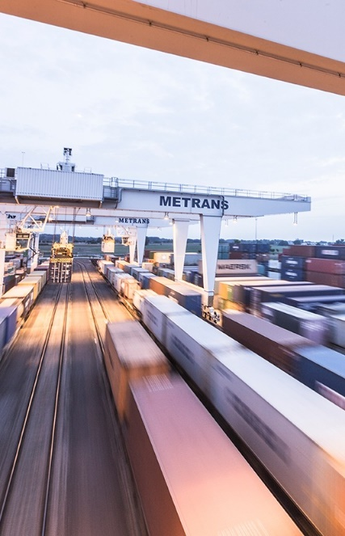
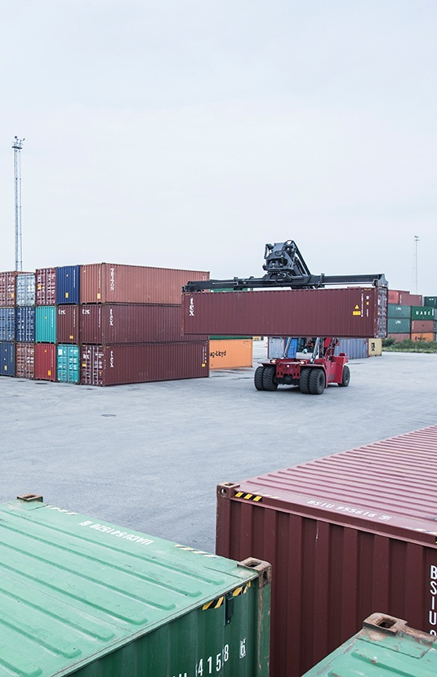
2026
Praha (since 1991)
Poznań – Gądki
(since 2011)
Terminal area: 420,000 m²
Storage capacity: 15,000 TEU full and 10,000 TEU empty
Trucking fleet: 263 trucks
Sidings – 7x600 m, 2x550 m, 6x350 m
6 Rail Mounted Gantry Cranes,
13 reachstackers, 2 forklifts, 4 shunters
10 trains can be handled at the same time
Repair facility for containers
On-site customs office
Operates 24/7/365
Terminal area: 175,000 m²
Storage capacity: 8,800 TEU
Trucking fleet: 42 trucks
Sidings – 1x750 m, 3x630 m
10 reachstackers
2 trains can be handled at the same time
On-site customs office
Handling of swap bodies and semi-trailers
Operates 24/7/365
Dunajská Streda (since 1999)
Krems an der Donau
(since 2012)
Terminal area: 326,000 m²
Storage capacity: 25,000 TEU full and 15,000 TEU empty
Trucking fleet: 223 trucks
Sidings – 5x650 m, 4x550 m
4 Rail Mounted Gantry Cranes,
18 reachstackers, 3 forklifts
9 trains can be handled at the same time
Repair facility for containers
On-site customs office
Operates 24/7/365
Terminal area: 45,000 m²
Storage capacity: 1,800 TEU full and 2,500 TEU empty
Trucking fleet: 15 trucks
Sidings: 4x680 m
6 reachstackers
Repair facility for containers
On-site customs office
Hub terminals

Slide 13
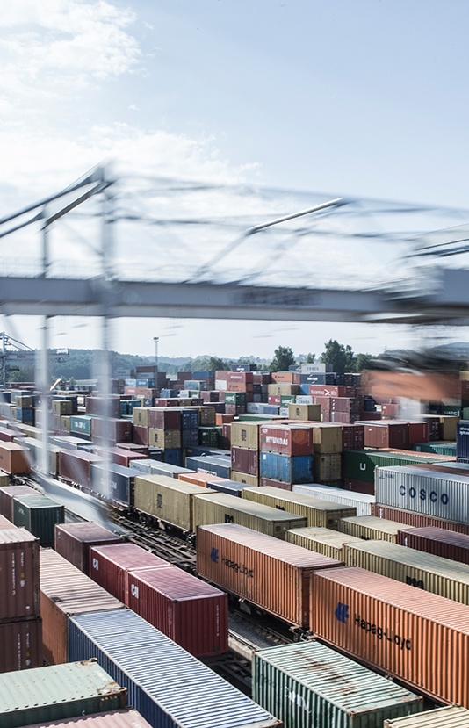
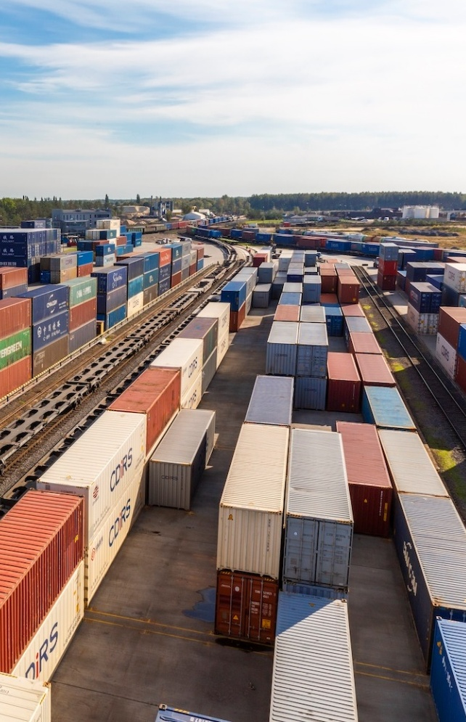
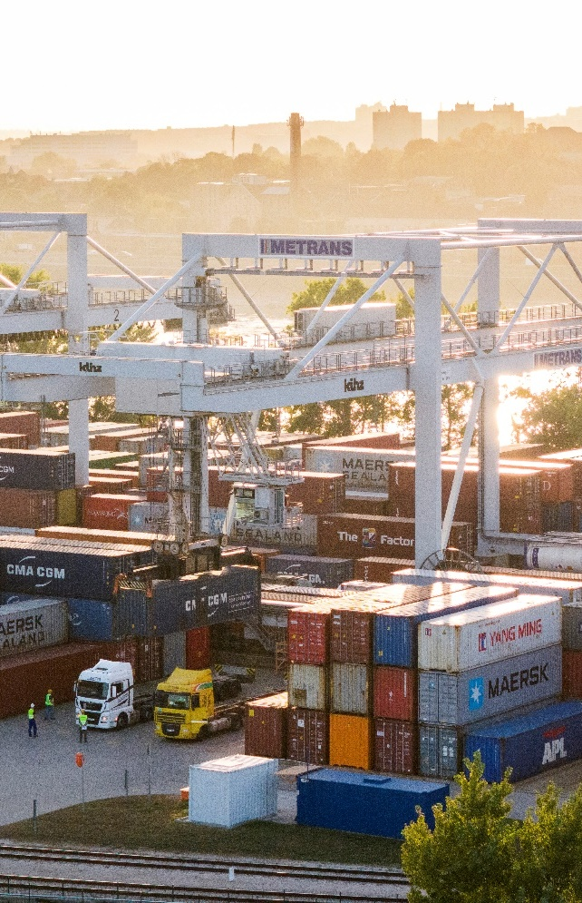
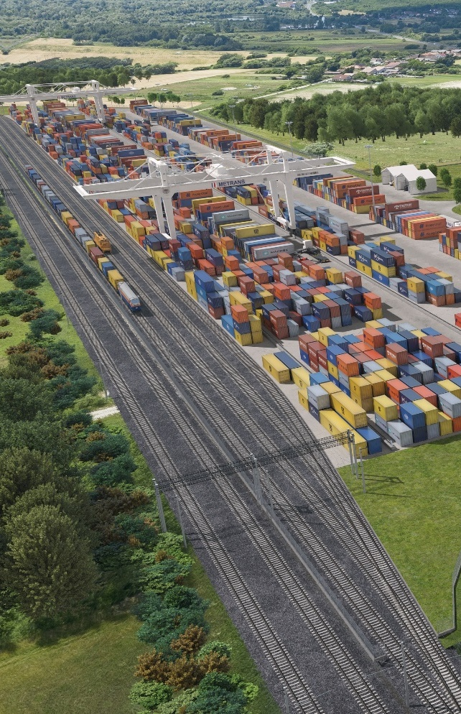
2026
Česká Třebová (since 2013)
Małaszewicze (since 2022)
Terminal area: 138,000 m²
Storage capacity: 4,500 TEU full and 4,200 TEU empty
Trucking fleet: 157 trucks
Sidings – 6x740 m
4 Rail Mounted Gantry Cranes,
3 reachstackers
6 trains can be handled at the same time
Repair facility for containers
On-site customs office
Operates 24/7/365
Terminal area: 190,000 m²
Storage capacity: 6,000 TEU
Trucking fleet: 5 trucks
Sidings – 1435 mm path – 3000 m
1520 mm path – 6000 m
1 Rail Mounted Gantry Crane,
5 reachstackers
Reefer plugs
Depot for empty containers
Operates 24/7/365
Budapest (since 2017)
Zalaegerszeg (...2027/2028)
Terminal area: 163,500 m²
Storage capacity: 8,500 TEU
Trucking fleet: 137 trucks
Sidings – 6x650 m, 2x500 m
4 Rail Mounted Gantry Cranes,
14 reachstackers, 3 forklifts
7 trains can be handled at the same time
Repair facility for containers
On-site customs office
Operates 24/7/365
New hub terminal in Hungary under construction.
Terminal area: 150,000 m²
Intermodal hub terminal & logistics center in western Hungary for the Adriatic Corridor (Koper, Trieste, Rijeka)
Daily connection to Hamburg, Bremerhaven and the whole METRANS network
Operation start 2025/2026
Hub terminals

Slide 14
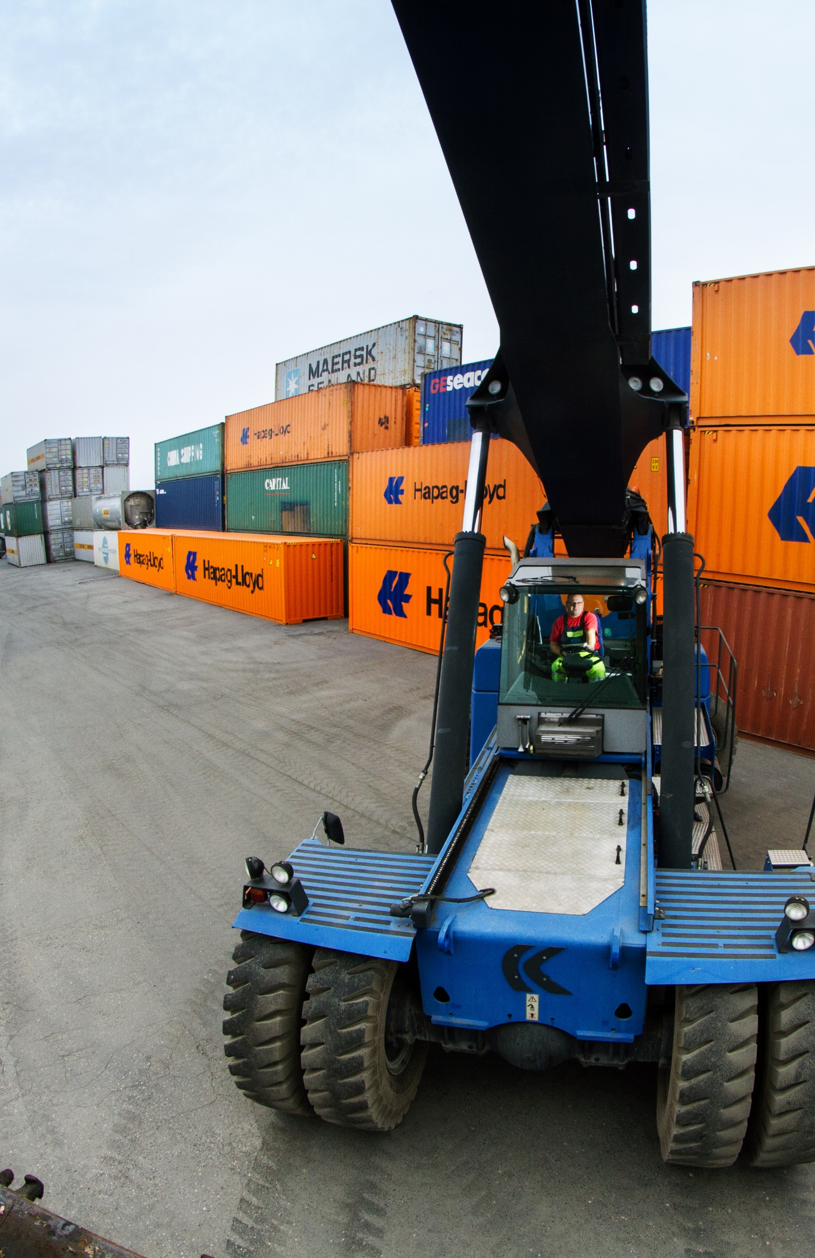
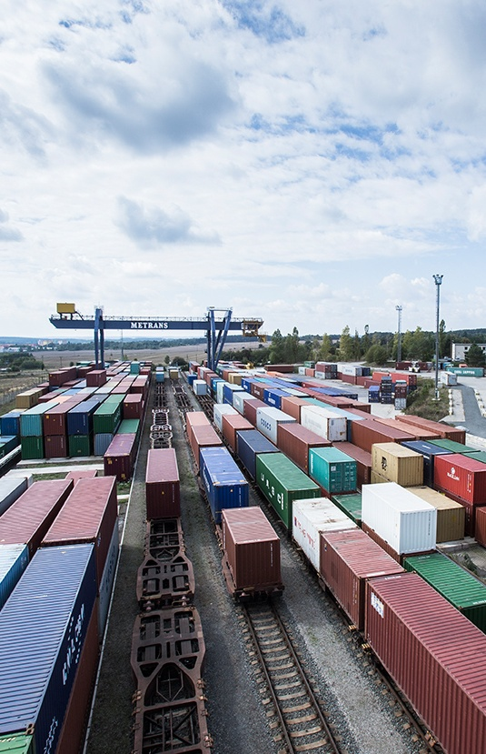
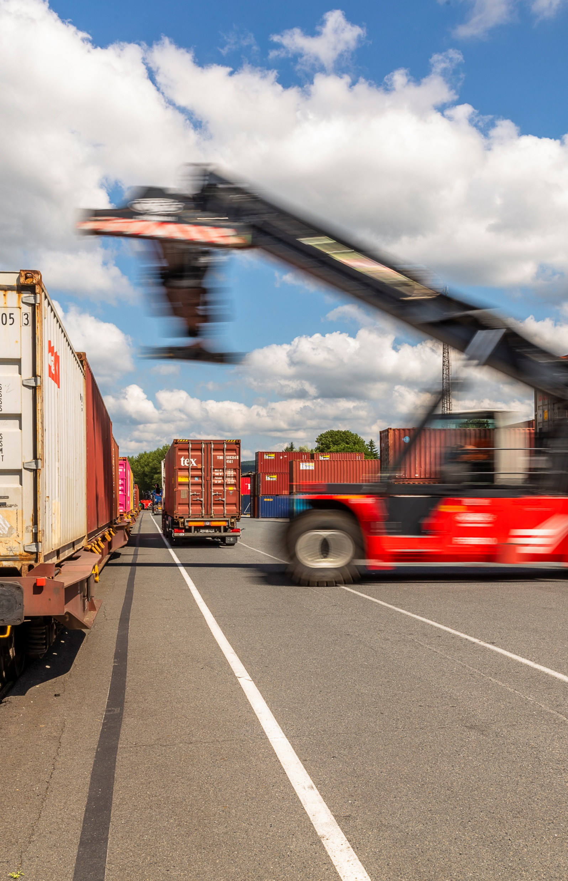
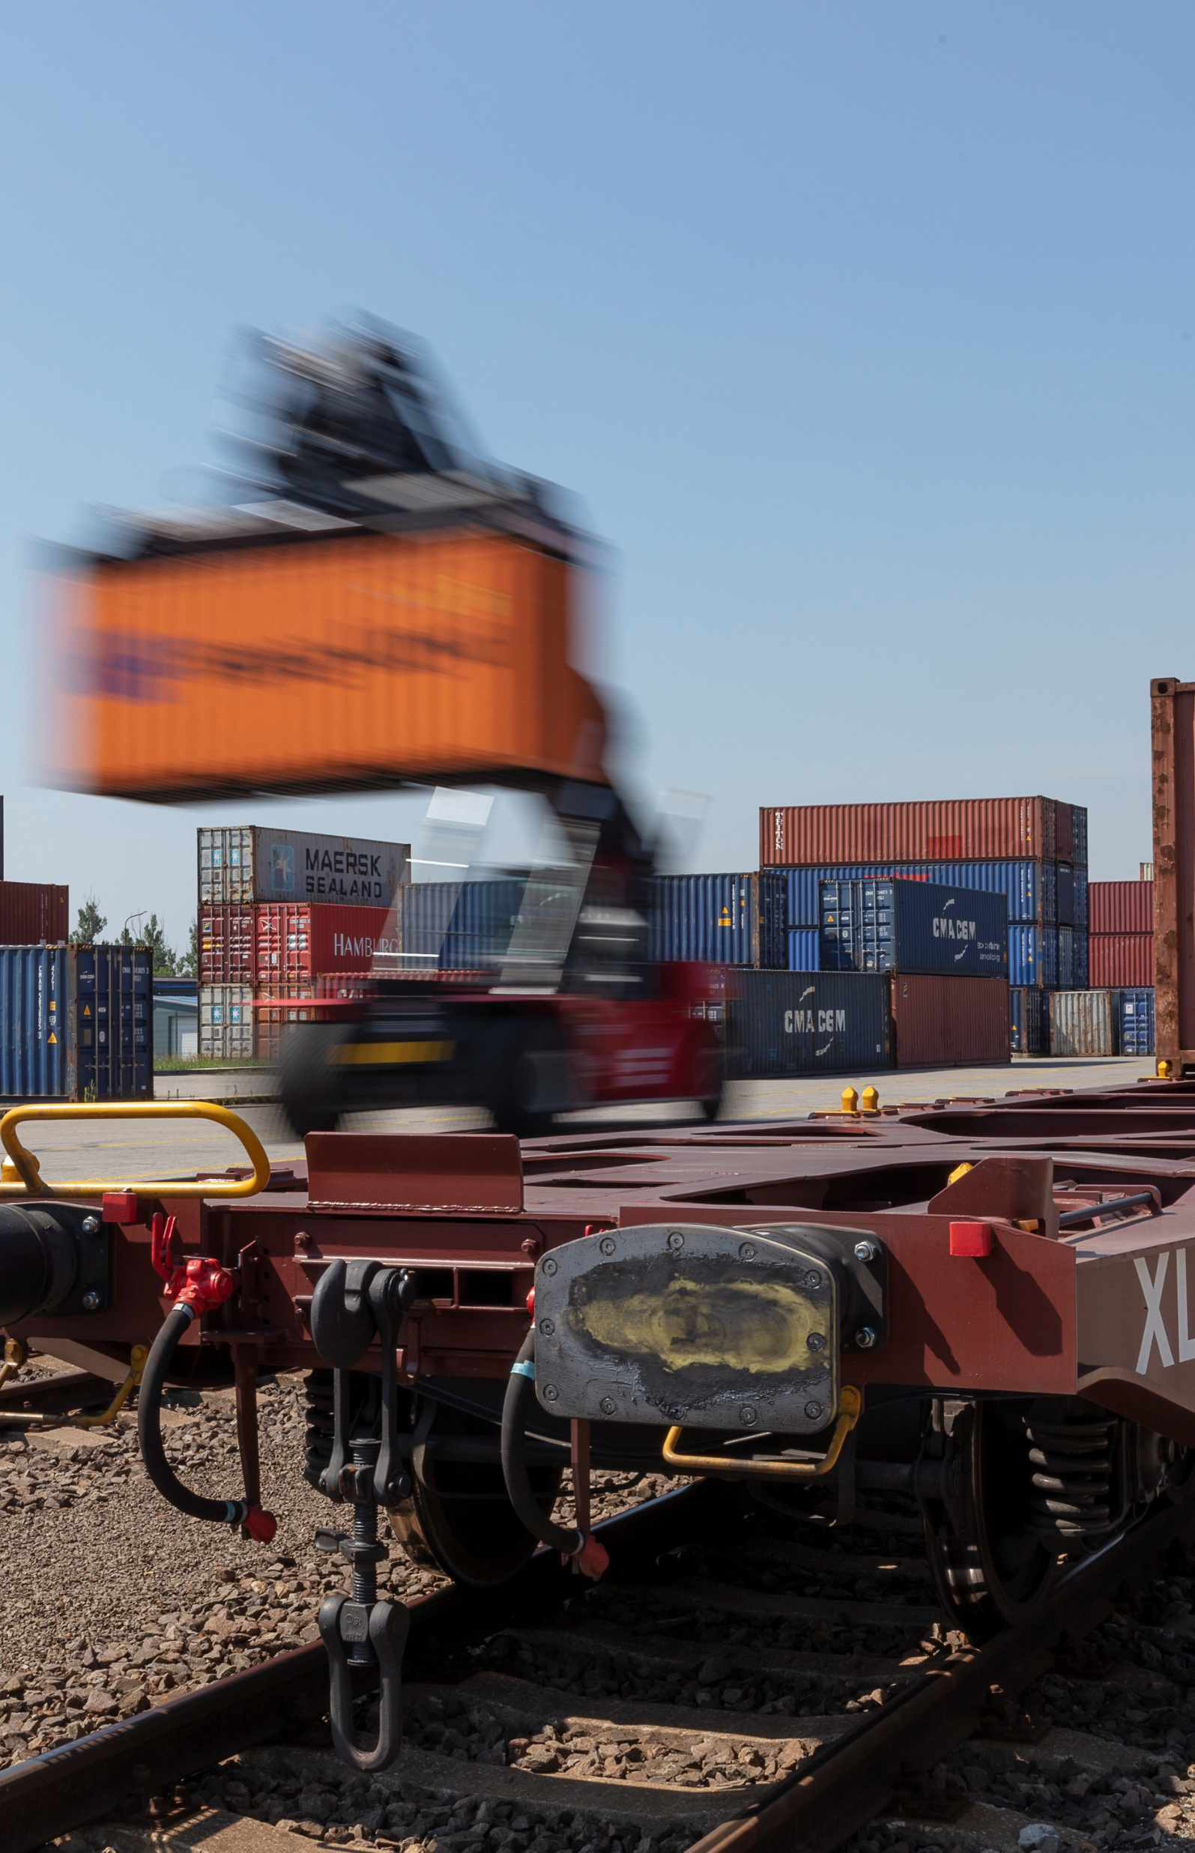
2026
Warszawa – Pruszków (since 1993)
Plzeň (since 2007)
Terminal area: 50,000 m²
Storage capacity: 1,700 TEU empty
Trucking fleet: 31 trucks
Sidings – 3x400 m
1 Rail Mounted Gantry Crane with multimodal spreader for handling trailers and swap bodies and Remote Operation Station control system, 2 reachstackers
Repair facility for containers
Operates 24/7/365
Terminal area: 57,000 m²
Trucking fleet: 39 trucks
Sidings – 2x600 m, 1x350 m
7 reachstackers
Handling of swap bodies and semi-trailers
On-site customs office
Zlín (since 1994)
Košice (since 2008)
Terminal area: 68,600 m²
Storage capacity: 1,300 TEU full and 1,200 TEU empty
Trucking fleet: 100 trucks
Sidings: 3x550 m, 1x400 m, 2x350 m, 2x300 m
8 reachstackers
Repair facility for containers
On-site customs office
Operates 24/7/365
Terminal area: 46,500 m²
Storage capacity: 3,000 TEU full and 2,000 TEU empty
Trucking fleet: 53 trucks
Sidings – 2x550 m
6 reachstackers, 2 forklifts
Repair facility for containers
On-site customs office
Operates 24/7/365
End terminals

Slide 15
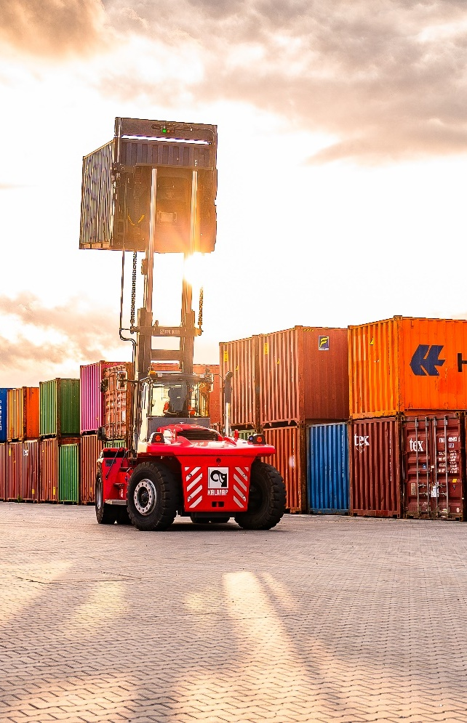
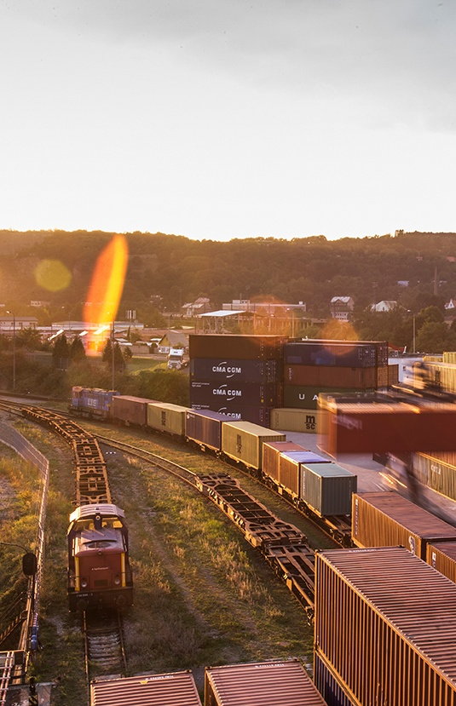
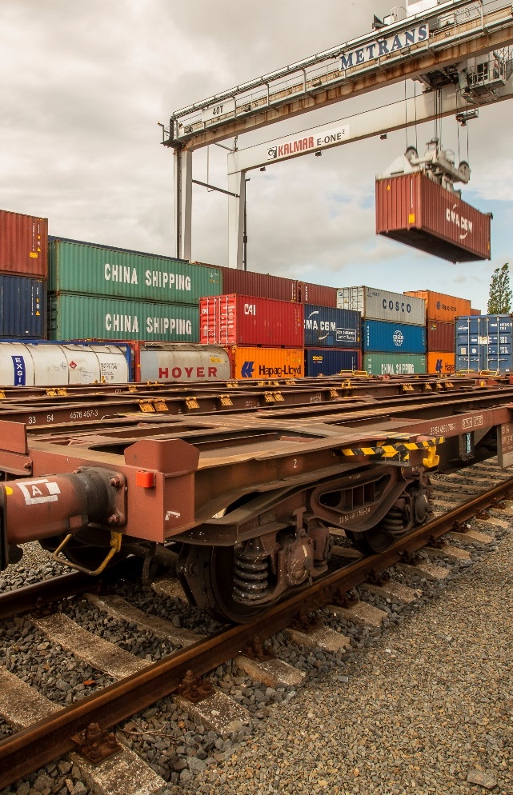
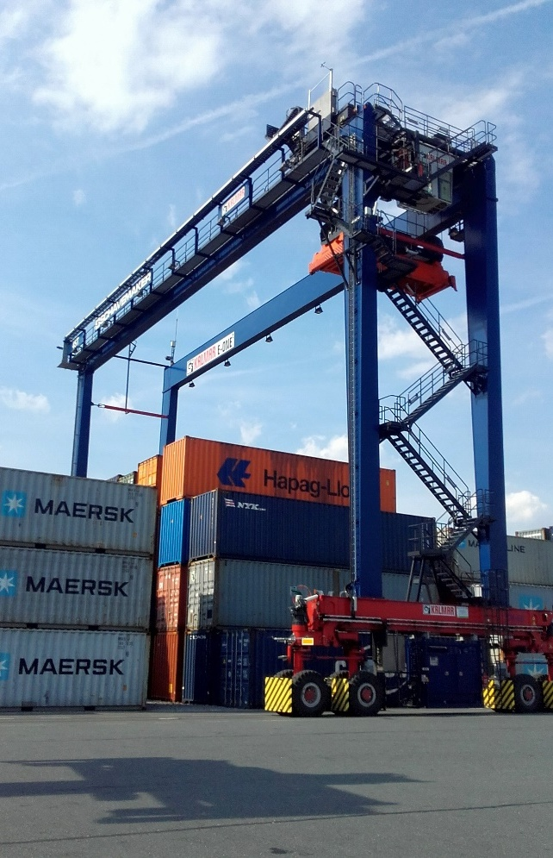
2026
Dąbrowa Górnicza
(since 2010)
Ústí nad Labem (since 2015)
Terminal area: 25,500 m²
Storage capacity: 1,500 TEU full and 2,000 TEU empty
Trucking fleet: 69 trucks
Sidings – 1x185 m, 2x160 m
1 Rail Mounted Gantry Crane,
5 reachstackers
Repair facility for containers
On-site customs office
Operates 24/7/365
Terminal area: 170,000 m²
Trucking fleet: 26 trucks
Sidings – 2x625 m, 1x600 m, 1x500 m
4 reachstackers
Reefer plugs – PTI incl. small repairs
Handling of swap bodies
On-site customs office
Ostrava (since 2011)
Wrocław – Kąty Wrocławskie (since 2015)
Terminal area: 100,000 m²
Storage capacity: 1,200 TEU full and 5,000 TEU empty
Trucking fleet: 80 trucks
Sidings – 2x250 m
1 Rubber Tyred Gantry Crane,
6 reachstackers
Repair facility for containers
On-site customs office
Operates 24/7/365
Terminal area: 65,000 m²
Storage capacity: 1.500 TEU empty
Trucking fleet: 15 trucks
Sidings – 2x600 m
1 gantry crane, 5 reachstackers
Reefer plugs – PTI incl. small repairs
Handling of swap bodies and semi-trailers
On-site customs office
End terminals

Slide 16
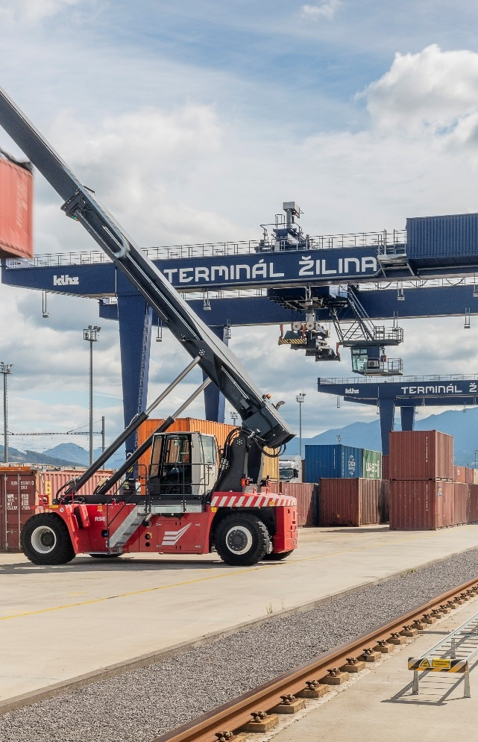
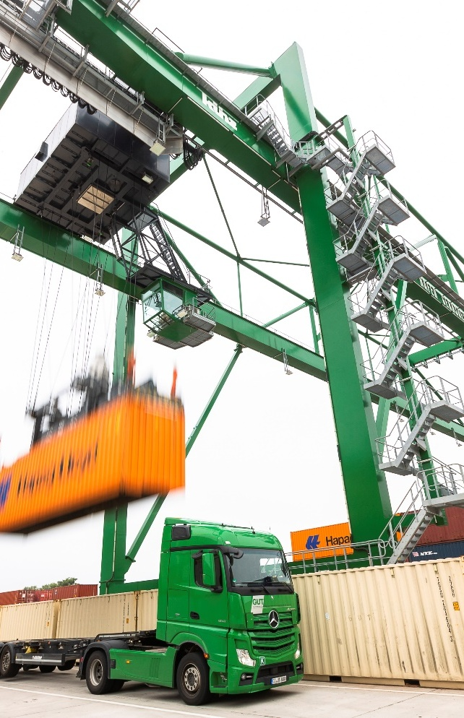
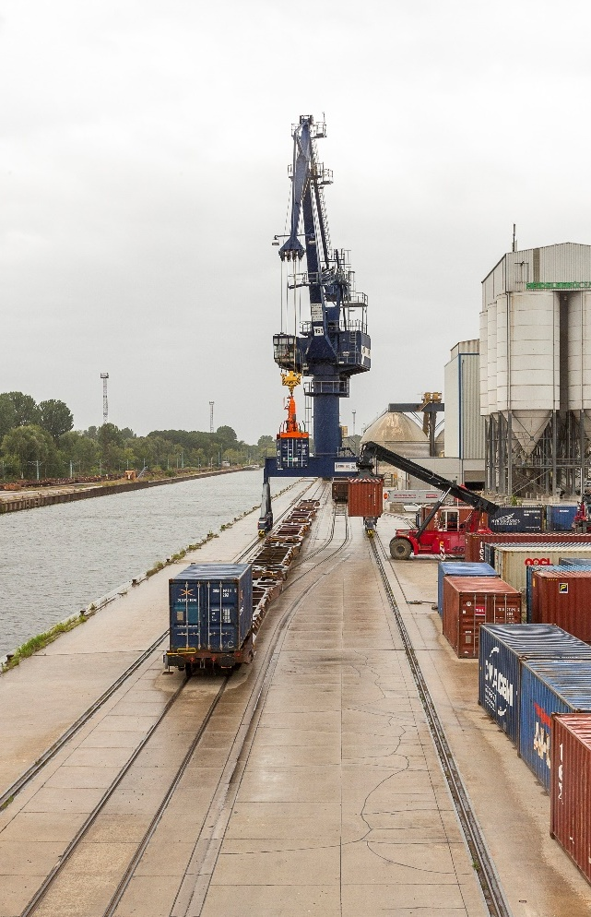
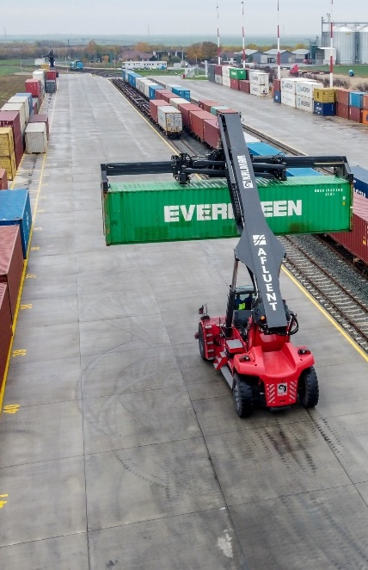
2026
Žilina (since 2019)
Operated by TIP Žilina
Gernsheim GUT (since 2020)
Terminal area: 54,000 m²
Trucking fleet: 30 trucks
Sidings – 2x340 m
1 Rail Mounted Gantry Crane,
1 slewing jib crane, 2 reachstackers
Stuffing/stripping dangerous goods storage
Reefer plugs, maintenance and repair, reefer service
Terminal area: 150,000 m²
Trucking fleet: 37 trucks
Sidings – 2x750 m
2 Rail Mounted Gantry Crane,
2 reachstackers
Repair facility for containers
Handling of swap bodies and semi-trailers
Berlin KoWu (since 2019)
Arad
(since 2021)
Terminal area: 20,000 m²
Storage capacity: 2,000 TEU empty
Trucking fleet: 15 trucks
Sidings – 1x800 m, 3x500 m
1 Rail Mounted Gantry Crane,
3 reachstackers
Reefer plugs – PTI incl. small repairs
On-site customs office
Terminal area: 75,000 m²
Storage capacity: 750 TEU
Sidings – 4x350 m
2 reachstackers
A1 highway – 3 km from the terminal
Parking capacity for 200 trucks, with in-house locomotive
Power outlets/sockets for reefer containers
Truck capacity: 30 chassis
(20’, 30’, 40’, 45’)
End terminals

Slide 17
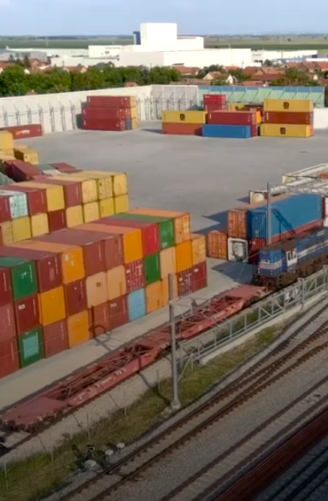
2026
Beograd – Inđija
(since 2023)
Terminal area: 47,500 m²
Trucking fleet: 25 trucks
Sidings – 2x250 m
5 reachstackers, 2 forklifts
Regular connections to/from port of Rijeka and METRANS terminal Budapest as gateway solution to reach northern and Adriatic ports
Container repairs, reefer plugs, heating of TK containers, PTI test
On-site customs office
Operates 24/6
End terminals

Slide 18
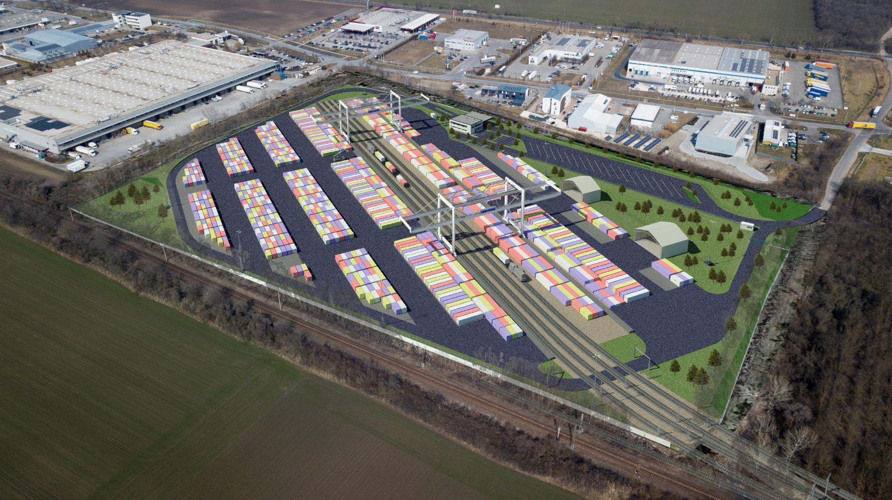
New terminal in Szeged, Hungary
Coming in 2027
2026
Terminal area: 100,000 m²
Annual capacity: ~ 300.000 TEU
Sidings: 4
Gantry cranes: 2
METRANS intermodal terminal in southern Hungary
Beginning of the construction works in 2025, completion in 2027
Connection to the highway to HU, RS, RO
Connection to the main railway track to the south via the Roszke crossing

Slide 19
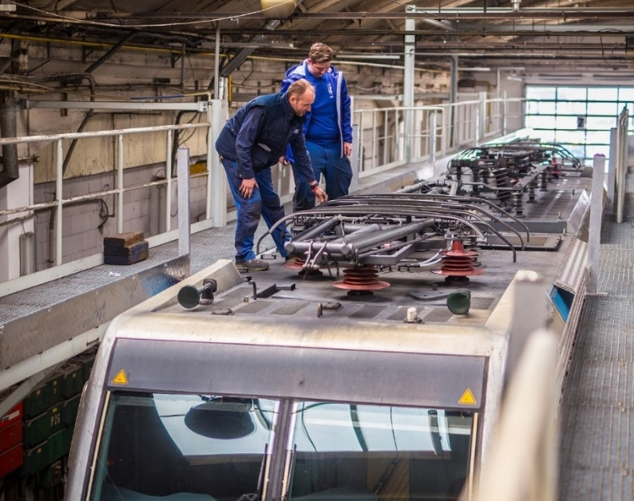
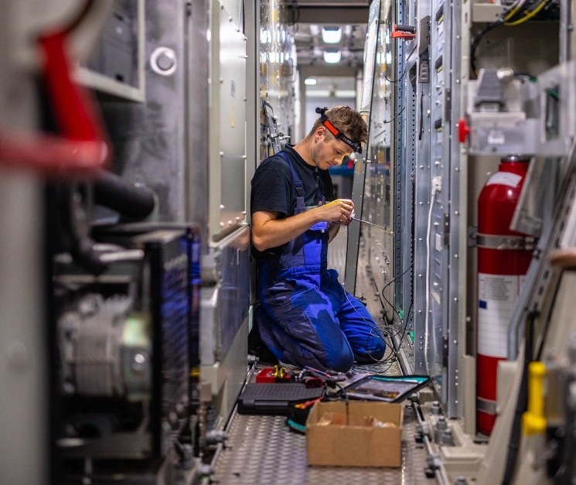
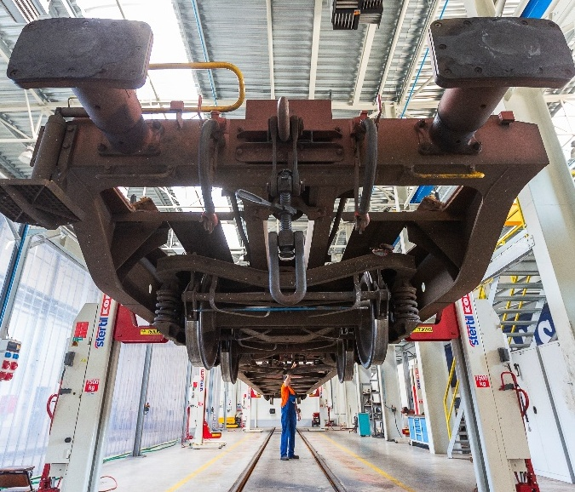
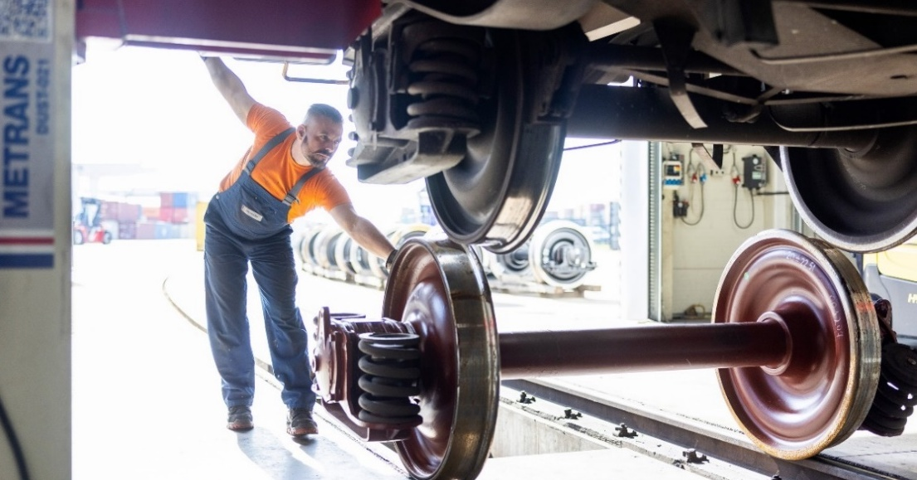
METRANS rail repair shops
2026
DYKO Rail Repair Shop
Kolín, Czech Republic
Established in 1940
Aquired by METRANS in 2007
Licensed to repair Siemens and Alstom (Bombardier) locomotives
Repairs: container wagons, running gear for passenger carriages, locomotives and wheelsets
Repairs within free capacities available also for external clients
Rail & Reachstacker Repair Shop
Dunajská Streda, Slovakia
Established in 2019
Repairs:
container wagons
locomotives
reachstackers

Slide 20
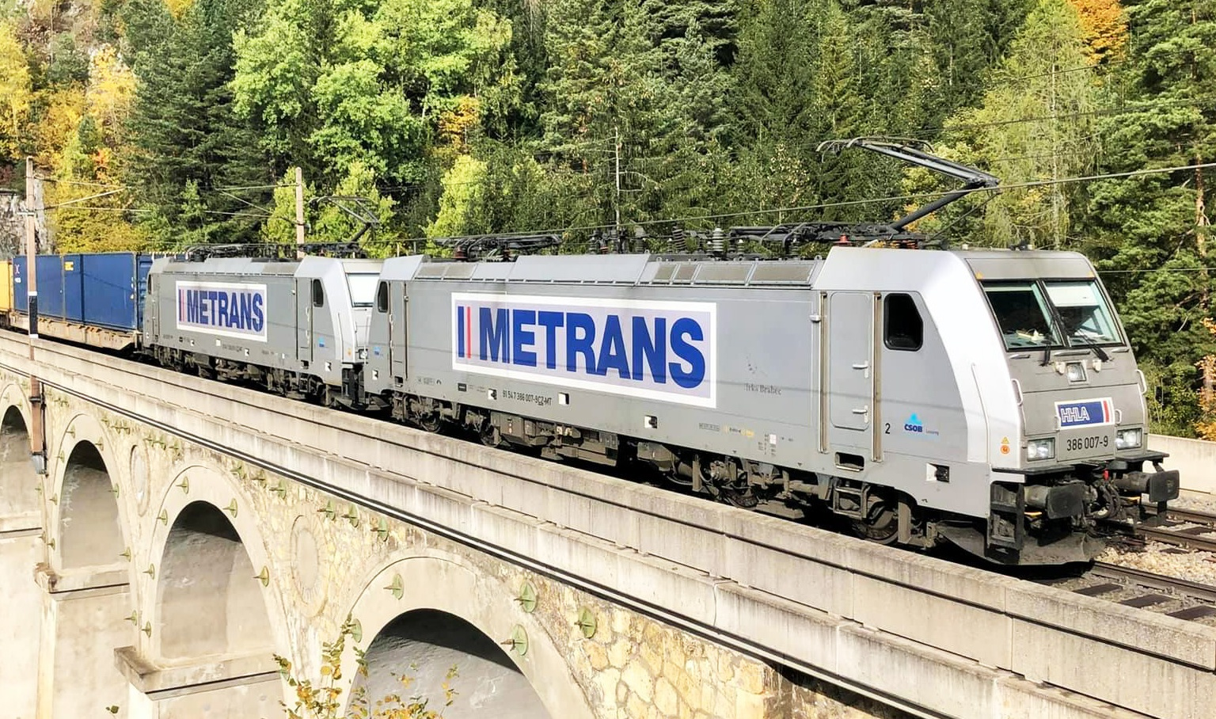

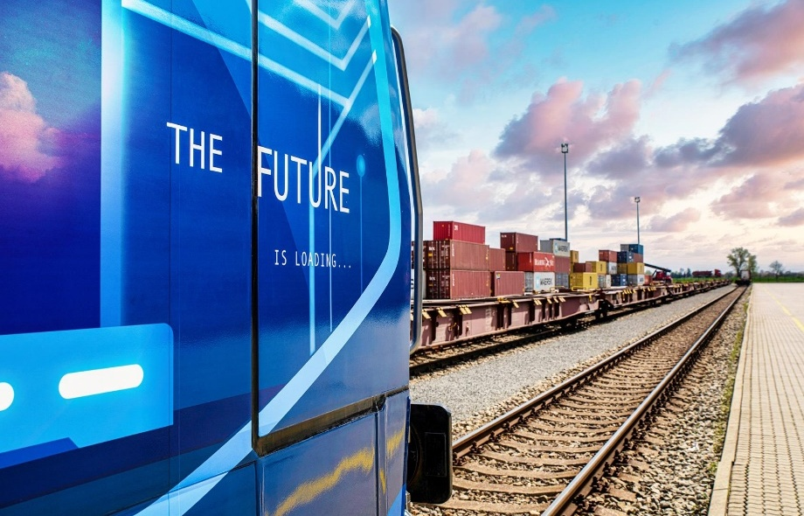
HHLA Pure
Verified CO₂ footprint and financial climate contribution
2026
With HHLA Pure we ensure handling and transport with a reduced CO₂ footprint, which has a real impact on climate protection.
Our approach
Modern hybrid & electric locomotives
Electrified port terminals with storage cranes & electric vehicles
Even for long distances, compensation matters. Since CO₂ emissions affect the entire planet, we offset any unavoidable emissions through certified environmental projects.
Till now we have already offset over
230.000
tonnes of CO₂

Slide 21
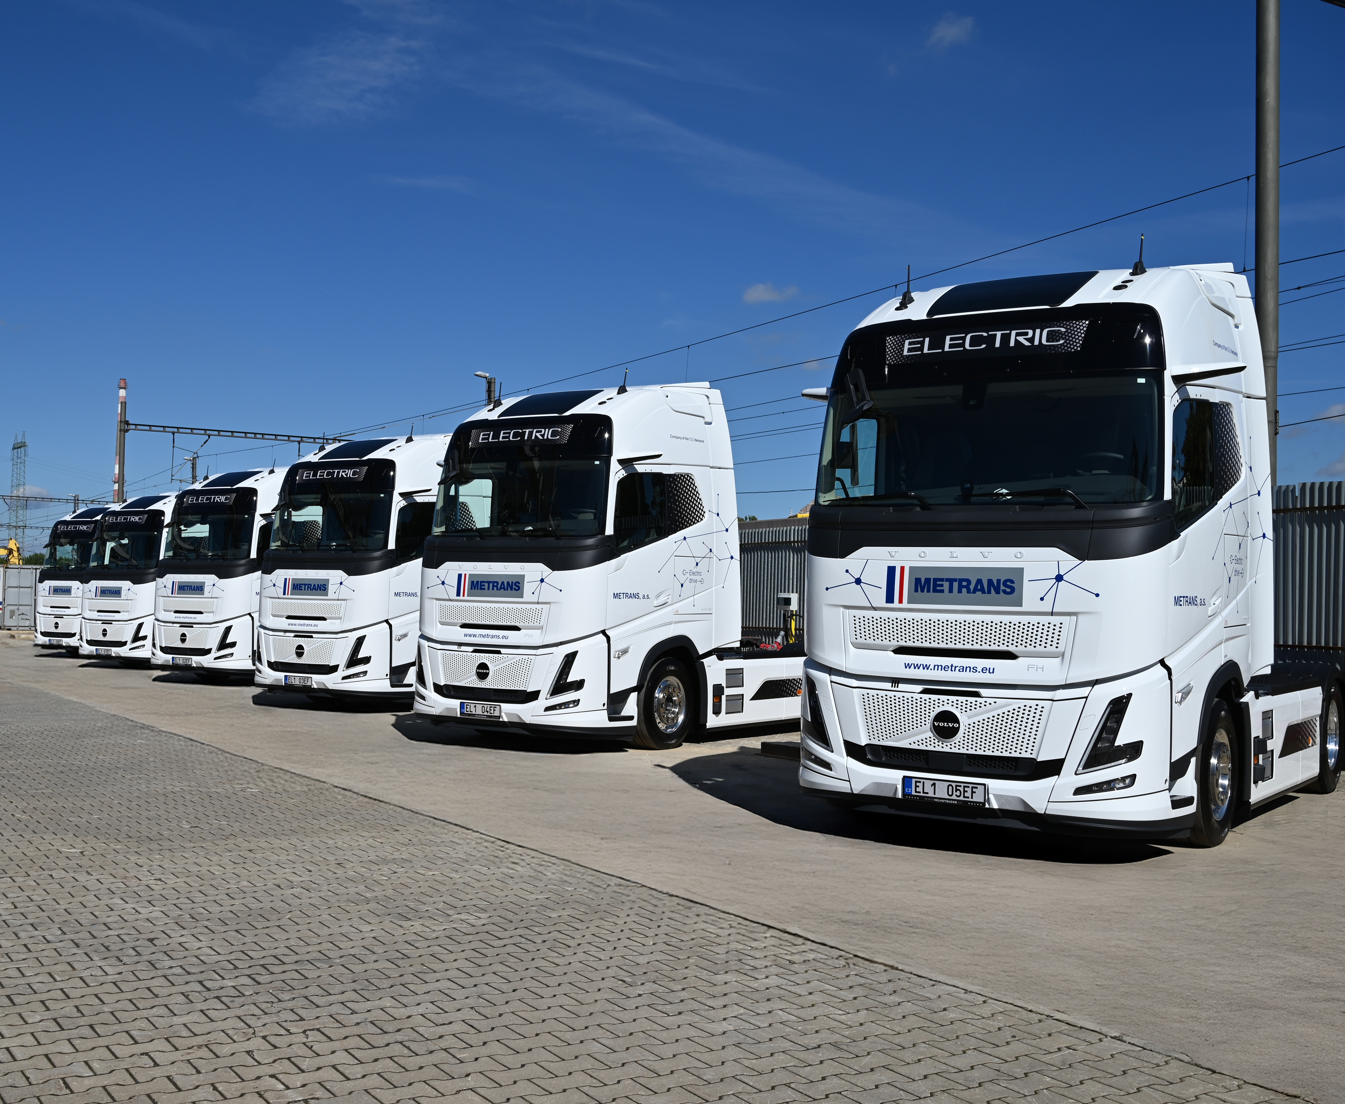
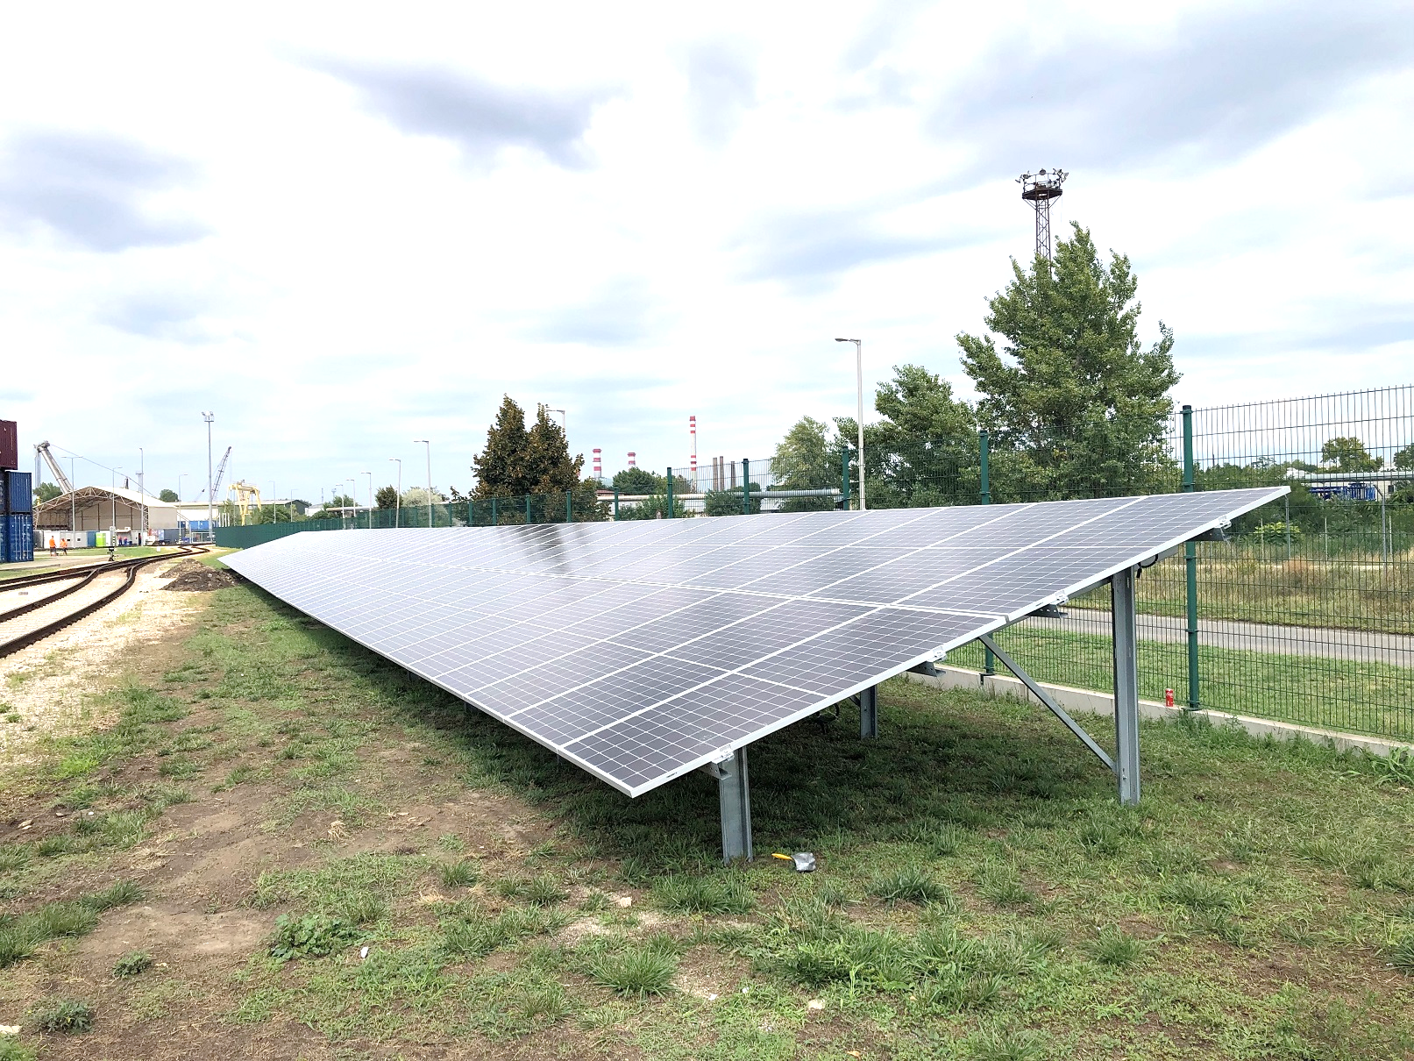
HHLA Pure
Verified CO₂ footprint and financial climate contribution
2026
Designed to reduce the transport-related CO₂ footprint from port operations into the European hinterland.
Our product
Low-impact cargo handling and transport
Electrified operations across HHLA terminals
CO₂-efficient METRANS locomotives and rolling stock
Unavoidable emissions are compensated through Gold Standard-certified projects
Customers receive confirmation of carbon-balanced transport
In Austria and Germany, METRANS electric trains run on renewable power
Process
Certification of HHLA Pure TÜV Nord
Receiving customer-specific transport (volume/route)
Offsetting and monitoring by TÜV Nord

Slide 22
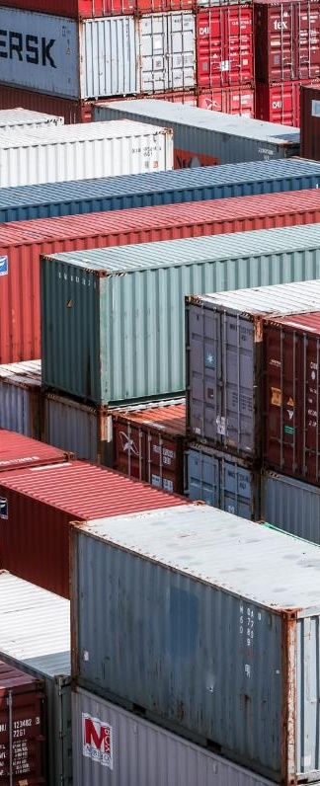




Pillars of our success
2026
One of the leaders of intermodal transport
Own network of 20 terminals
We are the largest Central European operator of intermodal transport with more than 30 years of container shipping tradition.
We operate 20 intermodal terminals in Czech Republic, Slovakia, Poland, Hungary, Austria, Germany, Serbia, Romania and we have further under construction.
Stable employer
Climate protection
We have a highly qualified team of employees with many years of experience.
Own hardware and software
Using modern hybrid and electric locomotives and with our HHLA Pure service we offer handling and transport with reduced CO₂ footprint.

Slide 23
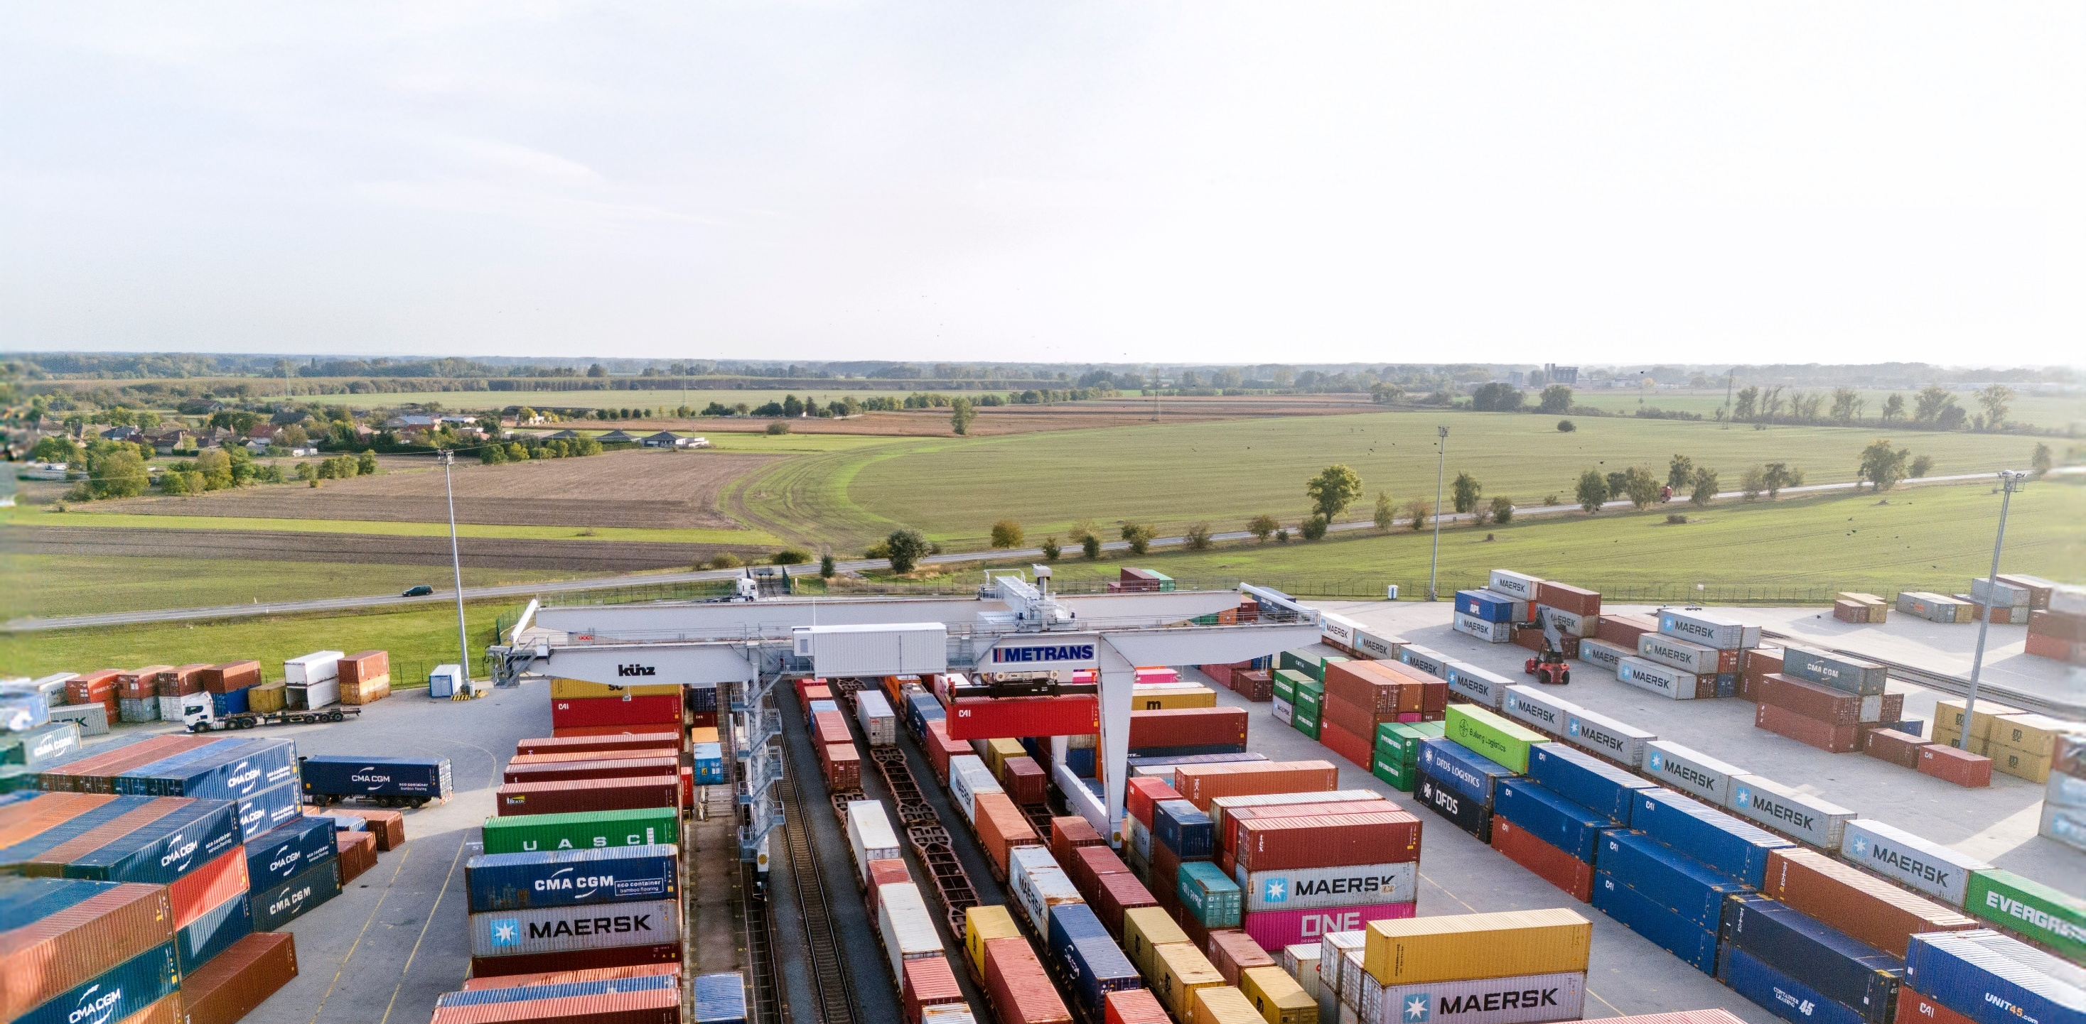

Thank you.
www.metrans.eu

